Slide 1
The Union Canal
Done by
Sophie M, Ieuan, Brandon
The Canal Experts!

Slide 2
Wildlife and normal facts
There is a lot of wildlife along the Union canal.
Watch out for Minks along the canal and in the canal.
The canal ends at the Falkirk wheel.

Slide 3
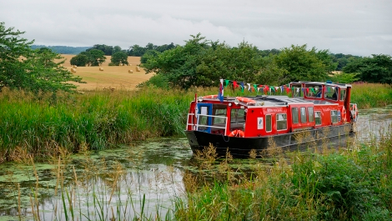
Facts
The Union Canal.
*On the Union canal paths people walk, cycle and live on the canal, and fish along the canal.
*The Union canal was used long ago for transporting coal around.
*The canal travels all the way throw Edinburgh.
*You can hire a boat on the canal.

Slide 4
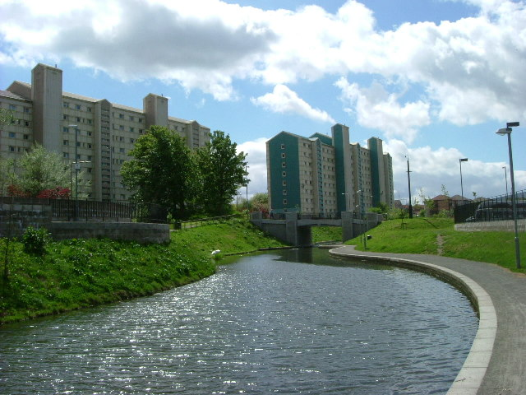
A Picture of the Union canal.

Slide 5
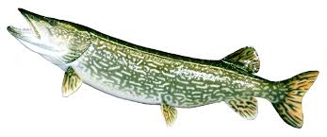
! All about Union canal !
Also you can do paddle sports.
The canal ends at the Falkirk wheel and from then on it is the Forth and Clyde canal.
There is different types of fish in the canal. One of them is a Pike.
This is a pike.

Slide 6
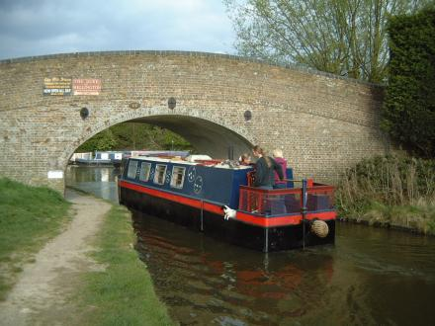
! More facts !
The Union canal.
There are 59 bridges along the canal.
There is numbers on all the bridges.
You cant fish in between the yellow signs or you will be electrocuted.

