Slide 1
Union Canal
By Megan L,Aayan,Rebecca
HOPE YOU ENJOY !!!!!!!!

Slide 2
Wildlife
Stay away from minks they are dangerous and vicious

Slide 3
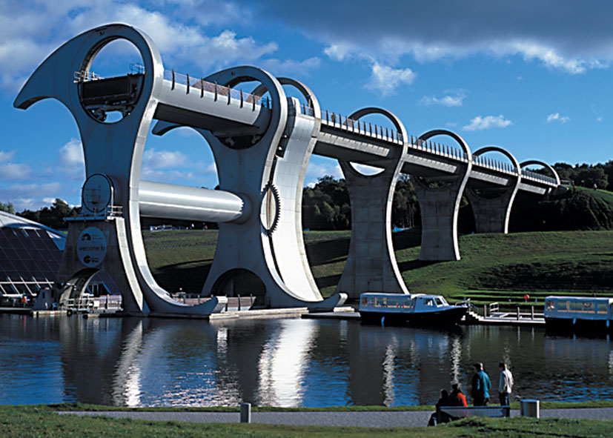
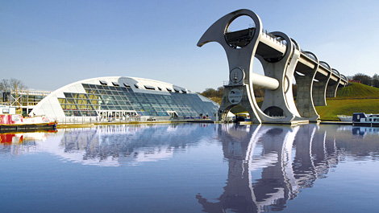
Falkirk wheel

Slide 4
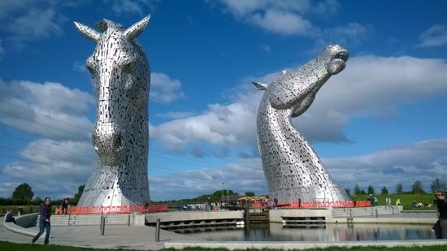
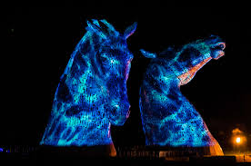
Kelpies

Slide 5
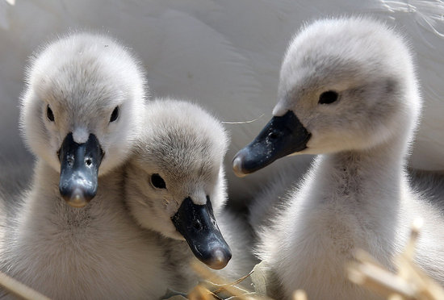
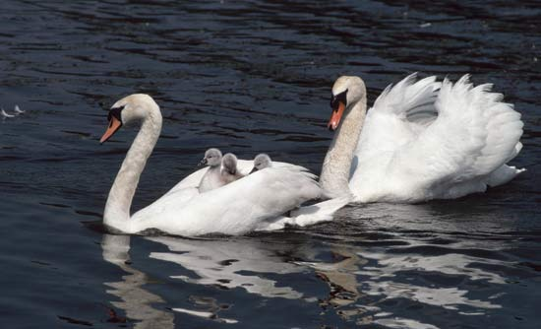
swans

Slide 6
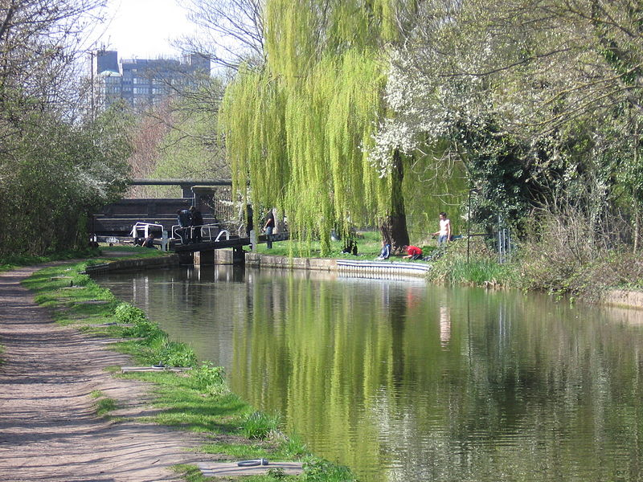
History of the canal

Slide 7
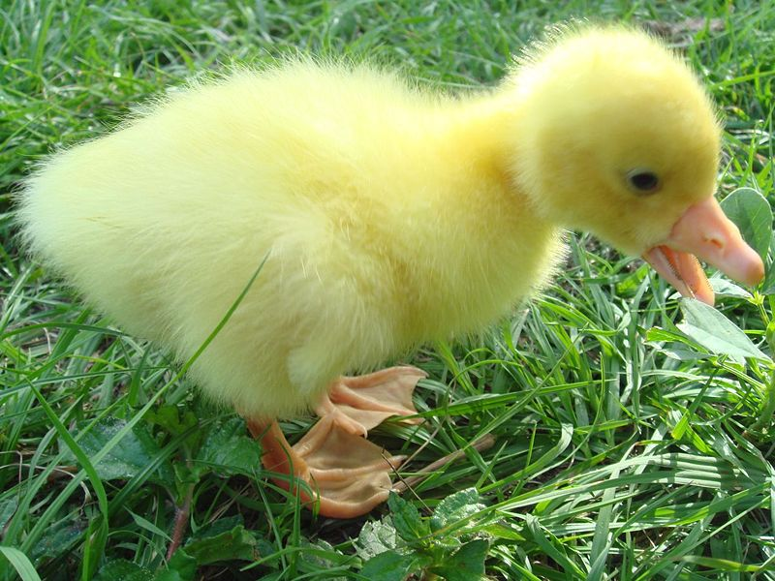
Geese are sometimes yellow and sometimes white they are sometimes friendly

Slide 8
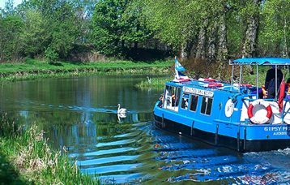
Boats in the union canal

Slide 9
The END !!!!!!!! Hope you enjoyed it!!!

