Slide 1
Disney Virtual Trip
Primary 1

Slide 2
Day 1

Slide 3
Art
Create a passport that you can use during your trip! Remember to include a front cover, your name, a picture of yourself and lots of space for characters names! Each time you see a character this week in a ride, video or song, make sure to write their name in your passport!
How many characters will you meet by the end of the week?

Slide 4
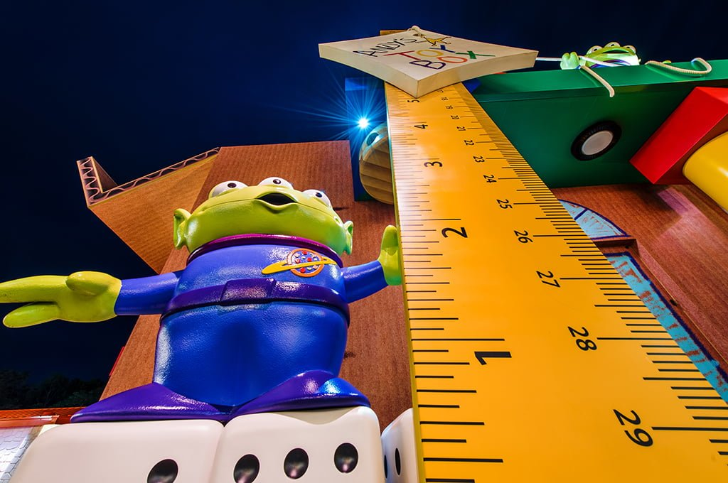
Numeracy
To go on today’s the rides you must be taller than:
6 pieces of cutlery
6 of your own shoes/socks
3 books
15 blades of grass
Estimate and then measure whether you are tall enough to ride!
Extension: If you have a measuring tape/ruler, you could measure how tall you are. Can you find 3 things that are taller and 3 things that are shorter than you. Measure the height of each thing.

Slide 5
Writing
Take a tour of Donald Duck’s house boat. What can you see? Draw and label 5 things that you can see inside his house.
Challenge: Can you think of a story using Donald Duck’s house as the setting?
Extension: Write about how Donald Duck’s house is different to yours, for example, my windows are not circles and I do not dry my washing on my roof!
https://www.youtube.com/watch?v=XERRGapwSVQ&t=17s

Slide 6
IDL
Task: Enjoy the ‘It’s a Small World’ ride. The ride shows many countries and places around the world.
Find out 2 facts about another country You could tell them to someone in your house/ add photos/drawings/text or record yourself saying what you have found out.
https://www.youtube.com/watch?v=I2Do309e4YU

Slide 7
Reading
Watch the Frozen ride – how many words can you think of that rhyme with snow.
Record yourself saying all of the words that you can think of.
https://www.youtube.com/watch?v=J8OHP9OriMA&t=33s
Challenge: Make silly sentences using as many of the words as you can.

Slide 8
Day 2

Slide 9
HWB
Safety Rules
Look at the video of Disney Land.
Can you think of any rules or things that you would need to do to keep safe at the park? Think about what you should do on rides, who you would speak to and any extra rules that you can think of.
Extension: Create a safety poster to display the rules.
https://www.youtube.com/watch?v=HyZfIlxwsfI

Slide 10
Numeracy
Look at the map of Disney Land (on the next page). Can you find your way through the map?
1 Start at the Entrance and go to Donald’s house boat.
2 Start at the log flume and go to the rollercoaster.
3 Start at the pond and go to the Frozen ride.
Challenge: Can you give detailed directions on how to get from each place to the next. For example, “Turn left then go straight until you get to the pond”.

Slide 11
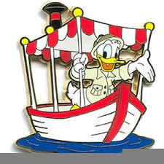
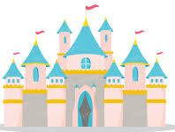
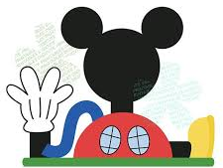
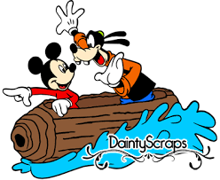

Slide 12
Writing
Watch the Monsters Inc ride clip, it is a 360 degree experience so you can drag the screen to see all around you.
Design your own monster and record yourself describing them. Are they kind, scary, fluffy, angry? Can you think of any other ways to describe them?
Challenge: – Create a story where your monster is the main character.
https://www.youtube.com/watch?v=vDNUXa5sIHU

Slide 13
IDL
Weather
Disney Land is in Orlando in America.
Find out what the weather is like in Orlando today. Is it sunny, cloudy or windy? What is the temperature?
Extension: What is the weather and temperature here? Is it hotter or colder?

Slide 15
Reading
Listen to ‘Under the Sea’.
https://www.youtube.com/watch?v=GC_mV1IpjWA
Why does Sebastian think it is better to live under the sea? Tell someone at home or record yourself explaining 2 reasons from the song.
Challenge: You could identify 2 reasons as above and then also think about why it might not be better to live on land. You could create your own short song/verse to convince Sebastian if you wish!

Slide 16
Day 3

Slide 17
Reading
Look closely at the pictures (on the next 3 pages) and see if you can spot any sounds/CVC words/common words.
Read the sounds/ words to someone at home or record yourself saying the sounds or reading the words.
You could create your own picture and hide words for somebody else to find. There are 3 pictures so that you can choose your challenge.

Slide 18
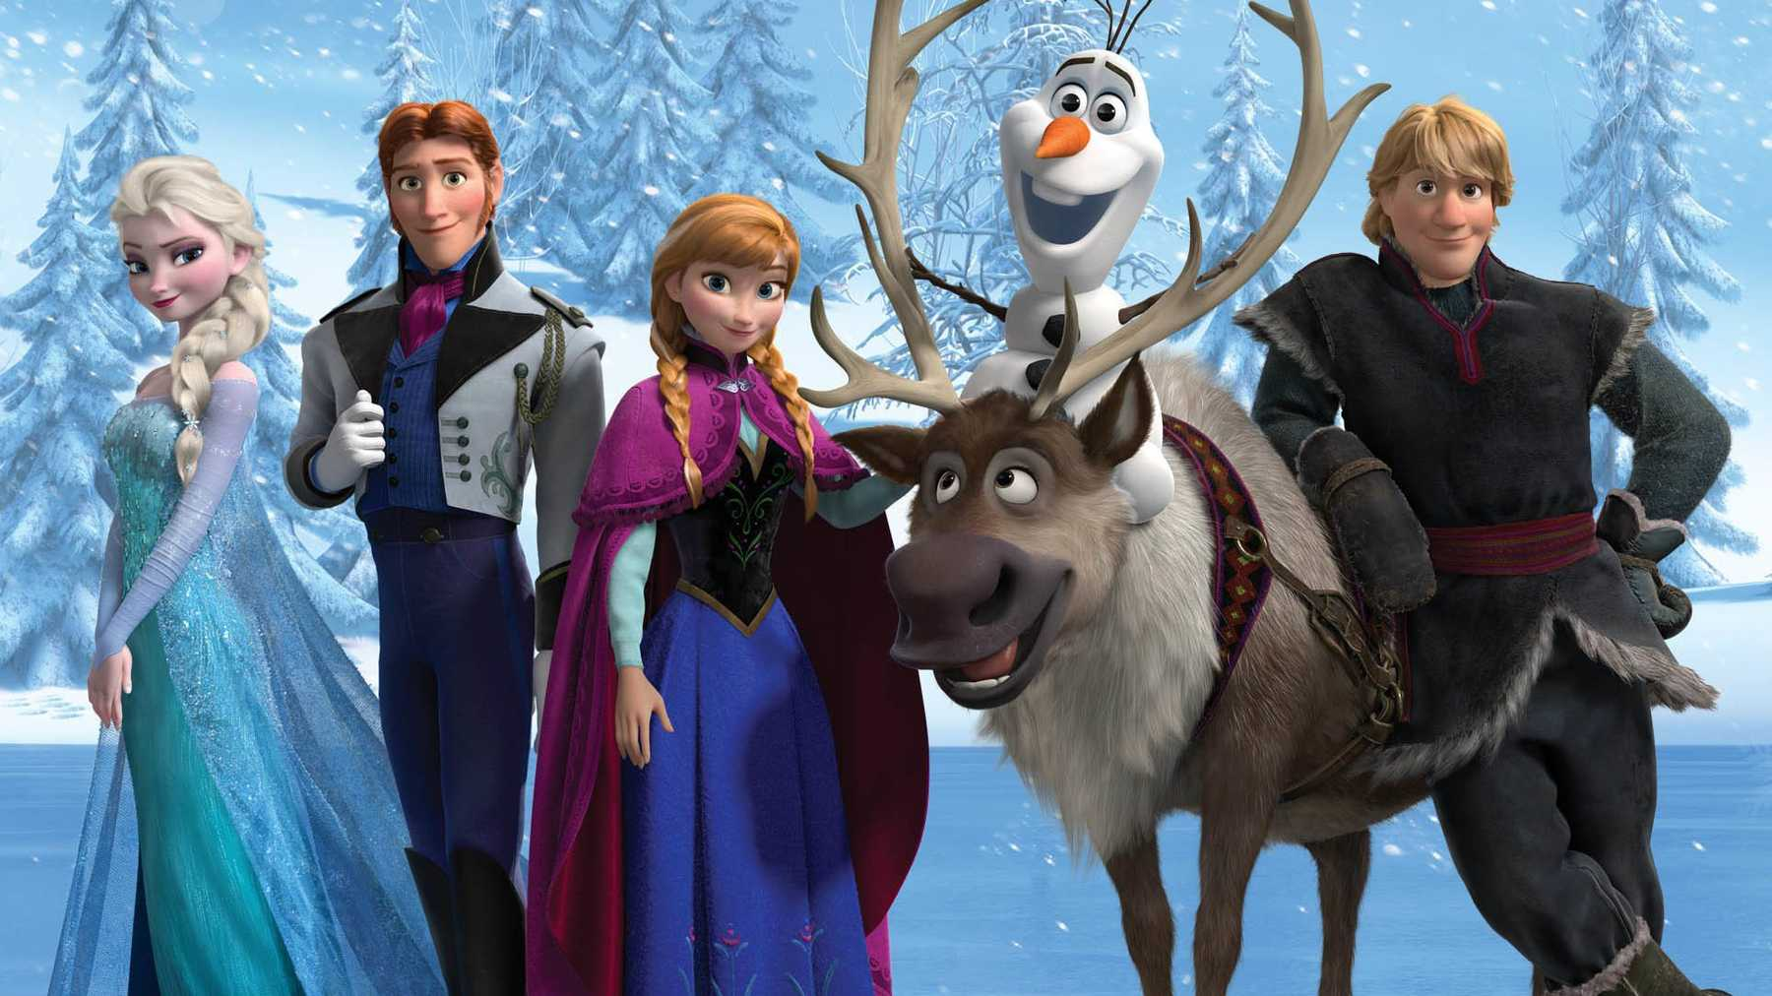
this
got
up
we
go
me
they
she
the
my
them

Slide 19
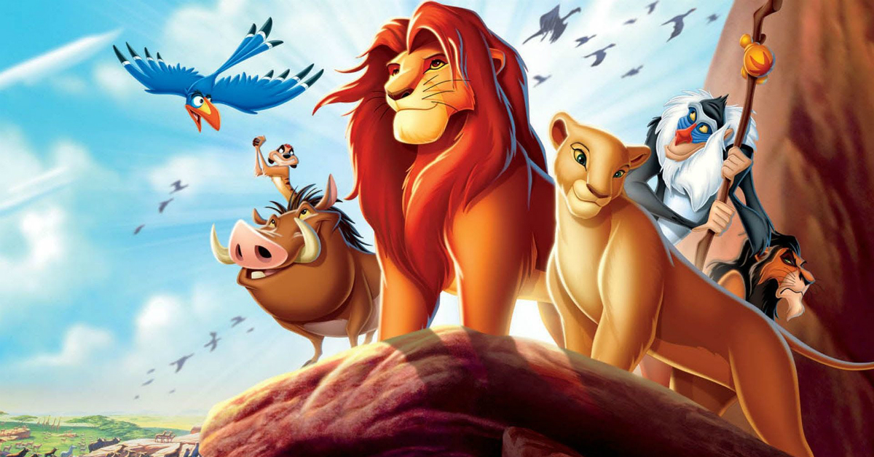
fly
bus
dog
log
leg
fan
red
fin
tin
gap
cub
rip
pig

Slide 20
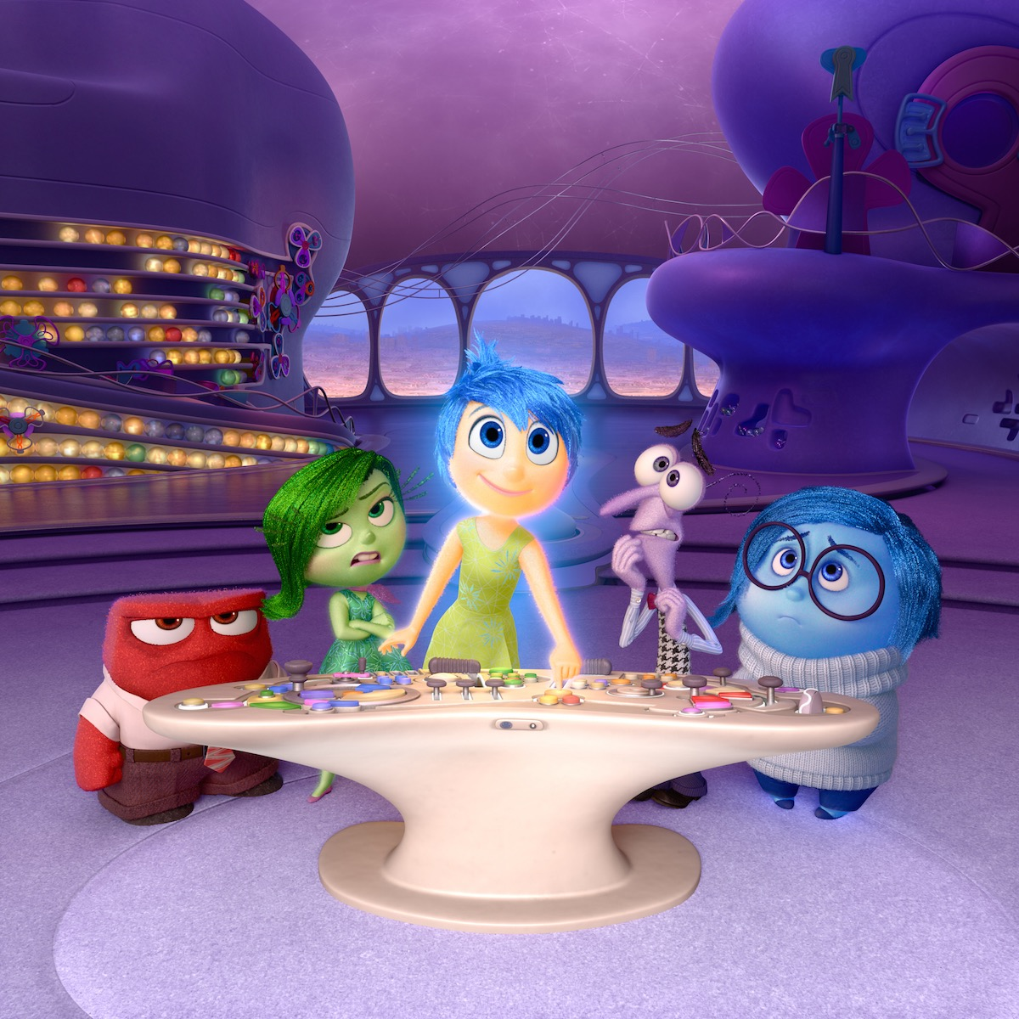
t
e
j
r
a
l
g
f
y
m
q
s
h

Slide 21
Writing
Make a postcard to tell somebody all about your virtual trip to Disney Land! You will need to draw a detailed picture on one side and write your message on the other side.
Challenge: Can you write the person’s address?

Slide 22
Numeracy
Here is a snack menu from Disney Land (see the next 3 pages).
Pick the snack that you would like, and choose the correct coins to pay for it. There are 3 pages, so you could do this 3 times.
Challenge: How much change would you get if you paid with a 10p coin?

Slide 23
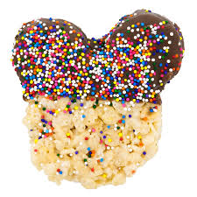
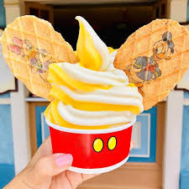
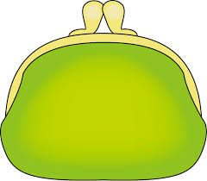
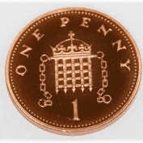
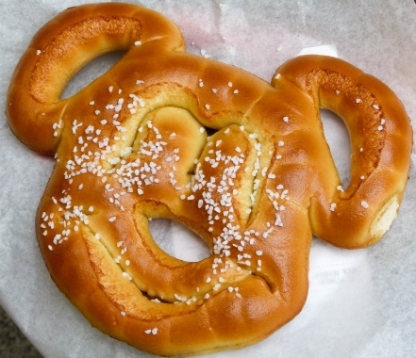
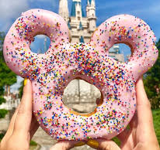
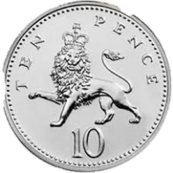
Mickey’s Snack Menu
Aladdin fruit skewers 5p | Pizza 7p
Ice cream 10p | Rice crispy treat 6p
Pretzel 4p | Doughnut 8p

Slide 24
Mickey’s Snack Menu
Aladdin fruit skewers 5p | Pizza 7p
Ice cream 10p | Rice crispy treat 6p
Pretzel 4p | Doughnut 8p

Slide 25
Mickey’s Snack Menu
Aladdin fruit skewers 5p | Pizza 7p
Ice cream 10p | Rice crispy treat 6p
Pretzel 4p | Doughnut 8p

Slide 26
HWB
Watch the clip of Ratatouille
Can you help to prepare a meal or snack today?
You could look at a recipe with an adult if they are using one.
https://www.youtube.com/watch?v=jwLKPDJqldw

Slide 27
IDL
Mickey has asked for your help to design a new ride for Disney Land! You could draw your ride, video yourself describing it, or build it out of blocks, recycling etc.
Challenge: You may wish to make a poster to advertise your ride
- Remember to include the price, height limit and any safety rules that you have.

Slide 28
Day 4

Slide 29
Reading (This page and Next 2 pages)
Can you read each character’s name? Can you match them to the correct pictures?
Challenge: Match the phrases to the correct pictures.

Slide 30
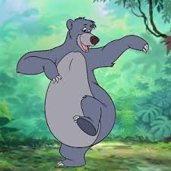
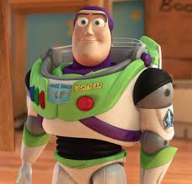
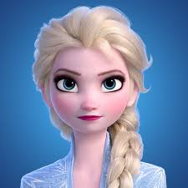
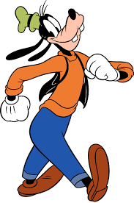
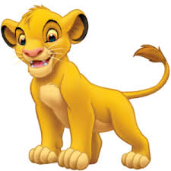
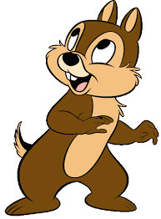
Elsa
Chip
Goofy
Simba
Baloo
Buzz

Slide 31
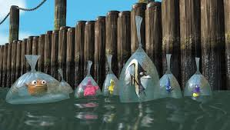
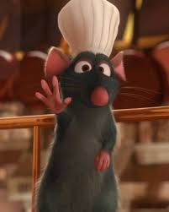
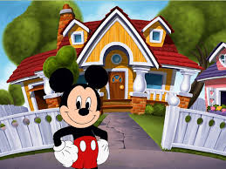
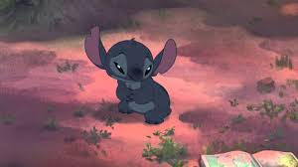
Match the phrases to the correct pictures.
Two ducks in a boat.
A mouse and his house.
There is a rat in a hat.
Stitch is sad.
The fish are in bags.

Slide 32
Writing
Task: We’re Flying Through the Air! Enjoy the Aladdin ride, where you fly through the sky on a magic carpet!
Can you draw pictures/make a list of things that can fly?
Challenge: Write a sentence to tell me where you would fly to if you had a magic carpet.
https://www.youtube.com/watch?v=fcbWb1FkSC0
.

Slide 33
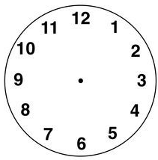
Numeracy: Primary 1
Draw the hour and minute hands to show the time.
The park opens at 9 o’clock.
You go on the log flumes at 11 o’clock.
You visit Mickey’s house at 4 o’clock.
Challenge: The park closes at half past 8.

Slide 34
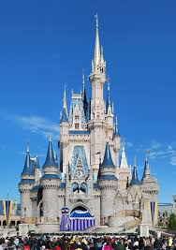
IDL
Science
Look at the picture of Cinderella’s castle. Can you create your own castle using materials of your choice? You could use sticks, blocks, or anything else that you wish. Be as creative as you can!

Slide 35
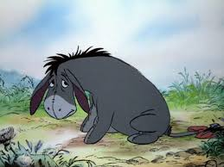
HWB
Eeyore is known for being sad sometimes. What could you do when you are feeling sad to make yourself feel a bit better?
Extension: How could you help a friend who was feeling sad?

Slide 36
Day 5

Slide 37
IDL
Look at this picture from the movie ‘Moana’.
Only 1 in 1000 turtles live to be adults, they need our help!
Can you help the baby turtle to get to the sea by pointing out all of the obstacles.
What do humans need to do when they are on the beach to keep turtles safe? Talk to someone at home about this

Slide 38
Reading
Watch the clip from ‘Moana’ and answer the questions:
https://www.youtube.com/watch?v=KGqBfyQFG_g
What did Moana find on the beach?
Where did the turtle go?
Why did Moana want to go back to the beach?
Challenge: You could think of a question to ask somebody else, to check that they were watching carefully!

Slide 39
Writing
Enjoy the Toy Story ride. https://www.youtube.com/watch?v=_oqkZbkZ6gg
The Toy Story characters are all very good friends.
Can you write a letter to one of your friends? You might want to tell them a piece of news, or what you enjoy doing with them.

Slide 40
HWB
Watch the video of the parade. Can you join in with any of the dancing?
https://www.youtube.com/watch?v=rR-KP8KH1Ng

Slide 41
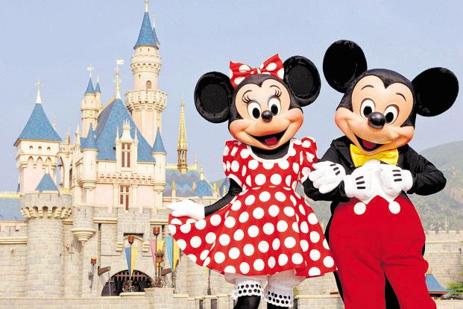
Create a souvenir photo! Take a close photo of your face and add it to the template as your souvenir!

Slide 43
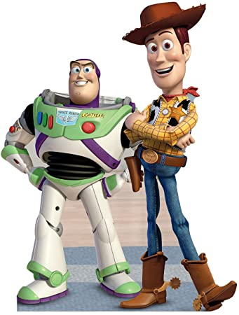

Slide 45
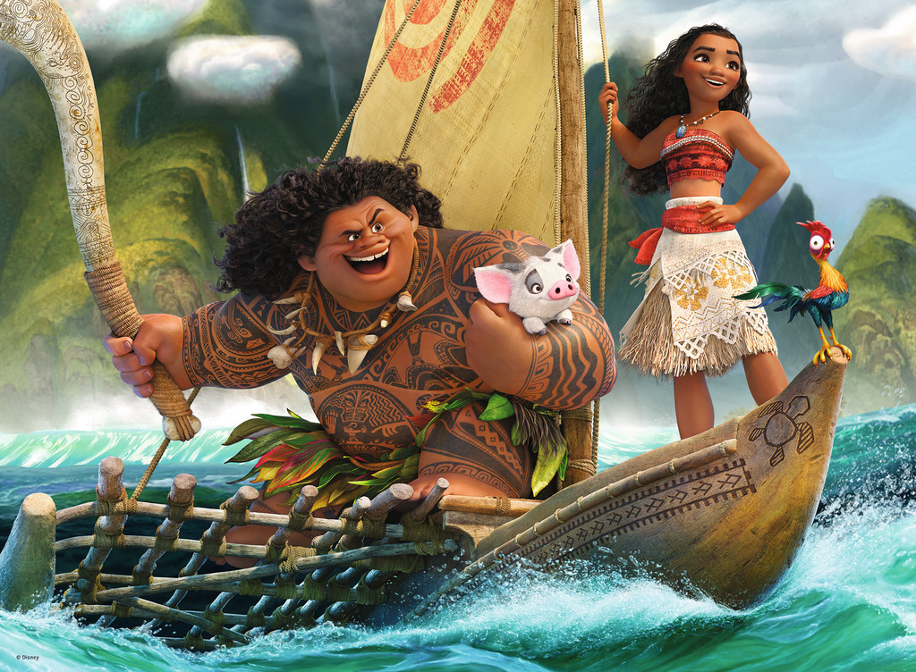

Slide 47
The End…
I hope you have enjoyed your week at Disneyland P1 ☺
Have a great weekend and I will be in touch on Monday!
Missing you all
Miss McCullagh

