Slide 1
Shape in Art

Slide 2
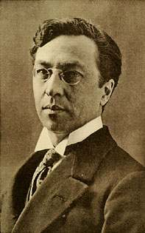
Wassily Kandinsky
Born in Russia.
Lived from 1866 – 1944.
Died aged 77.
His style of painting changed a great deal during his lifetime. Shapes were just one source of inspiration.

Slide 3
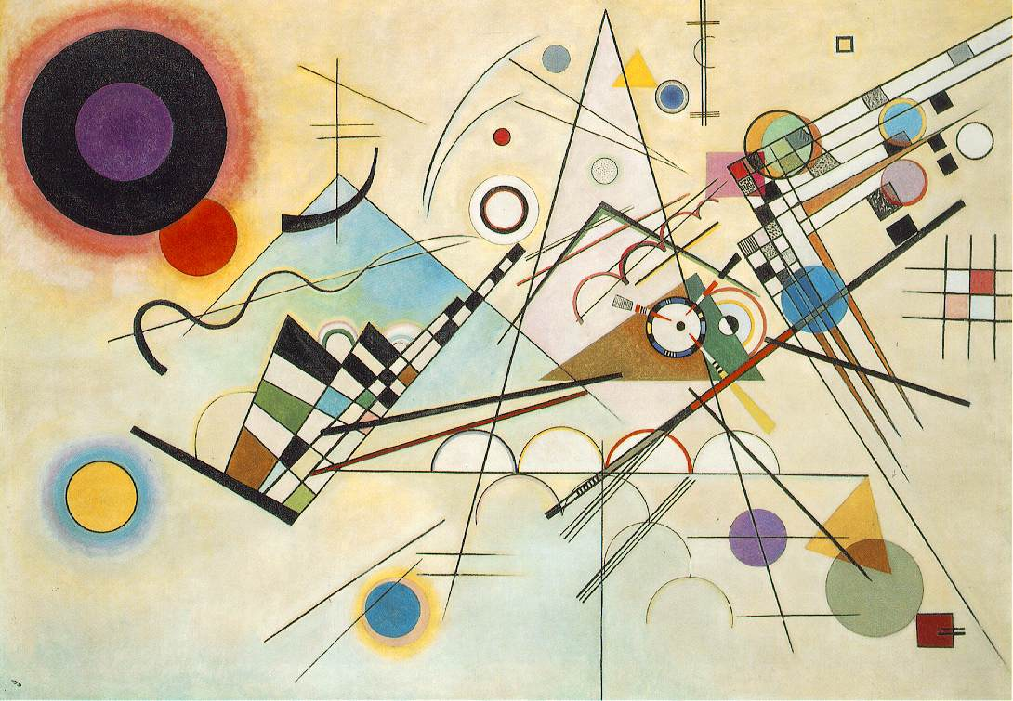

Slide 4
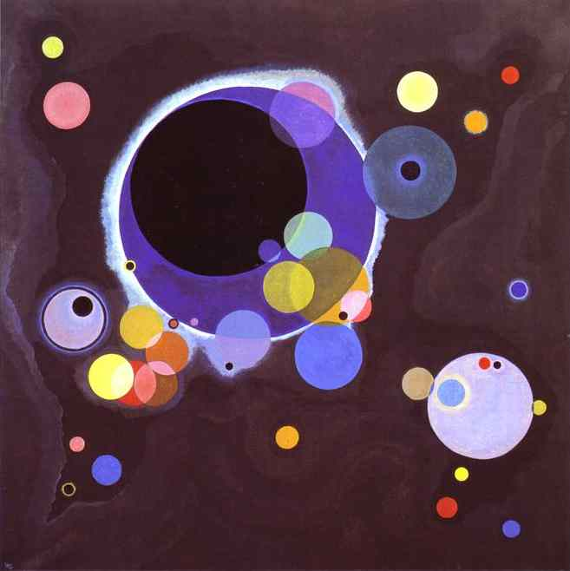

Slide 5
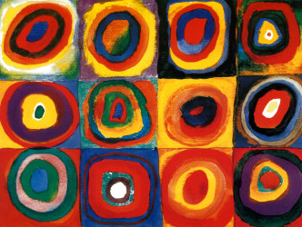

Slide 6


Slide 7
