Slide 1
Language Is Fun Together An Intervention for Early Years

Slide 2
What is LIFT?
LIFT was a project from Stirling and Clackmannanshire, now being run across Midlothian, and parts of Edinburgh
It involved parent workshops run by nursery staff with Speech and Language Therapy support.
The aim was to give all parents ways of improving their children's communication skills

Slide 3
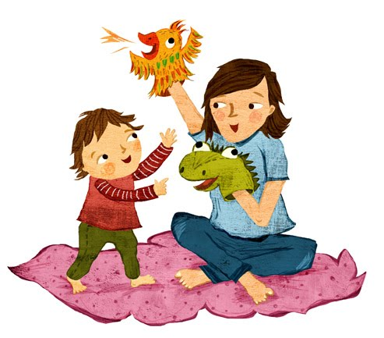
Stay and Play
To have fun and play with your child!
The aim is for you to learn some new skills to build your child’s language at home.
LIFT is the everyday experience children have at home which are key to building their language e.g. bath time ,stories ,walk to the shop. The experiences children have at home have a higher impact than nursery.

Slide 4
Add to your child’s language
Your child’s use of language will change and develop. Always add on another word to the words they use.
“Car”- “blue car”
“Fast car”- “Fast shiny car”
“A big dog”- “A big furry dog”
“Quack quack”- “Duck goes Quack”

Slide 5
Fewer Questions More Comments
When playing together try to use lots of words to help your child learn new words and match this to the level of your child's language. For example: You are playing cars with your child. Instead of “what’s your car doing?” You could say:
Your have the blue car 1. Blue car
The car is driving fast 2. Fast car
The car has stopped at the traffic lights 3. Stop, lights
The car goes brum, beep beep 4. brrmmmm

