Slide 1
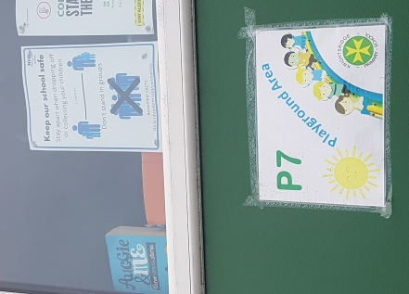
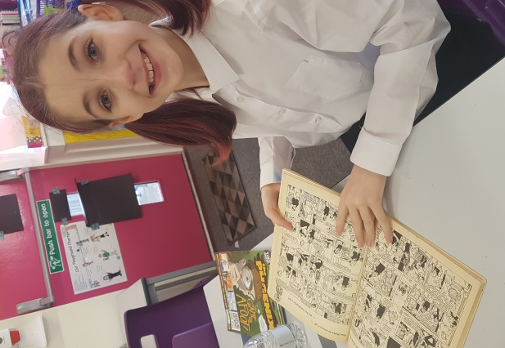
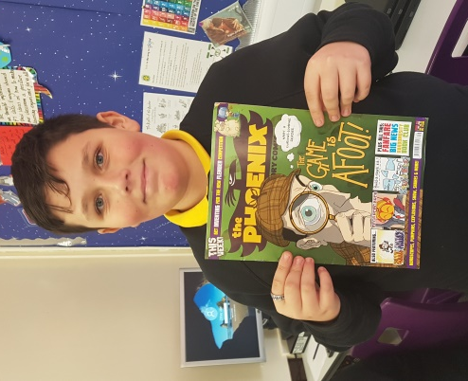
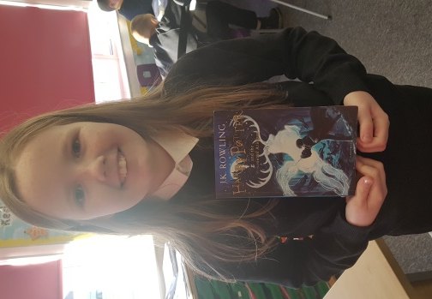
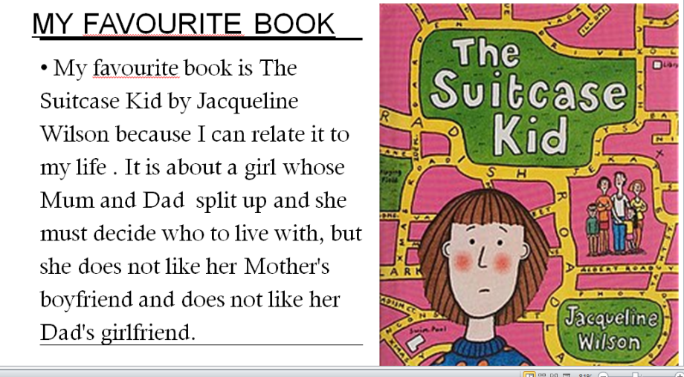
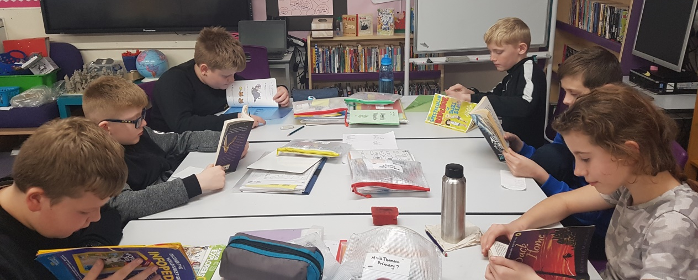
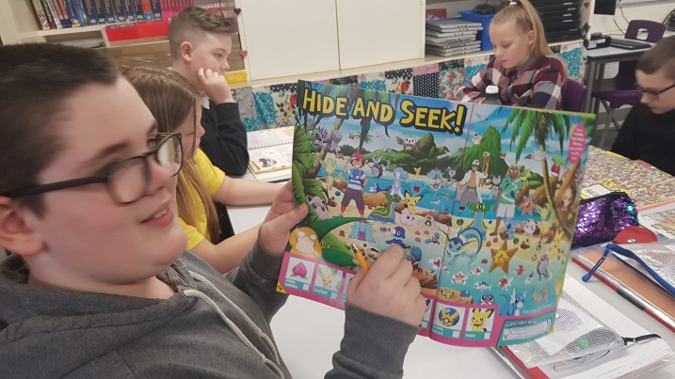
Book Week Scotland
in Primary 7
We really enjoyed our reading time this week to celebrate Book Week, reviewed & shared our favourite books and magazines with each other. Olivia finished Harry Potter!!! We read that one of the characters in Wonder was a bully and discussed this in depth. We put our book in the window to share it with others.

