Slide 1
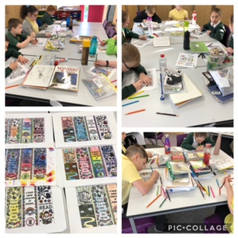
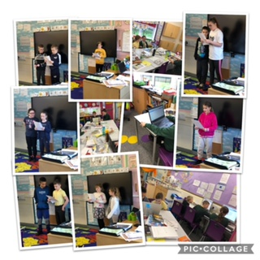
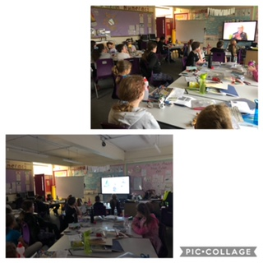
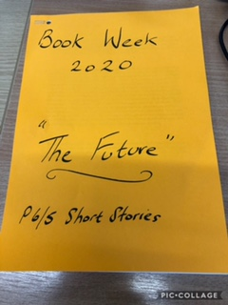
Book Week Scotland Activities in P6/5
We wrote short stories to read to the class and bound them into a book for everyone to read
We made book marks for family and friends
We enjoyed watching Scottish Book Trust events as part of the Book Week celebrations

