Slide 1
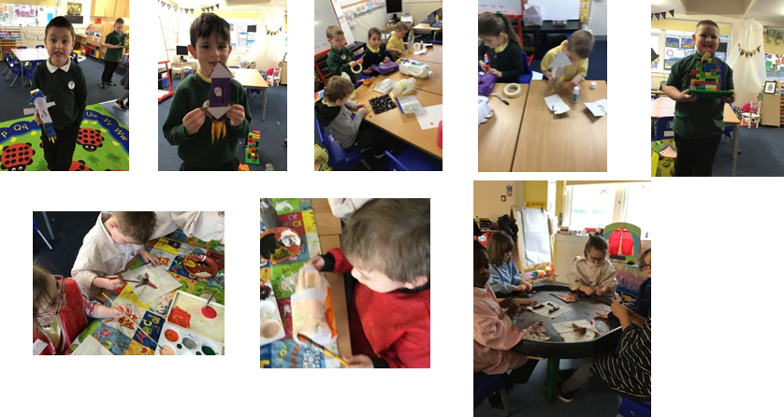
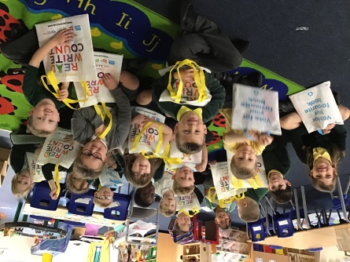
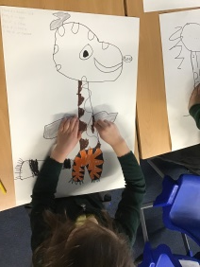
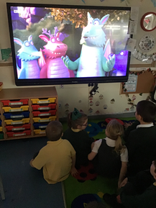
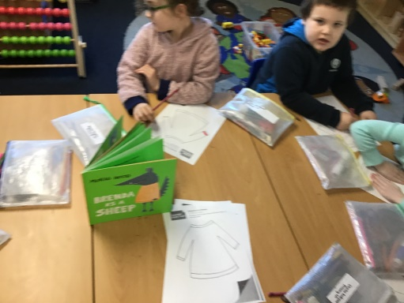
Book Week in Primary 2/1
We were given gifts from the Scottish Book Trust and had so much fun using the stories to learn this week!
Primary 2/1 enjoyed making rockets for Rocketmole to use!
We read stories about the future!
We read Julia Donaldson stories and watched short films about her stories at snack time!

