Slide 1
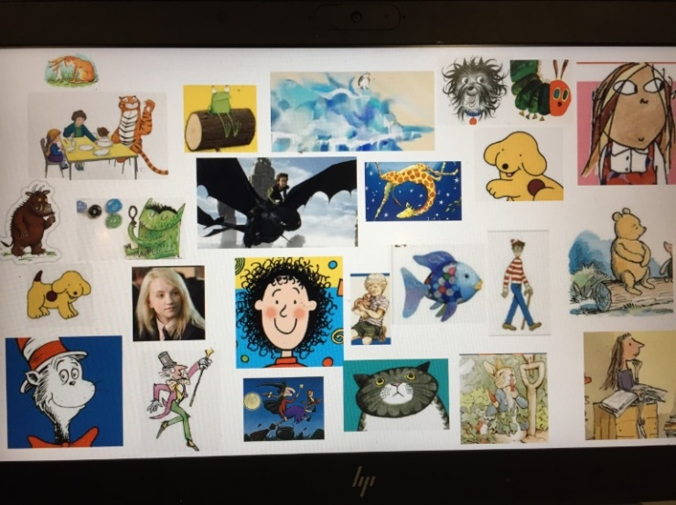
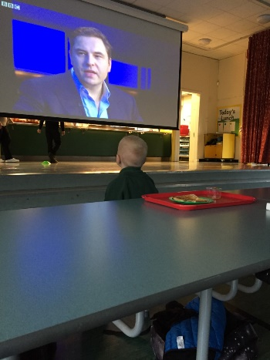
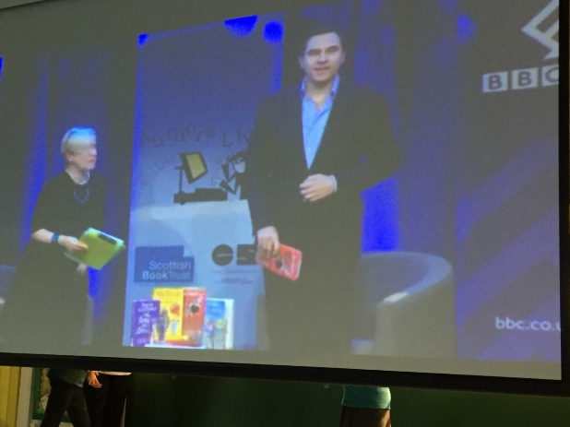
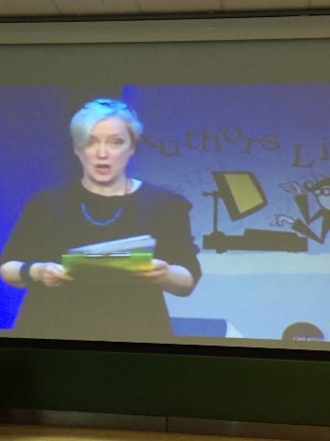
Book Week Scotland at Breakfast Club
We had fun and lots of good discussions about book titles, protagonists, authors, illustrators and characters.
We enjoyed listening to David Walliams on Scottish Book Trust Authors Live too.

