Slide 1
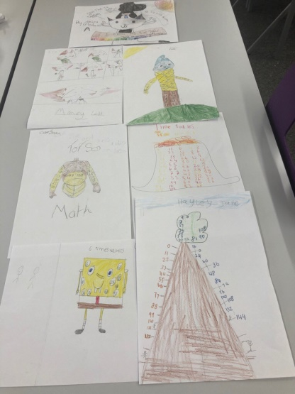
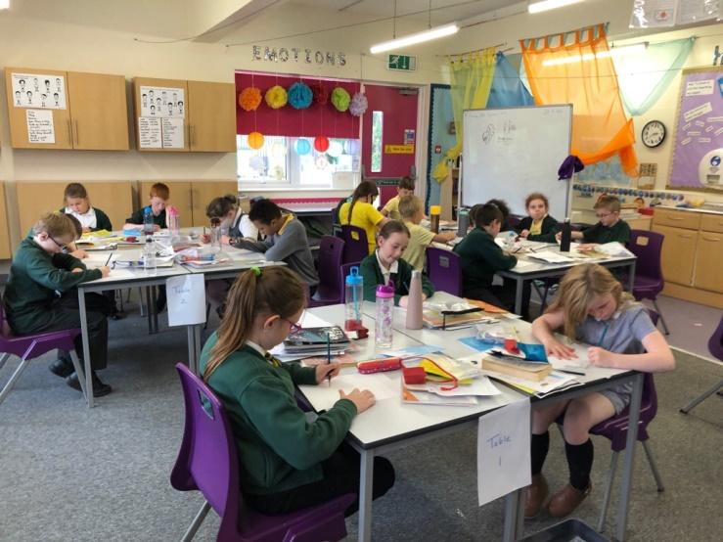
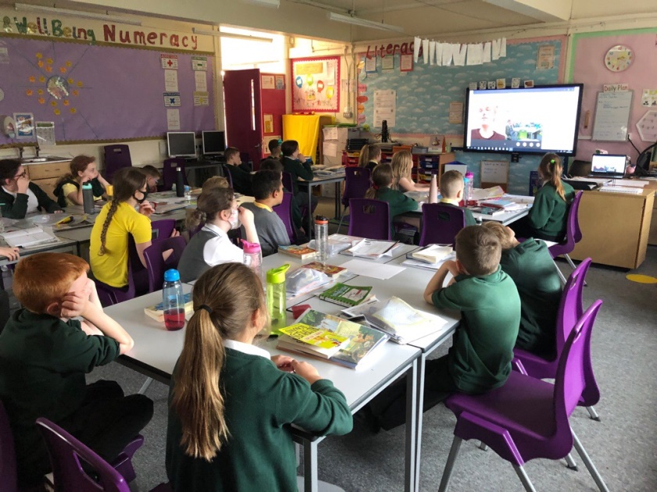
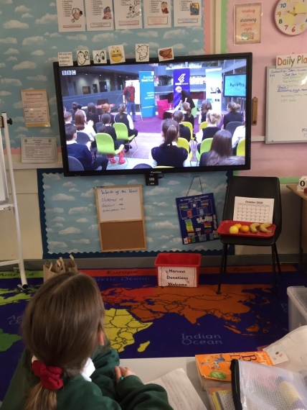
We took part in a live online event live Rossie Stone and Dekko Comics where we learned new ways to make notes and revise numeracy facts.
Primary 6/5 Maths Week Scotland learning activities
Here we are being inspired watching Kjartan Poskitt presenting an Authors Live event called Murderous Maths!

