Slide 1
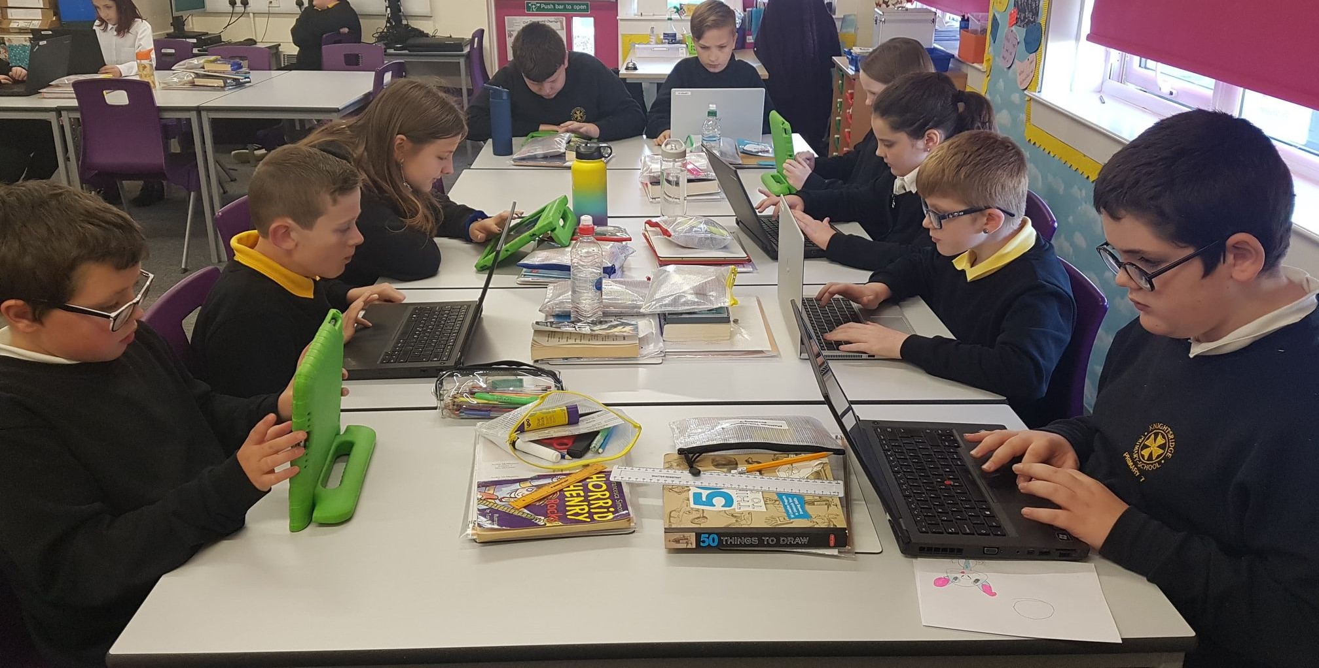
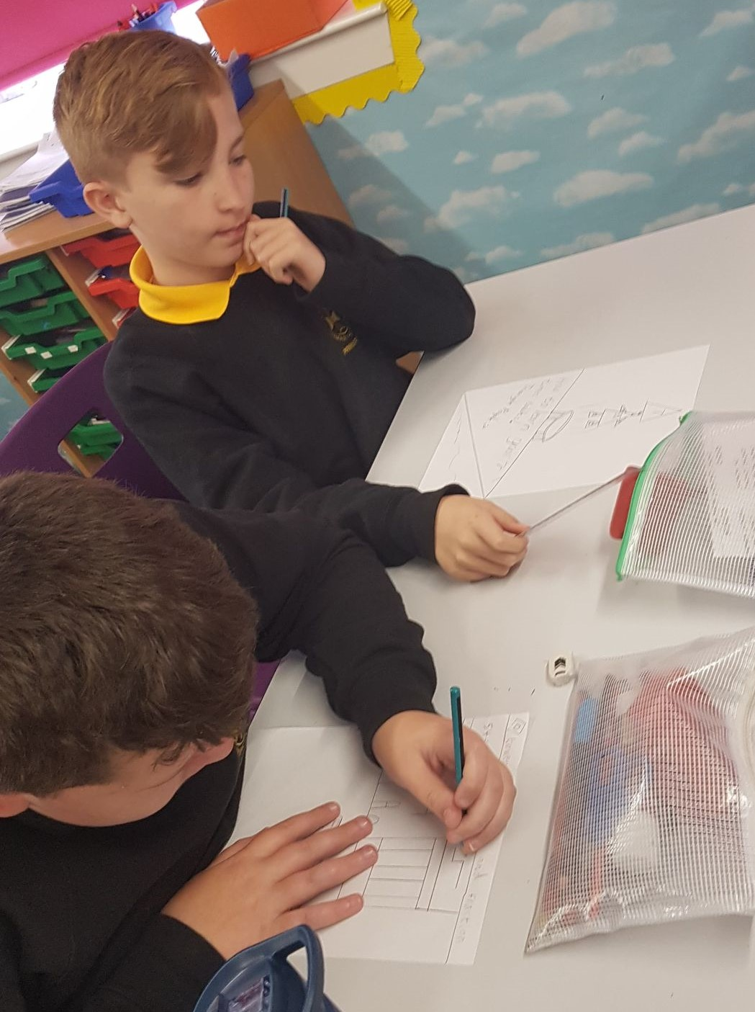
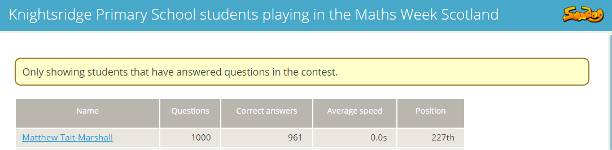
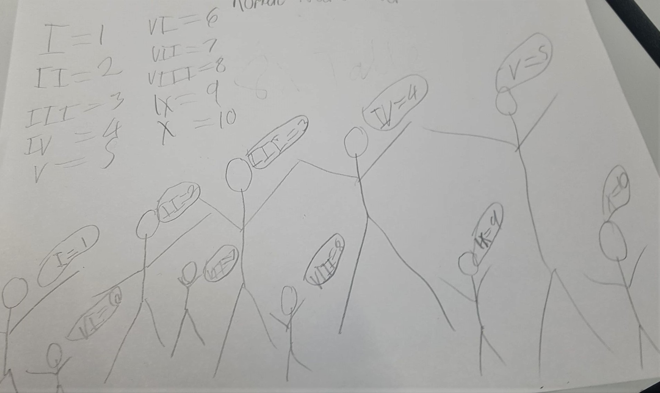
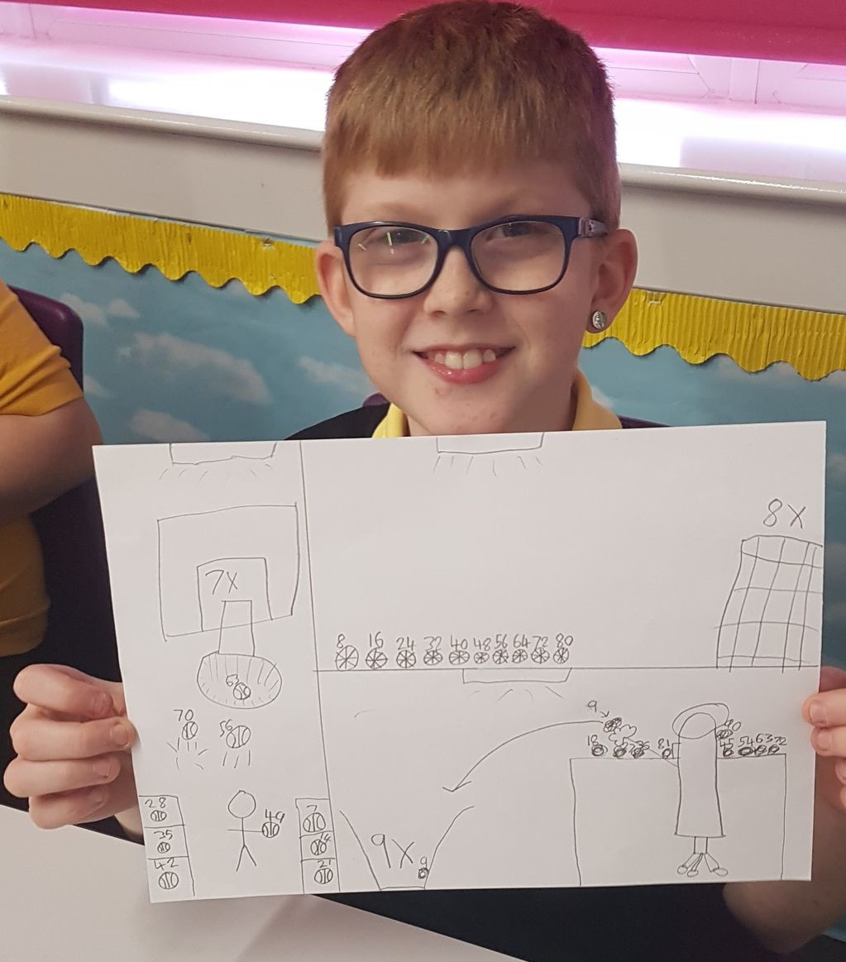
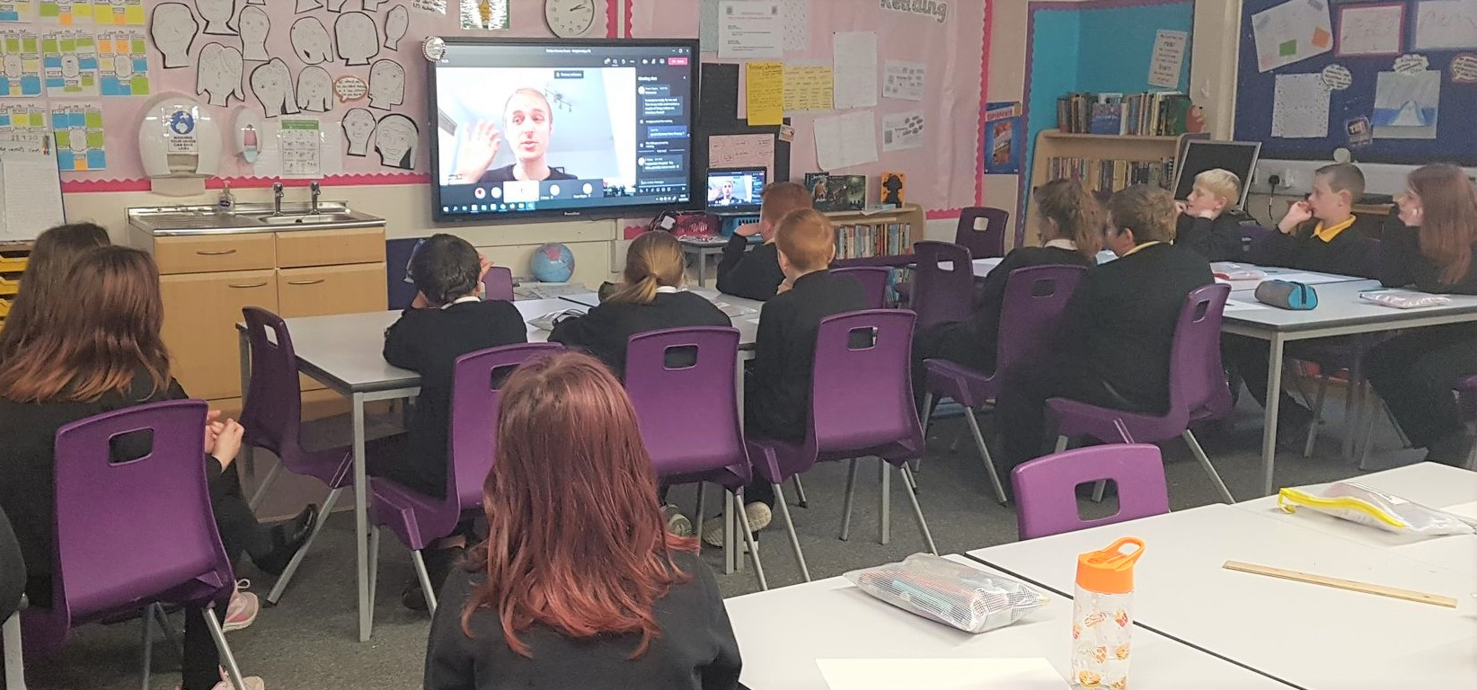
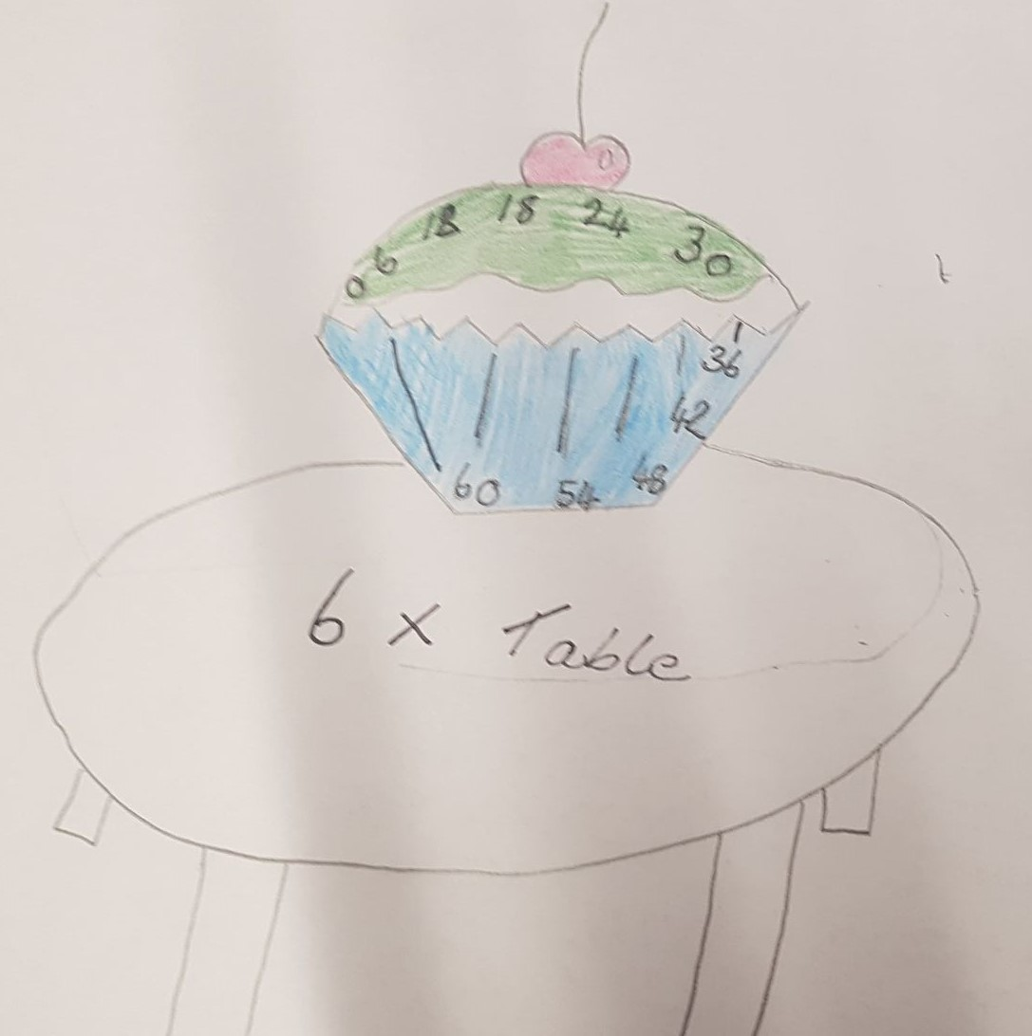
Maths Week Scotland in Primary 7
Creativity
Focus & concentration in theScotland wide competition – accuracy and perseverance!
Roman Numerals
Making Maths fun!
Sumdog competition
Authors Live – Dekko comics
Problem Solving
Real Life Problems
Different strategies
Inspired to create our own Maths Week comics
Times tables
Times tables

