Slide 2
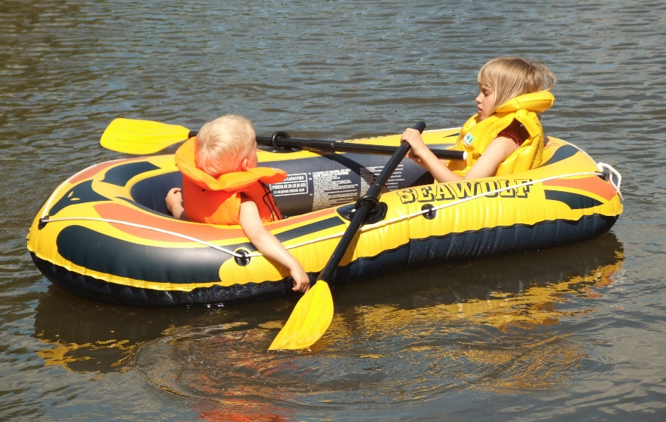
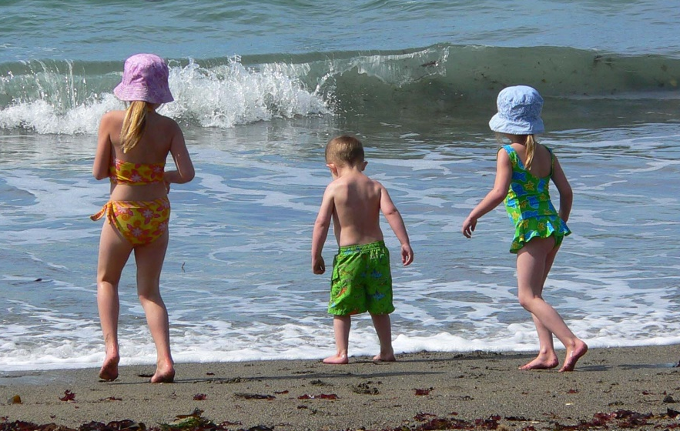
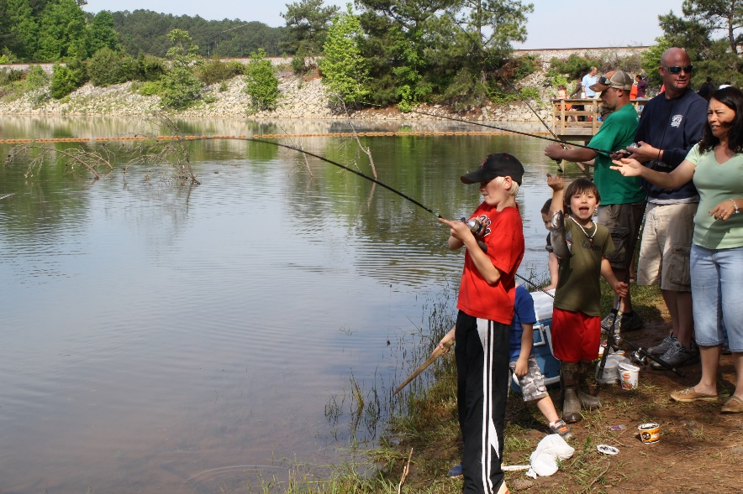
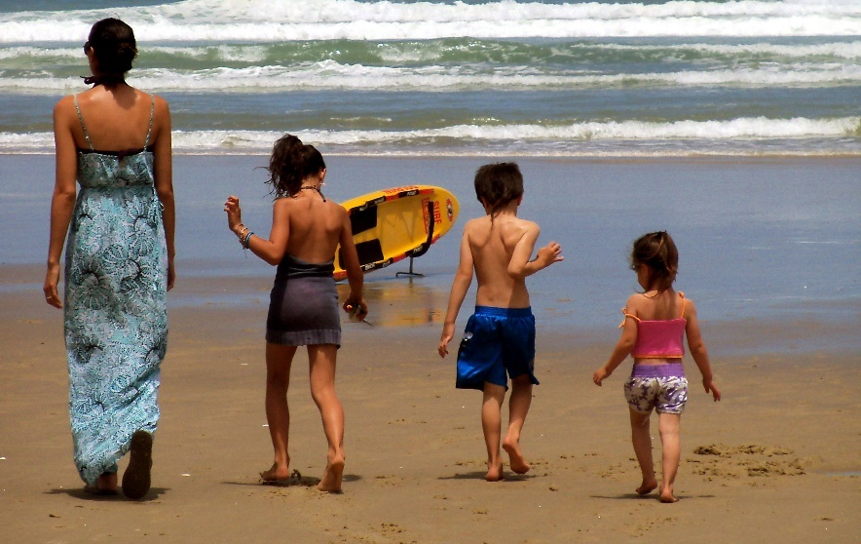
Staying Safe Around Water
Photos courtesy of Jerzy Kociatkiewicz, docentjoyce, U.S. Army Corps of Engineers Savannah District and Kiran Foster (@flickr.com) - granted under creative commons licence – attribution
Photos courtesy of Jerzy Kociatkiewicz, docentjoyce, U.S. Army Corps of Engineers Savannah District and Kiran Foster (@flickr.com) - granted under creative commons licence – attribution

Slide 3
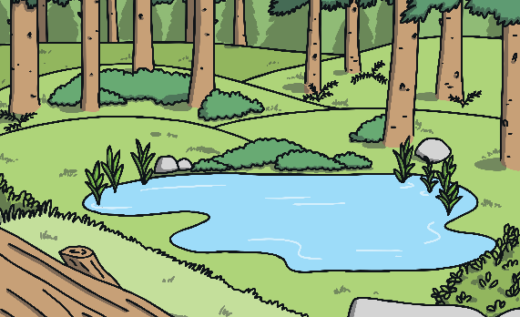
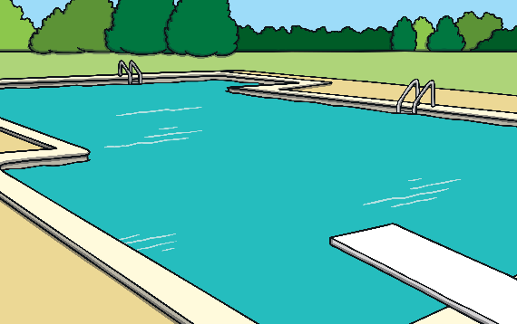
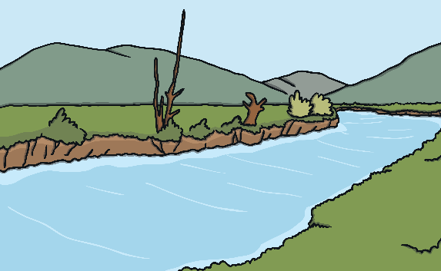
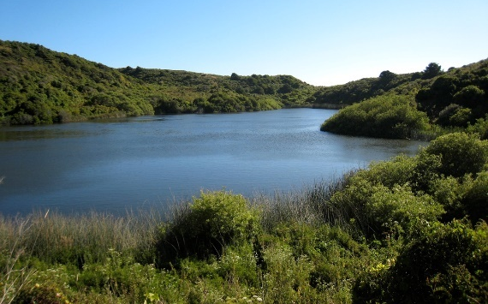
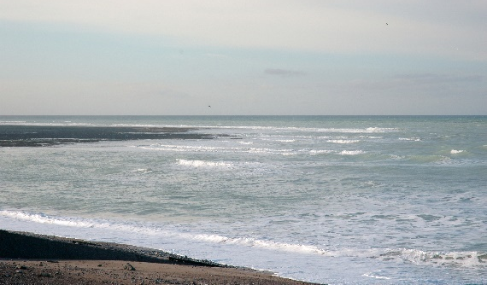
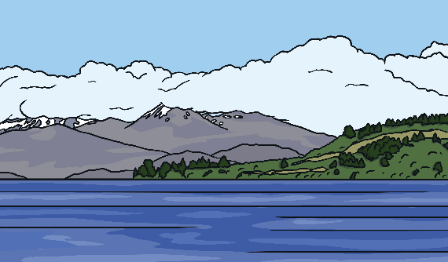
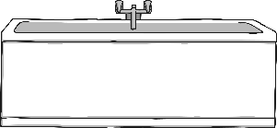
Where Do We Find Water?
ponds
pools
rivers
lakes
baths
oceans
Photos courtesy of Jerzy Kociatkiewicz, docentjoyce, U.S. Army Corps of Engineers Savannah District and Kiran Foster (@flickr.com) - granted under creative commons licence – attribution

Slide 4
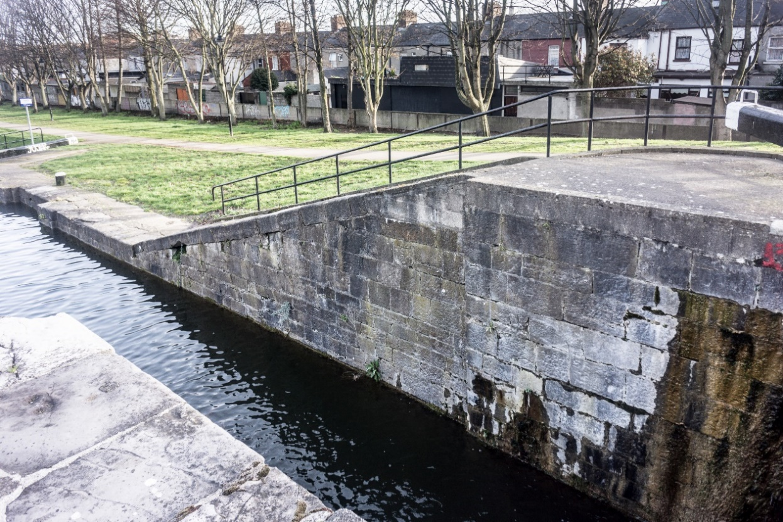
How Do We Stay Safe Around Water?
When out and about near water, there is a special code we should follow:
S
A
F
E
Stay
Away
From the
Edge
Why is this important?
Photo courtesy of William Murphy (@flickr.com) - granted under creative commons licence – attribution
Photos courtesy of Jerzy Kociatkiewicz, docentjoyce, U.S. Army Corps of Engineers Savannah District and Kiran Foster (@flickr.com) - granted under creative commons licence – attribution

Slide 5
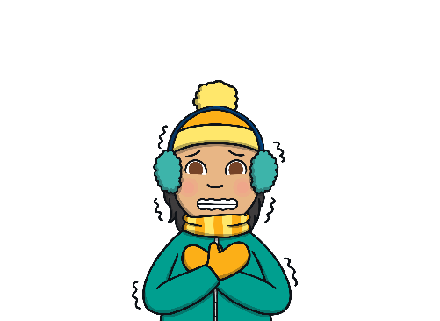
Water Safety
To keep yourself safe when you are in, on, or near outdoor water, always follow The Water Safety Code.
The Water Safety Code helps you to spot the dangers around water:
It will be cold.
It can be difficult to get out.
It can be deep.
Photos courtesy of Jerzy Kociatkiewicz, docentjoyce, U.S. Army Corps of Engineers Savannah District and Kiran Foster (@flickr.com) - granted under creative commons licence – attribution

Slide 6
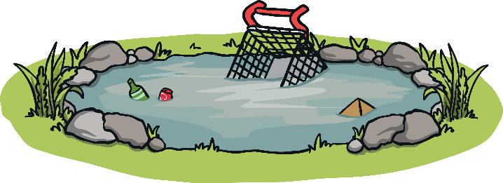
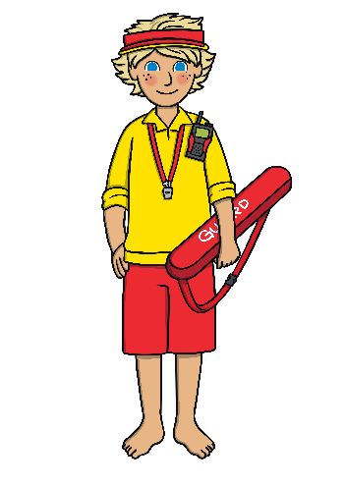
Water Safety
There may be hidden garbage that could hurt you.
There may be no lifeguards.
The water may be dirty and could make you ill.
Photos courtesy of Jerzy Kociatkiewicz, docentjoyce, U.S. Army Corps of Engineers Savannah District and Kiran Foster (@flickr.com) - granted under creative commons licence – attribution

Slide 7
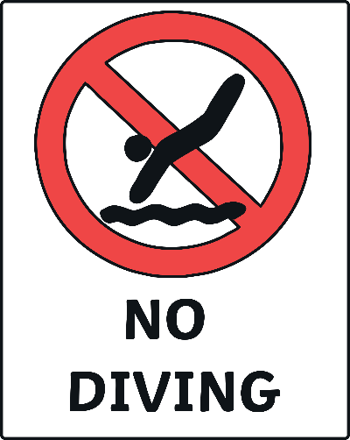
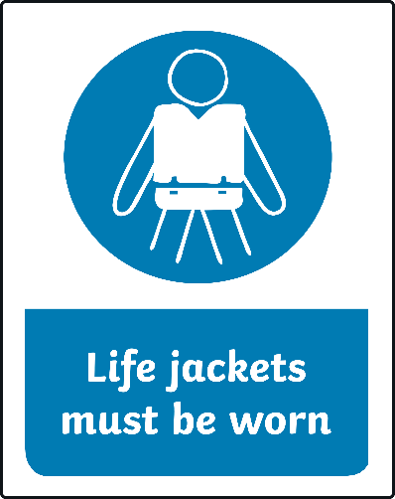
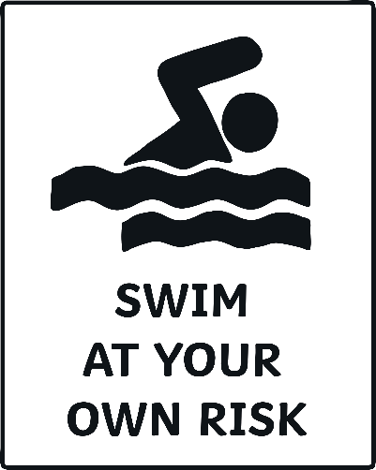
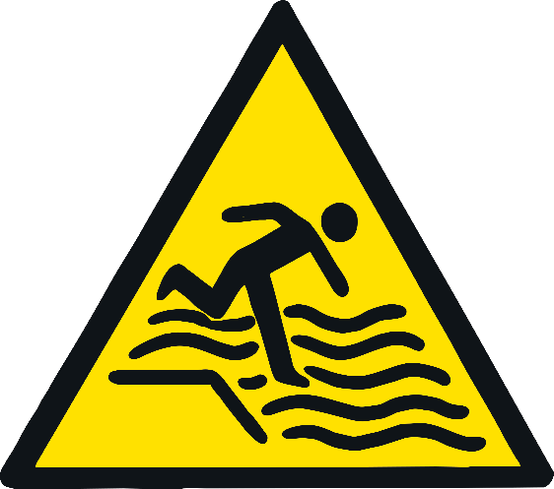
Water Safety
These signs can help you spot danger.
Can you guess what these signs mean?
Photos courtesy of Jerzy Kociatkiewicz, docentjoyce, U.S. Army Corps of Engineers Savannah District and Kiran Foster (@flickr.com) - granted under creative commons licence – attribution

Slide 8
Water Safety Signs
Signs that warn you of danger are a yellow triangle shape and are placed to help you spot danger. This one means there is a steep drop.
Signs that mean you should not do something are a red circle shape with a red line running through it, a white background, and black symbols. They tell you about something you are not allowed to do.
Photos courtesy of Jerzy Kociatkiewicz, docentjoyce, U.S. Army Corps of Engineers Savannah District and Kiran Foster (@flickr.com) - granted under creative commons licence – attribution

Slide 9
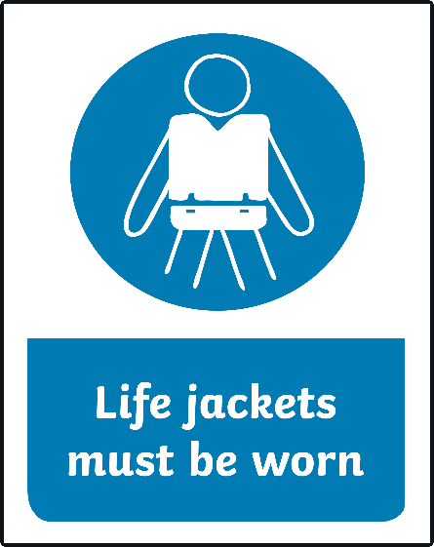
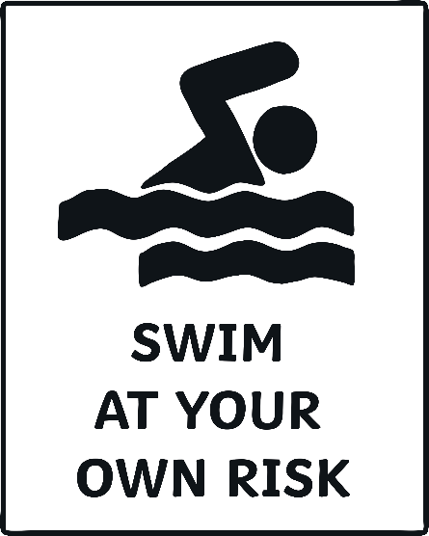
Water Safety Signs
Signs that tell you to do something are usually a blue circle shape with white symbols.
Information signs are white with black symbols.
Photos courtesy of Jerzy Kociatkiewicz, docentjoyce, U.S. Army Corps of Engineers Savannah District and Kiran Foster (@flickr.com) - granted under creative commons licence – attribution

Slide 10
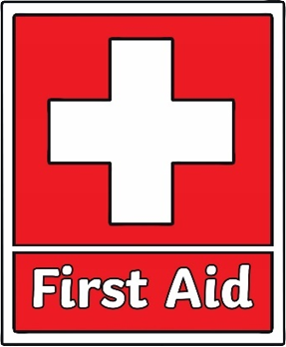
Water Safety Signs
“Safe” signs are red with white symbols.
Photos courtesy of Jerzy Kociatkiewicz, docentjoyce, U.S. Army Corps of Engineers Savannah District and Kiran Foster (@flickr.com) - granted under creative commons licence – attribution

Slide 11
Safety Flags
At beaches there are special flags:
red flag – it is not safe to swim
red and yellow flags – recommended swimming area
with lifeguard supervision
black and white flags – surfboards and other
non-powered watercraft allowed
Photos courtesy of Jerzy Kociatkiewicz, docentjoyce, U.S. Army Corps of Engineers Savannah District and Kiran Foster (@flickr.com) - granted under creative commons licence – attribution

Slide 12
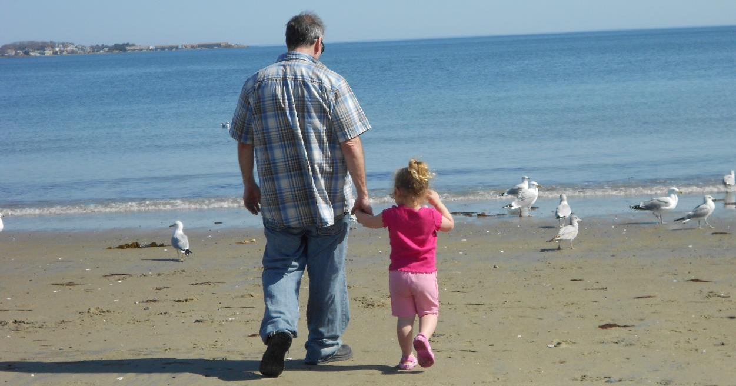
Go Together
Children should always be with an adult around water. Adults can help to point out any dangers.
Photo courtesy of ECraig4 (@flickr.com) - granted under creative commons licence – attribution
Photos courtesy of Jerzy Kociatkiewicz, docentjoyce, U.S. Army Corps of Engineers Savannah District and Kiran Foster (@flickr.com) - granted under creative commons licence – attribution

Slide 13
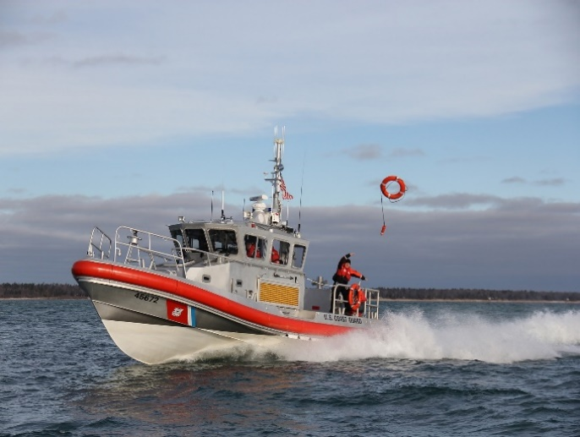
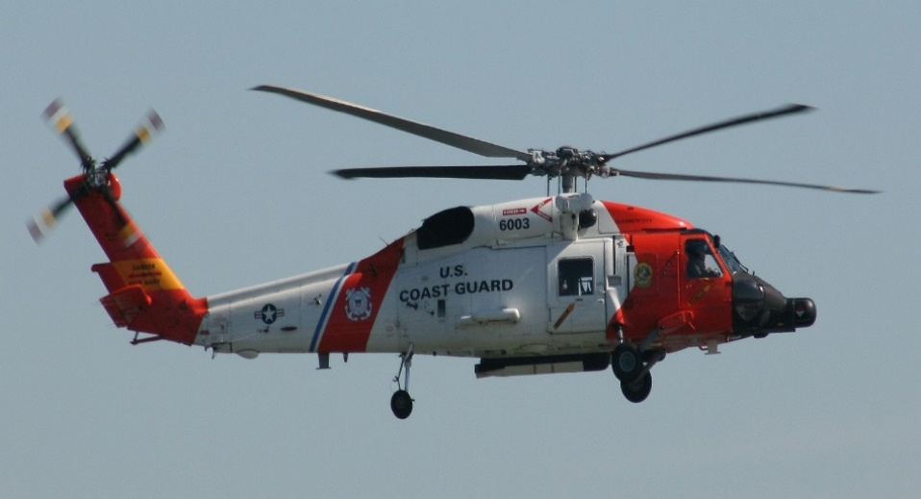
Learn How to Help
If you see someone in trouble, tell an adult.
Call 911 if there is an emergency.
Ask the lifeguard to help.
Photos courtesy of Jerzy Kociatkiewicz, docentjoyce, U.S. Army Corps of Engineers Savannah District and Kiran Foster (@flickr.com) - granted under creative commons licence – attribution

Slide 14
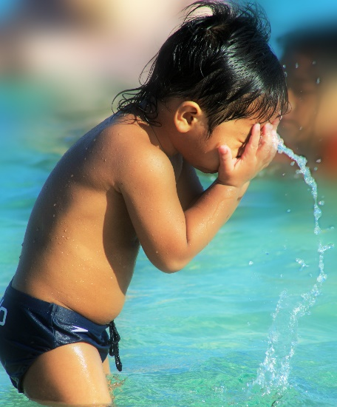
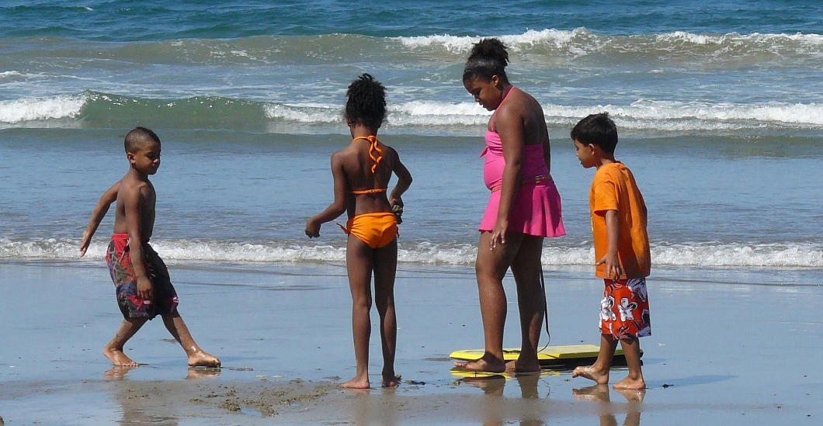
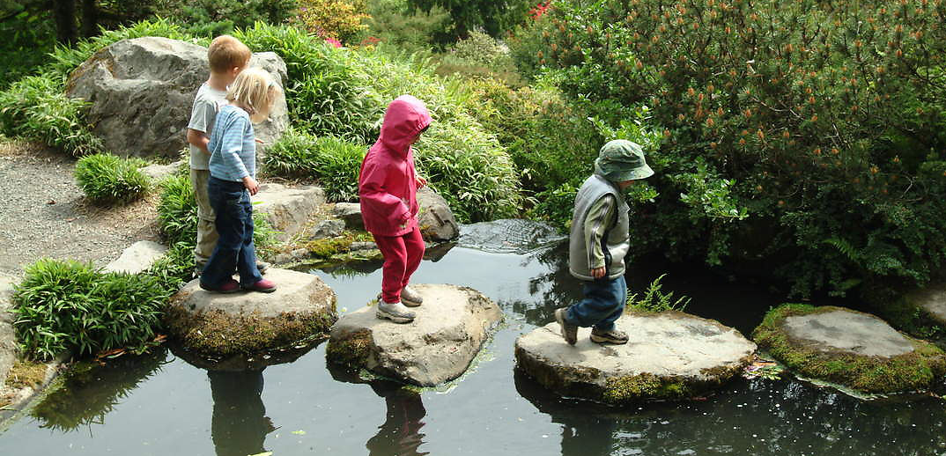
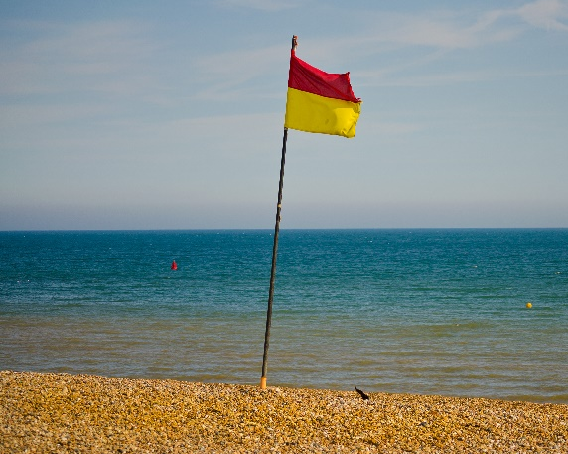
Water Safety
Can you think of different ways to keep yourself safe near water?
Photo courtesy of Allan Donque, docentjoyce, Seattle Municipal Archives and Garry Knight (@flickr.com) - granted under creative commons licence – attribution
Photos courtesy of Jerzy Kociatkiewicz, docentjoyce, U.S. Army Corps of Engineers Savannah District and Kiran Foster (@flickr.com) - granted under creative commons licence – attribution

