Slide 2
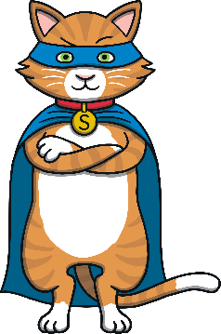
Notes to Practitioners
Super Cat’s Road Safety Story can be used to teach young children how to cross the road safely, in a fun way!
Throughout Super Cat’s Road Safety Story, the children listening to the story are referred to as Super Cat’s Super Kittens.
When Super Cat asks the Super Kittens a question related to road safety, you may like to ask the questions to your children to initiate different road-safety discussions.
A catchy road safety rap is also included within the story to reinforce the key road safety messages. You may like to introduce actions for the children to perform alongside the rap, to help to make the message more memorable. Use Super Cat’s actions to help you!

Slide 3
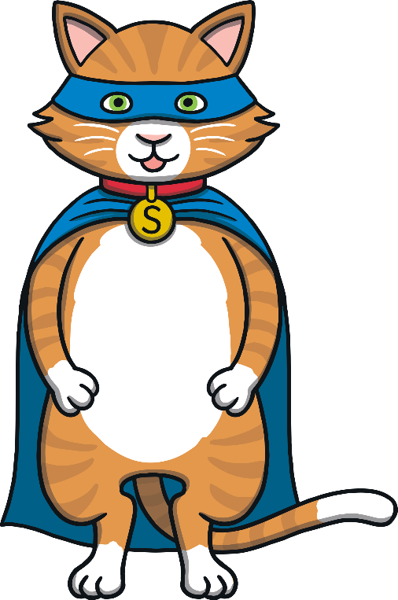
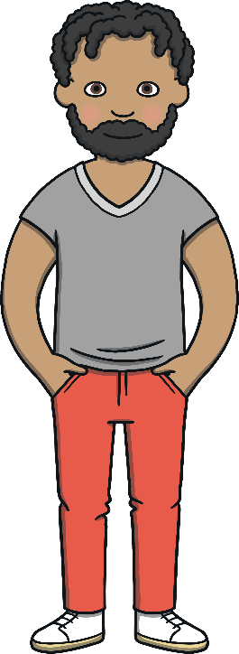
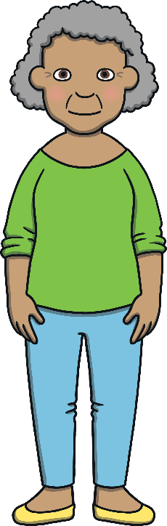
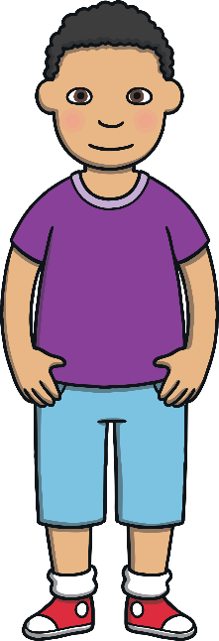
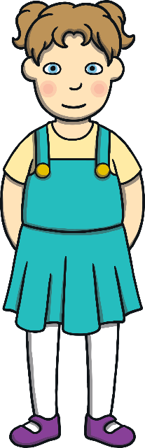
Characters
There are 5 characters in this exciting story!
Sam
Mia
Super Cat
Daddy
Granny

Slide 4
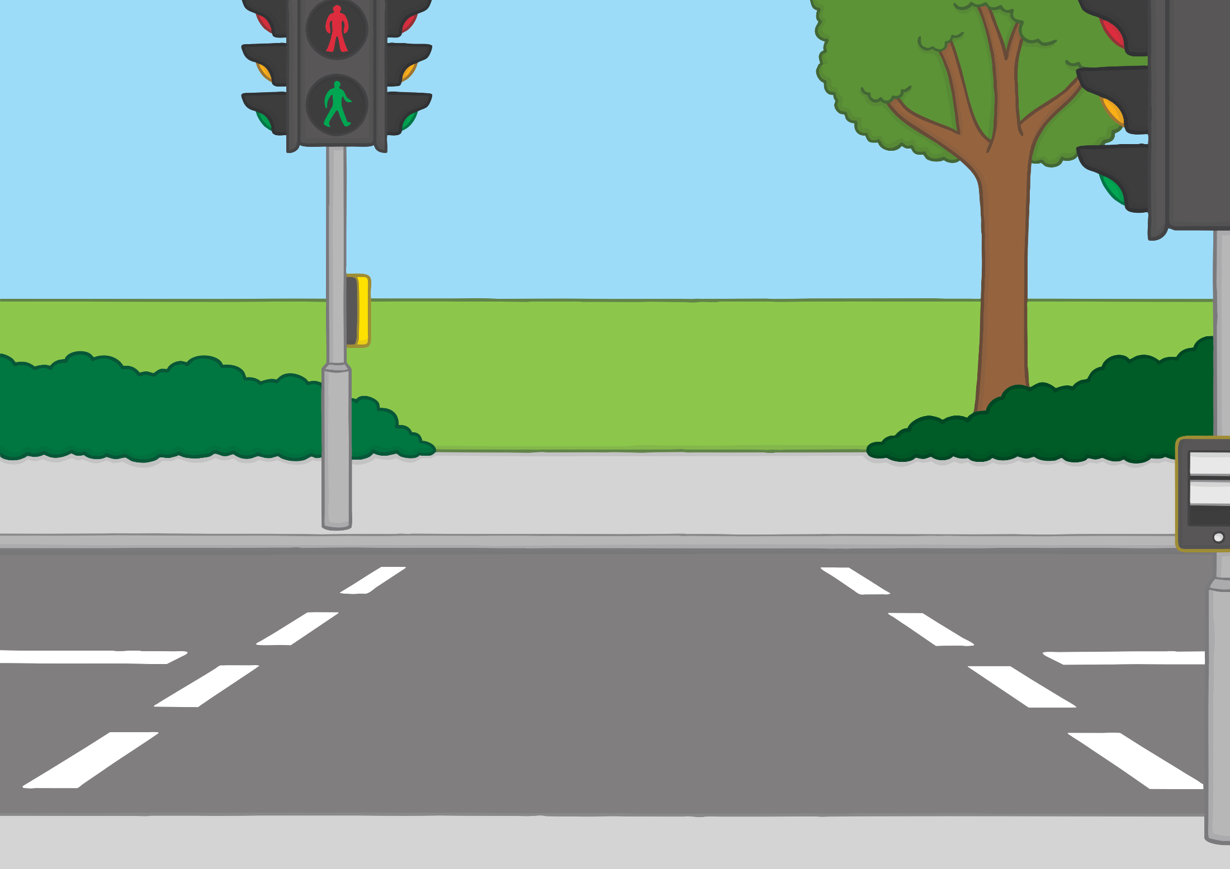


Super Cat! That’s what they call me and do you know why they call me that? Because I am a cat and I have super senses!
Don’t worry, I use my super senses for good. I use them to help children to stay safe on the roads.
The only thing is, it is a very busy job trying to keep all of the boys and girls safe and I need some super kitten helpers.
Will you help me?

Slide 5
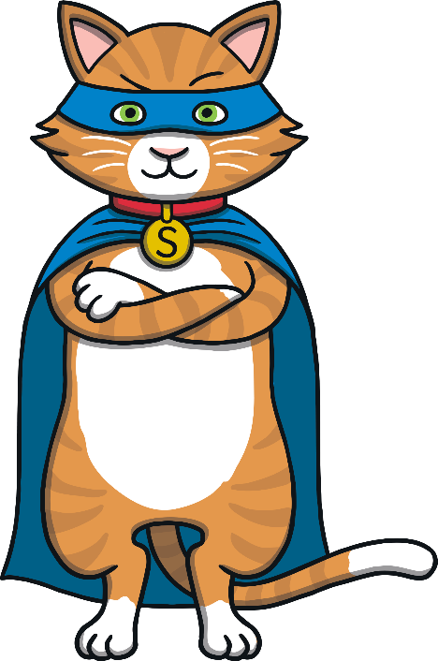
If you are going to help me, there is something very important you need to learn – my road safety rap!
If my super senses ever pick up the scent of someone about to get into trouble near a road, I race to them as quick as a flash, I strike my superhero pose and I say...

Slide 6

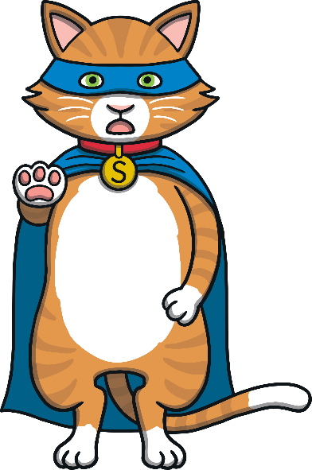
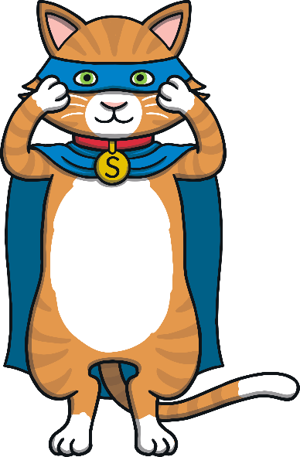
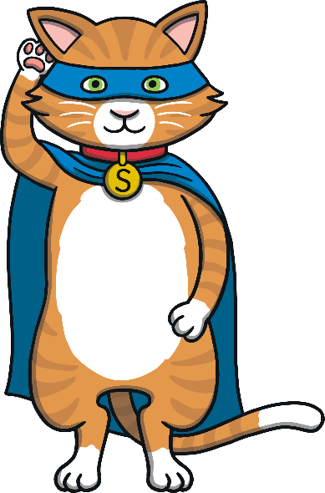
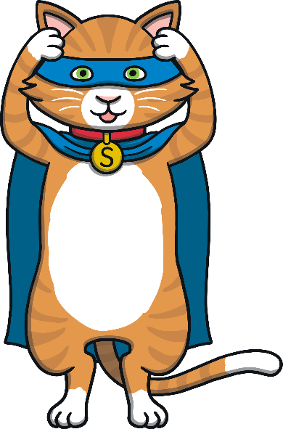
Super Cat’s Road Safety Rap
Super Cat’s here, so say ‘meow’!
Want to cross roads, safely? I’ll tell you how!
First, you
stop and
look from side-to-side.
Then you
listen and
think; that’s the Super Cat guide!
stop
look
listen
think

Slide 7

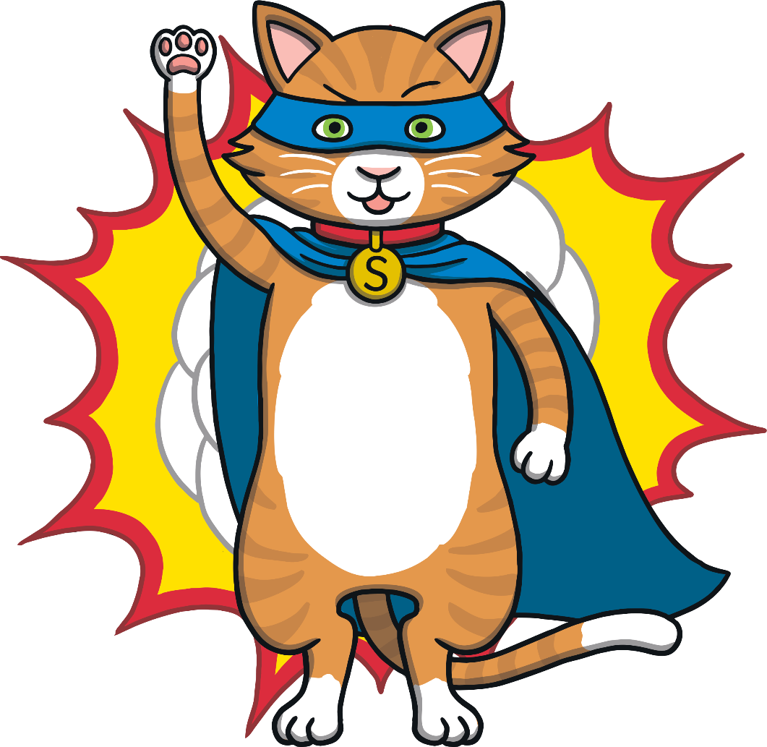
Perfect, now you know my Super Cat Road Safety Rap you can come and help me.
Come on Super Kittens, let’s go! I can smell trouble ahead...

Slide 8
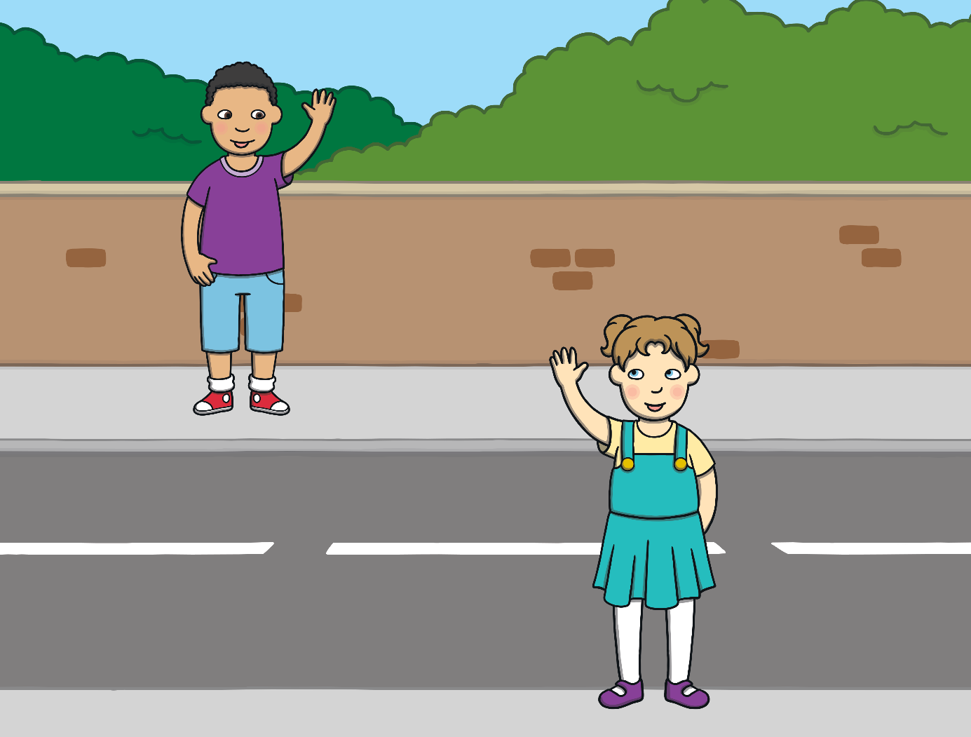
On a street, not far away, lived a little boy called Sam. Sam lived with his daddy and his granny. Sam’s daddy had to work a lot so his granny normally looked after him.
Sam was very lucky! His best friend, Mia, lived just across the road and they played together all the time!

Slide 9
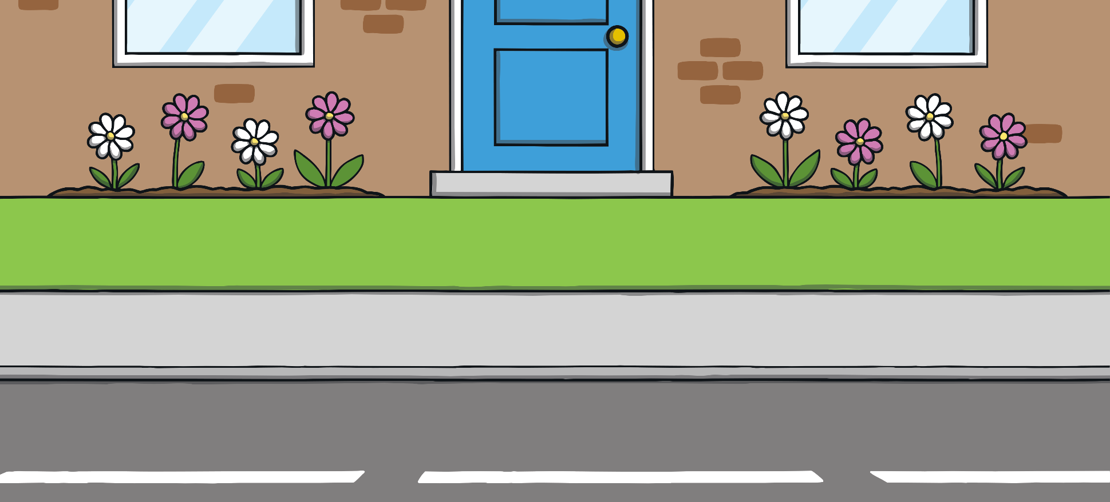
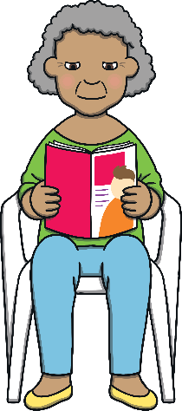

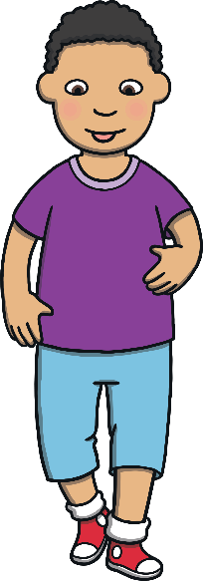


One sunny, Monday afternoon, Sam and Mia were playing football together in Sam’s front garden and Granny was reading her magazine.
Mia accidentally kicked the ball a little too hard and it flew straight past Sam, onto the road.
Sam started to chase after the ball and was about to step into the road when suddenly, Super Cat appeared!
Sam was so startled by Super Cat’s appearance that he stopped just in time!

Slide 10
Super Cat’s Road Safety Rap
Super Cat’s here, so say ‘meow’!
Want to cross roads, safely? I’ll tell you how!
First, you
stop and
look from side-to-side.
Then you
listen and
think; that’s the Super Cat guide!
stop
look
listen
think

Slide 11
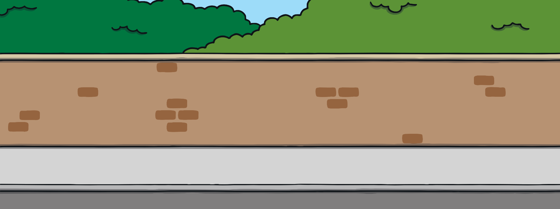
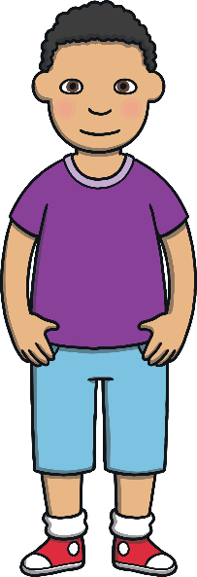

Super Kittens, do you think Sam should run out into the road to get his football?
It was a good job Super Cat stopped Sam when he did because a car was going very fast down the road!
Super Cat explained to Sam that it is never safe to run into a road. He told him that before we cross any road, we always need to stop, look both ways, listen for traffic and think whether it is safe to cross.
Sam thanked Super Cat for saving him!

Slide 12
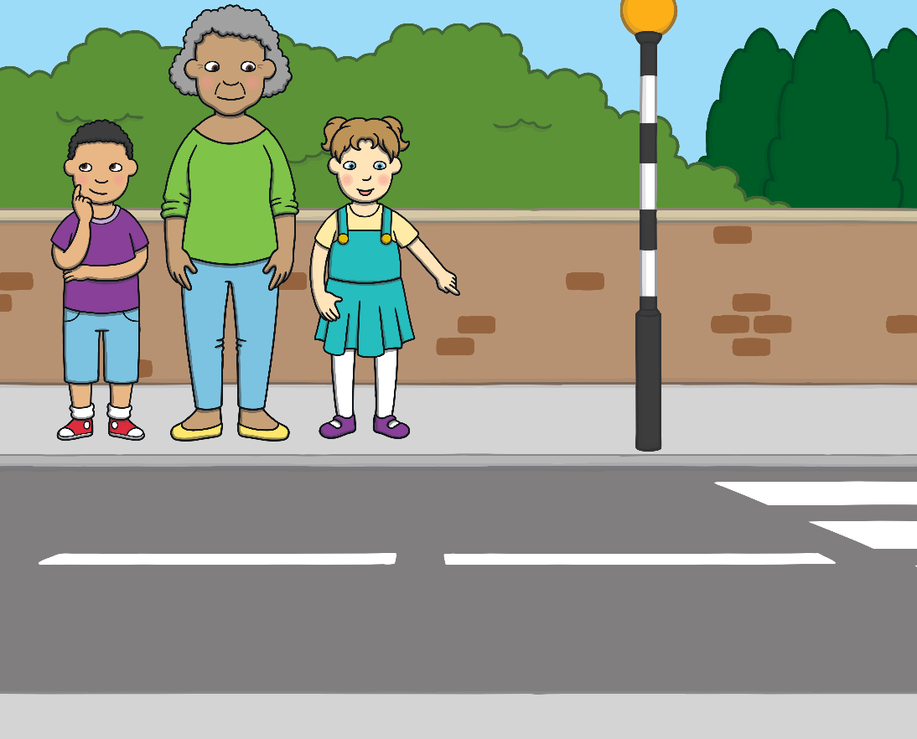


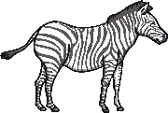
A few days later, Sam and Mia were very excited as they walked with Granny to the park. The minute they saw the park, they wanted to cross the road to get to it.
Sam’s granny told them they needed to wait until they got to the zebra crossing to cross the road.
Just for a second, Sam imagined a real zebra!
“Not a real zebra! When cars and motorbikes see you at the zebra crossing, they stop and let you cross.”
“A zebra?” asked Sam, very confused.
“A zebra?”
“Not a real zebra!” laughed Mia.
Mia pointed to the black and white stripes painted on the road and explained to Sam that zebra crossings help us to cross the road safely.

Slide 13
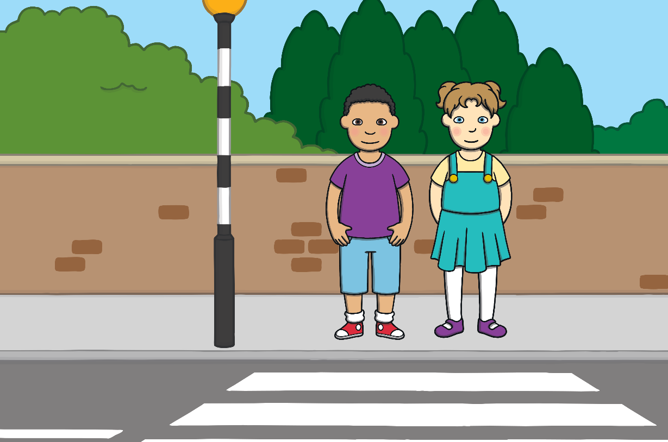

When Sam and Mia got to the zebra crossing, they were about to walk straight onto the road, when suddenly, Super Cat appeared again.
Super Kittens, do you think it is safe for Sam and Mia to step straight onto the zebra crossing on the road?
Super Cat explained to Sam and Mia that zebra crossings are great! They do help you to cross the road safely but sometimes people in cars may not see you and they may not stop.
Super Kittens, can you remind Sam and Mia what we have to do every time, before we cross a road, even if there is a zebra crossing?

Slide 14
Super Cat’s Road Safety Rap
Super Cat’s here, so say ‘meow’!
Want to cross roads, safely? I’ll tell you how!
First, you
stop and
look from side-to-side.
Then you
listen and
think; that’s the Super Cat guide!
stop
look
listen
think

Slide 15
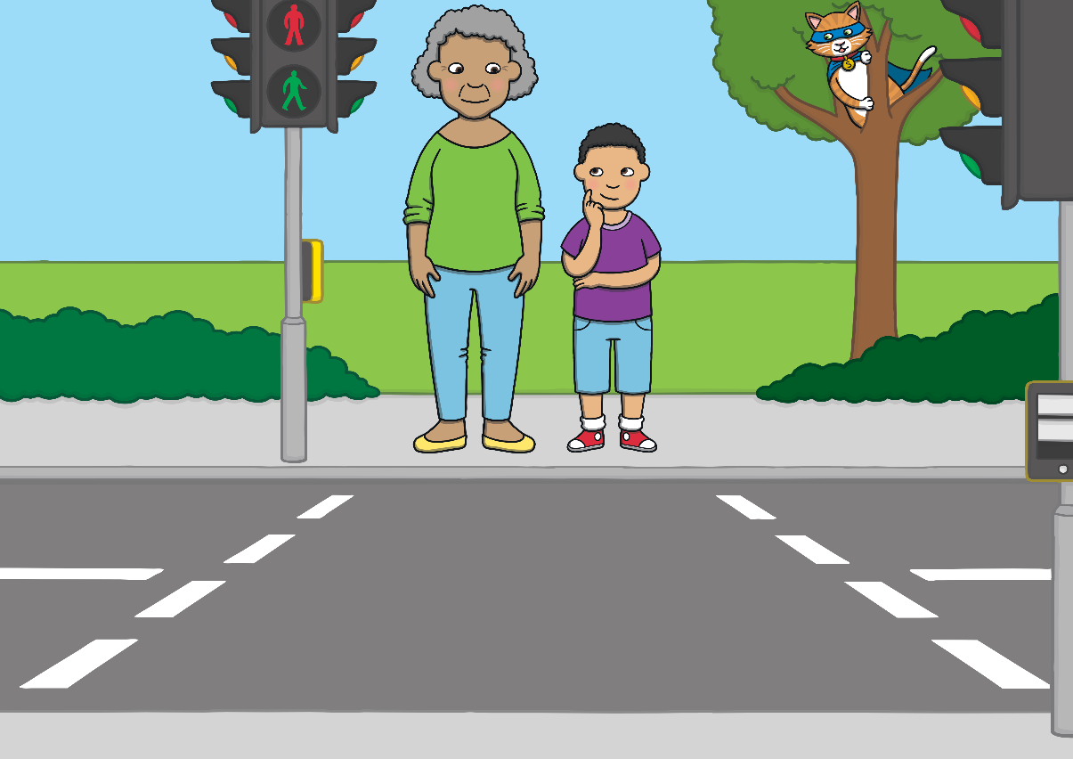
A few days later, Sam and his granny were walking home from the shops. This time, Granny said they would cross at the pelican crossing. Even though Sam knew she didn’t mean a real pelican, he still imagined one!
Sam knew that at a pelican crossing, there are traffic lights and when he pressed a special button, he had to wait for the red man to turn green!
Super Cat was watching in a tree close by.
Super Kittens, when Sam sees the green man appear, what do you think he should do?
Thankfully, Sam remembered Super Cat’s advice and when the green man appeared, he used his super sense of sight, looked both ways and waited for the cars to stop before crossing the road.

Slide 16


Super Cat was feeling happy that Sam had remembered to use his super senses. But then, as Sam was halfway across the road, he let go of his granny’s hand and ran the rest of the way!
Super Cat climbed down the tree, as quick as a flash, and appeared in front of Sam.
Super Kittens, please can you help Sam by telling him what he did that was unsafe when he crossed the road?
Super Cat told Sam that he should never run across the road, in case he falls over. He also told him that he should always hold his grown-up’s hand when crossing a road to help to keep him safe.
Sam couldn’t believe how clever Super Cat was! He thanked him and watched as Super Cat hurried away.

Slide 17

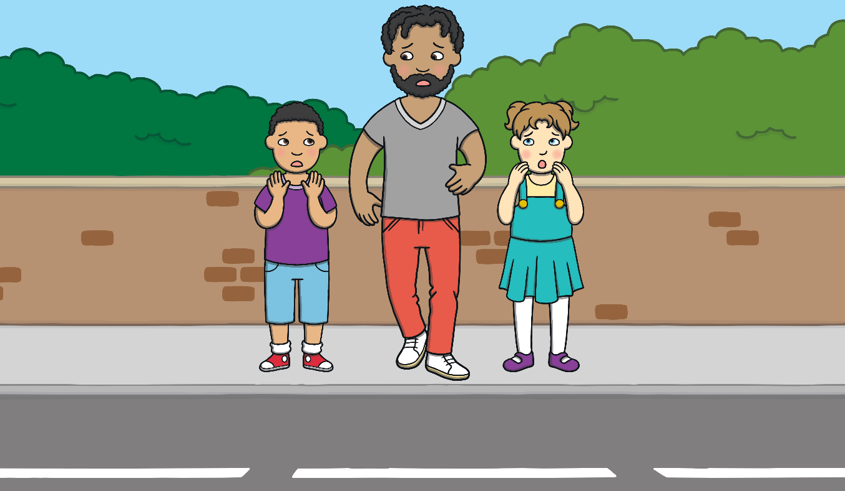

When Sam woke up the next morning, it was the weekend. Sam was very excited that his daddy didn’t have to work today and could take him and Mia to football practice.
To get to football practice, they needed to cross a road. As they got close, Daddy began to step out and onto the road.
Super Cat was about to come to the rescue when suddenly, Sam shouted, “Daddy, STOP!”
“What’s wrong?”
Sam’s daddy was shocked. He stopped and asked Sam, “What’s wrong?”
“Daddy, STOP!”
Sam decided he needed to teach his daddy how to cross a road safely!

Slide 18




How to Cross a Road Safely
1. STOP
Any time you get to a road, you have to stop! Even if there is a zebra or pelican crossing there to help you.
2. LOOK
Then, you have to use your super sense of sight to look both ways to see if you can see any traffic coming.
3. LISTEN
Next, turn on your super sense of hearing and listen to check if you can hear any traffic coming.
4. THINK
Finally, think and ask yourself if it is safe to cross.

Slide 19
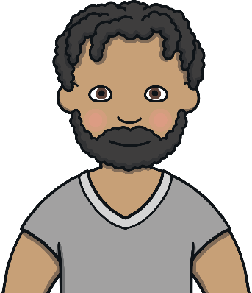
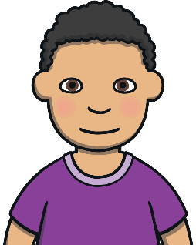

Dad was amazed and asked Sam how he knew so much about how to cross a road safely.
Sam just smiled and said, “My friend Super Cat and his Super Kittens helped to teach me.”
Super Cat felt so proud of Sam, he could burst!
Super Kittens, now it is your turn to make sure your friends and family all know how to cross the road safely. If you are ever unsure what to do, just remember my Super Road Safety Rap and it will help you!
“My work here is done,” said Super Cat, with the biggest smile you have ever seen on a cat!

Slide 20
Super Cat’s Road Safety Rap
Super Cat’s here, so say ‘meow’!
Want to cross roads, safely? I’ll tell you how!
First, you
stop and
look from side-to-side.
Then you
listen and
think; that’s the Super Cat guide!
stop
look
listen
think

