Slide 1
Thursday 18th June
Primary 3 Problem Solving

Slide 2
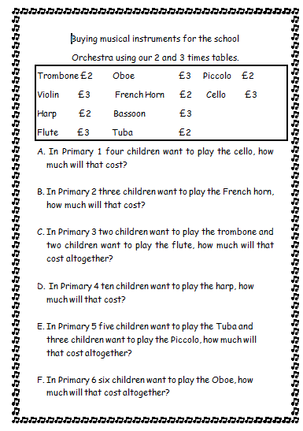
Mild

Slide 3
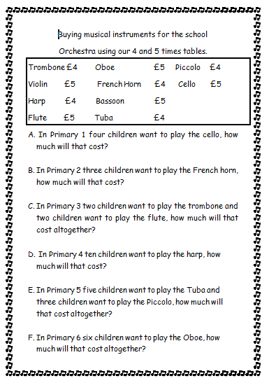
Spicy

Slide 4
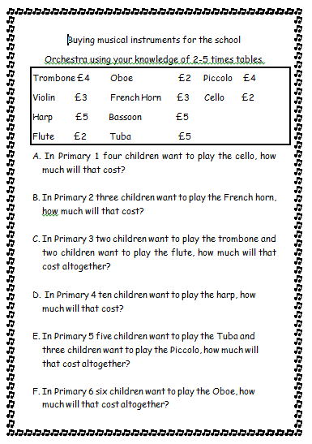
Hot

Slide 5
