Slide 1
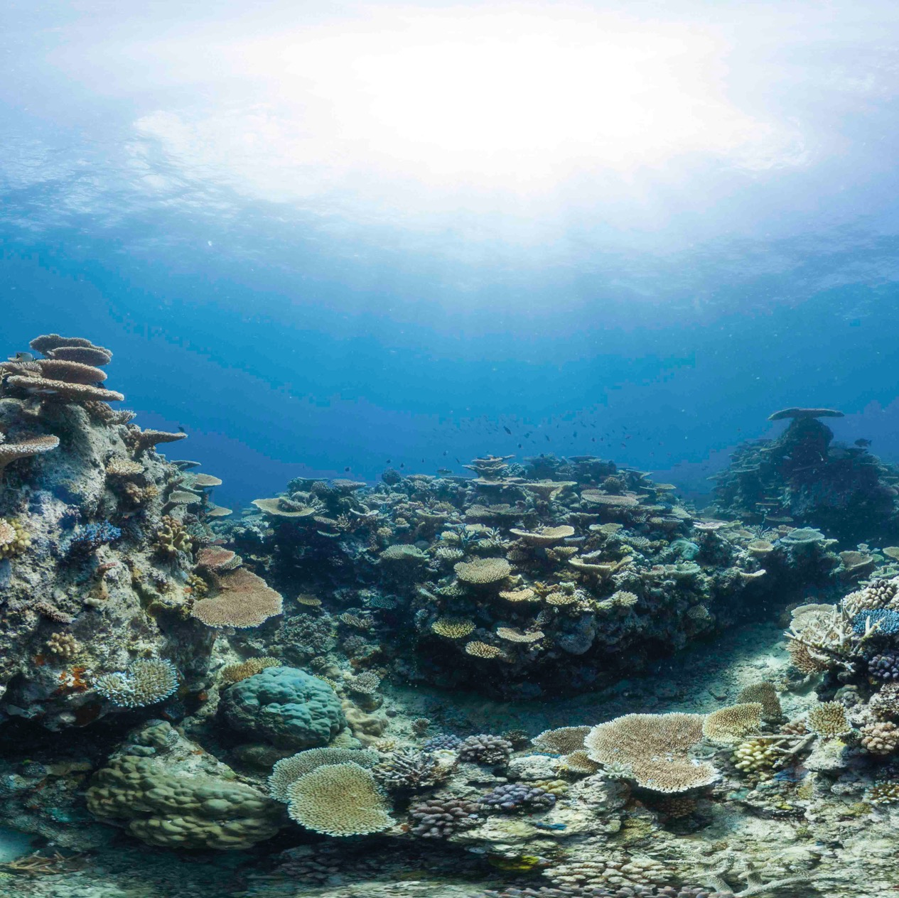


Oceans for beginners
X-Curric | Ages 5-7
Lesson 1
Our wonderful ocean

Slide 2

Lesson 1: Our wonderful ocean
Name and describe the features of living things
Understand the size of the ocean
Create a poster about a marine creature
Ask questions and share knowledge

Slide 3
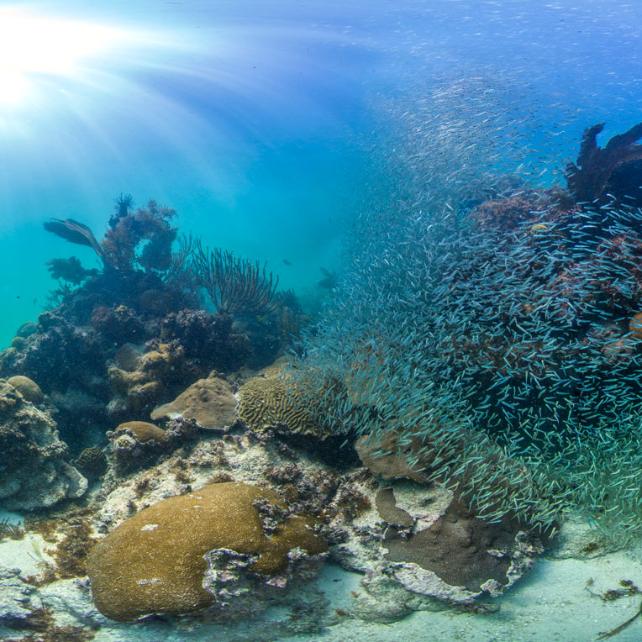
Lesson 1: Our wonderful ocean
What do you know about the ocean?

Slide 4

Lesson 1: Our wonderful ocean
With a partner…
You have 30 seconds to name all the marine animals you can think of.
Keep a tally.
Try not to repeat any!

Slide 5
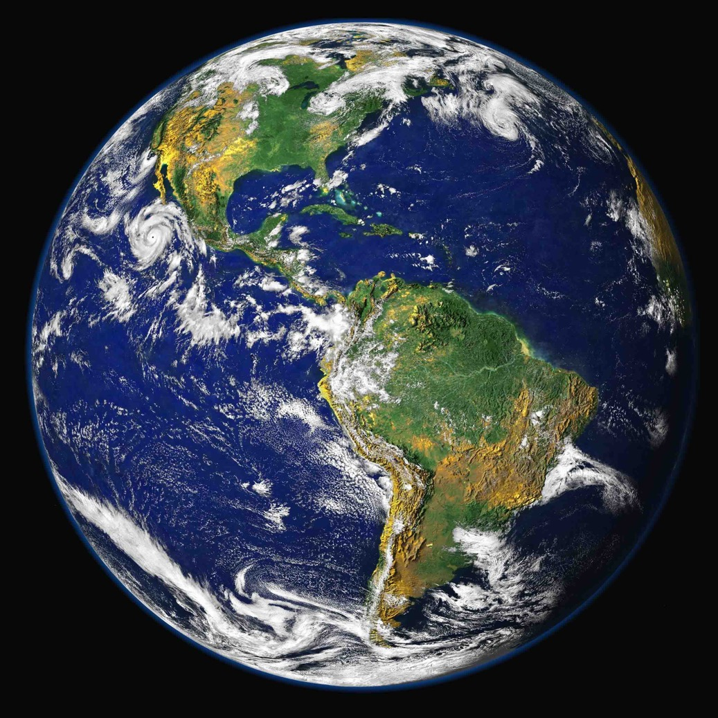
Lesson 1: Our wonderful ocean
The Blue Planet
How much of the Earth do you think is covered in water?

Slide 6
Lesson 1: Our wonderful ocean
The Blue Planet
71% of the planet’s surface is covered by ocean.
That is over 2/3.

Slide 7
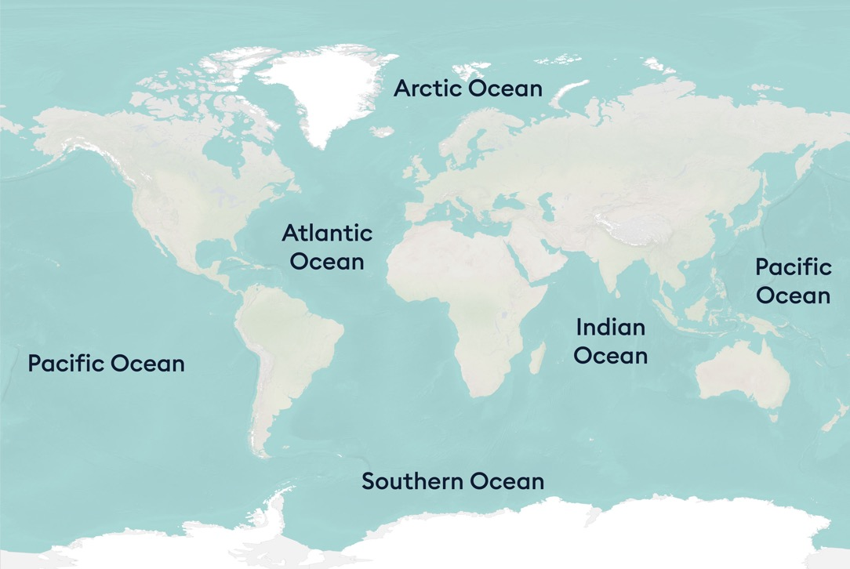
Lesson 1: Our wonderful ocean
Use globes and maps to understand how much of our planet is covered in oceans.

Slide 8
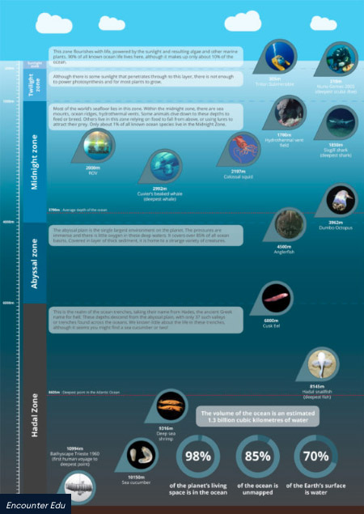
Lesson 1: Our wonderful ocean
Deep ocean poster
VIEW DIAGRAM

Slide 9
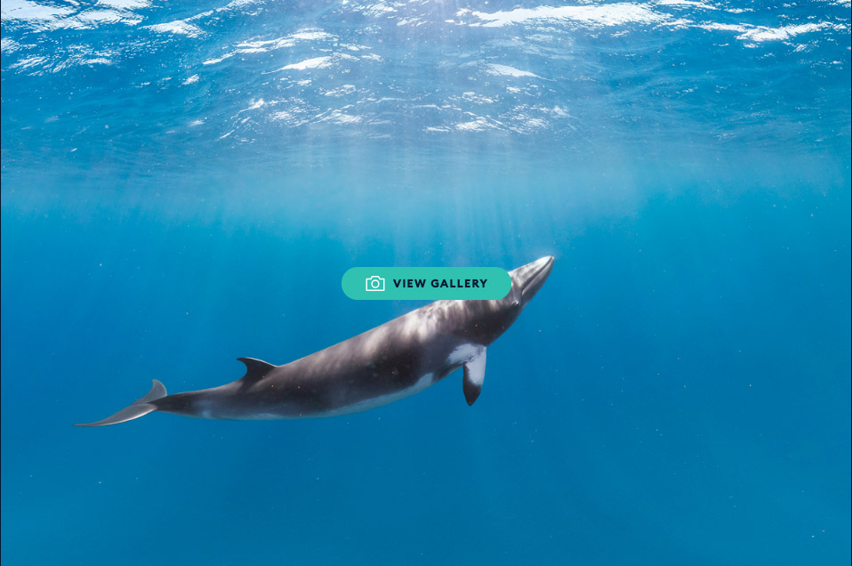
Lesson 1: Our wonderful ocean
Living reef
VIEW GALLERY

Slide 10
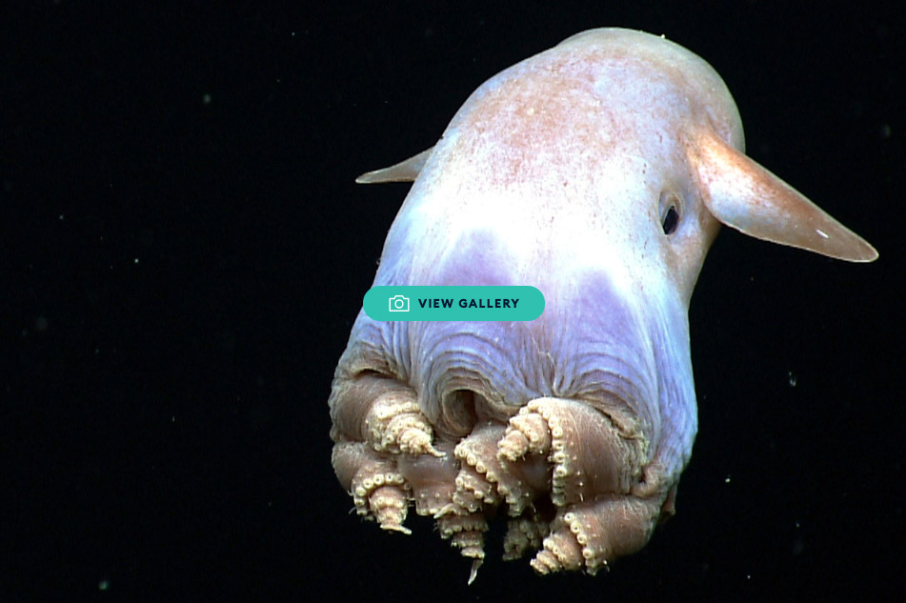
Lesson 1: Our wonderful ocean
Deep sea creatures
VIEW GALLERY

Slide 11
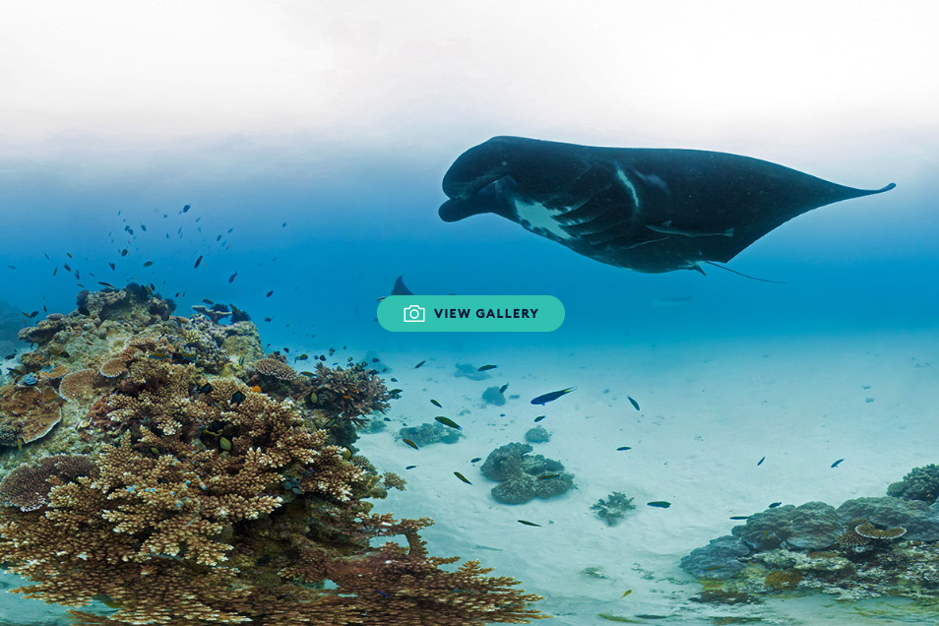
Lesson 1: Our wonderful ocean
The Great Barrier Reef
VIEW GALLERY

Slide 12
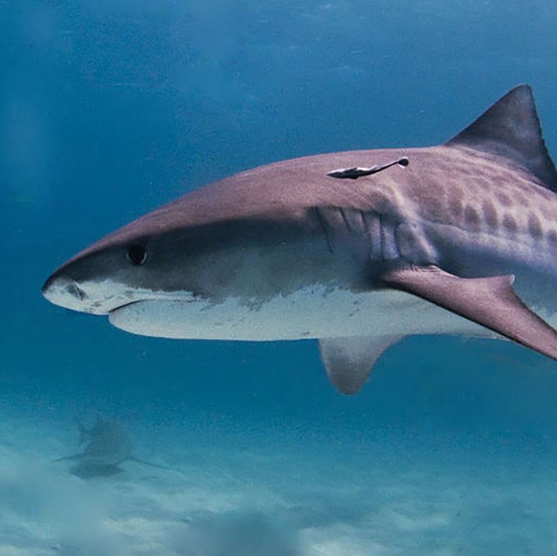
Lesson 1: Our wonderful ocean
Ocean icon
Tiger shark
One of the largest sharks in the world, the tiger shark is one of the top predators in the ocean. It gets its name from the dark stripes along its sides that resemble a tiger's stripes. It is a solitary creature, mainly hunting at night.

Slide 13
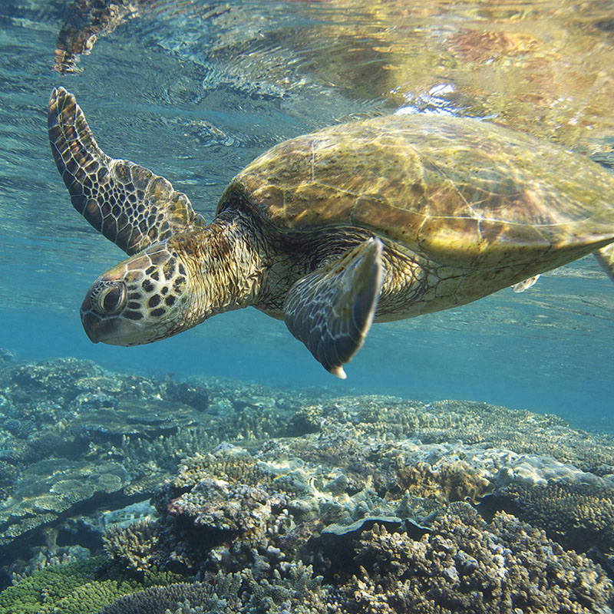
Lesson 1: Our wonderful ocean
Ocean icon
Green turtle
Green turtles are one of the seven species of sea turtle that are found in the world’s ocean.
Green turtles lay their eggs in pits they dig on beaches on islands. Female turtles return to the beaches where they hatched to lay their eggs.

Slide 14
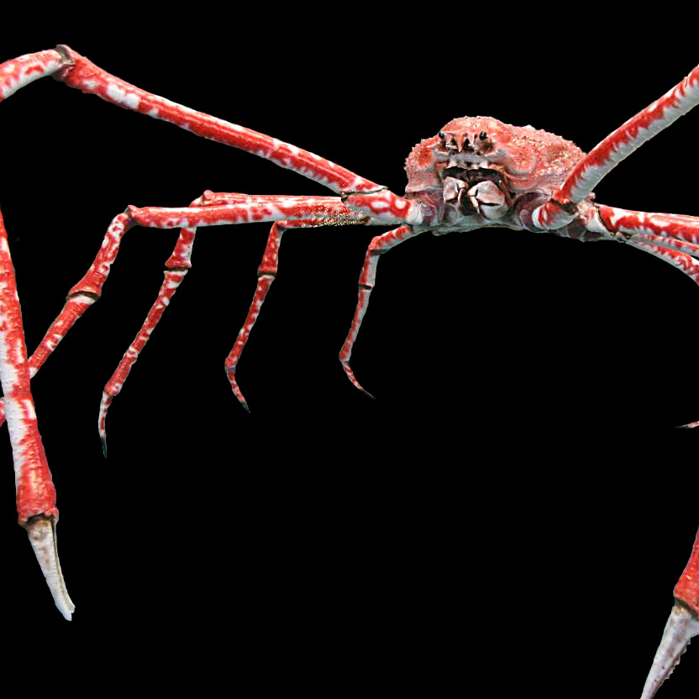
Lesson 1: Our wonderful ocean
Ocean icon
Japanese spider crab
The Japanese spider crab has the largest leg span of any crab reaching up to
5.5 meters, their bodies can grow to be up to 40cm across. It is an omnivore, eating both plants and animals and it is also a scavenger and will consume dead animals. They can mainly be found in the temperate waters of the Pacific Ocean near Japan and have been found as deep as 300 meters.

Slide 15
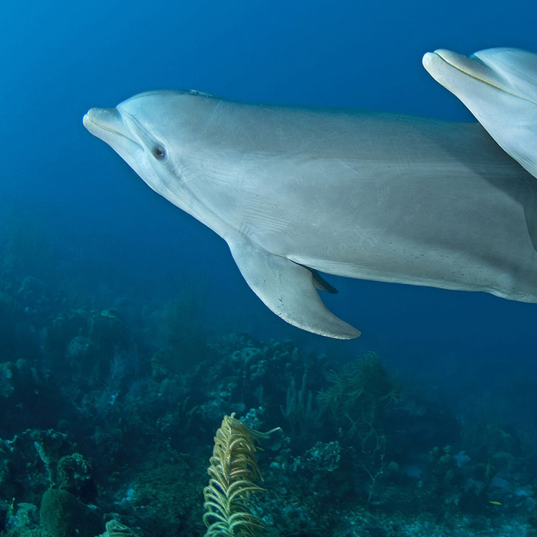
Lesson 1: Our wonderful ocean
Ocean icon
Bottlenose dolphin
Bottlenose dolphins live all over the world. They are excellent swimmers, because of their arrow-like shape. Bottlenose dolphins are some of the cleverest animals on Earth because of their large brain.
Bottlenose dolphins cannot breathe underwater and have to rise to the surface to breathe oxygen from the air.

Slide 16
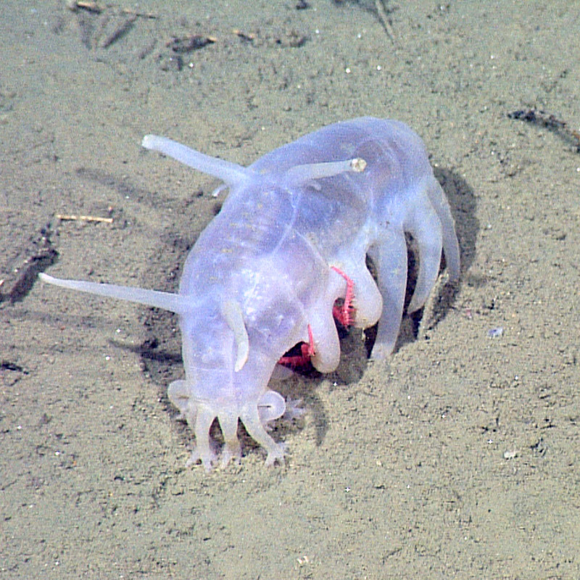
Lesson 1: Our wonderful ocean
Ocean icon
Sea pig
The sea pig is a type of sea cucumber that can live at a depth of 5 kilometers. It is the only sea cucumber that has 'legs'. These are not true legs but water filled tubes attached to the side of the sea pig. These small animals vacuum the sand, sucking up rotting tissue for food.

Slide 17
Lesson 1: Our wonderful ocean
Ocean icons
Draw a picture of your favorite ocean icon.
Find the fact cards on your tables that go
with your animal.
Add the facts to your poster.

Slide 18
Lesson 1: Our wonderful ocean
With your partner, share three new things you’ve learnt today.
Do you have any questions?

Slide 19
Lesson 1: Our wonderful ocean
Review: Learning outcomes
Name and describe the features of living things
Understand the size of the ocean
Create a poster about a marine creature
Ask questions and share knowledge

Slide 20
Lesson 1: Our wonderful ocean
Home learning
Choose a different ocean icon and create a postcard with pictures and information to send to the headteacher.

Slide 21
Lesson 1: Our wonderful ocean
Slide | Title | Attribution
1 | Wilson reef | XL Catlin Seaview Survey
3 | Florida keys | XL Catlin Seaview Survey
4 | Stopwatch | Free-Photos via Pixabay
5, 6 | Earth | Wikimages via Pixabay
12 | Tiger shark | XL Catlin Seaview Survey
13 | Green turtle | XL Catlin Seaview Survey
14 | Japanese spider crab | Wikipedia / Michael Wolf
15 | Bottlenose dolphin | XL Catlin Seaview Survey
16 | Sea pig | NOAA

