Slide 1
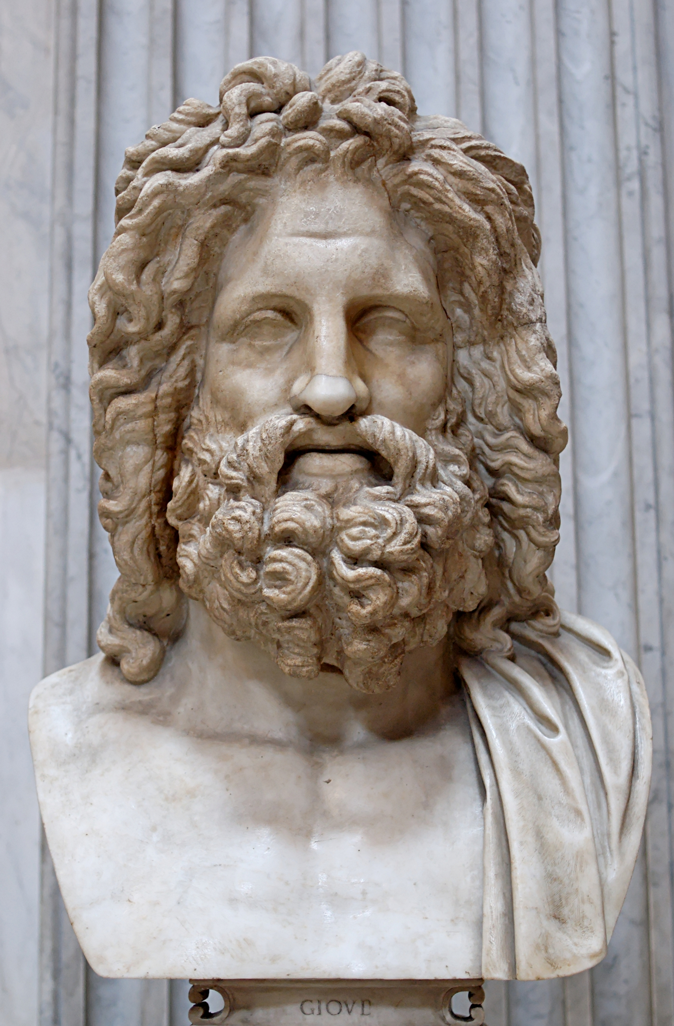
What do you know?

Slide 10
https://greece.mrdonn.org/myths.html
https://www.greekmyths4kids.com/
https://www.ducksters.com/history/ancient_greek_mythology.php
https://kids.britannica.com/kids/article/mythology/353513

