Slide 1
Thursday 4th June
Primary 3 Literacy Tasks

Slide 2
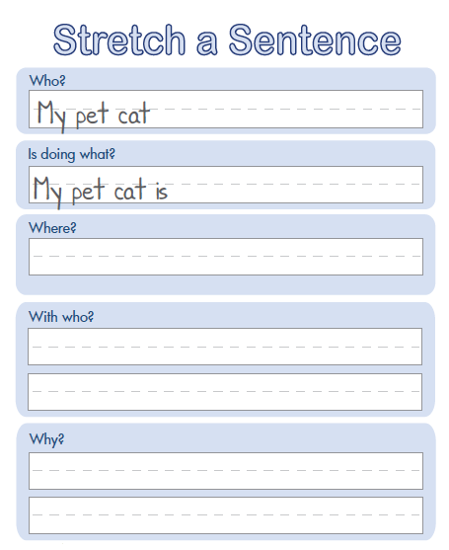
Activity One
I can dig deep and write detailed sentences. If I do my audience will know more about my topic.
Copy and complete
into your jotter.

Slide 3
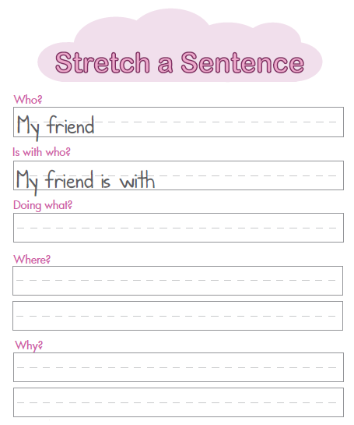
Activity Two
Can you add detail by s-t-r-e-t-c-h-i-n-g the sentence.

