Slide 1
Thursday 4th June
Primary 3 Rounding Activities

Slide 2
A helpful reminder:

Slide 3
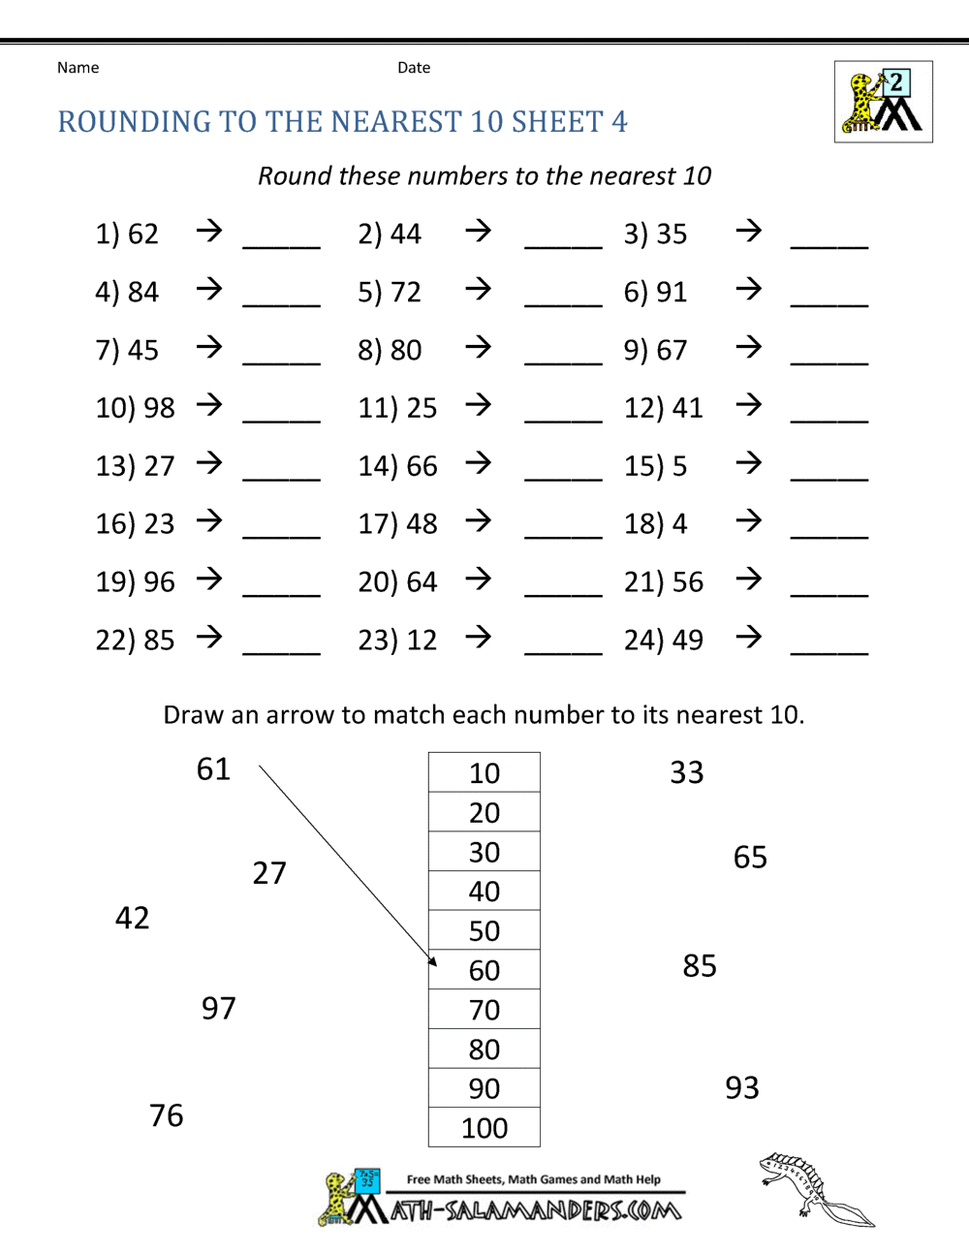
Mild

Slide 4
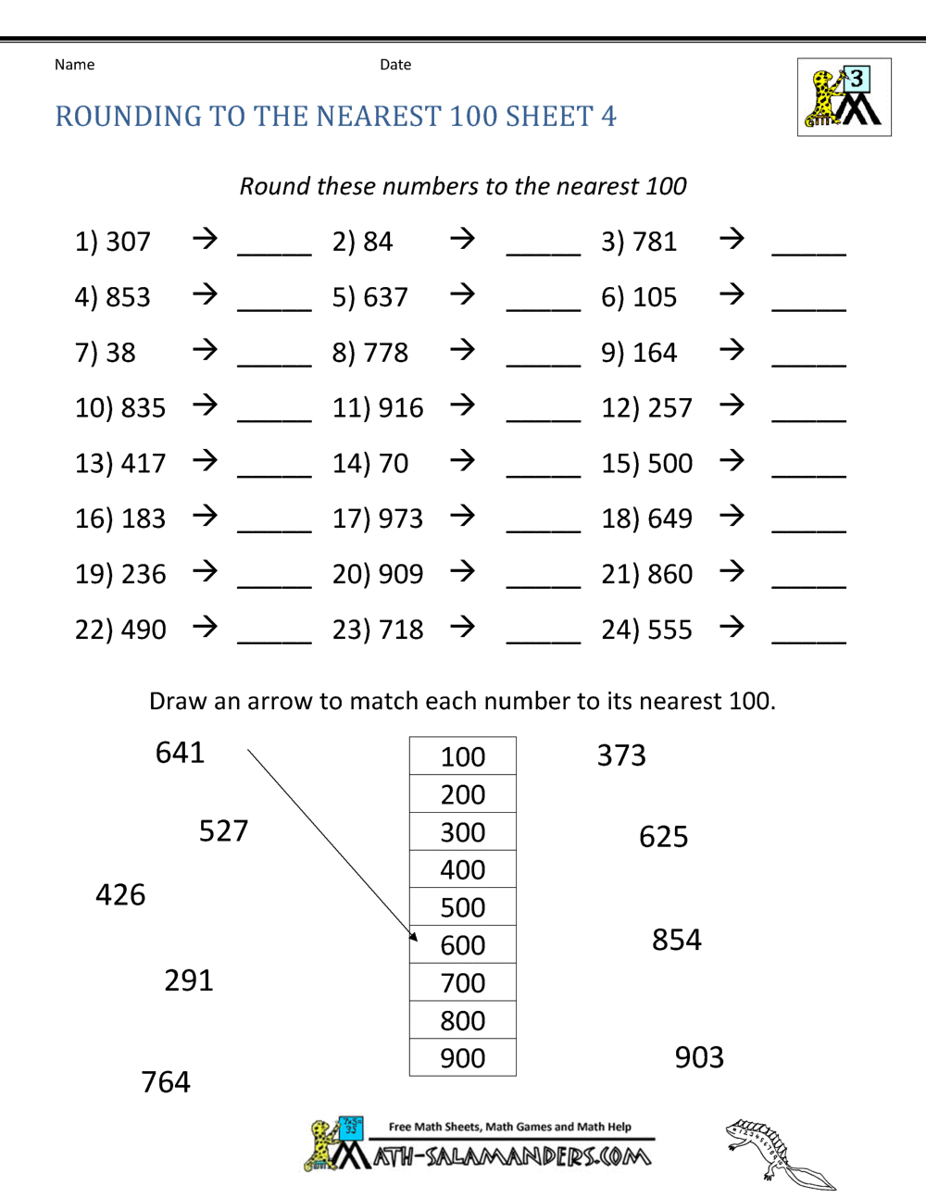
Spicy

Slide 5
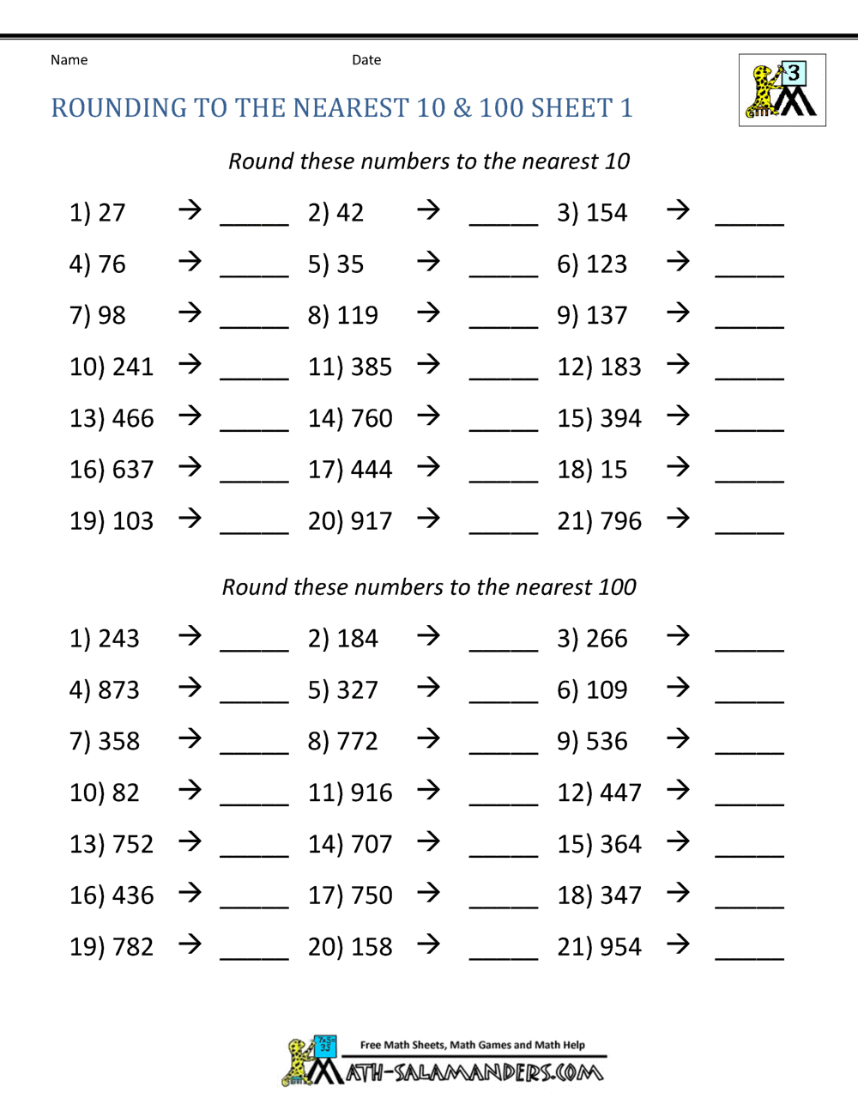
Hot

Slide 6
Challenge

