Slide 1
Starter brain teasers

Slide 2
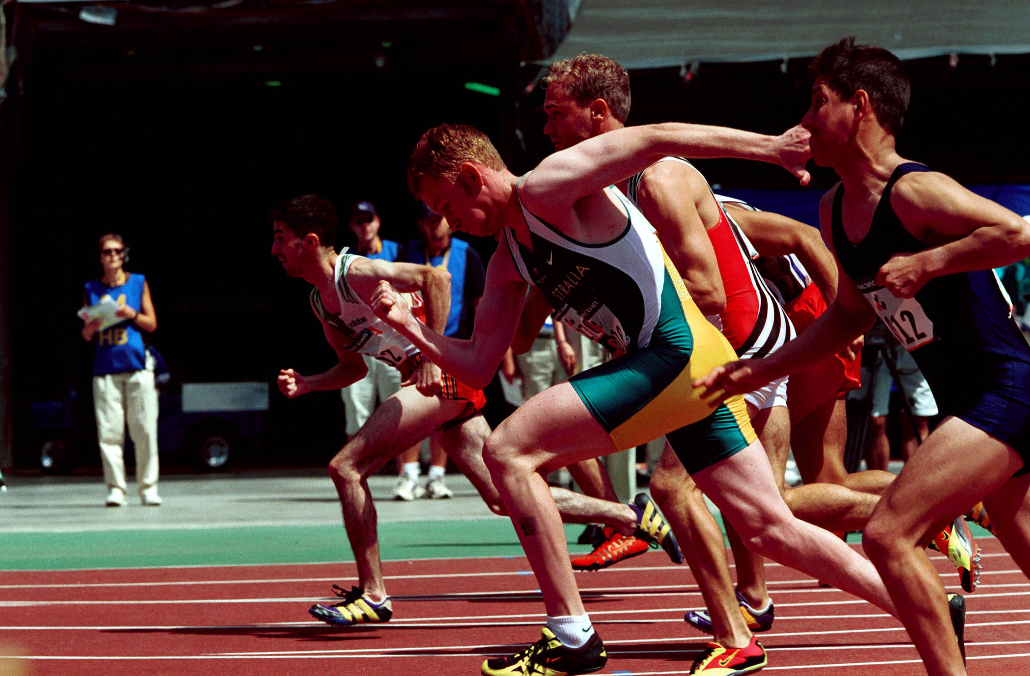
1. You’re in a race and you overtake third place. What position are you in? A. Second B. Third C. Fourth

Slide 3
1. B, Third.
Answer!!!

Slide 4
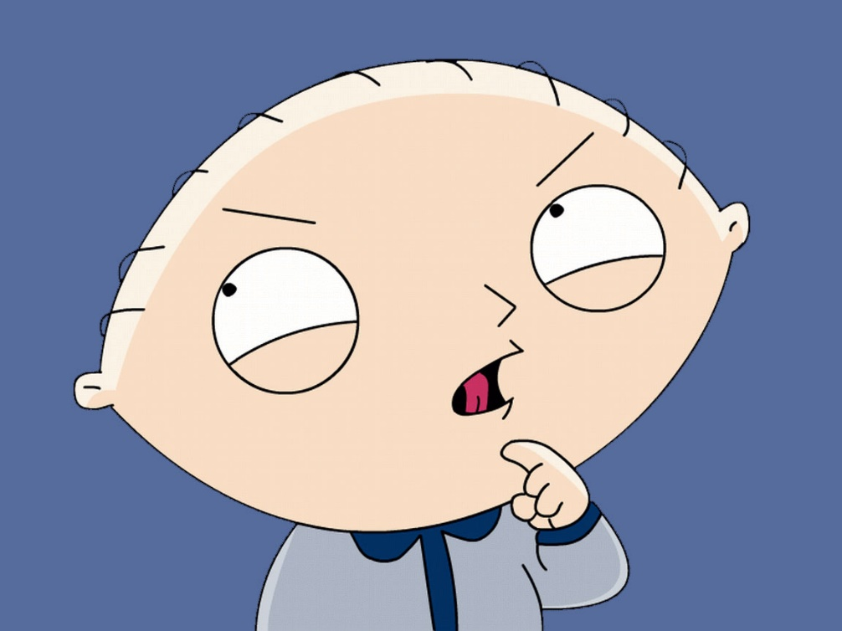
2. If you re-arrange the letters CIFAIPC you will get the name of a kind of what? A. Country B. Animal C. City D. Ocean E. River

Slide 5
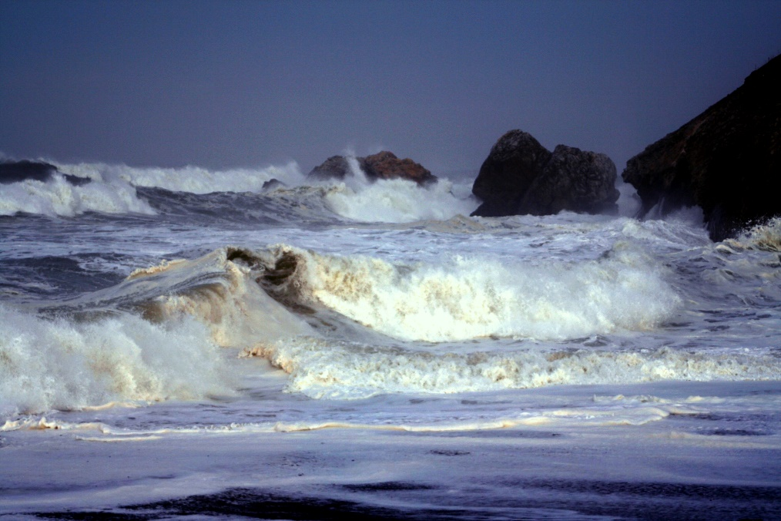
2. D, Pacific Ocean.
Answer!!!

Slide 6
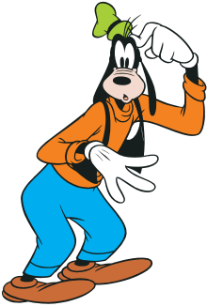
3. Which one of these five is least like the other four? A. Painting B. Statue C. Novel D. Flower E. Poem

Slide 7
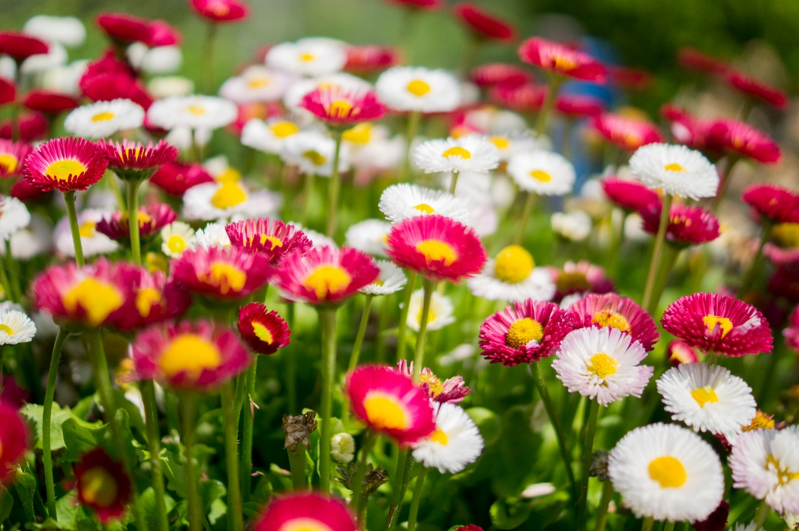
3. D, Flower is the only object that isn’t man-made.
Answer!!!

Slide 8
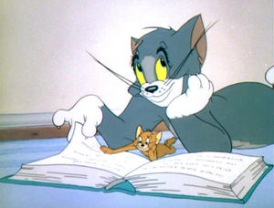
4. Complete the sequence: A, Z, B, Y, C, X, D, W, E . . .? A. Q B. H C. V D. F

Slide 9
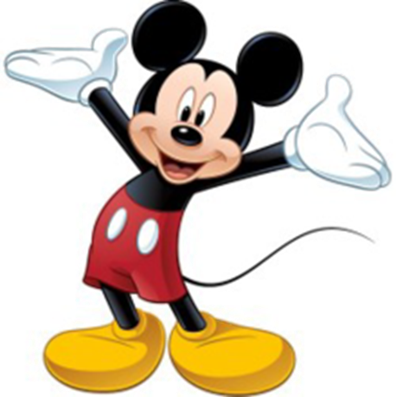
4. C, V.
Answer!!!

Slide 10
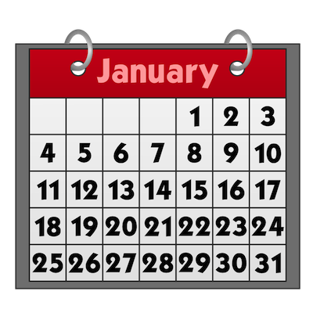
5. The day before the day before yesterday is three days after Saturday. What day is it today? A. Monday B. Tuesday C. Wednesday D. Thursday E. Friday

Slide 11
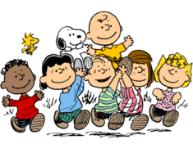
5. E, Friday.
Answer!!!

Slide 12
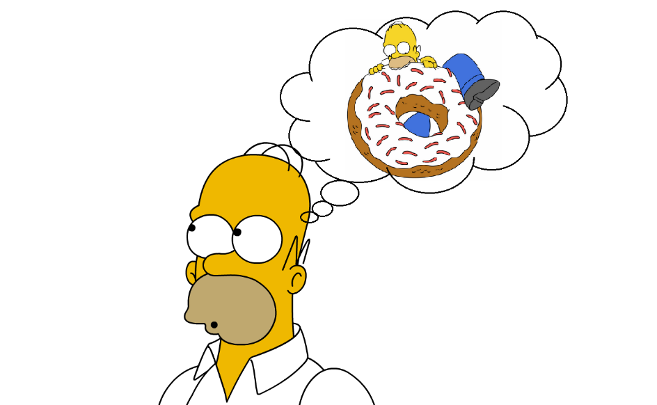
6. People climb me, cut me and burn me. My rings aren’t made of gold but do tell my age. What am I?

Slide 13
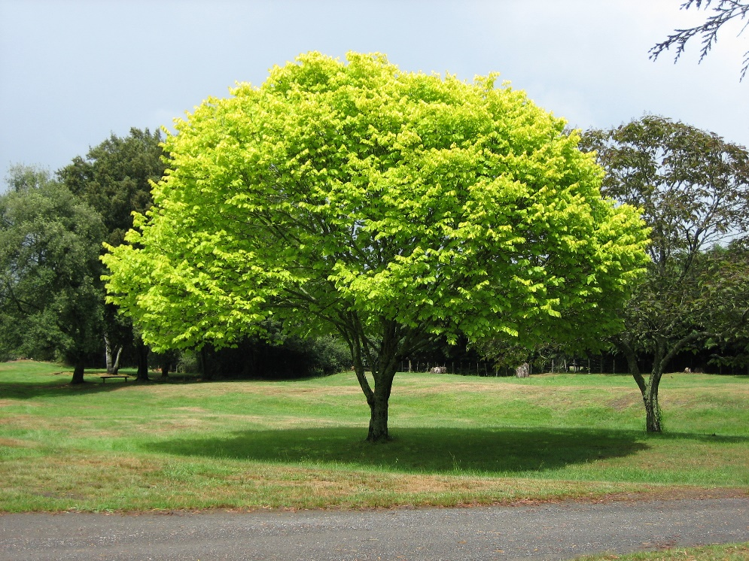
6. A tree.
Answer!!!

Slide 14
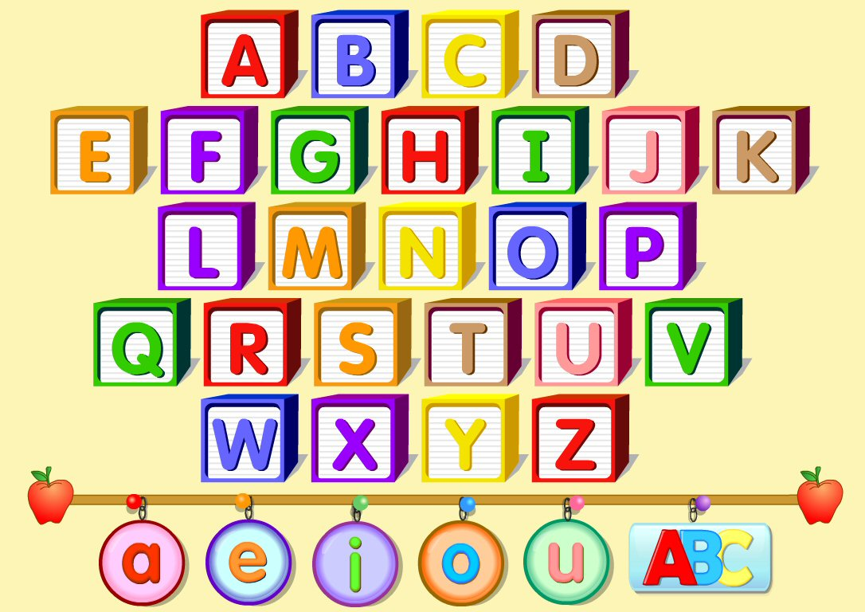
7. There are thirty-nine letters in this sentence. A. True B. False C. Impossible to say

Slide 15
7. a, true.
Answer!!!

Slide 16
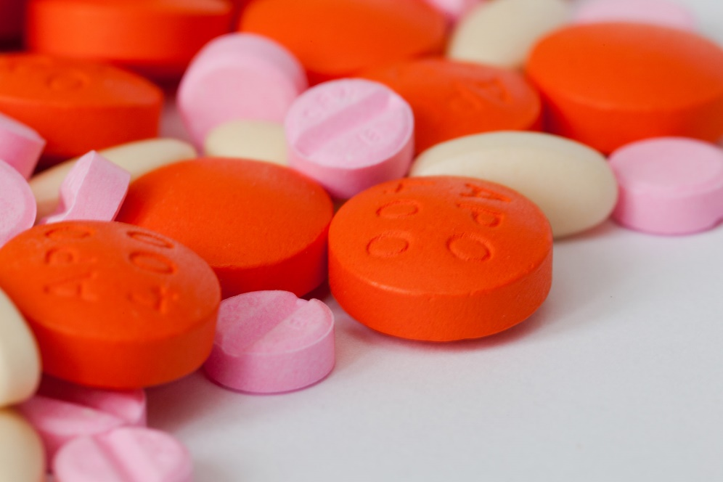
8. If a doctor gives you three pills and tells you to take a pill immediately and another every half an hour, how long is it before all the pills are taken?

Slide 17
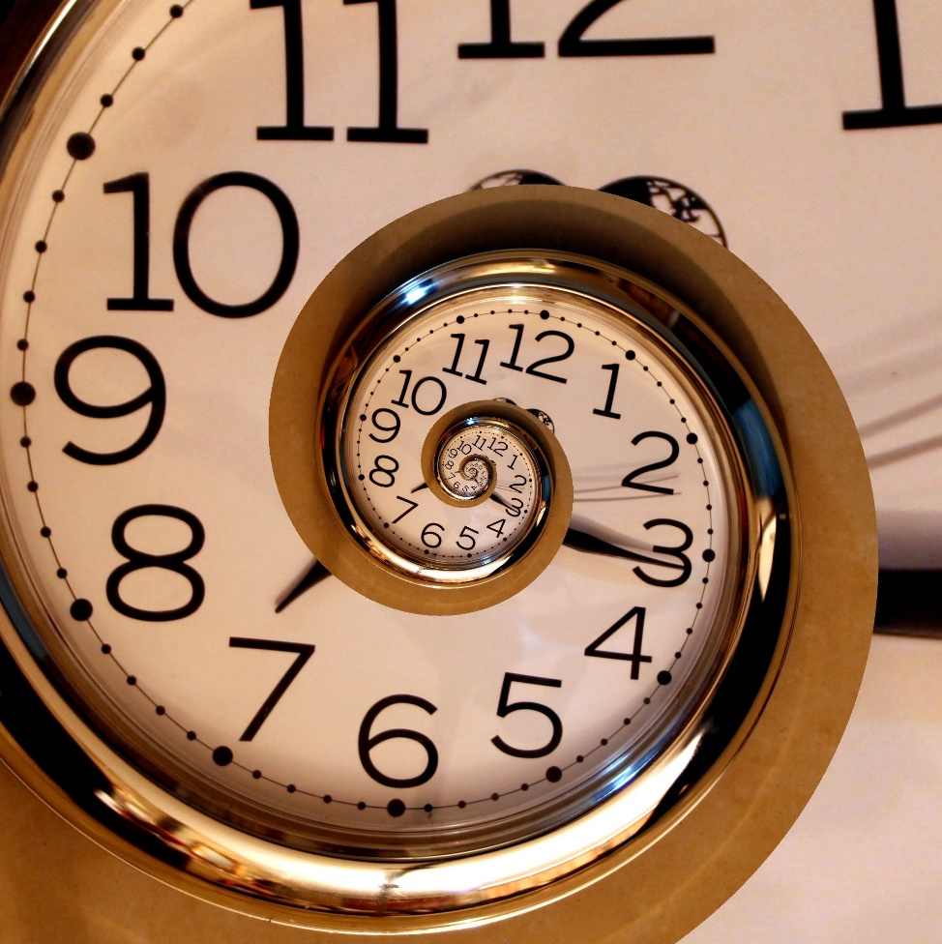
1 hour
Answer!!!

Slide 18
9. The letters in the word ABOUT are in alphabetical order. A True B False

Slide 19
B false
Answer!!!

Slide 20
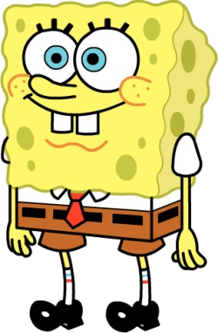
10. Which word does not belong? A. Apple B. Marmalade C. Orange D. Cherry E. Grape

Slide 21
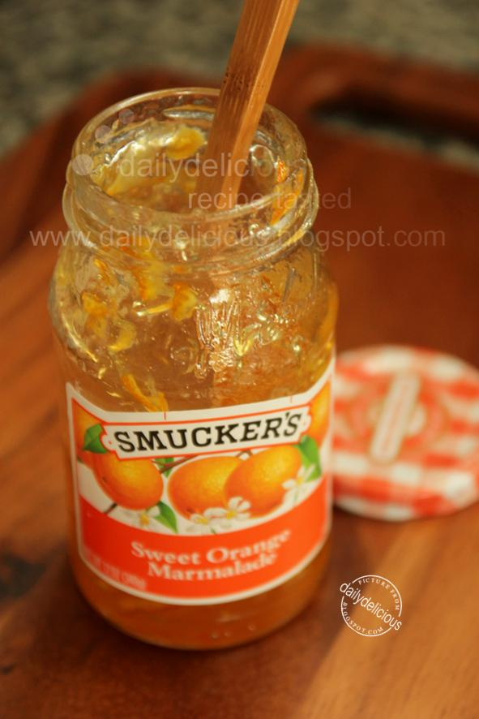
B, Marmalade.
Answer!!!

Slide 22
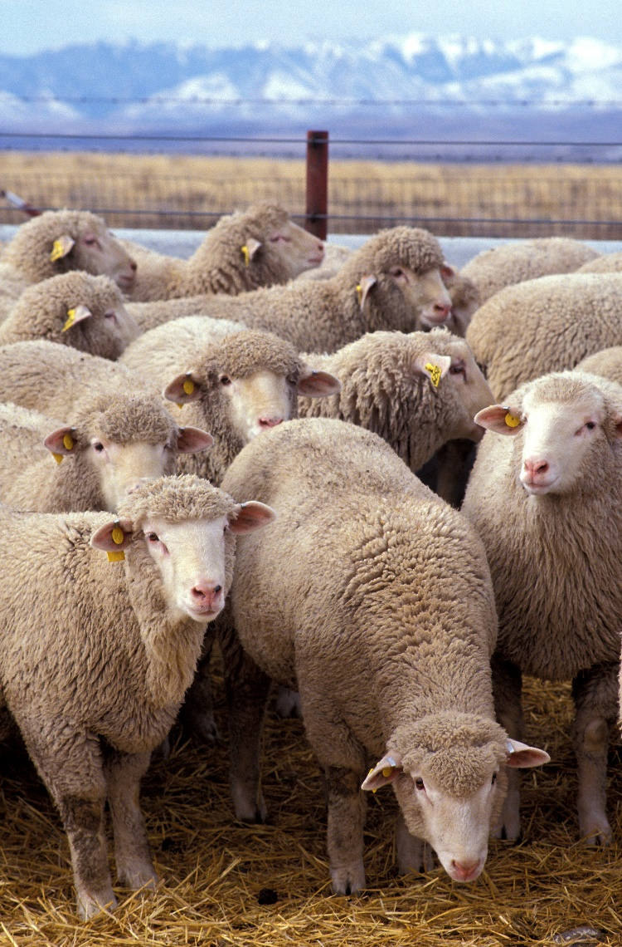
11. A farmer had 17 sheep. All but nine died. How many live sheep does he have left?

Slide 23
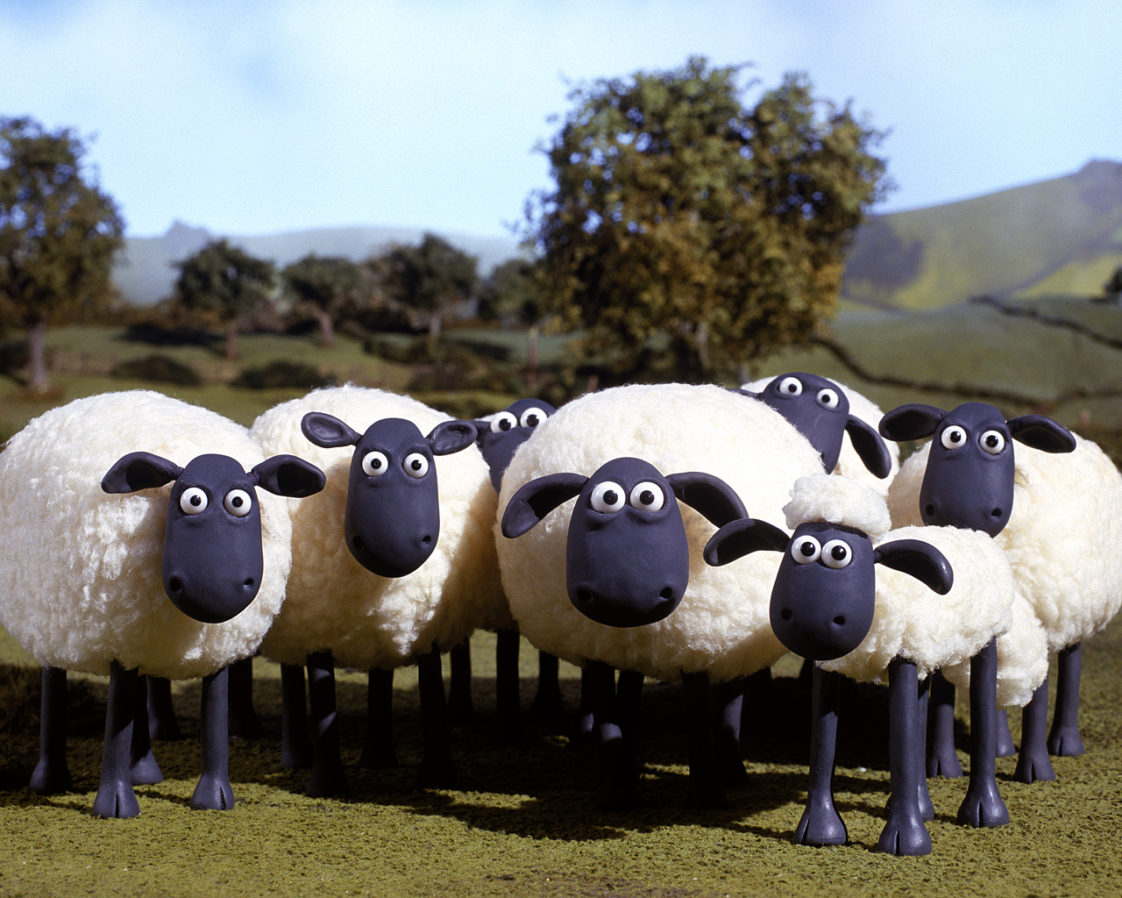
Nine sheep.
Answer!!!

Slide 24
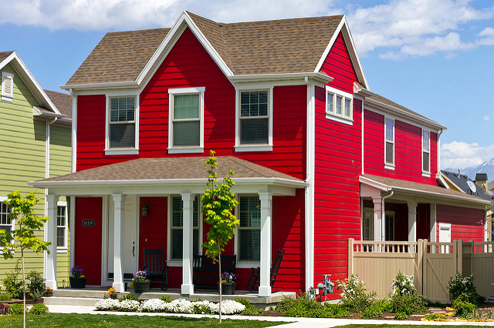
12. There’s a red bungalow on a red street with red walls, tables and chairs. What colour is the staircase?

Slide 25
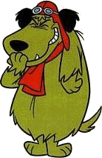
It was a bungalow, no staircase.
Answer!!!

