Slide 1
Wednesday 3rd June
Primary 3 Literacy Tasks

Slide 2
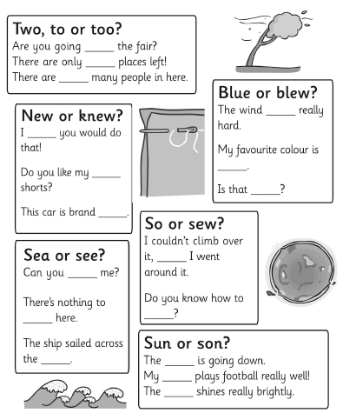
Mild
Complete these sentences with the homophone in your jotter.

Slide 3
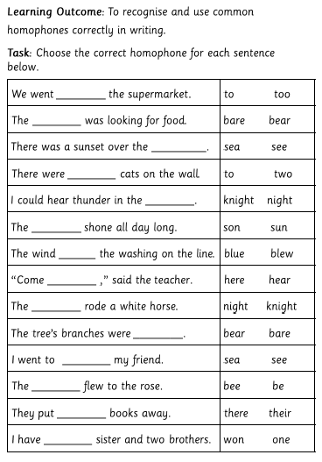
Spicy

Slide 4
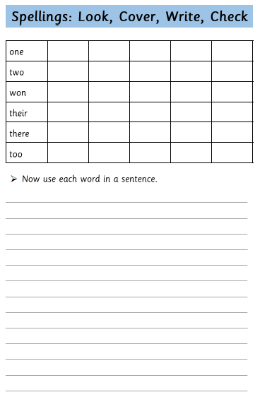
Extension

