Slide 1
Tuesday 2nd June
Primary 3 Literacy Tasks

Slide 3
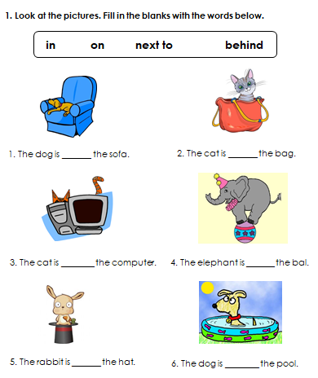
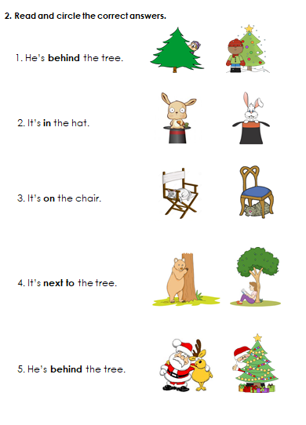
Mild

Slide 4
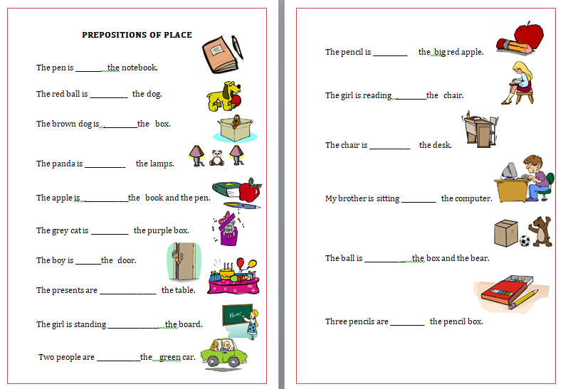
Spicy
Use the word bank to help you!

Slide 5
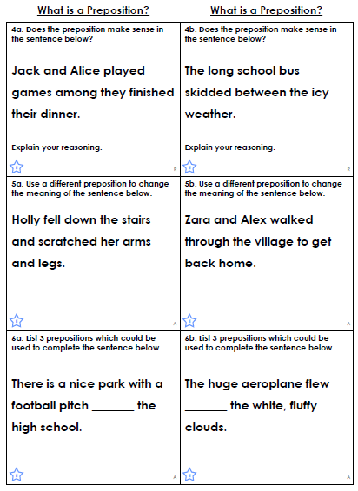
Hot

Slide 6
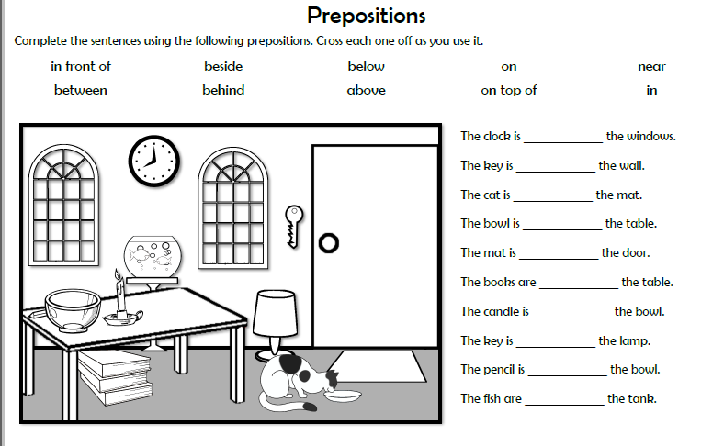
A little extra practice! You could create your own sentences using the picture.
Extension

