Slide 1
STARTER
Think about the most inspirational person in your life.
Do you know why they mean this much to you?
This is particularly relevant during this difficult time for the world.

Slide 2
Monday 27th November 2017
Inspirational People
To understand what inspires people.
1. Identify what an inspirational person is.
2. Describe some of the qualities an inspirational person has.
3. Begin to evaluate how inspirational people impact on the lives of others.

Slide 3
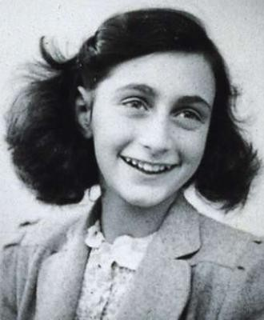
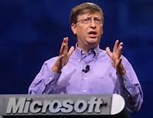
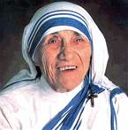
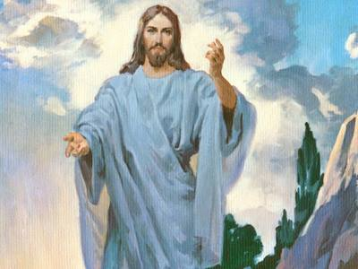
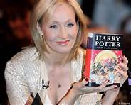
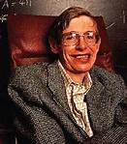
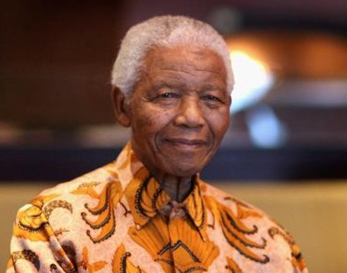
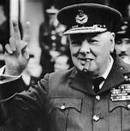
Who’s who?
Consider these pictures – do you know who they are? Why may these people be considered inspirational?

Slide 4
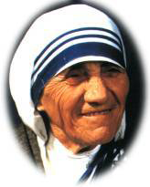
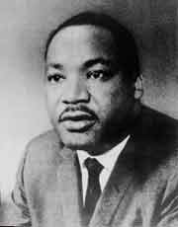
My Name is & I…..?
I am Mother Teresa.
I helped the poor and helpless in India.
I am Martin Luther King.
I was a Civil Rights Leader in America.

Slide 5
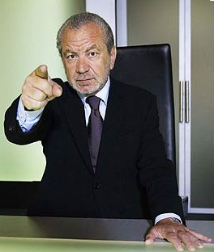
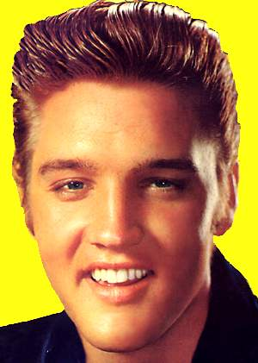
My Name is & I…..?
I am Lord Sugar.
I am a Self Made Millionaire & I am now worth around £790 Million.
I am Elvis Aaron Presley.
I was the King of Rock & Roll and Achieved the “American Dream”.

Slide 6
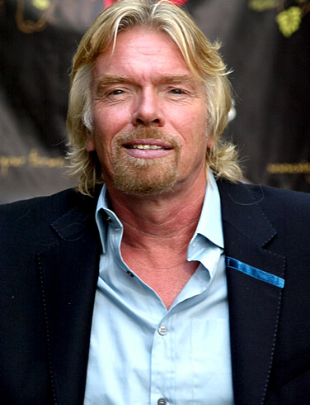
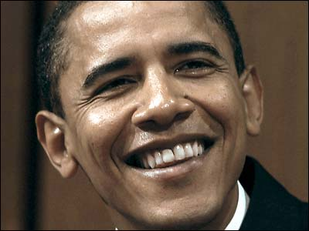
My Name is & I…..?
Sir Richard Branson
I am a Self Made Millionaire & I have dyslexia and I was told I would never achieve anything I am now worth around £790 Million.
I am Barack Obama.
I was the first person of colour to be the President of America.

Slide 7
Qualities of an inspirational person…
What qualities should an inspirational person have and why do you think this?
What qualities might all inspirational people have in common?

Slide 8
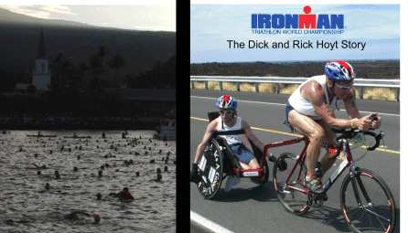
Two other inspirational people to add to our list?
Dick and Rick Hoyt are a father-and-son team from Massachusetts (USA) who together compete in marathon races. When they’re not in a marathon they are participating in a triathlon…
a daunting combination of 26.2 miles of running, 112 miles of bicycling, and 2.4 miles of swimming.

Slide 9
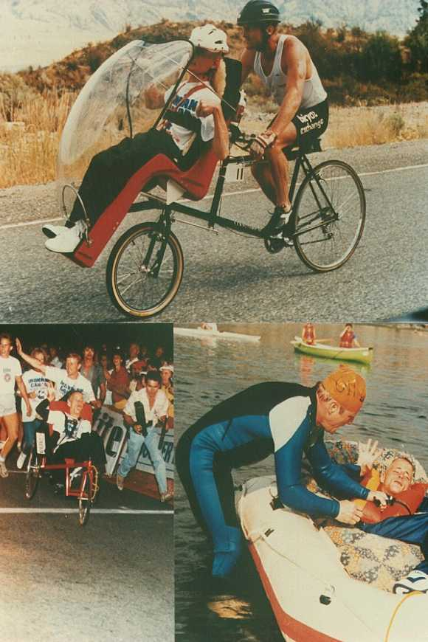
At the start of the race when Dick swims, Rick is in a small but heavy, firmly stabilised boat being pulled by Dick.
Next Dick cycles and Rick is placed in the seat-pod from his wheelchair which is then attached to the front of the bike.
Finally when Dick runs, Rick is in his wheelchair that Dick is pushing.

Slide 10
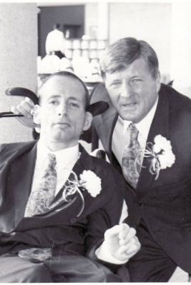
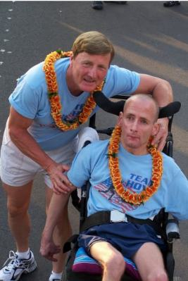
    The message of Team Hoyt is that everybody can achieve their goals.”

Slide 11
    Let’s watch a video of this… https://www.youtube.com/watch?v=64A_AJjj8M4
    (take notes on the inspirational qualities you see)
    What inspirational qualities die you see?
    Did the father and son display the same qualities?
    How did it make you feel watching the clip?

Slide 12
Things that a person may do if they have been inspired by others:
Work hard at school
Turn to faith
Work with charity
Overcome hard life issues (like the Hoyt brothers)
Be creative
Fight for human rights
Any others?

Slide 13
Choose a task to complete
TASK 1
Can you think of an inspirational person? You can come up with any person you like.
You should consider:
What does this person do in life that is inspirational?
What qualities you think they need to do this and why?
What impact do they have you and the lives of others?
Think how you want to share this – there is a template for you to take notes first then you can do a poster, a powerpoint or a SWAY – it would be lovely to see who you think is inspirational – remember they don’t need to be famous or rich!

Slide 14
TASK 2
On your sheet, devise your own mini-action plan for how you will display the qualities of an inspirational person. You can come up with any idea you like.
You should consider:
What you might like to do in your life that is inspirational.
What qualities you think you will need to do this and why.
What impact you might be able to have on the lives of others.
Think how you want to share this – there is a template to help you organise your thoughts - you can do a poster, a powerpoint or a SWAY – it would be lovely to see what you think you can do with your life to be inspirational!

Slide 15
What ideas did we come up with?

