Slide 2
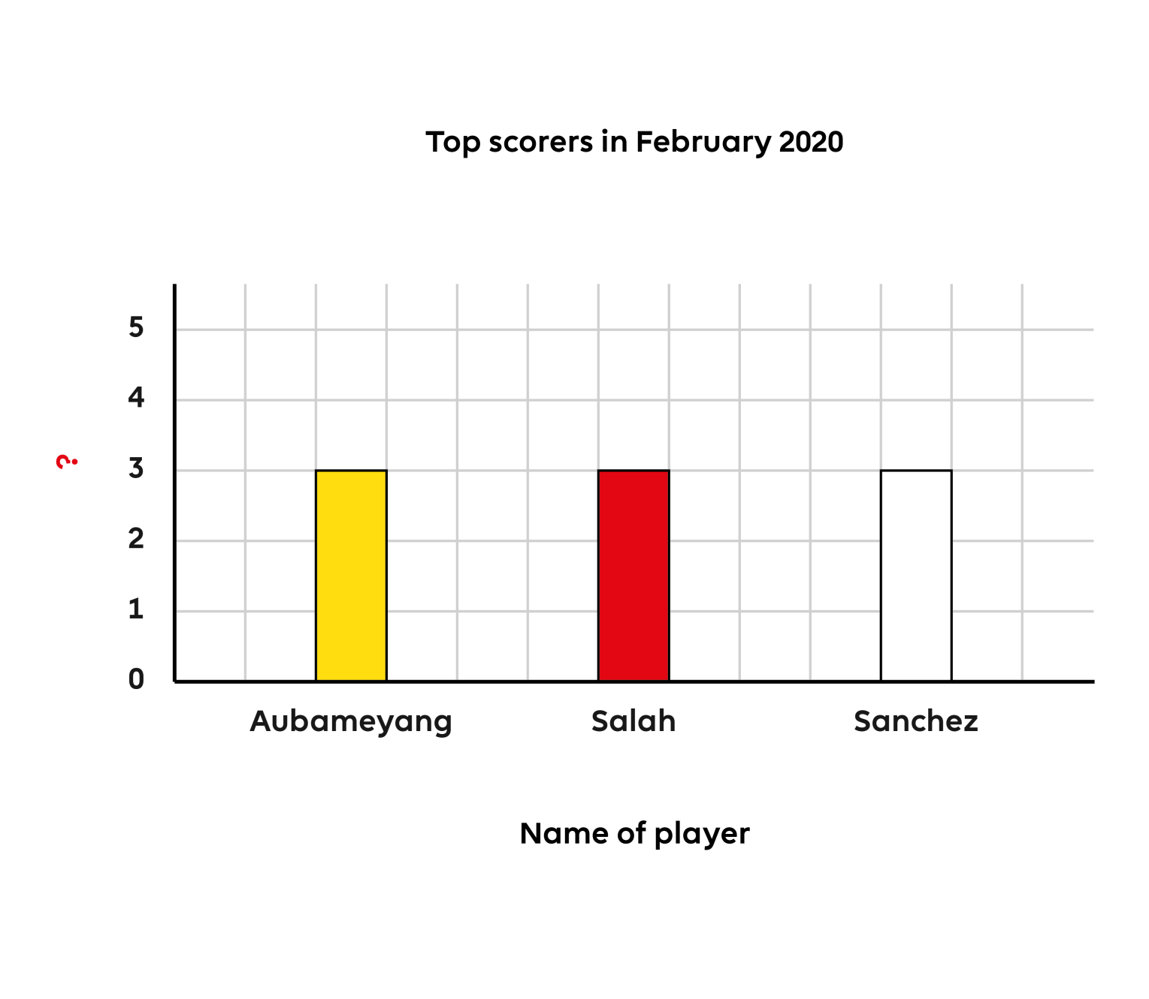
Q1
This bar chart has a label missing. What should the missing label say?
Month
Number of goals
Top scorers
Number of wins
Notes:
Q1. Answer is B

Slide 3
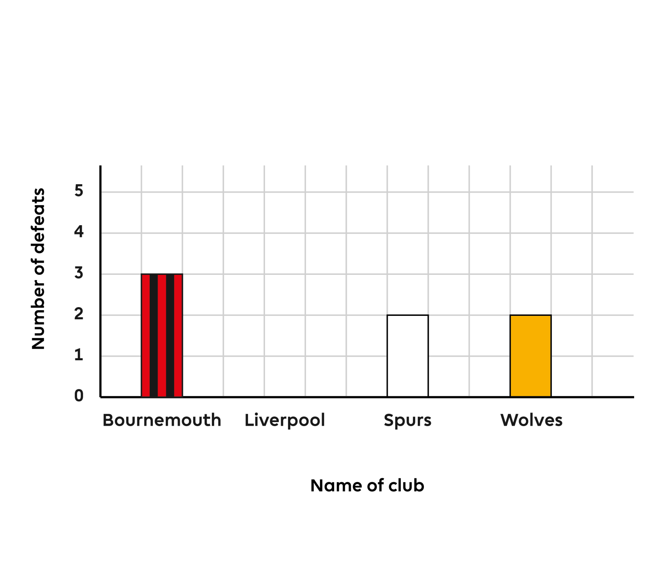
Q2
What is missing from this graph?
The axes
A scale
Labels
A title
Notes:
Q2. Answer is D

Slide 4
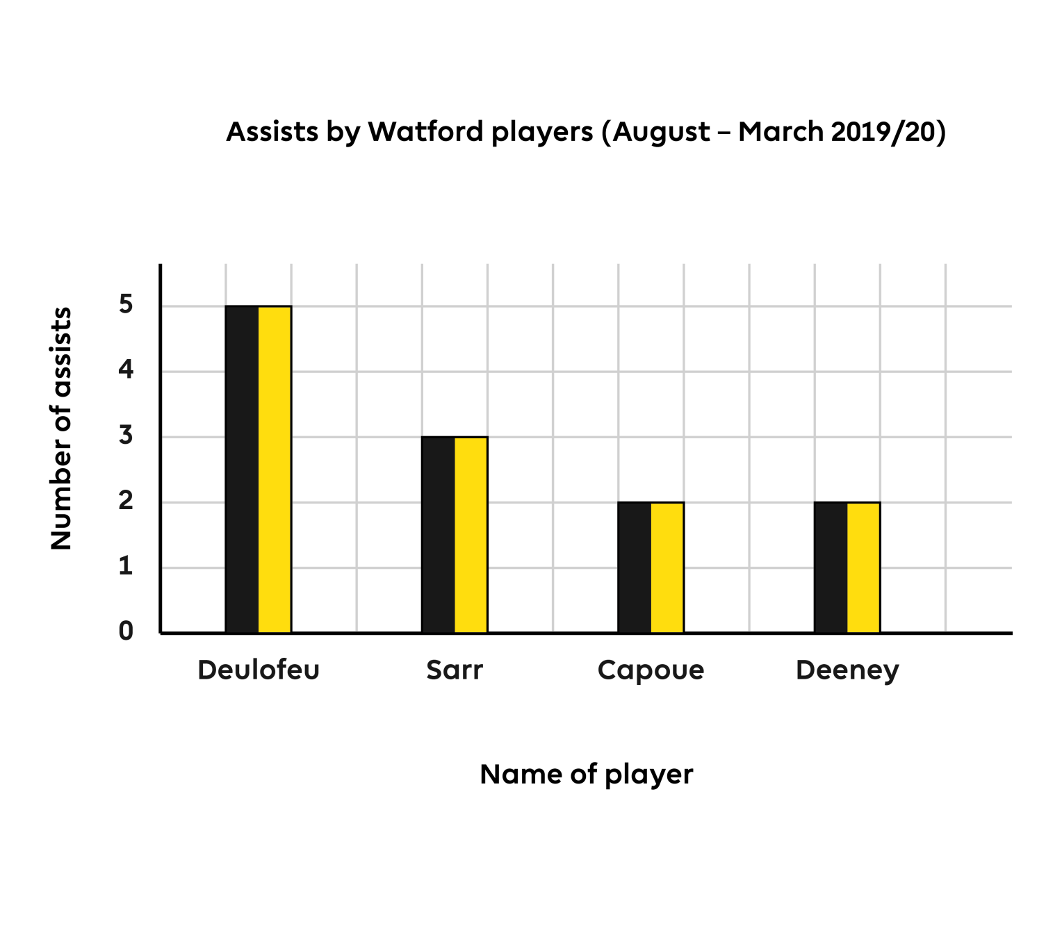
Q3
What does the vertical axis represent in this bar chart?
Number of assists
Name of players
Shots by Watford players
Top scorer
Notes:
Q3. Answer is A

Slide 5
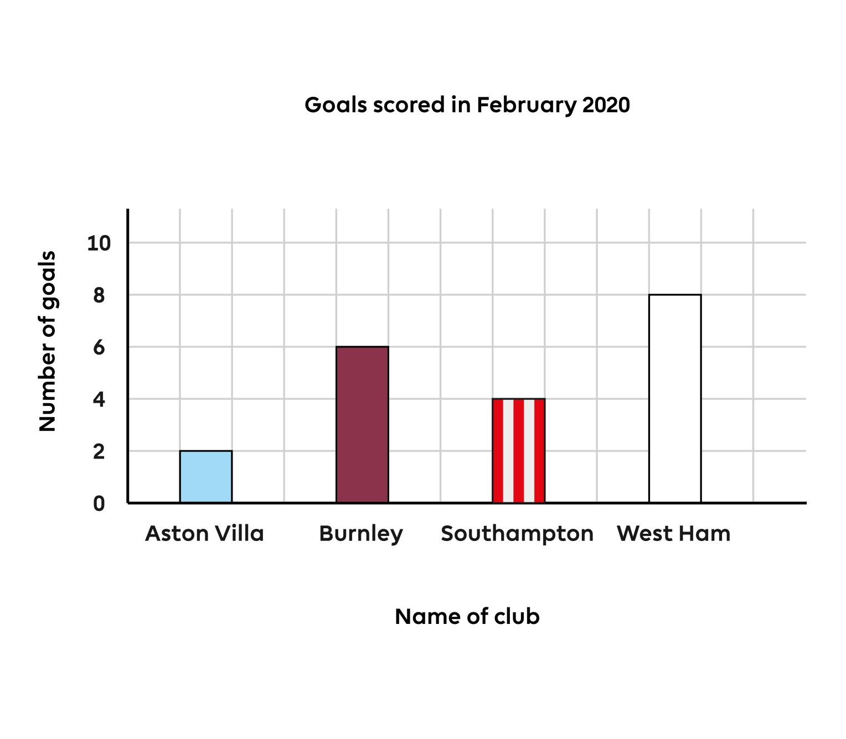
Q4
Which club scored the most goals?
Aston Villa
Burnley
Southampton
West Ham
Notes:
Q4. Answer is D

Slide 6
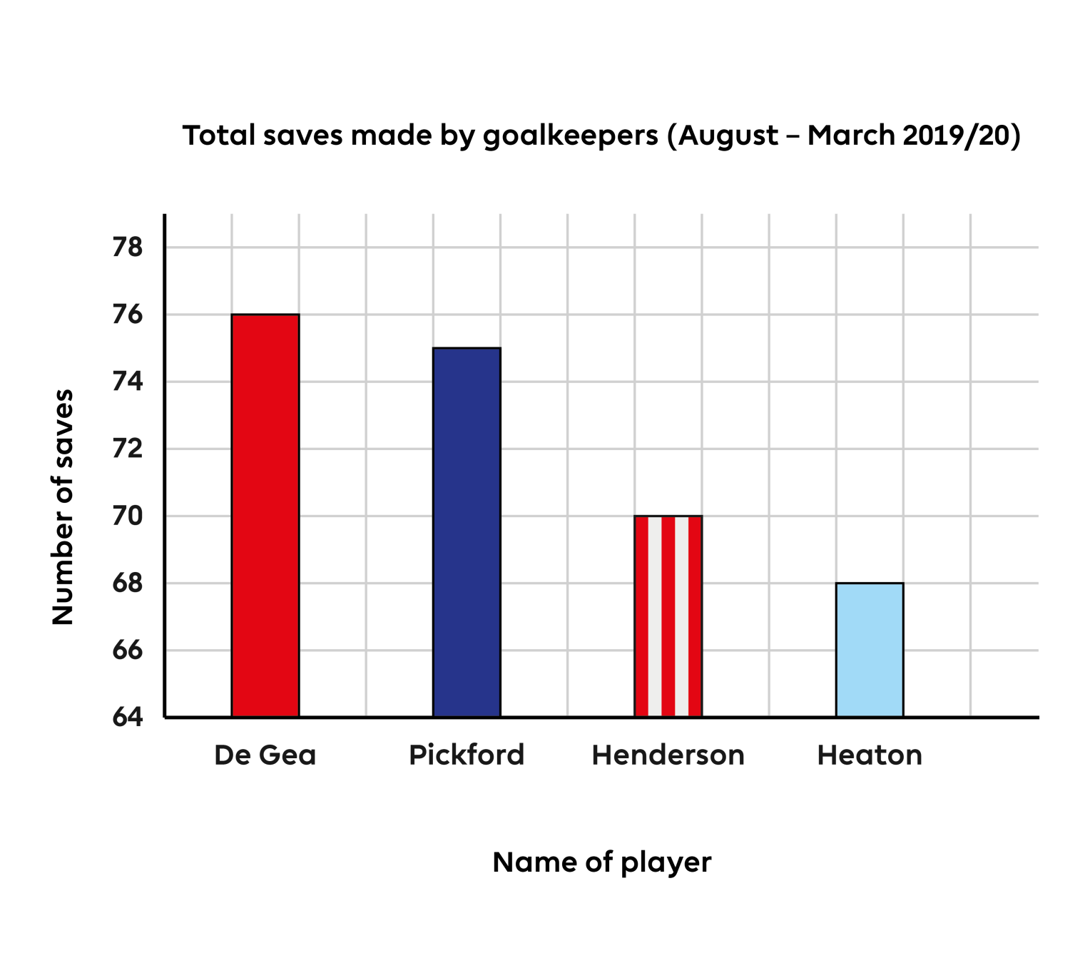
Q5
How many saves has Pickford made for Everton?
76
75
70
68
Notes:
Q5. Answer is B

Slide 7
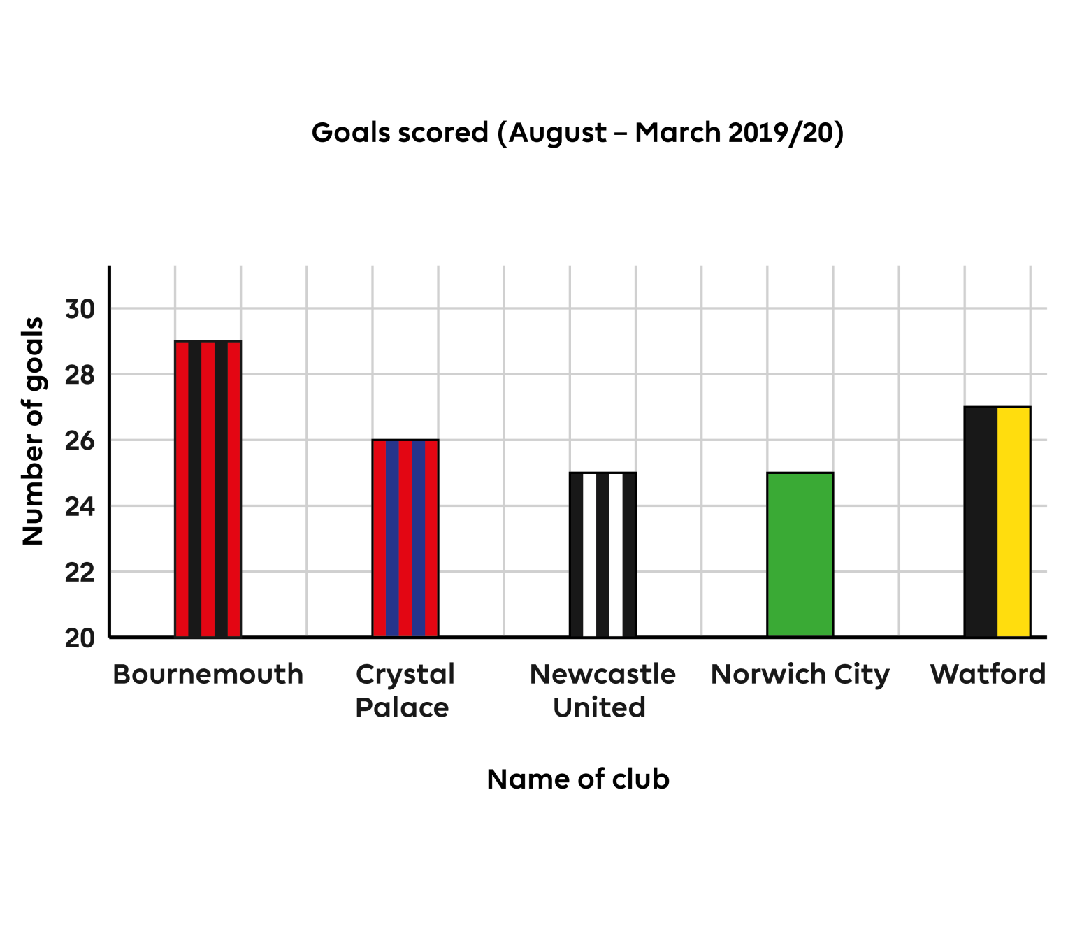
Q6
What is the difference in goals between Newcastle United
and Bournemouth?
Newcastle United
have scored more
Two
Four
Six
Notes:
Q6. Answer is C

Slide 8
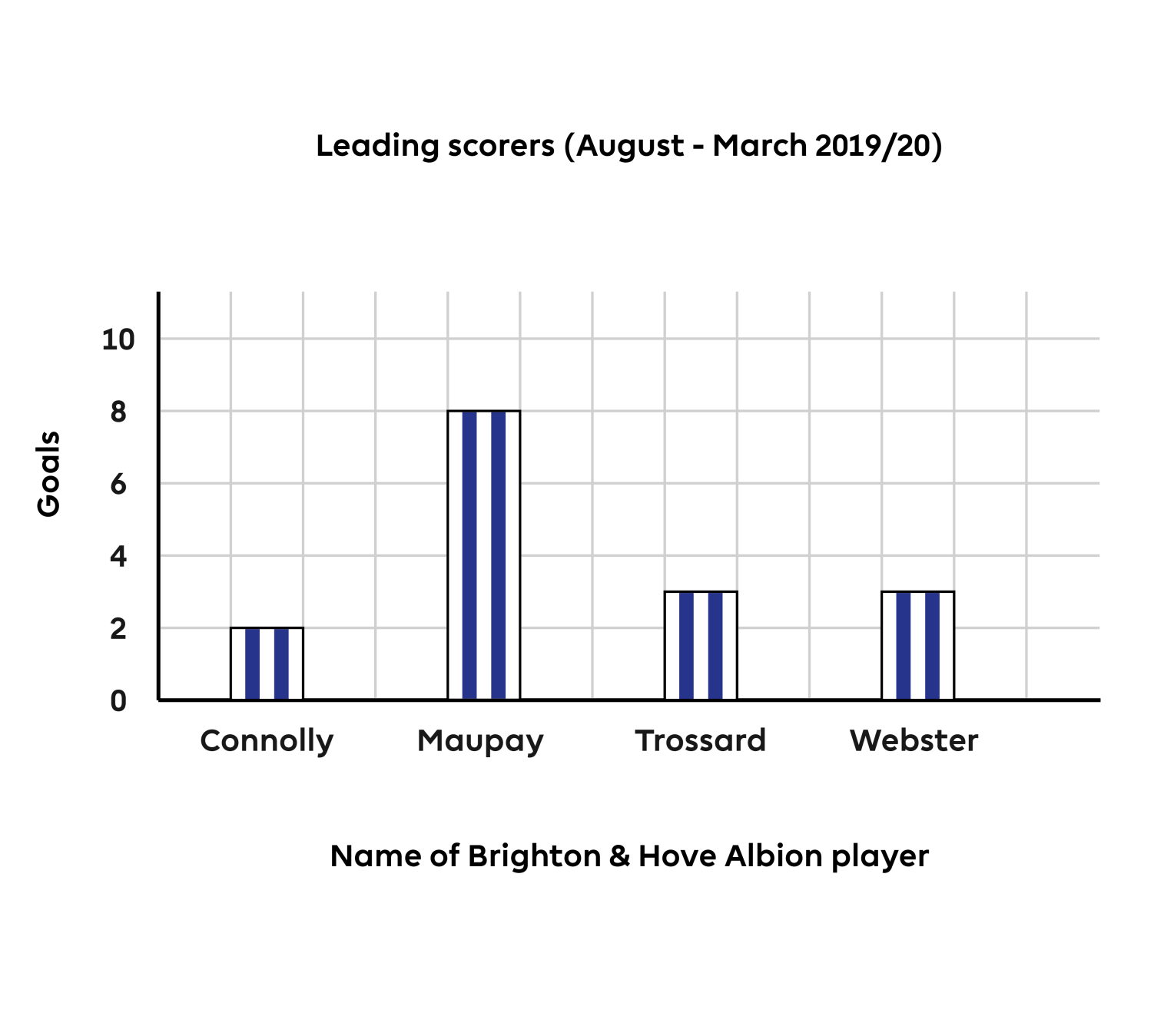
Q7
What is the total number of goals scored by Maupay and Webster?
11
10
6
26
Notes:
Q7. Answer is A

Slide 9
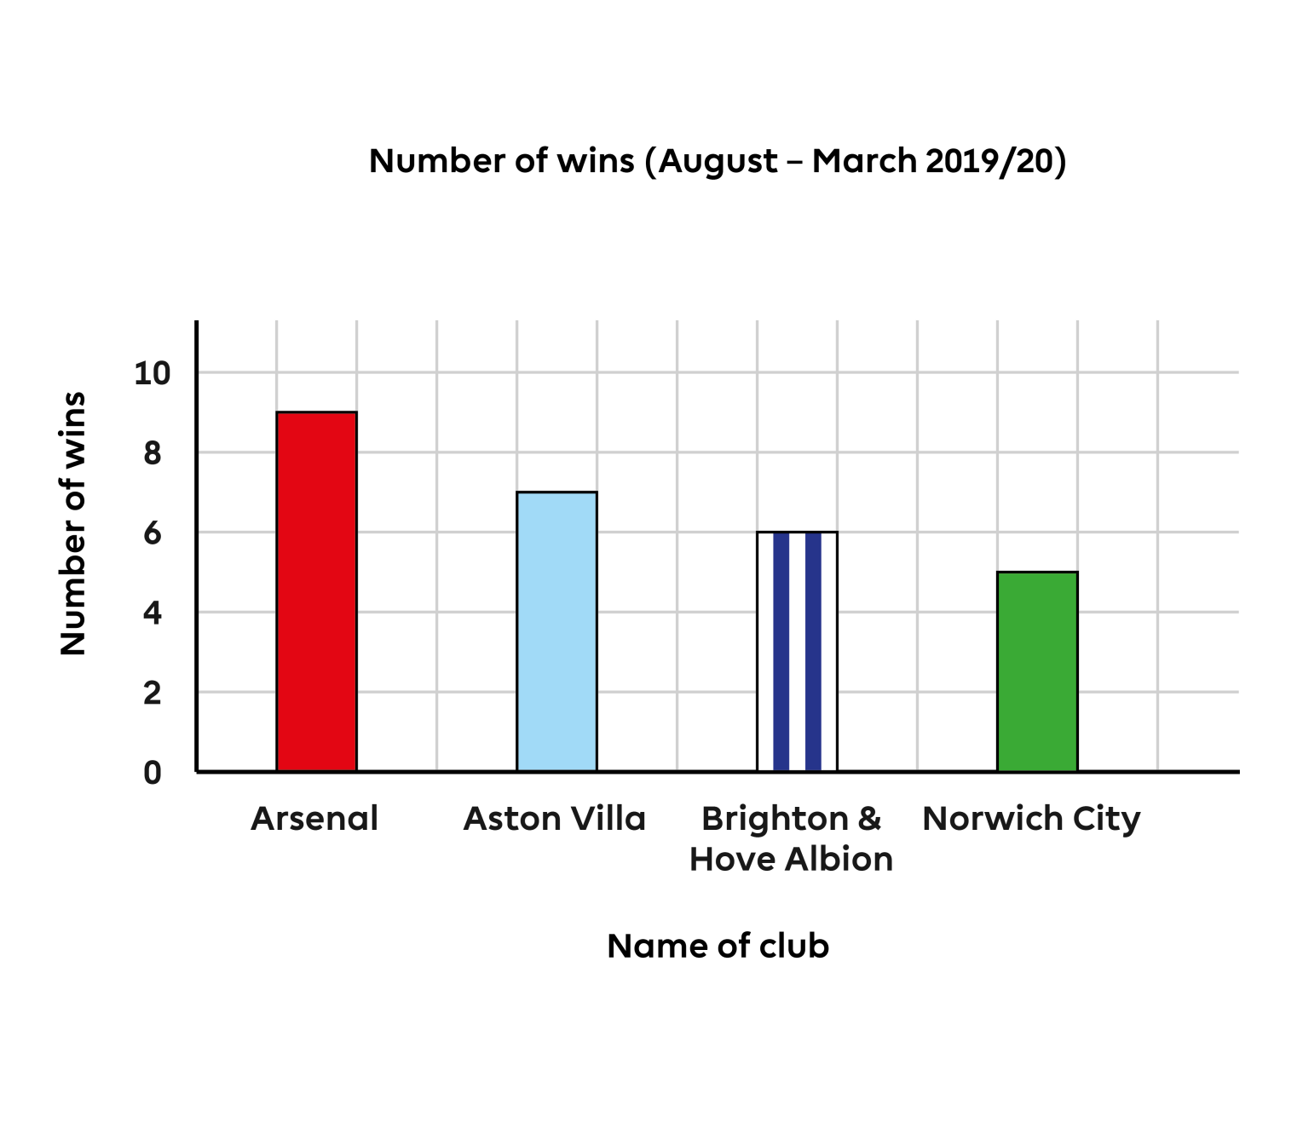
Q8
How many fewer wins did Norwich City have than Arsenal?
3
7
4
2
Notes:
Q8. Answer is C

Slide 10
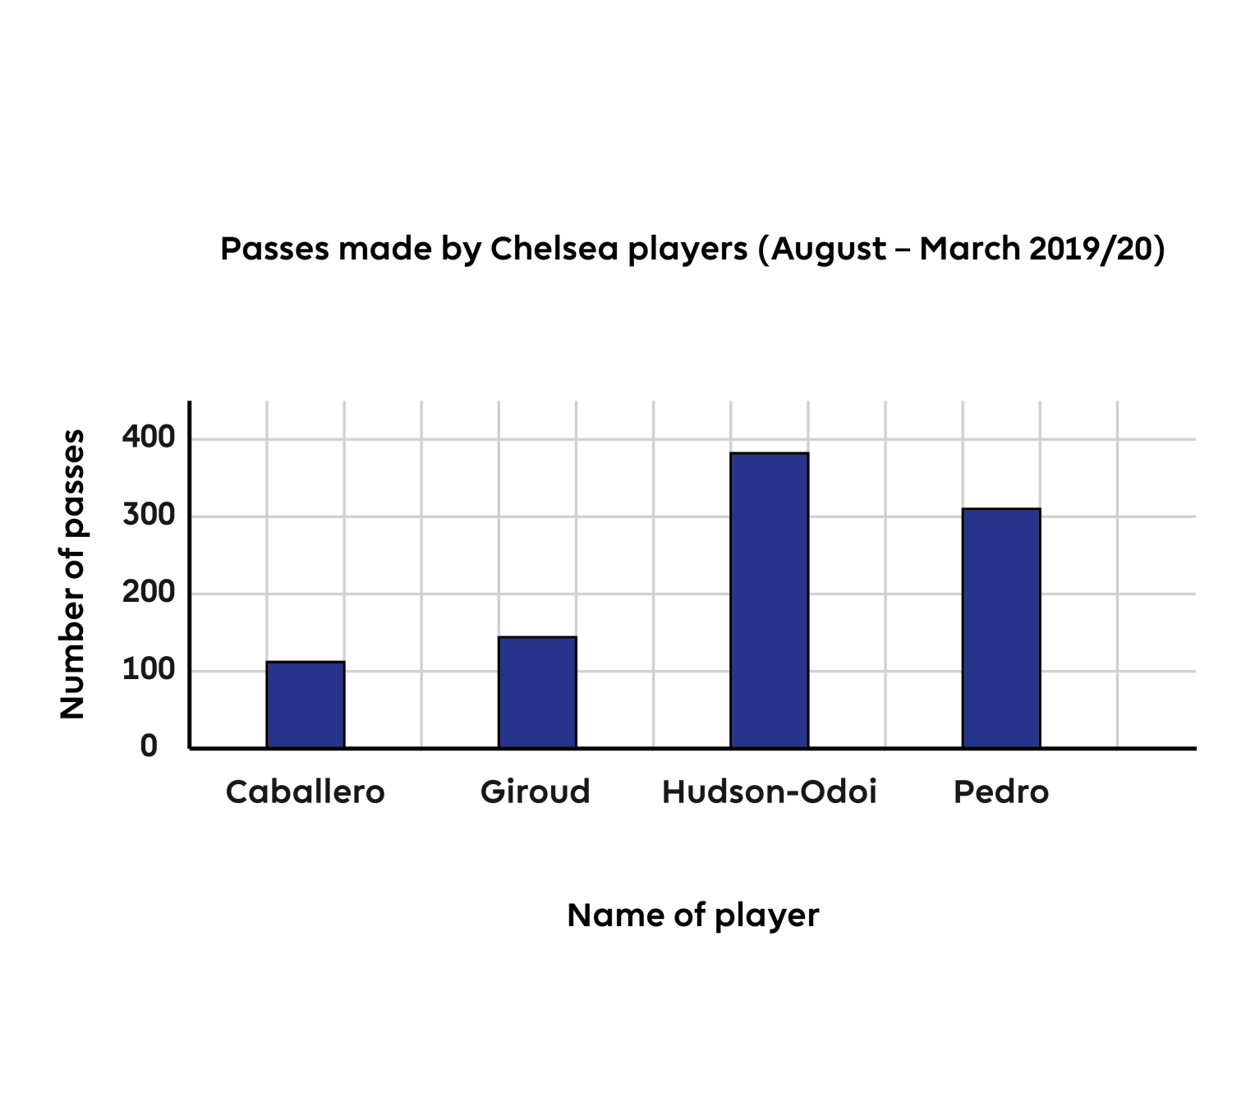
Q9
One player has made 310 passes. Who is it?
Caballero
Giroud
Pedro
You can’t tell
Notes:
Q9. Answer is C

Slide 11
Q10
What would be the best scale
to use to make a bar chart for
this information?
0, 1, 2, 3, 4 and so on
0, 5, 10, 15, 20 and so on
0, 10, 20, 30, 40 and so on
0, 100, 200, 300, 400 and so on
Passes made this season
Leicester City |  | Southampton
Pérez | Vardy | Redmond | Ings
557 | 315 | 686 | 420
Notes:
Q10. Answer is D

Slide 12
Answers
Q1. Answer is B
Q2. Answer is D
Q3. Answer is A
Q4. Answer is D
Q5. Answer is B
Q6. Answer is C
Q7. Answer is A
Q8. Answer is C
Q9. Answer is C
Q10. Answer is D

