Slide 3
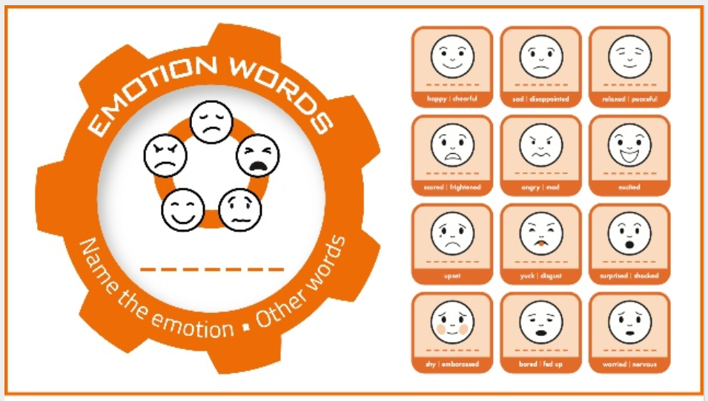

Slide 4
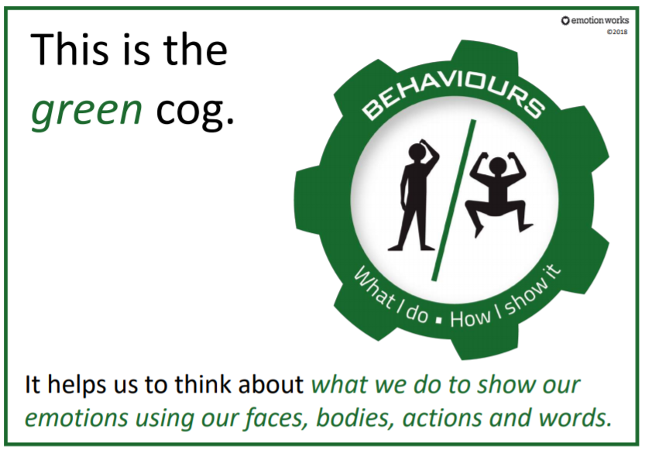

Slide 10
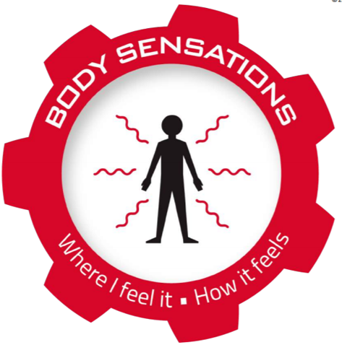
Body Sensations Cog Challenge….
Over the next few weeks, create a piece of body sensation art work.

Slide 11
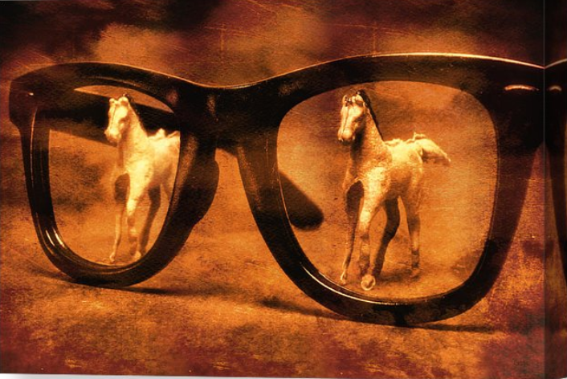
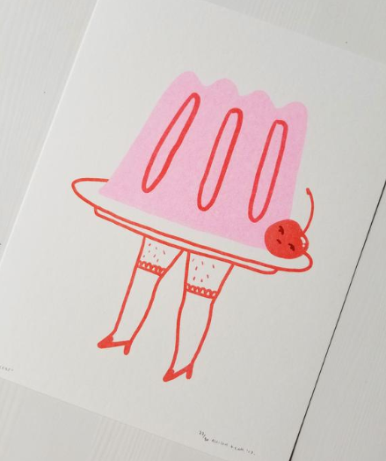
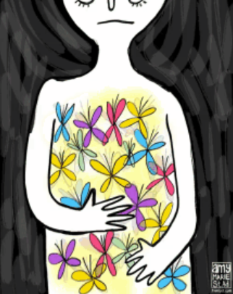
Body Sensations Cog Challenge….
Butterflies in your tummy
Double vision glasses
Jelly legs

Slide 15
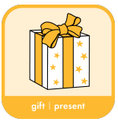
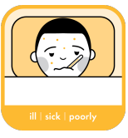
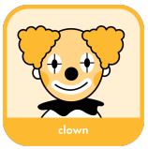
Positive and Negative Triggers
Each individual person will feel and react differently to different triggers.
Some triggers can bring positive emotions, behaviours and body sensations.
Some triggers can bring negative emotions, behaviours and body sensations.
Some triggers may bring negative and positive emotions, behaviours and body sensations.

Slide 16
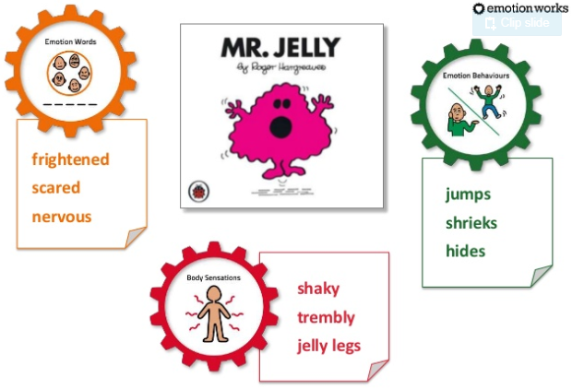

Slide 17
https://www.youtube.com/watch?v=52u5frOoKto

Slide 18
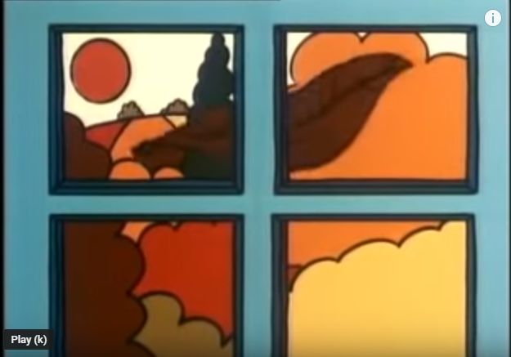
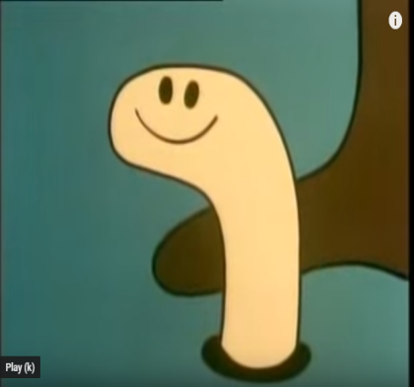
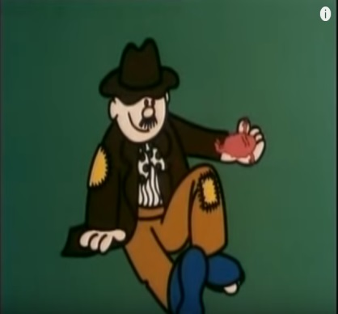
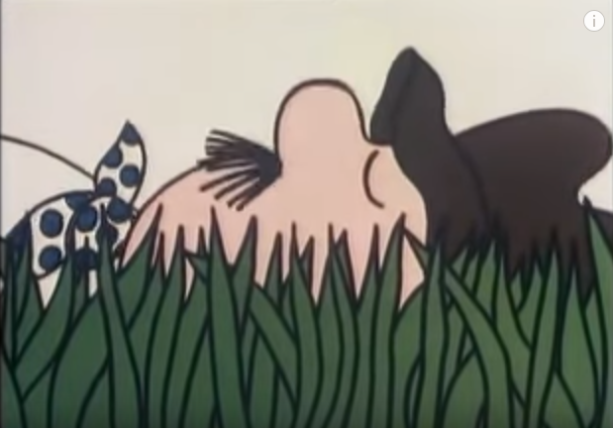
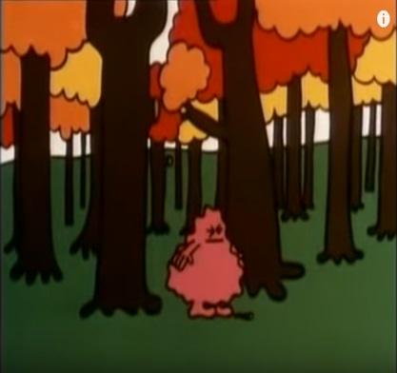
What are Mr Jelly’s Emotion Triggers?
A leaf on his bedroom window
(He thought it was an earthquake!)
A worm
(He thought it was a snake!)
The man
(He thought he was a giant!)
A man snoring
(He thought it was a lion!)
A twig
(He thought a tree was falling!)

Slide 21
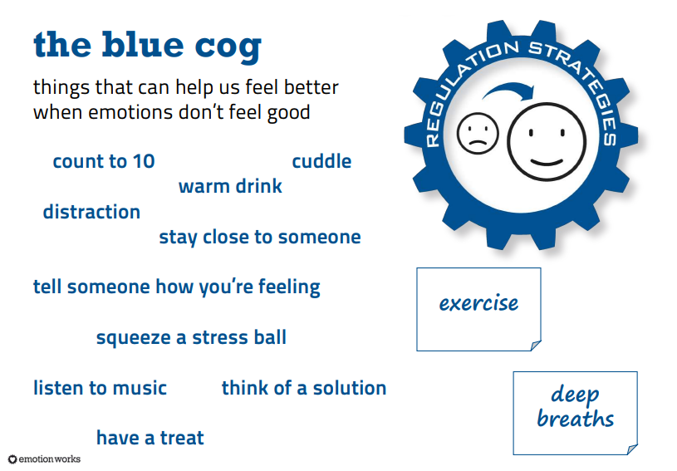

Slide 22
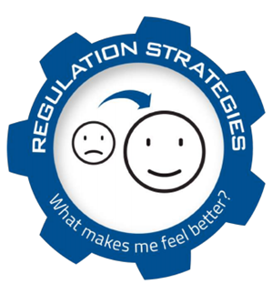
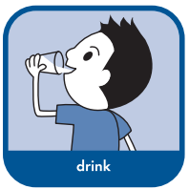
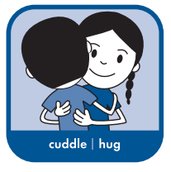
Different types of regulation…
Some types of regulation, you can do on your own.
For some types of regulation, you need to have help from an adult or a friend.
Some types of regulation, can be done straight away. Sometimes you may have to wait for a period of time.
Regulation can be needed for both positive and negative emotions.

Slide 25
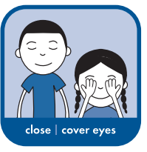
What was Mr Jelly’s Regulation Strategy?
Mr Jelly was taught a strategy that he could do on his own by the snoring man.
He closed his eyes and counted to 10 and that helped him to calm him down.

Slide 26
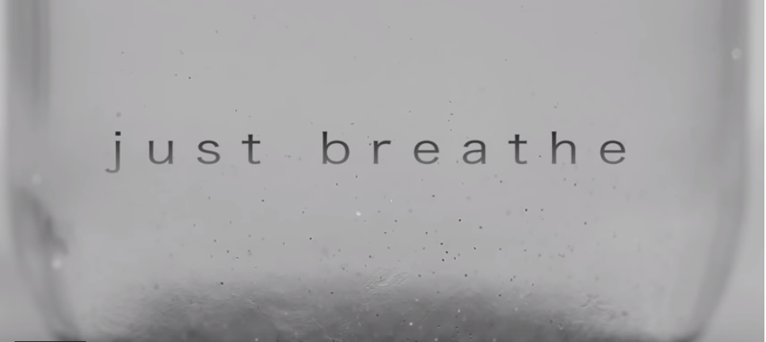
Just Breathe Video…
https://www.youtube.com/watch?reload=9&v=RVA2N6tX2cg&feature=youtu.be&fbclid=IwAR22TDO9lMJOLM1idiNcqzaxaxnPtbJ4U-KMCLd6OrLu_K4NJdqFt2B9g4s

