Slide 1
Thursday 21st May
Primary 3
Outdoor Classroom Day Activities

Slide 2
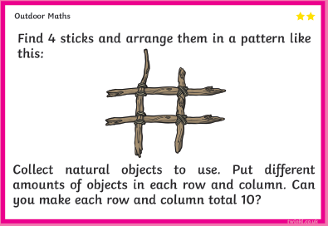
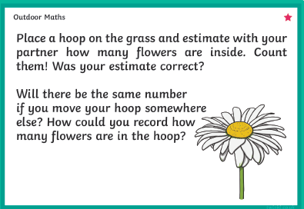
You could take a picture or sketch it and send it to your teacher – We would love to see you apply your problem solving skills outdoors.
Don’t worry if you haven’t got a hoop, you could line the area using your jackets (whether dependent) or use twigs.
Whatever works for you!

Slide 3
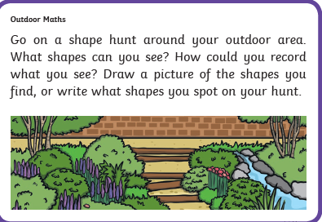
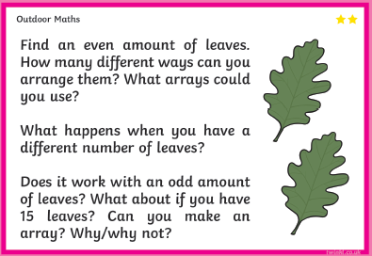
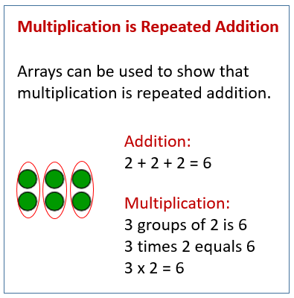
Keep your eyes pealed. Perhaps you will find different shapes and sizes of triangles.. Possibly even a pentagon. Don’t forget to note it down!
We have used arrays to develop our multiplication knowledge:

Slide 4
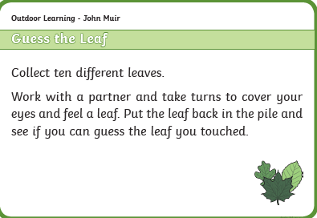
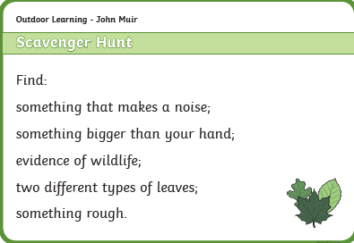
Your adult can be your partner for this game. You’ll both have to think carefully about size and texture – Have Fun!
This is your final activity
GOOD LUCK!

