Slide 1
Tuesday 19th May
Primary 3
Numeracy Tasks

Slide 2
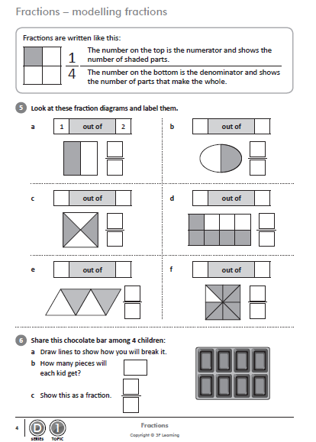
Mild

Slide 3
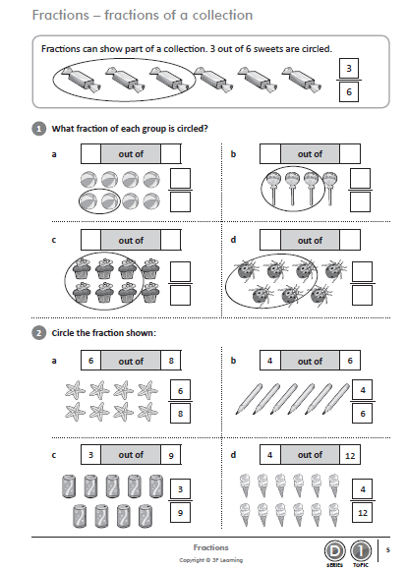
Hot

Slide 4
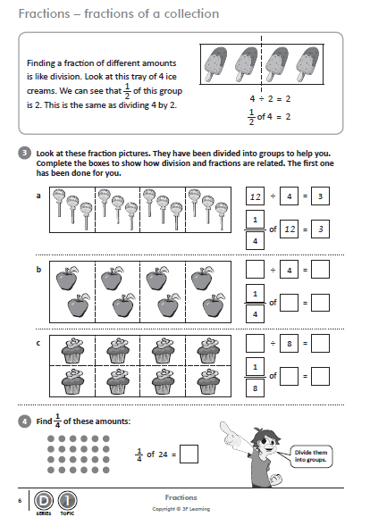
Spicy

Slide 5
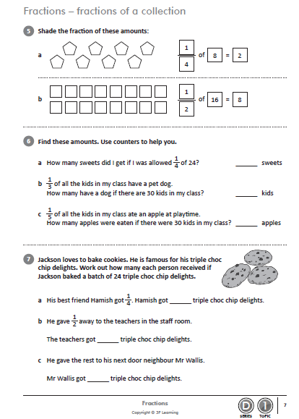
Extra
Spicy

