Slide 1
Tuesday 12th May
Primary 3 Literacy Tasks

Slide 2
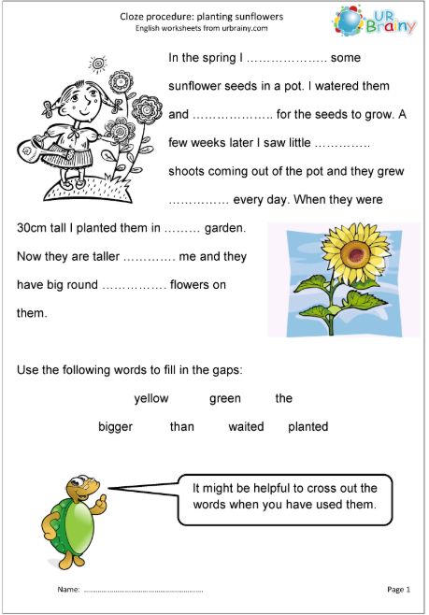
Mild

Slide 3
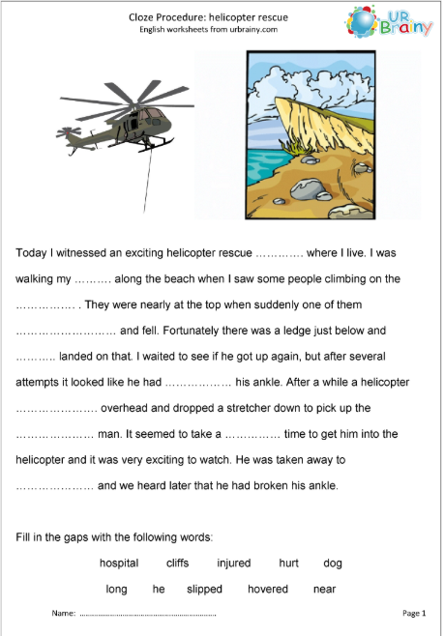
Spicy

Slide 4
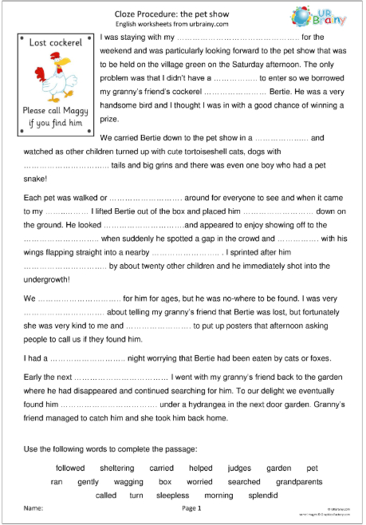
Hot

