Slide 1
Monday 11th May
Primary 3 Mental Agility

Slide 2
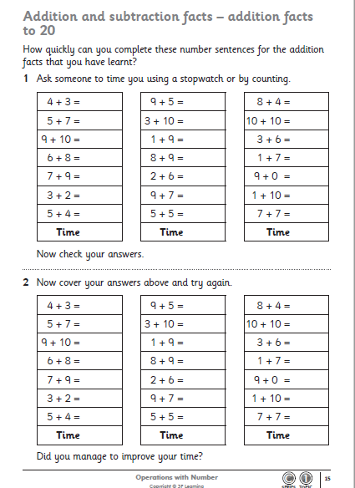

Slide 3
