Slide 1





Creative Writing
Sometimes it’s difficult to think of where to start when you are asked to write a “story”. Here are some prompts or ideas that you could tell the story of – be as creative as you like and remember you can include detail about character, setting and plot.
Is there an ending you want to achieve? How do you get there? Make notes and plan out the structure of your story –
You can edit once you are finished , today is all about getting your ideas down on paper (or laptop/ipad) - Good luck!

Slide 2
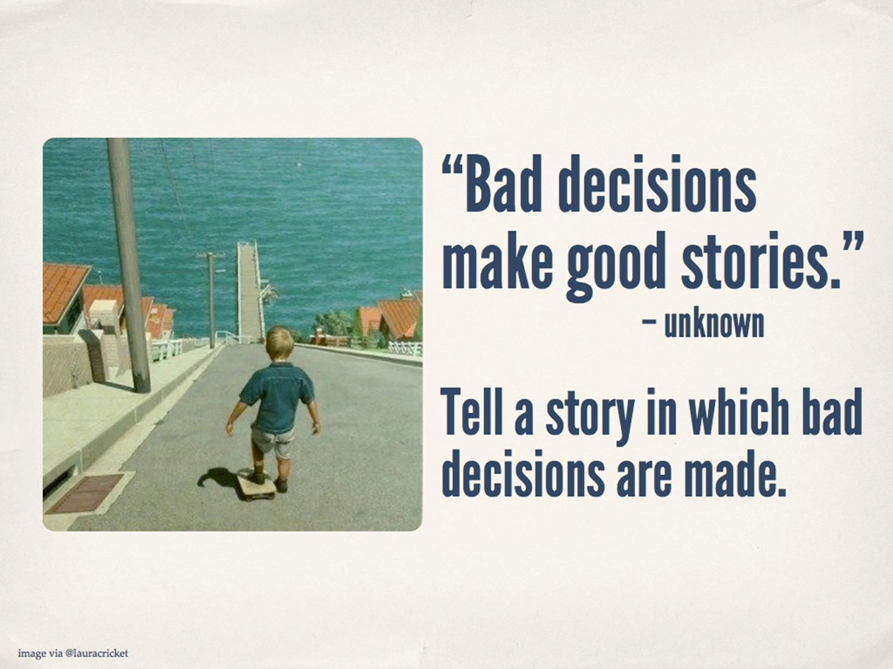

Slide 3
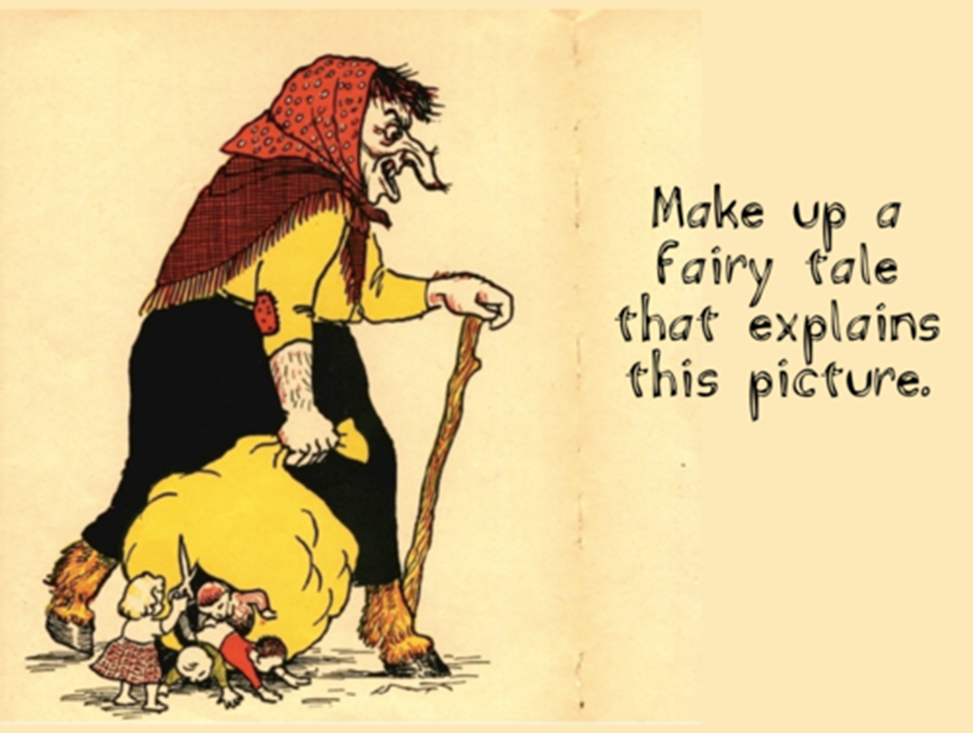

Slide 4
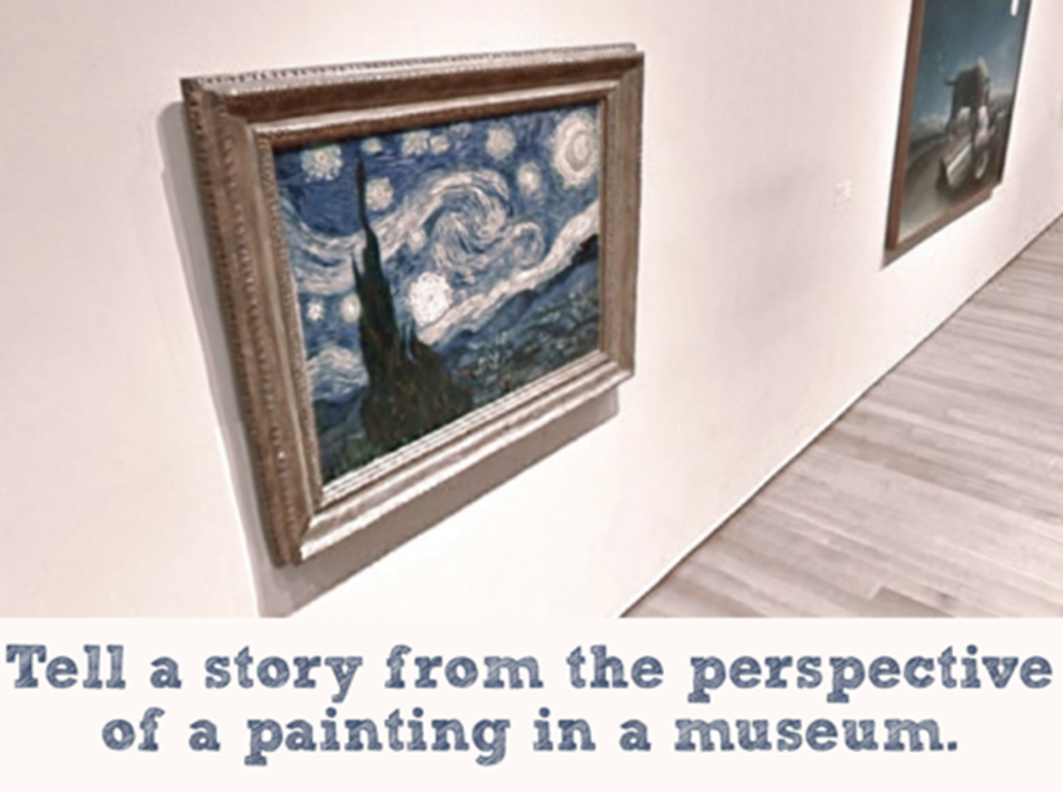

Slide 5
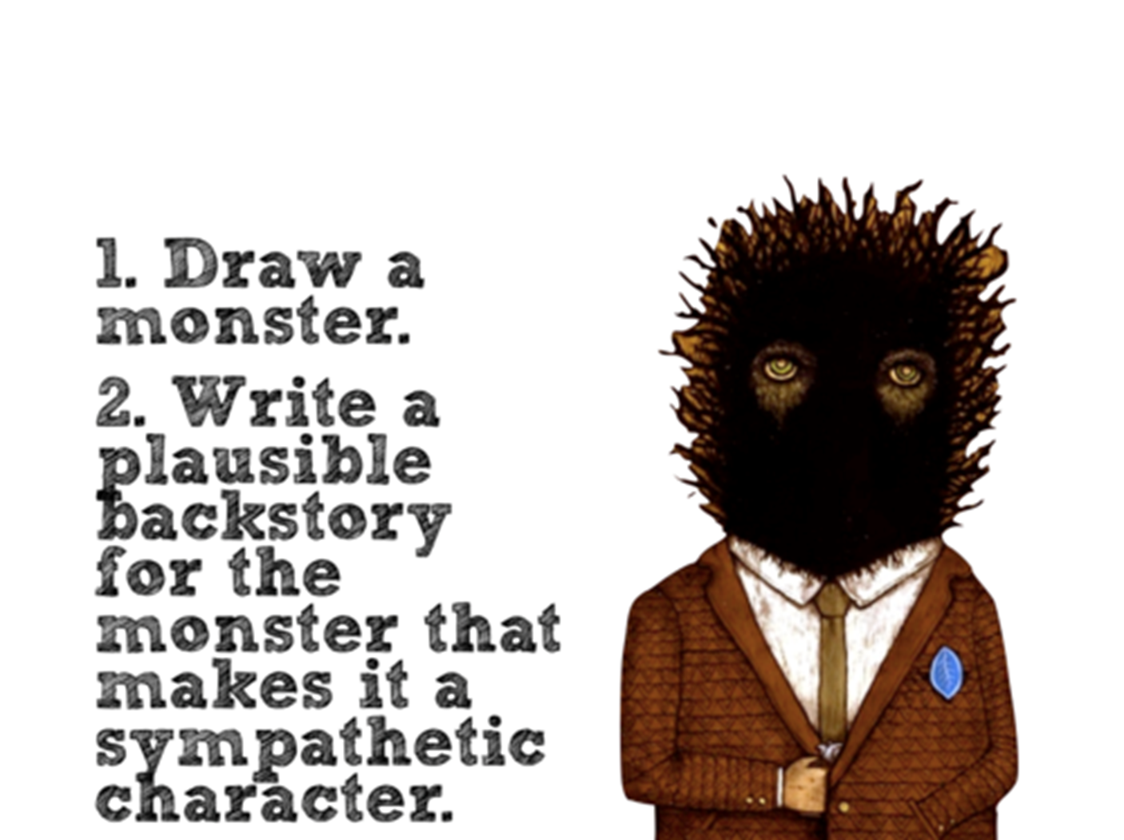

Slide 6
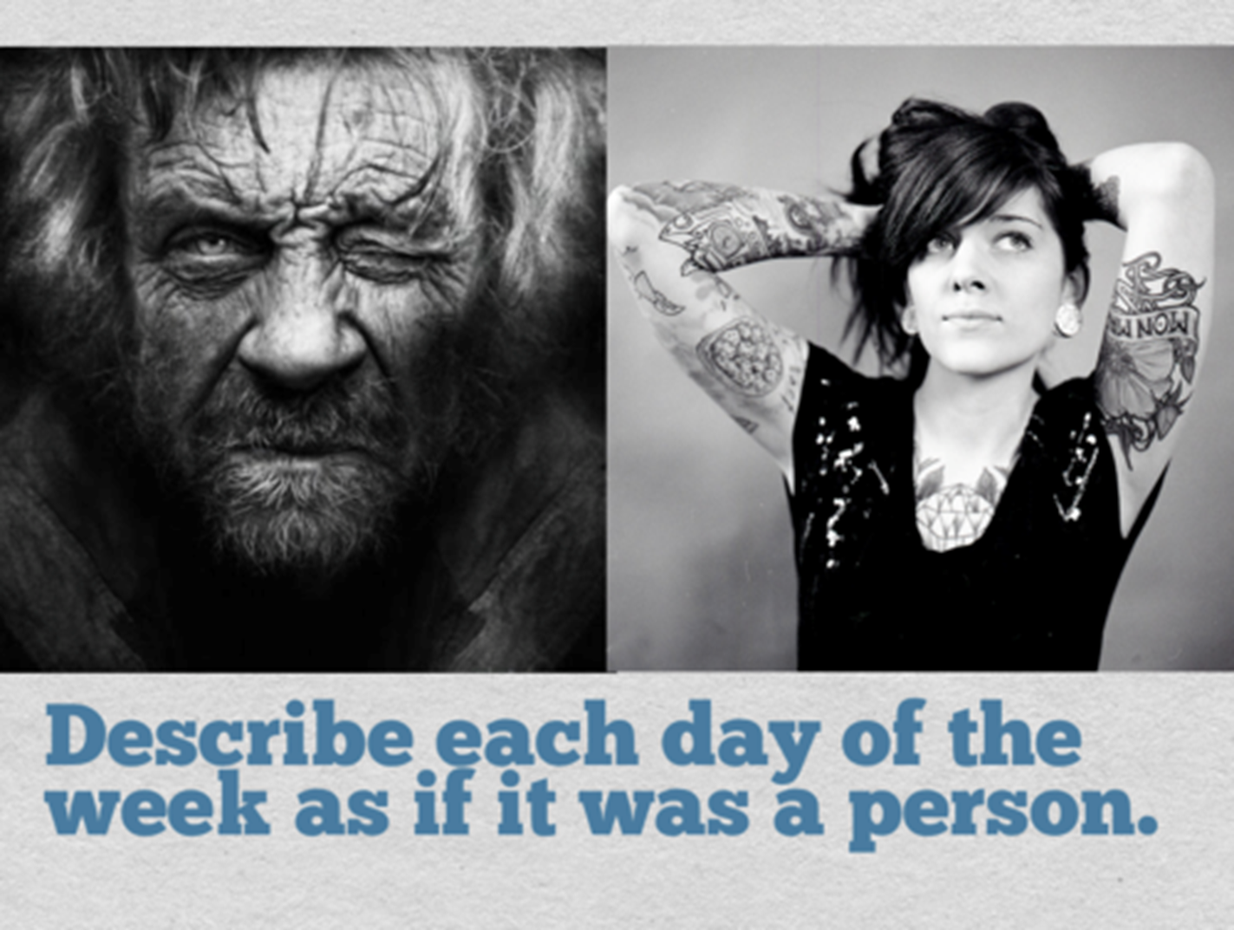

Slide 7
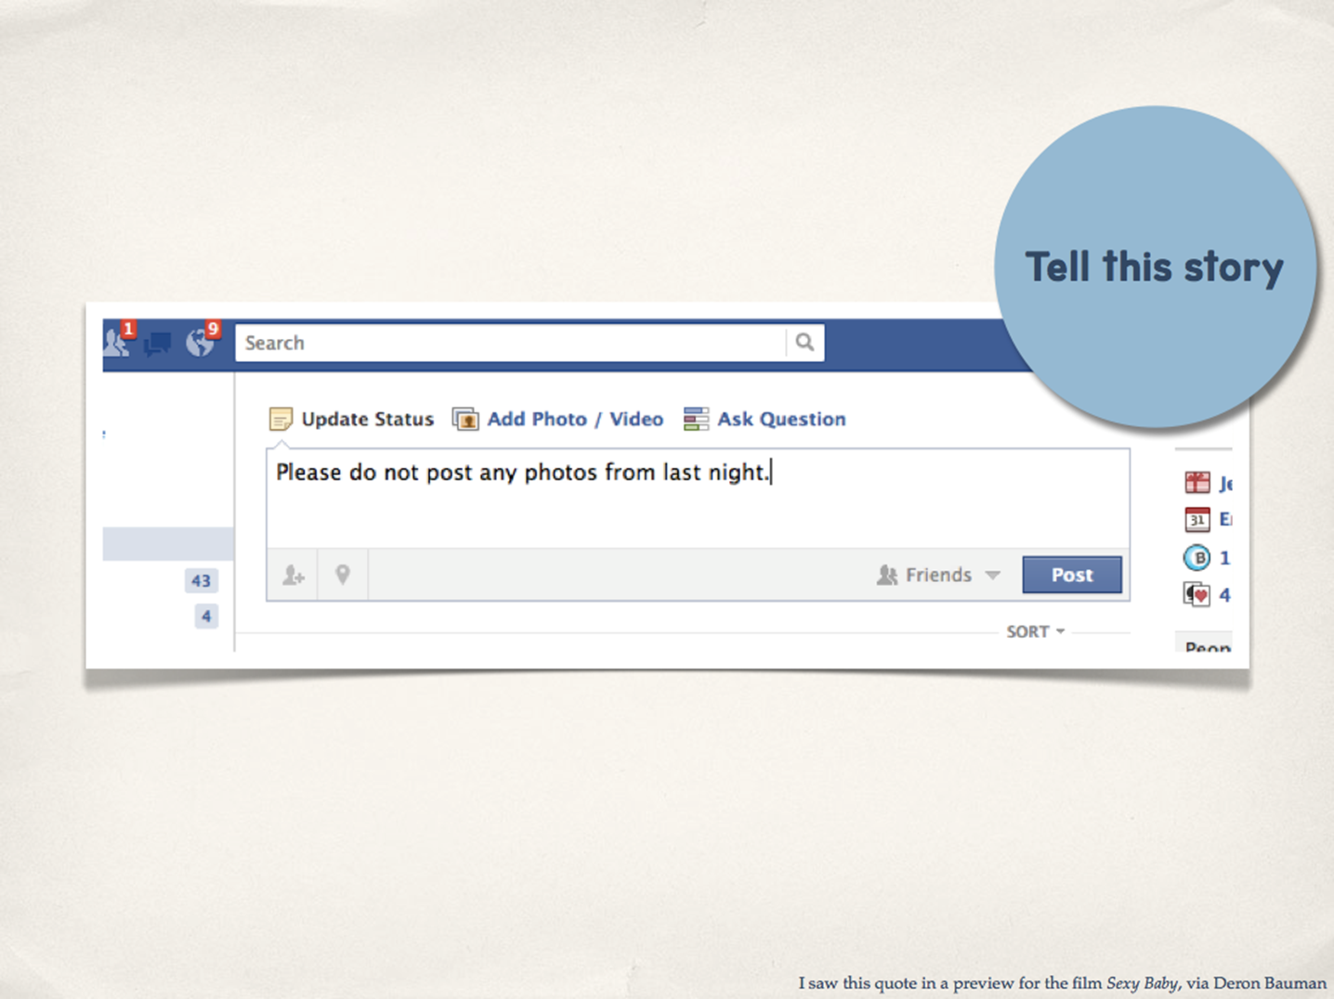

Slide 8


Slide 9
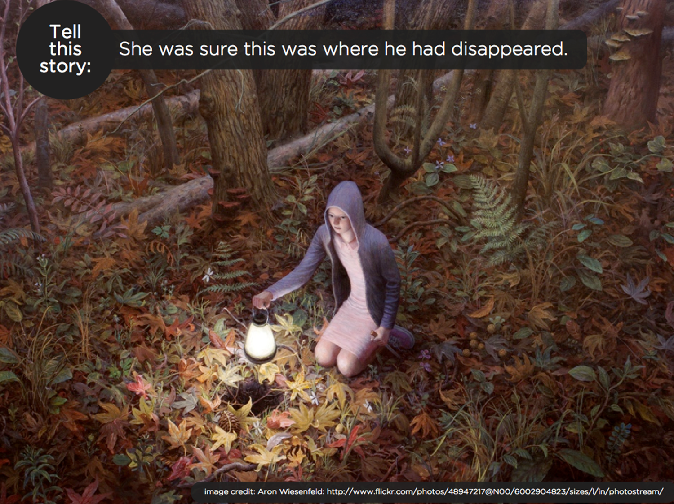

Slide 10
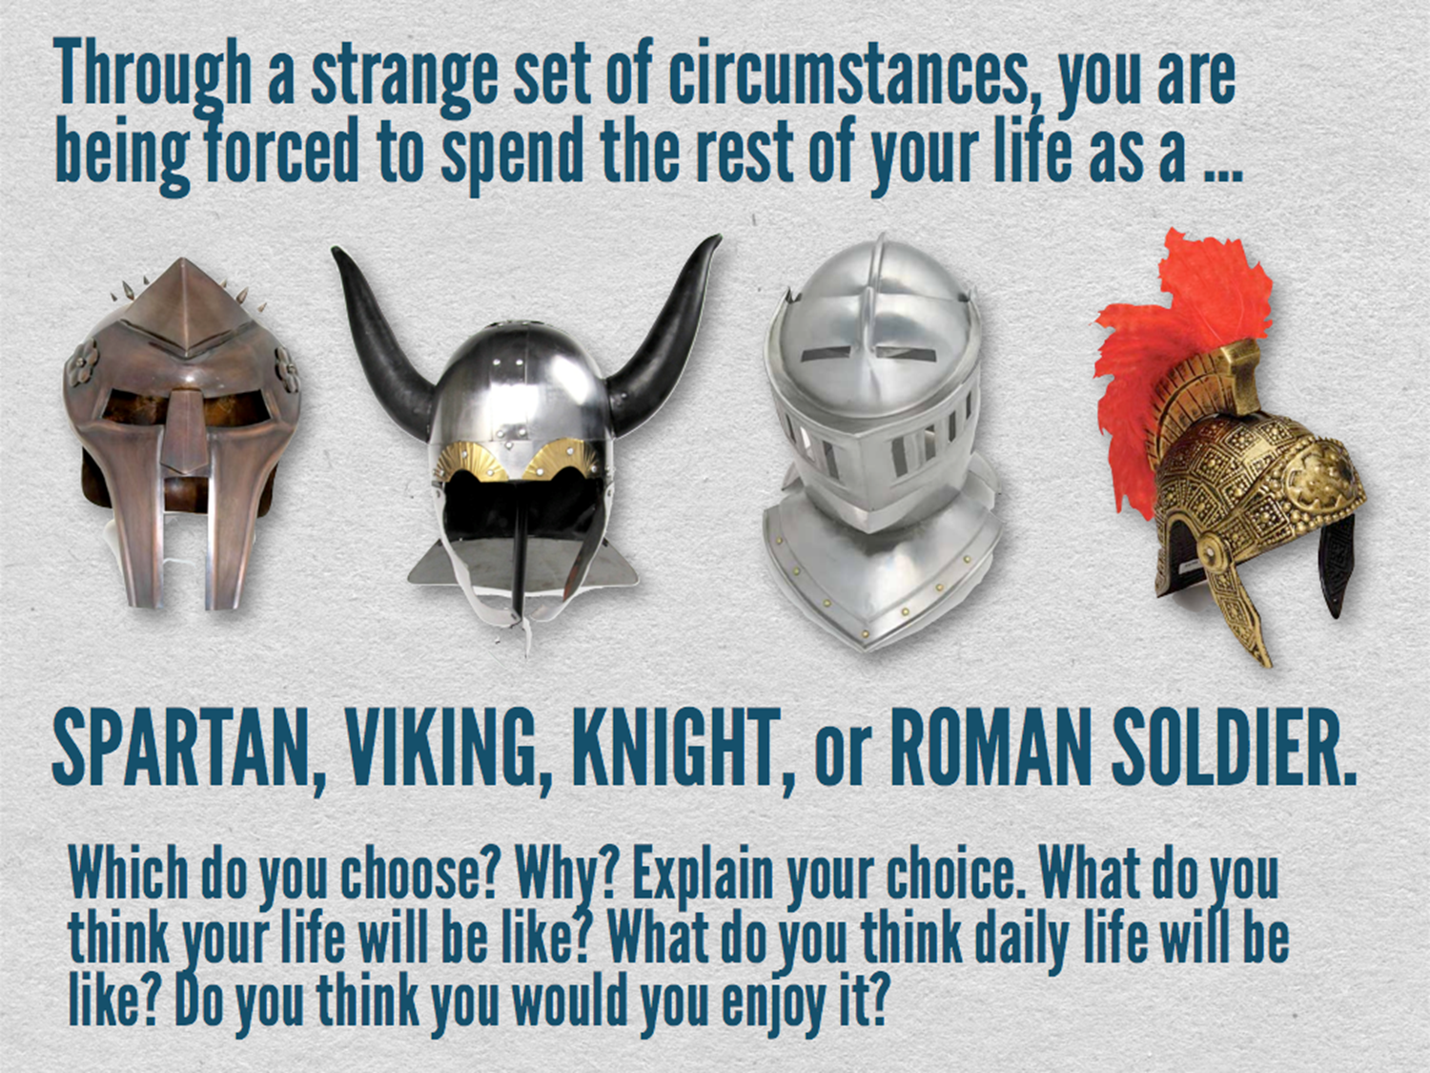

Slide 11
