Slide 1




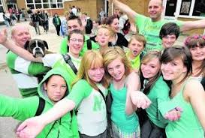
Mrs Kennedy’s Challenge – Thursday 7th May 2020
Lots of us are participating in ‘Clap for the NHS’ every Thursday at 8.00pm. This week I would like all of our children to participate, with their families , - to clap, play music, dance and cheer to say a huge thank you to the NHS and all of the Key Workers across our school community who continue to support us all . It would be wonderful if you could all wear your green school jumpers , anything green or nursery polo shirt to demonstrate our fabulous community spirit. Please ensure you adhere to social distancing guidance.
Please take a photograph of you showing your appreciation and send it to allison.kennedy@westlothian.org.uk

