Slide 1
Thursday 30th April
Primary 3 Data Handling Tasks

Slide 2
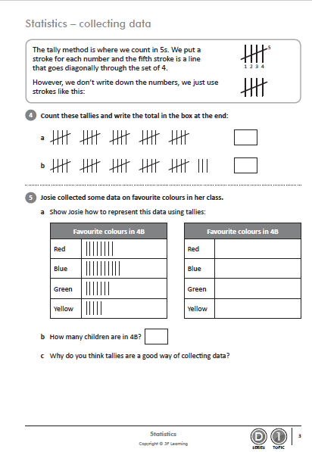
Collecting Data

Slide 3
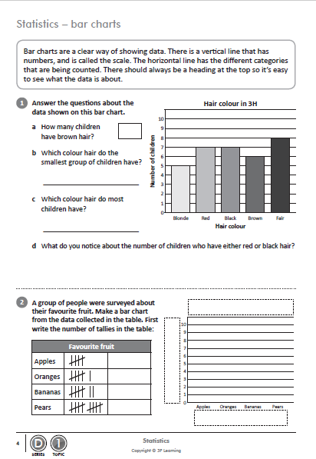
Bar Chart

Slide 4
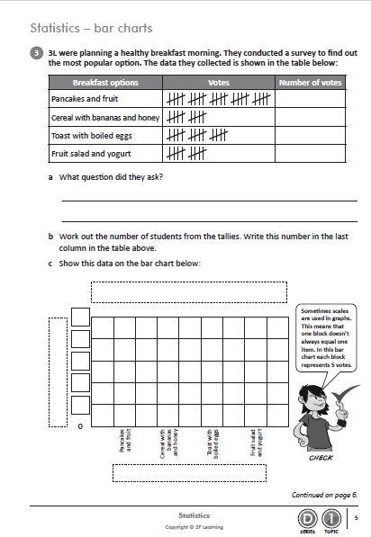
Bar Chart

Slide 5
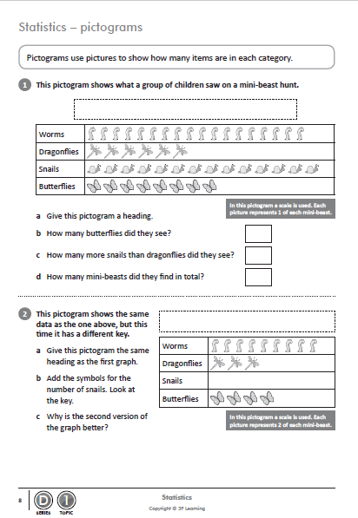
Pictogram

