Slide 1
Tuesday 28th April
Primary 3 Editing Tasks

Slide 2
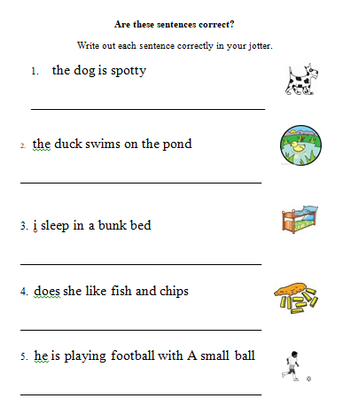
Mild

Slide 3
Hot

Slide 4
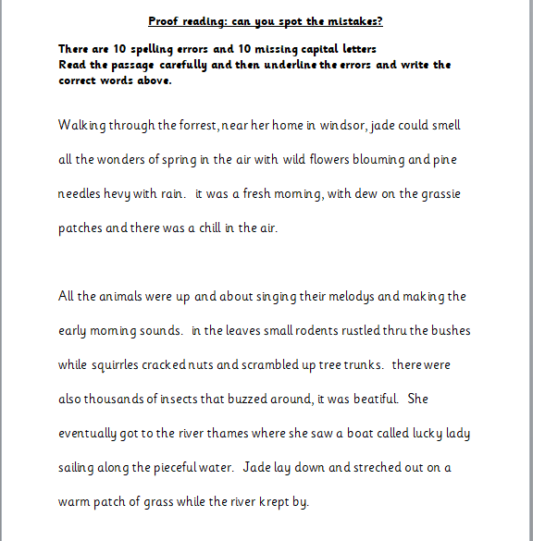
Spicy

