Slide 1
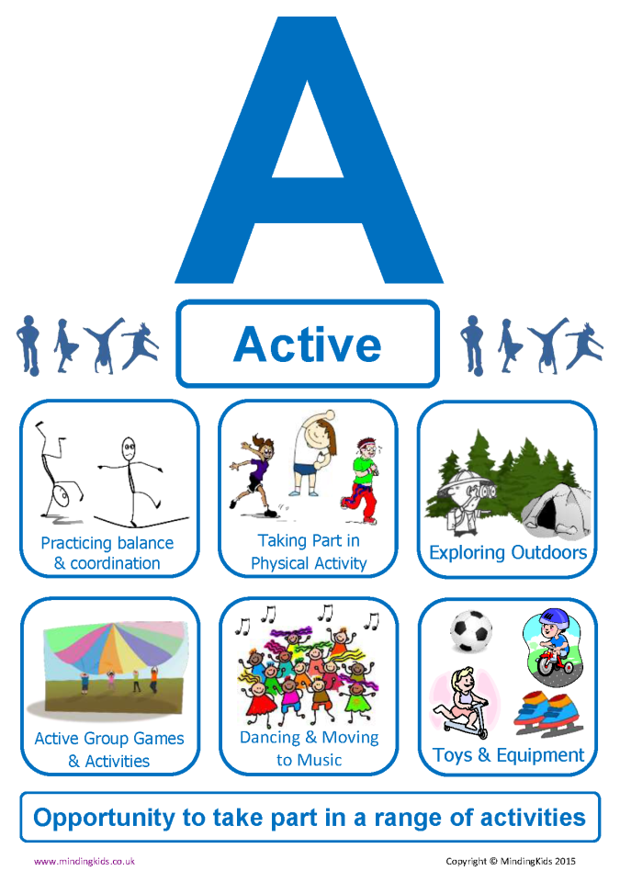

Slide 2


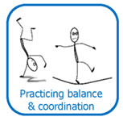
Taking part in PE lessons in school
Using equipment in playparks and in school to practise balance and coordination.
Taking part in games and sports where coordination and balance is needed.

Slide 3
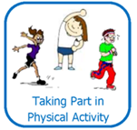
Taking a full part in PE lessons in school
Playing games that make you out of breath and your heart beat faster.
Look for opportunities to join clubs or take part in competitions.

Slide 4

Playing outdoors with friends and/or family
Visiting outdoor spaces, like parks, beaches, woods, etc. with family
Going to play outdoors even when the weather isn’t sunny.

Slide 5

Playing games with friends at playtime.
Joining clubs, like Scouts, Brownies, etc.
Playing in teams or taking part in competitive activities.

Slide 6

Taking part in PE or drama lessons which
have music or dance as part of them
School Shows and Nativities
Music lessons in class or playing an instrument.

Slide 7

Choosing to play with toys that give you exercise too.
Using equipment in playparks and public areas that challenge you to use your body.
Making sure the toys you choose are safe and well maintained.

Slide 8


