Slide 1
Technology in the classroom.

Slide 2
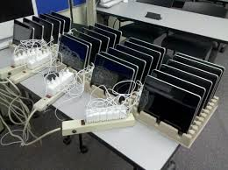
Introduction
iPads…

Slide 3
The Levels of Teaching Innovation (LoTi®) Framework (Moersch 1994)
Level 1
Awareness
Level 4
Integration
Level 2
Exploration
Level 5
Expansion
Level 3
Infusion
Level 6
Refinement

Slide 4
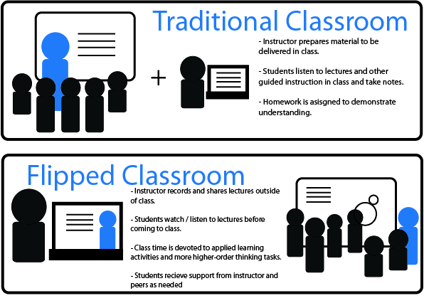
Flipped & Blended learning

Slide 5
Flipped & Blended learning

Slide 6
Research
“by undertaking a wide range of high-quality, sustained professional learning experiences, teachers are more likely to inspire pupils and provide high quality teaching and learning experiences, enabling learners to achieve their best.” (GTCS, 2011)

Slide 7
Research

Slide 8
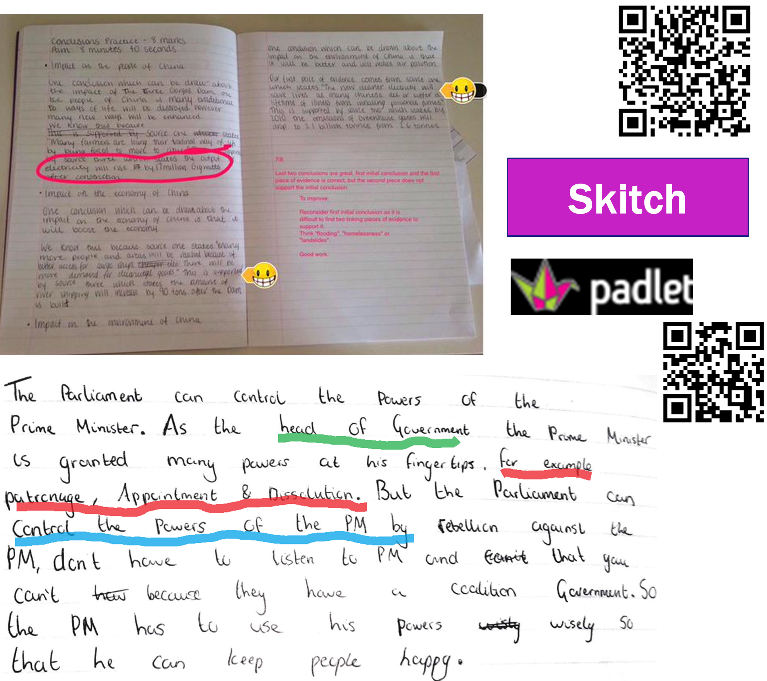
Guerrilla tactics…

Slide 9
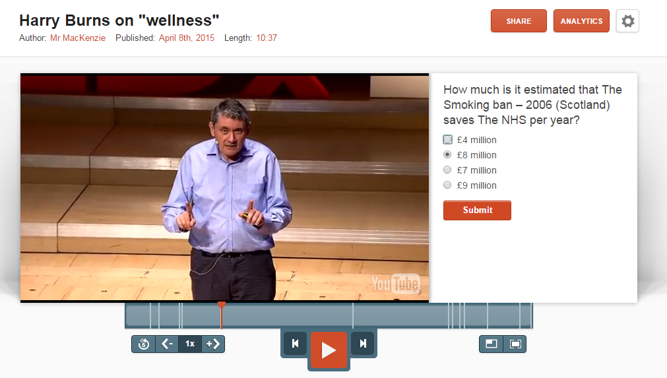

Slide 11
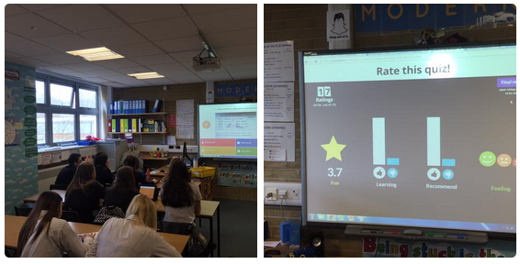

Slide 12
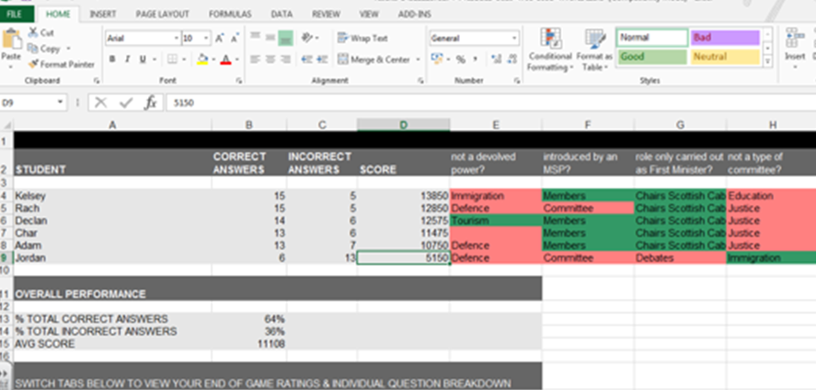

Slide 13
Towards a more systematic enquiry
Future research focus:
To establish the impact of Kahoot on revision.

Slide 14
Rationale
Raising attainment
Revision Strategies
Previous investigation into use of ICT in classroom
“As technology becomes more and more embedded in our culture, we must provide our learners with relevant and contemporary experiences that allow them to engage successfully in it” (Education Scotland)

Slide 15
Rationale
“though he only found out about Kahoot! three weeks before the exam, his scores went from 79% passing the previous year to 88% passing this year. He credits a large part of the increase to Kahoot!, which helped his students enjoy learning before the writing exam.”

Slide 16
Success Criteria
If the enquiry is as productive as I hope it might be…
For me:
I will have evidence of the impact of Kahoot on subject knowledge and engagement, as well as its strengths and limitations in terms of learning.
For Pupils:
Pupils will have engage more enthusiastically in the revision process and show improved subject knowledge, demonstrated by observations of engagement in lessons and test results before and after the use of Kahoot in class.

Slide 17
Planning data gathering & analysis.
What I want to explore more closely | What I will look for during data analysis
Pupil engagement in the revision process and the impact of Kahoot. | A change in student enthusiasm or engagement in revision. Measured through the use of focused observations recording time spent on task, instances of pupils going ‘off’ task etc.

Slide 18
Planning data gathering & analysis.
What data I need to gather | Fitness for purpose
Structured observation sheets focused on pupil engagement in whole class revision tasks both before the introduction of Kahoot and after. This could be carried out at set intervals throughout the lessons. Pupil questionnaires focused on engagement and enjoyment of the task. | Structured observations – effective to make a professional judgement on pupils’ engagement. “To provide a factual or descriptive record of classroom activity” (Hopkins, 2002) Questionnaires – to gain specific feedback from the pupils’ perspective. - “Certain information can be obtained only by asking” (Tuckman and Harper, 2012)

Slide 19
