Slide 1
Outdoor Learning
The importance of children being outside and learning outdoors in Primary one and beyond.

Slide 2
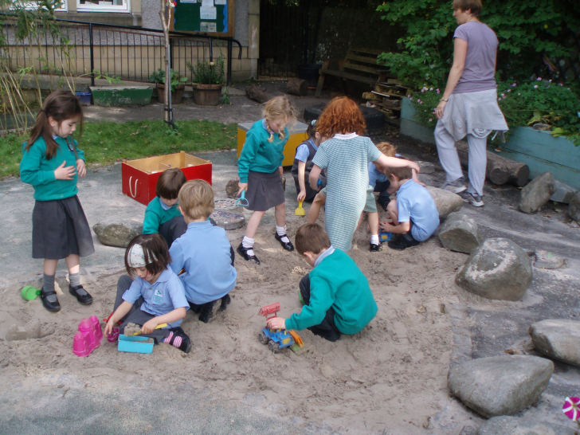
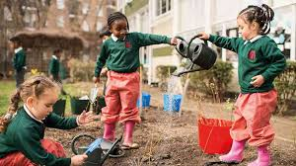
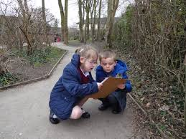
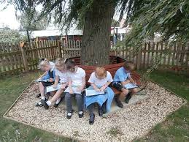
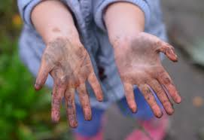

Slide 3
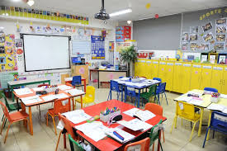
What is outdoor learning?
Outdoor learning is an integral part of Curriculum for Excellence.
Scotland is one of only a handful of countries that includes outdoor learning as part of it’s curriculum.
It is not simply taking what can be learned inside the classroom, outside; there is much more to it.

Slide 4
“We are not saying ‘good bye’
to our classrooms;
we are opening them up.”
Simon Beames, Outdoor Education Lecturer, Edinburgh University

Slide 5
Why Outdoor Learning?
Outdoor Learning provides a diversity of resources and spaces that is hard to replicate in an indoor environment.
Outdoor Learning provides opportunities to develop skills for learning, life and work.
There is a visible impact on children and young people’s health and wellbeing, wider achievements, attainment and personal development as a result of Outdoor Learning.

Slide 6
The Benefits of Outdoor Learning
Children can make connections between the classroom and the real world.
Outdoor Learning provides stimuli for creative thinking and learning.
It develops critical thinking skills and problem solving skills.
Children can see relevance to what is being taught in the classroom – developing life skills.
It provides a multi-sensory approach to learning.
Outdoor learning can be a more relaxing environment for some learners.

Slide 7
Benefits of Outdoor learning
Encourages risk taking and risk assessment.
Health benefits – more fresh air and children are more active.
Reduces stress: “The life stress impact is lower among children with high levels of nearby nature than among those with little nearby nature”
Being ‘Nature Smart’ is a recognised intelligence.

Slide 8
Early Years Outdoors
Many nurseries are now becoming more ‘outdoors’ and in all weathers.
There are many benefits to these outdoor experiences and other settings (P1 and beyond) are incorporating this approach into their routines.
Children have the opportunity for free play outdoors as well as structured learning opportunities.

Slide 9
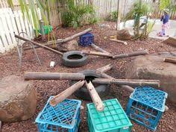
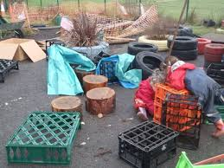
Outdoors in P1 at Greenrigg
We are currently developing our outdoor space.
It is hoped that eventually, this space will be fully and openly accessible to the children at all times.
In order to do this, we need to ensure that the area is safe and filled with meaningful resources.

Slide 10
Loose Parts Outdoor Play
Loose parts are defined as:
“materials that can be moved, carried, combined, redesigned, lined up, and taken apart and put back together in multiple ways. They are materials with no specific set of directions that can be used alone or combined with other materials.”

Slide 11
Loose Parts Outdoor Play
So far, we have some tyres and cable drums.
To enhance our outdoor loose parts, we need:
Guttering
Wooden planks
Small gardening tools
Pipes
Crates
Logs
Tarpaulin
Can you help us?

Slide 12
A final note…
Outdoor learning should occur in all weathers.
The children are encouraged to be adventurous and explore the outdoors - they might get dirty! We hope that you realise this as an important part of their learning, and they will have had fun!
You can send in spare shoes, waterproof trousers and jackets to be kept in class for your child to use if this is something you are concerned about.

Slide 13
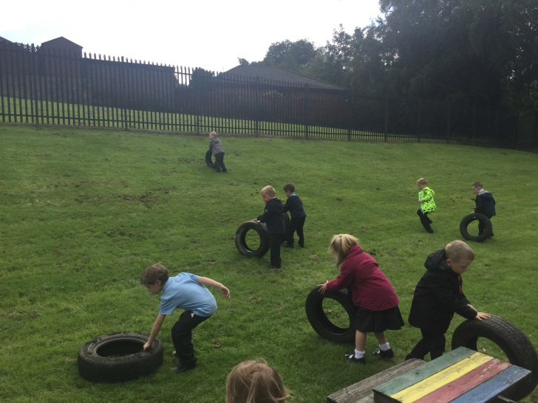
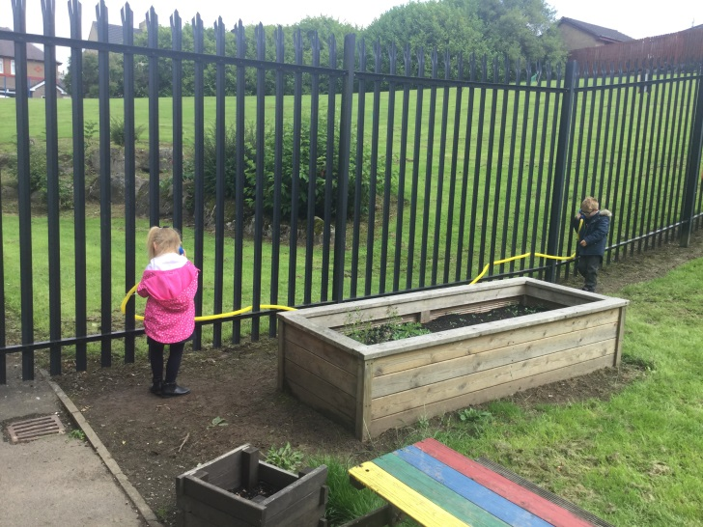
A Few Of Our Outdoor Experiences So Far…
Talking Tubes
Investigating our shadows
Rolling tyres – how fast will they go?
Risk assessment – “Better make sure I don’t bump into anyone!”

