Slide 2
The JRSO’s
Hi we are the Junior Road Safety Officers and our names are Boyd, Taylor , Angeline, Emma and Emma.
Our aim for this school session is to make our roads safer for children to cross to and from school.
And, while it is our aim, it is actually very much linked to our Rights – as you will hear!

Slide 3
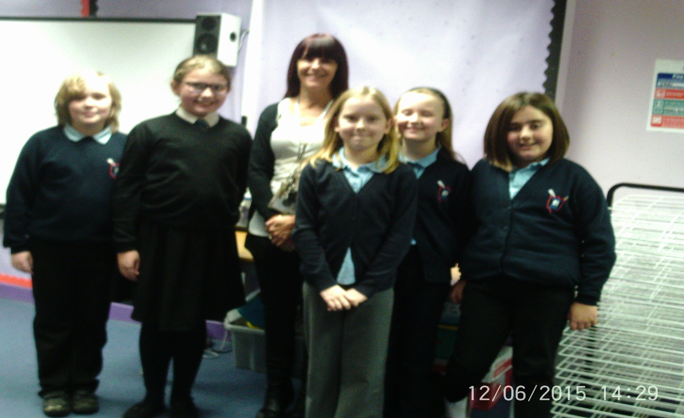
Our Team

Slide 4
Road Safety Week
One of our jobs in promoting road safety is to promote activities during Road Safety Week.
We were very busy during road safety week .
We were in the nursery and all of our classes in the school - teaching the children about the Green Cross Code .
We took primary 1 and 2 outside to teach them how to cross the road safely.
We read books and played road safety games with our other classes .
We also ran a competition to design a road safety mascot for our school.

Slide 5
Counting cars…
Last year on Road Safety week (17th to the 23rd November) we counted vehicles outside our school gates .
The Overall total was 133 vehicles in the Morning, 16 at lunch and 159 in the afternoon.
This is a huge concern for us as this is a massive amount of cars parked outside our school . Causing serious congestion!
We have counted the cars this year again for our road safety week and our total for the week are …
142 cars parked in the morning ,27 in the afternoon and 186 cars parked at home time. As you can see an increase on last year – despite our school role staying the same!!
Our most amazing figure for one day was 57 cars parked on a Friday at home time. Friday is by far the busiest day! And the most dangerous!

Slide 6
Our Campaign
Last year our J.R.S.O’s wrote to Mr George Paul, our local councillor, to ask him to help us get double yellow lines on the road outside our school to make it safer to cross .
We were contacted by West Lothian Council, about this matter, and were informed that because Polkemmet Road has houses, it is a restricted area and we were refused the double yellow lines.
Our J.R.S.O.’S also campaigned, along with the Parent Council, about the traffic problem on the main road and the difficulties in getting children safely across from Bailie Avenue. Unfortunately, again, there seems to be very little that West Lothian Council can do to help us. Apparently the number of children who live there is too small! Surely every single child is important!!!
As the new J.R.S.O’s in Greenrigg the campaign will go on to try and solve these issues with road safety.
We took photos of cars parked outside our school to show how hard it is to cross the road…

Slide 7
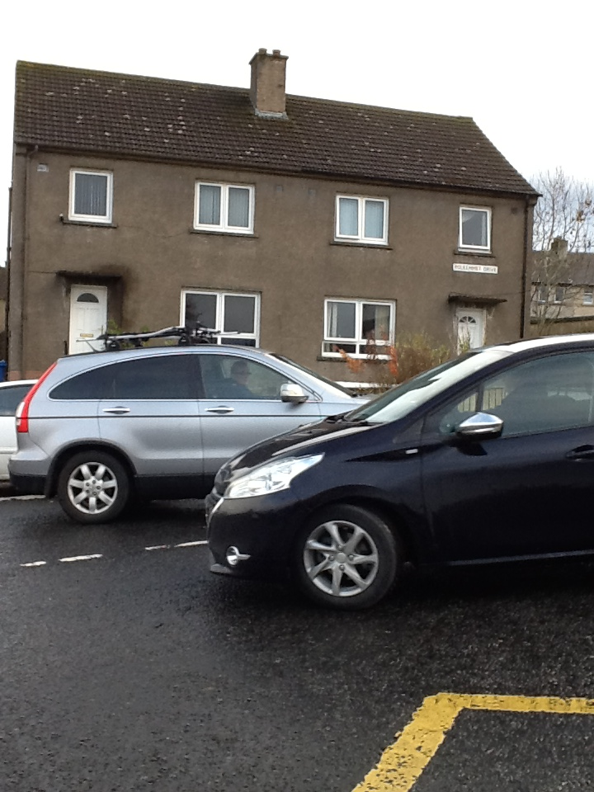
Cars blocking the road - an everyday occurrence!

Slide 8
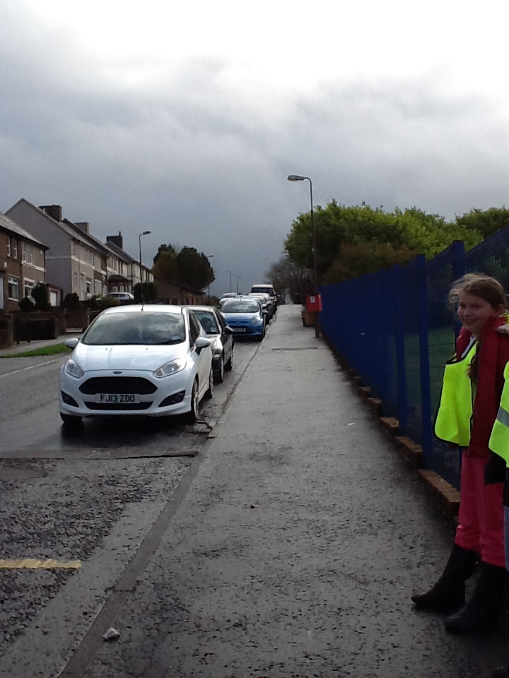
Restricted view when looking right and when looking left!
Our road outside school

Slide 9
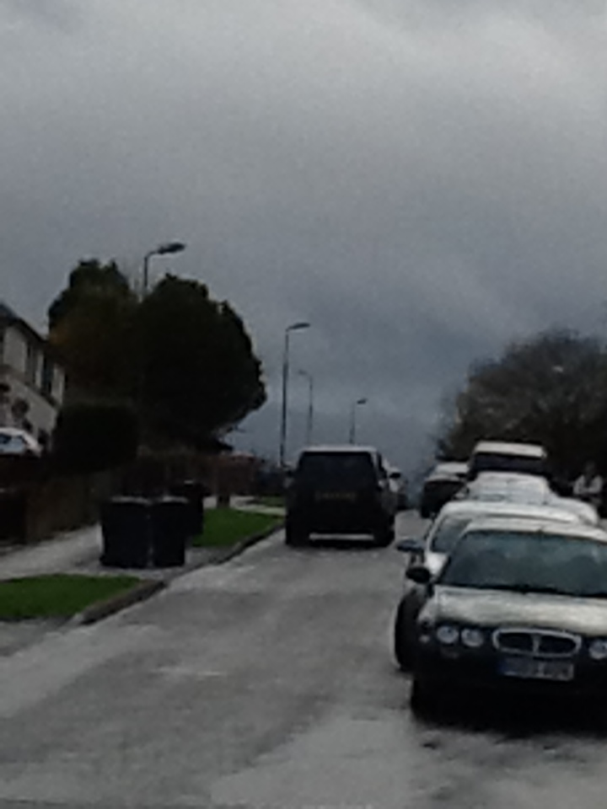
This car is blocking the road

Slide 10
Traffic outside our school gate
As you can see we can’t possibly follow the Green Cross Code – we don’t have any choice but to walk between parked cars!

Slide 11
Safety on Polkemmet Road
As you can see from our photographs, parking on the road outside our school gates, makes it unsafe to cross without an adult.
The cars are parked on the hill restricting any child’s view from the right.
And just to remind you - cars park straight across from the school gates mean we have to cross between parked cars and this is not following the green cross code .
We are asking all parents and guardians to keep us safe (and healthy) and let the children of Greenrigg walk to school.

Slide 12
Our Aims for this year:
To promote sustainable travel to or from school (healthy, no or low cost, low pollution)
To get more children cycling and scooting to school
To make sure all the children in our school know how to cross safely
To keep campaigning for a safer crossing
To keep our notice board up to date with information on issues about road safety
To complete our travel action plan and share this with everyone in Greenrigg

Slide 13
Travel Action Plan
We have been working closely with Mrs Gibson and Miss Benson to begin to create a Travel Action Plan for our school
We have been looking at ways to cross safely and keep healthy by walking, biking or scooting to school
This is going to be a big thing on our agenda and we are hoping to promote this at our assembly
We are looking at ways to get every child to walk to school and we have registered with the WOW campaign (Walk once a Week)
We did a survey in September
Our hands up survey school results were :
56% walked
32% car
7% park and stride
Our target is to have almost all children walking at least once a week!

Slide 14
Children’s Rights
We are a rights respecting school and feel that our rights are not being respected -
The United Nations Convention on the Rights of the Child states:
‘the government must make sure that all children grow as healthy as possible, can learn at school, receive protection and have their views listened to, and are treated fairly.’
We urge you to listen to our views!!

Slide 15
Rights of the Child:
Article 3: The best interest of the child must be a top priority in all things that affect children.
We can’t cross safely - this is affecting our rights for our safety.
Article 12: Every child has the right to have a say in all matters affecting them, and to have their views taken seriously.
Our views are that the road outside our school is unsafe – we want to be able to cross safely
There are too many cars parked
Please take our views seriously

Slide 16
Our rights
Article 31: Every child has the right to relax, play and take part in a wide range of cultural and artistic activities
We have a serious problem crossing from Bailly Avenue ,this restricts us from joining our friends to play and join other activities
Surely we should be able to play with our friends!

Slide 17
Thank you
We know that we have a great deal to do to persuade adults to keep us safe
We would like to thank you for giving us the opportunity to share our concerns, and our hopes for every child in our school
We now need you to support us…

Slide 18
And now over to you…
Questions
Comments
Feedback

