Slide 1
Guidance for Video/Audio in PowerPoints
1. Open the folder and copy all the files.
2. Paste the copied files into a new folder.
3. Open the PowerPoint file, enable editing and enter presentation mode (start the slide show). Go to slide 3 and the backing track will start automatically.
Please note the embedded audio may not be compatible with early versions of PowerPoint.
You may wish to delete this slide before beginning the presentation.

Slide 3
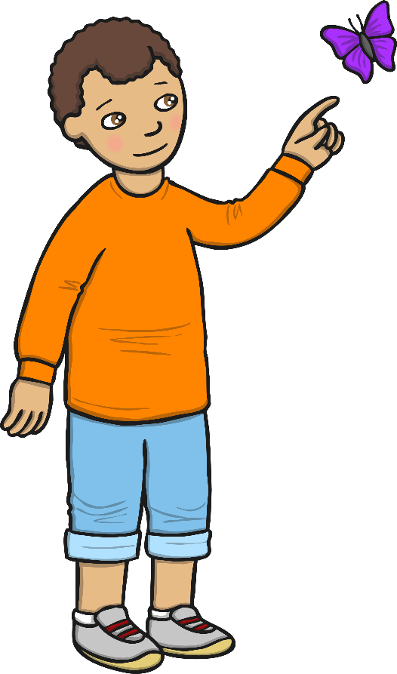
On my face I’ve got two eyes,
I use them every day!
I use my eyes so I can see,
When I work and play!
With a look, look here,
A look, look there,
Here a look, there a look,
Everywhere a look, look!
On my face I’ve got two eyes,
I use them every day!

Slide 4
On my face I’ve got a nose,
I use it every day!
I use my nose so I can smell,
When I work and play!
With a sniff, sniff here,
A sniff, sniff there,
Here a sniff, there a sniff,
Everywhere a sniff, sniff!
On my face I’ve got a nose,
I use it every day!

Slide 5
On my face I’ve got a mouth,
I use it every day!
I use my mouth so I can taste,
When I work and play!
With a chew, chew here,
A chew, chew there,
Here a chew, there a chew,
Everywhere a chew, chew!
On my face I’ve got a mouth,
I use it every day!

Slide 6
On my head I’ve got two ears,
I use them every day!
I use my ears so I can hear,
When I work and play!
With a listen, listen here,
A listen, listen there,
Here a listen, there a listen,
Everywhere a listen, listen!
On my head I’ve got two ears,
I use them every day!

Slide 7
On my body I’ve got two hands,
I use them every day!
I use my hands so I can feel,
When I work and play!
With a touch, touch here,
A touch, touch there,
Here a touch, there a touch,
Everywhere a touch, touch!
On my body I’ve got two hands,
I use them every day!

