Slide 1
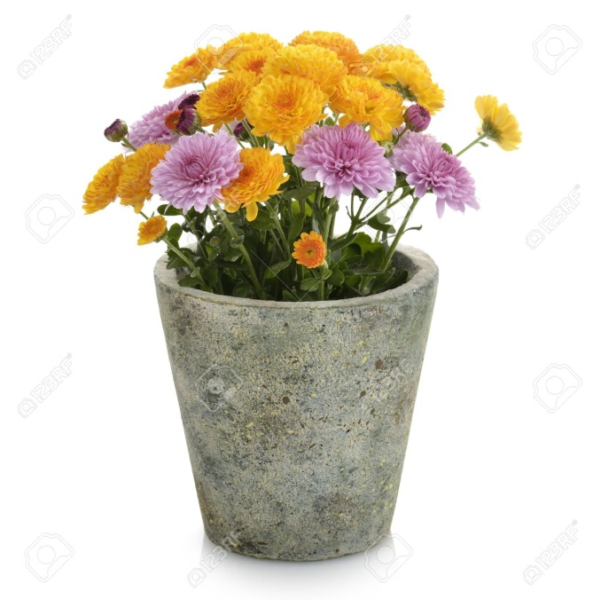
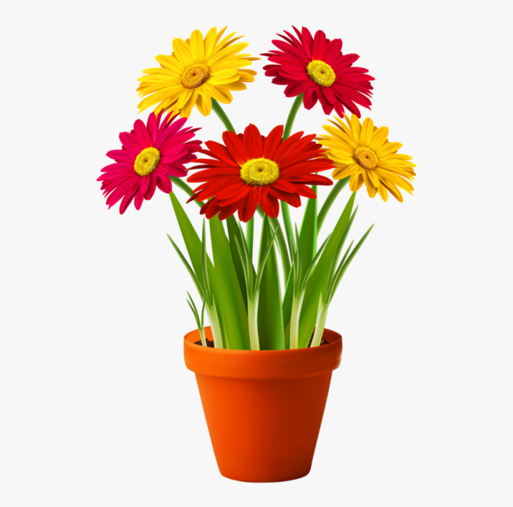
Planting a seed

Slide 2
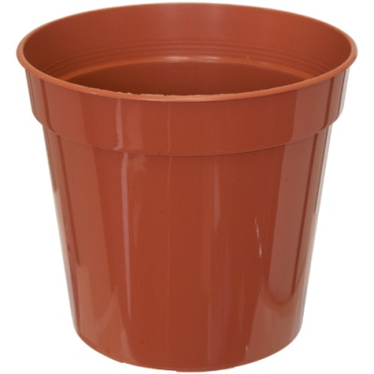
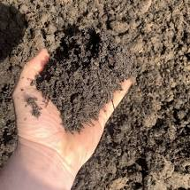
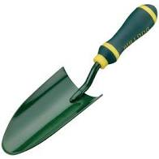
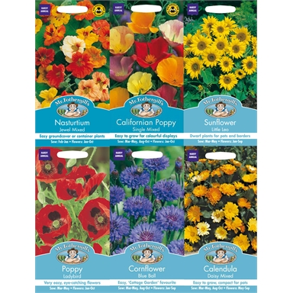
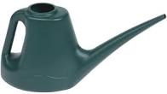
What you will need…
A pot
compost
A trowel
Watering can
seeds

Slide 3
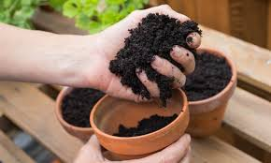
Step 1
Fill the pot half way up with compost.

Slide 4
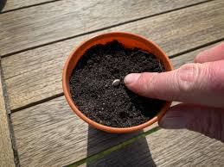
Step 2
Put a few seeds in the compost.

Slide 5
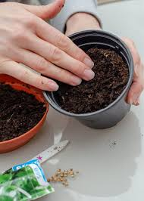
Step 3
Fill the rest of the pot with compost.

Slide 6
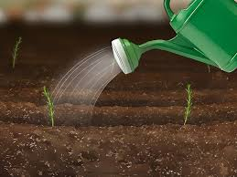
Step 4
Water the pot.

Slide 7
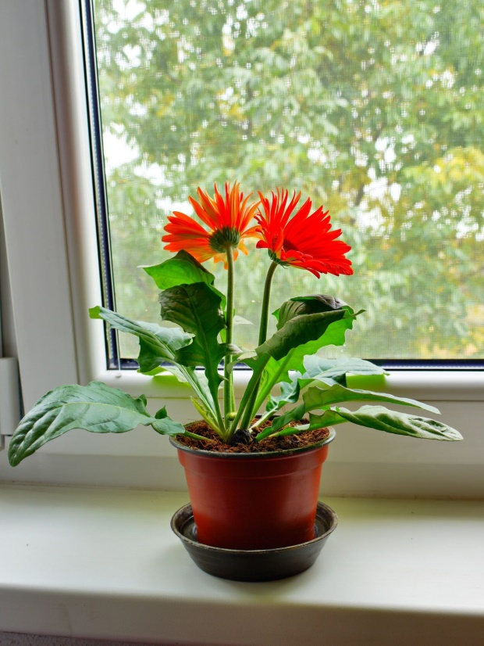
Step 5
Leave in a sunny place for the plant to grow.

Slide 8
Miss Christy’s planting
At the start of lockdown, Miss Christy decided to plant an amaryllis plant in her house. An amaryllis is different from some other plants because you plant it from a bulb instead of a seed. She followed the same steps, can you check if she got it right?

Slide 9
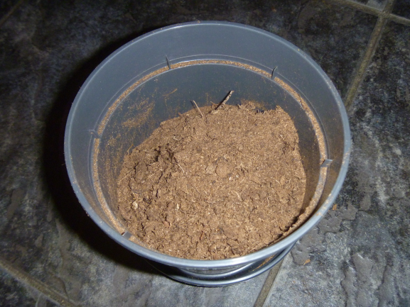
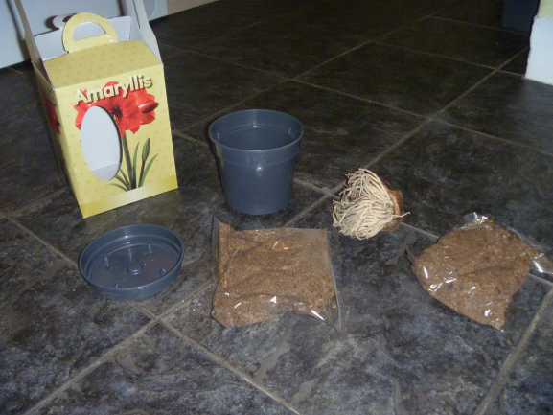
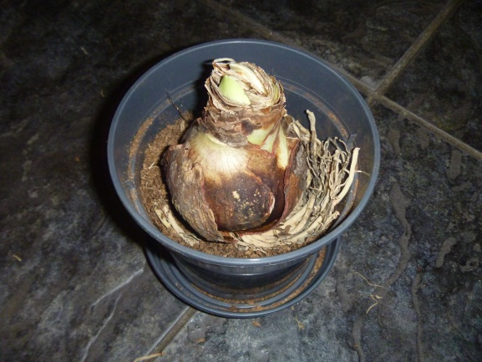
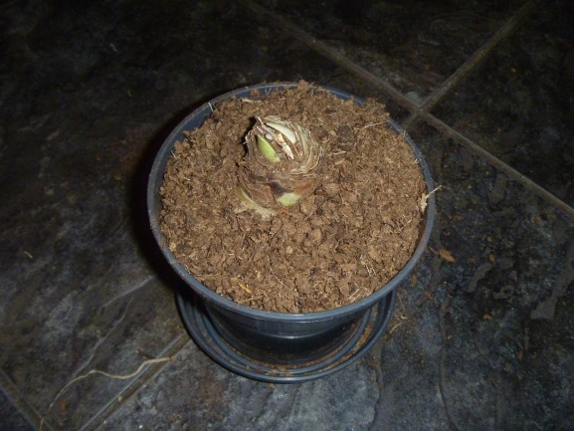
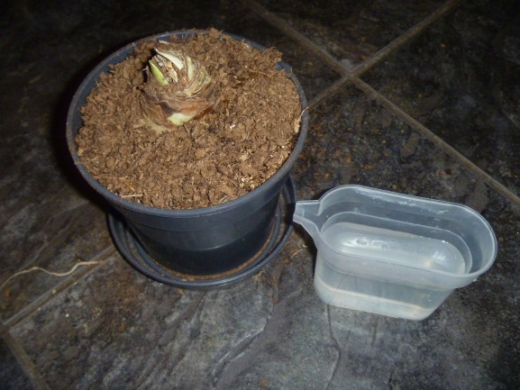
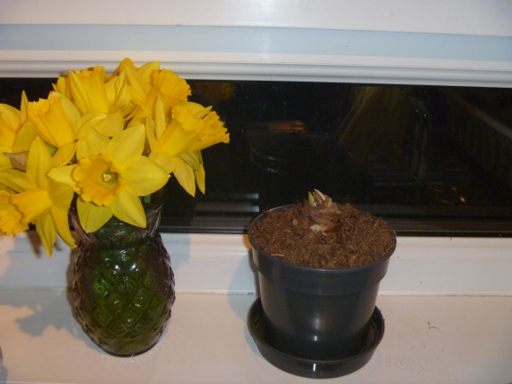
1
2
3
4
5
6

Slide 10
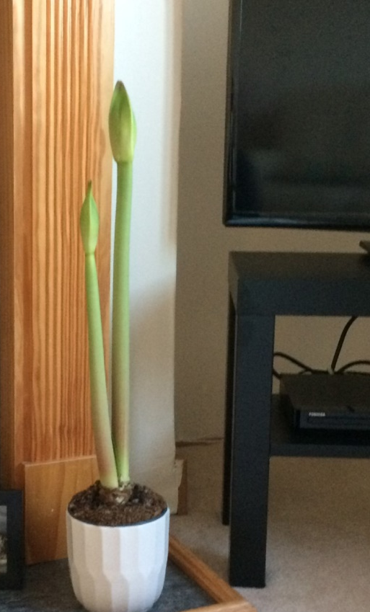
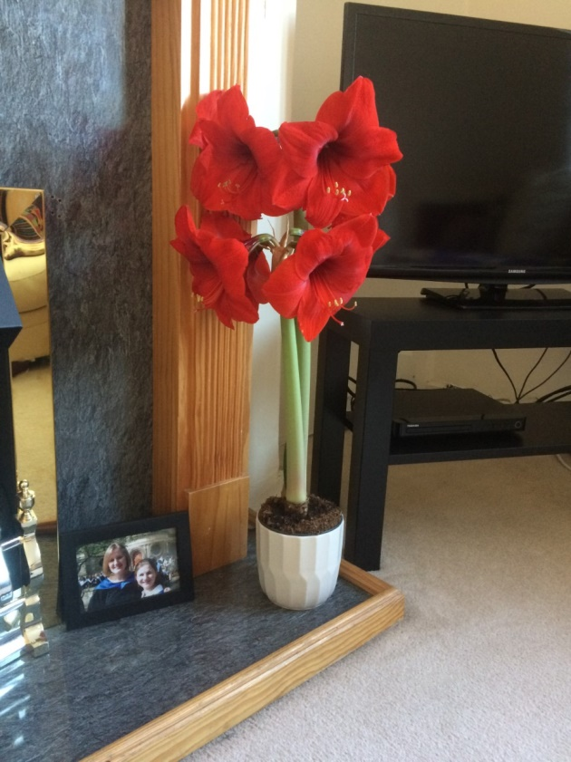
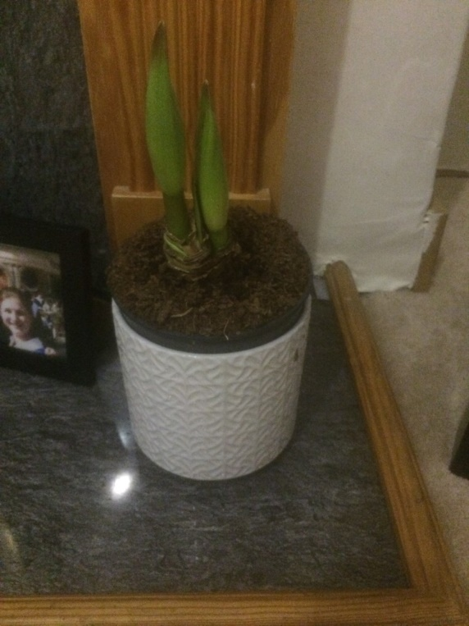
Look at how well it grew!
Week 2
Week 4
Week 6

Slide 11
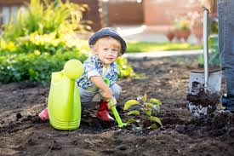
Now it’s your turn…
We can’t wait to see photos of you busy gardening and the finished instructions posted on the Learning Journals.

