Slide 1
Pick it up, please!

Slide 2
A little bit of story behind….
Our class walks to the shops every Wednesday to buy ingredients needed for food technology. During our walks we have noticed a lot of dogs poo laying on the path near school grounds. We came to the conclusion we need to do something.
Together, in the class, we have decided we need to make some posters to support others knowledge how important it is to tidy up after your own dog.
We went to see Miss Clarkson and share our views with her. We got a green light to put posters up on the fence. You can see them when coming into the school.
We would like everyone to help us and make even more posters that we could put up. We ask all the classes to create posters and drop them off at A1 class so we can distribute them round the school grounds.

Slide 3
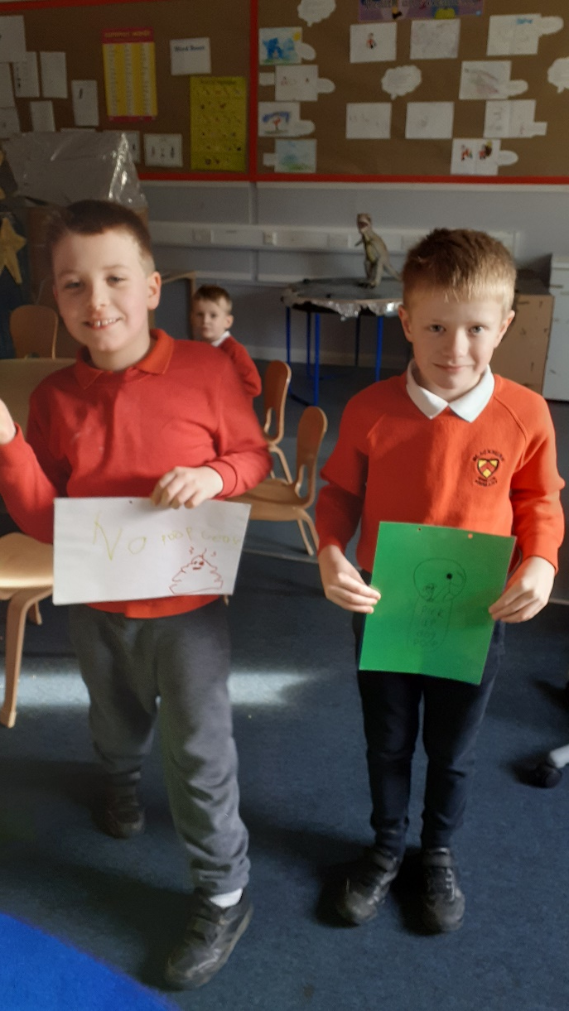
We made posters.

Slide 4
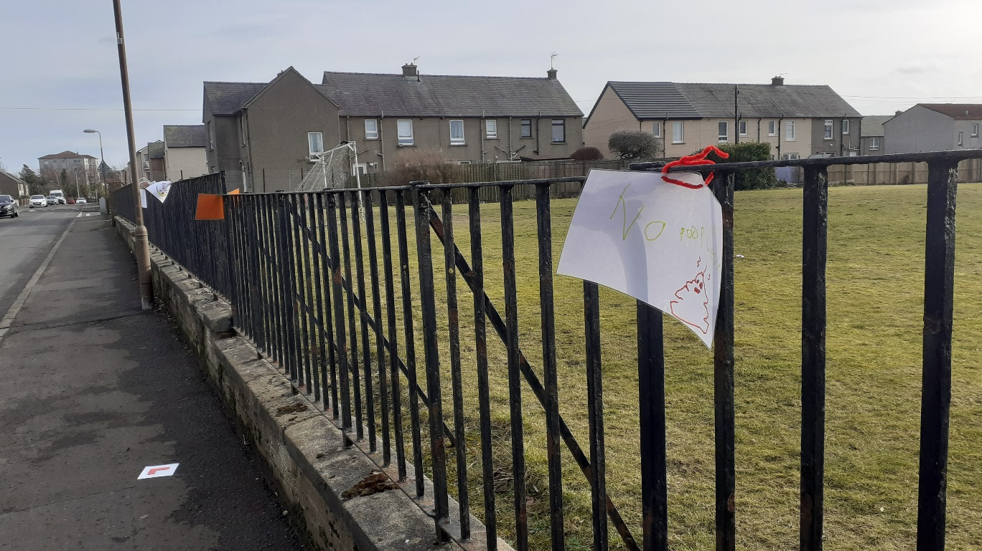
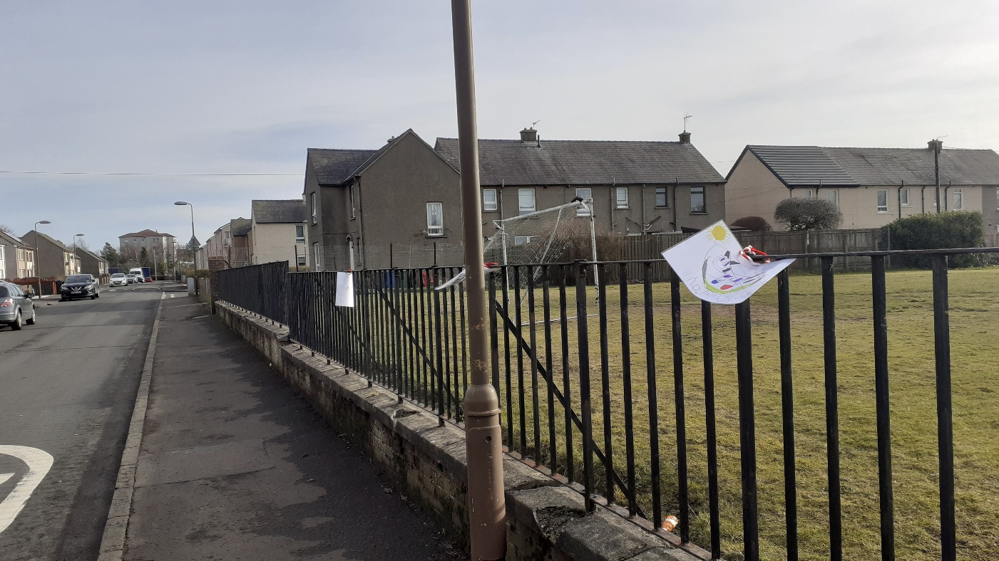
We hang the posters on the school fence.

Slide 5
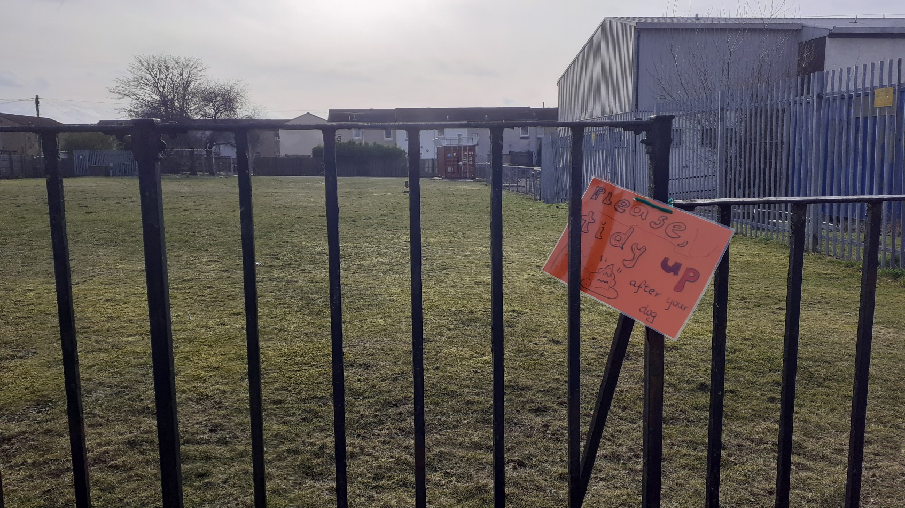
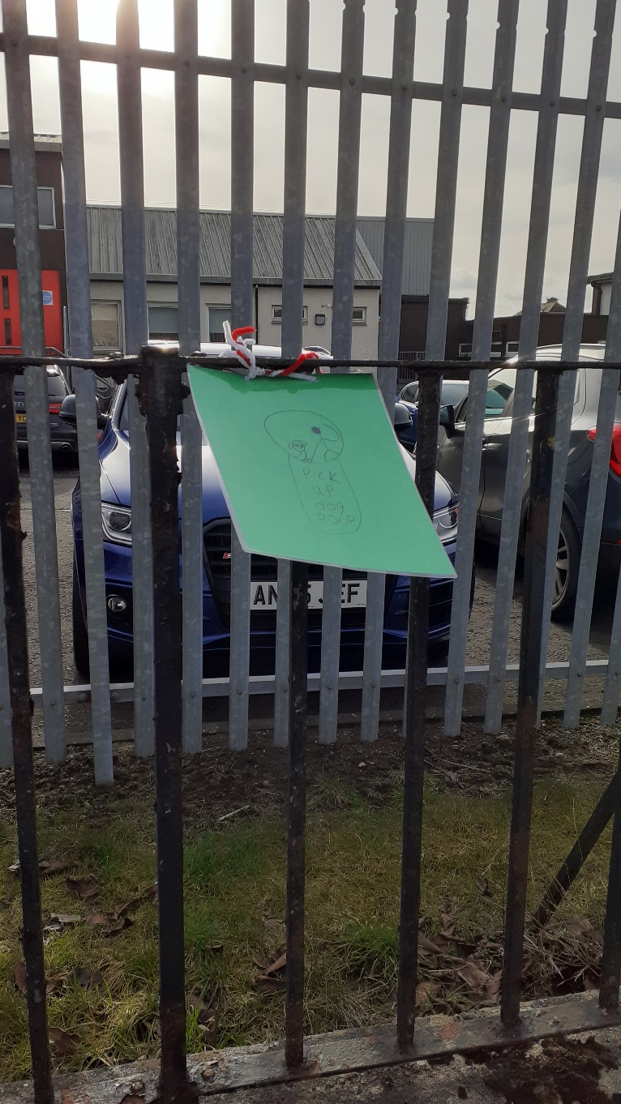

Slide 6
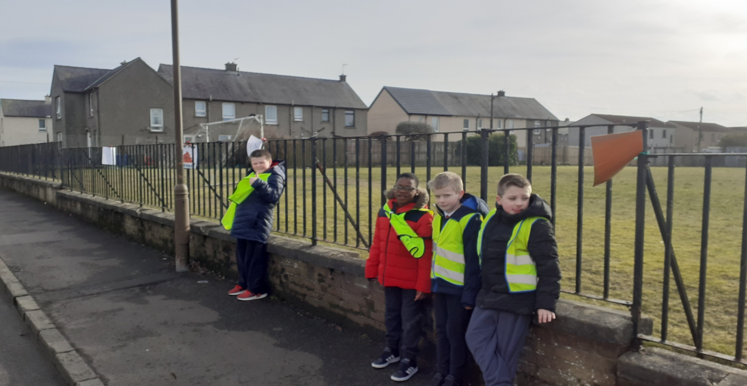

Slide 7
Please remind everyone you know (and have a dog) to always clean up after the dog ☺

Slide 8
Thank you for your support
Nathan, Dean, Jack,
Gabi, Billy & Alex

