Slide 1
The world worst children
By Zoe

Slide 2
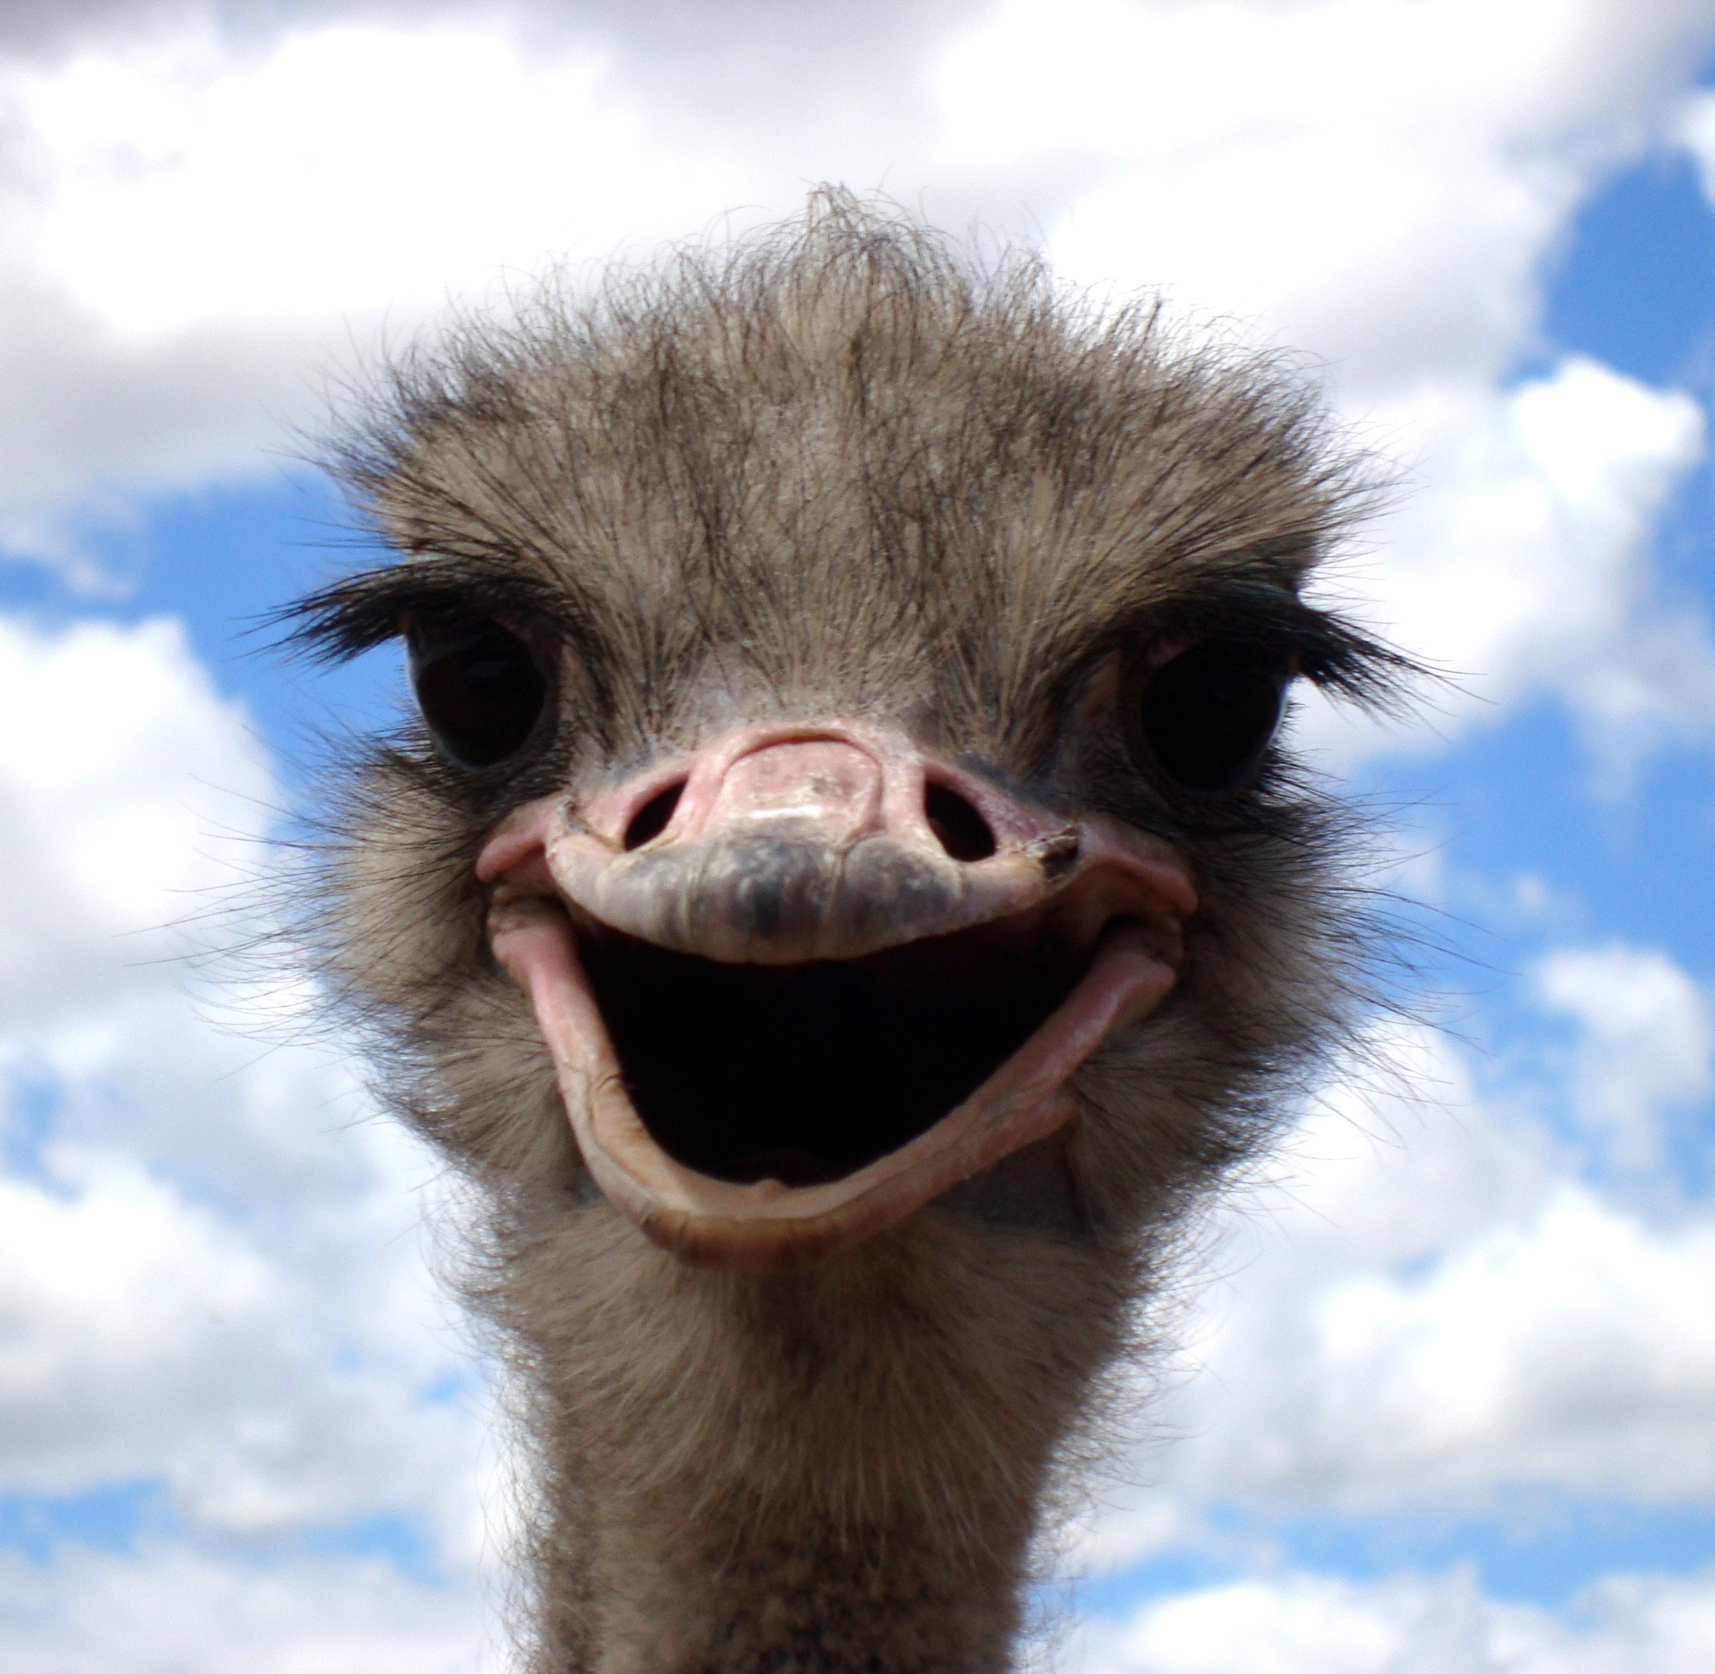
I think the genre of this book is:
Comedy because with my favorite charter she is very funny, and you will find out why the book is funny in my main charter slide

Slide 3
My favourite charter :
My favourite charter is called Bertha the blubber I will show you her.
She is my favourite because she is a bit of a drama Queen and always want stuff her way and she is a MASSIVE CRY BABY my god she will cry ALOT, and she always blames her brother on everything

Slide 4
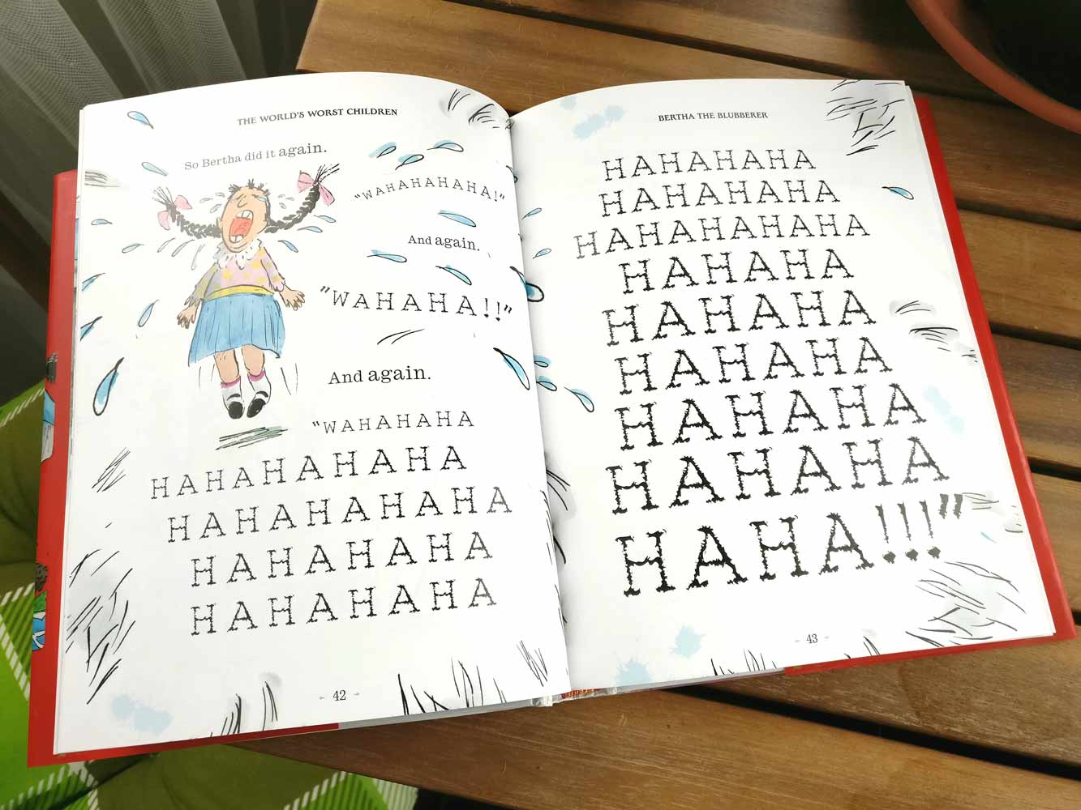
My favourite part:
My Favourite part is when she is up in her room, and she pulled a strand of her hair from her scalp and then she kept pulling and pulling and until she know it all her hair was GONE and of course she looked in the mirror and screamed she ran down the stairs and she was baling her eyes out and then blamed her brother but for her to know her brother was with his mum and dad the whole time and then Bertha got in BIG trouble

Slide 5
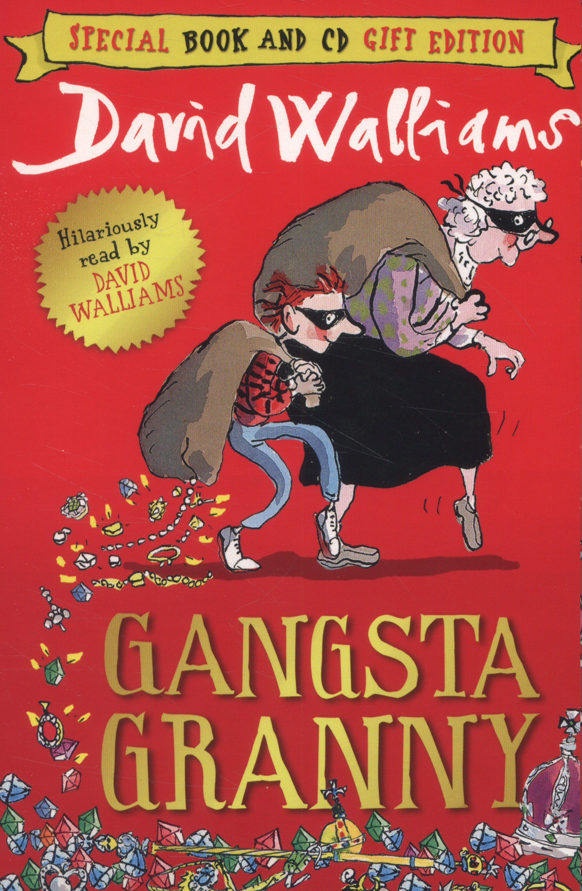
Have I read a same book by the same the author and if not, who would I chose instead:
Yes, I have I like David Williams I have read gangster granny and I am on the 2 world's worst children

Slide 6
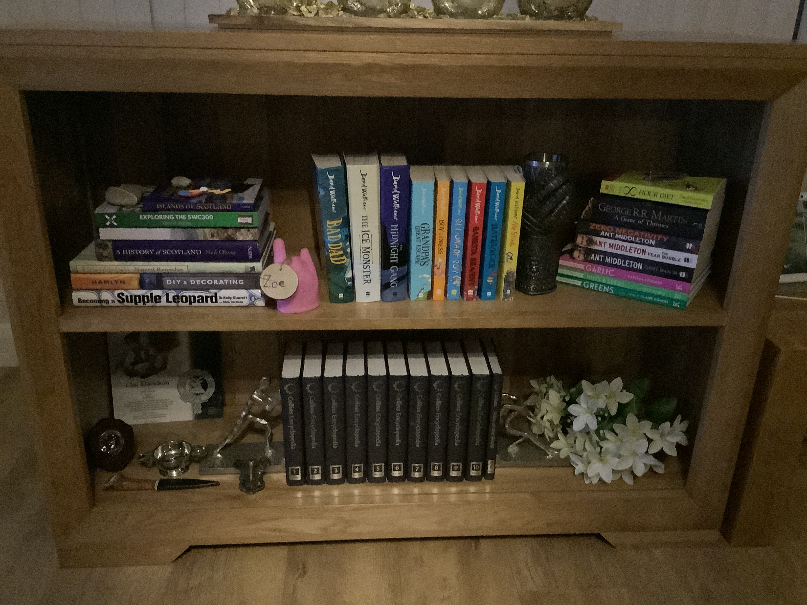
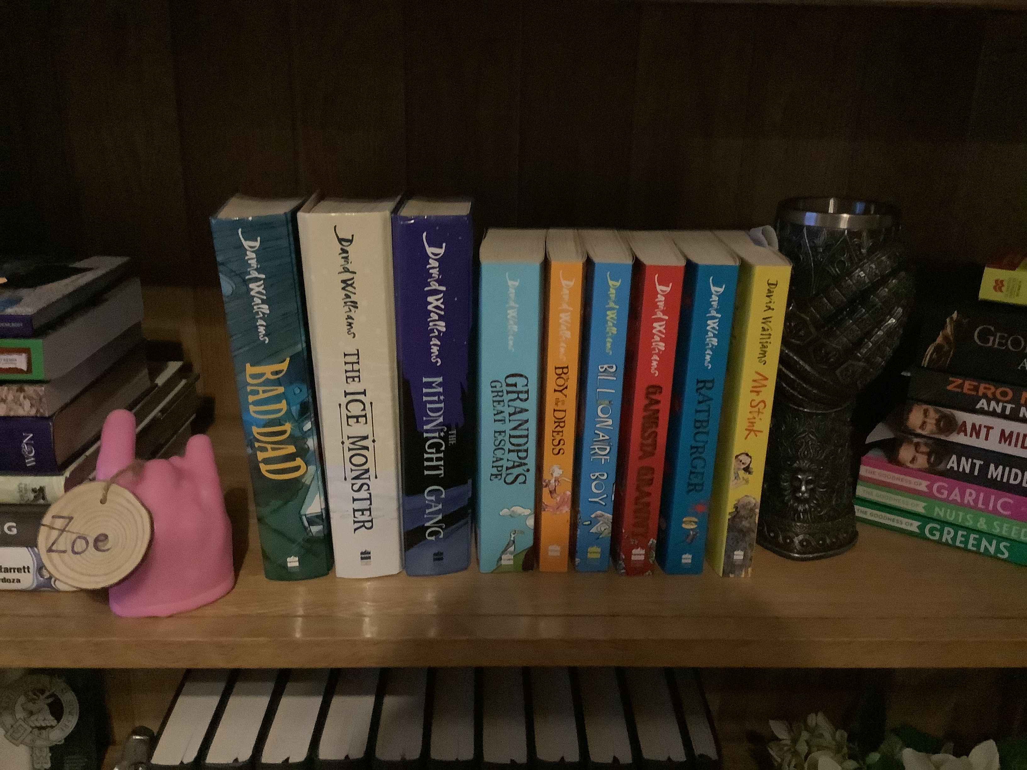
Would you pick the same type of Author again and if not why
Yes! As I said, I really like David Williams books and my dad has technically got the whole bookshelf covered in David Walliams books from small to large here I will show you.

Slide 7
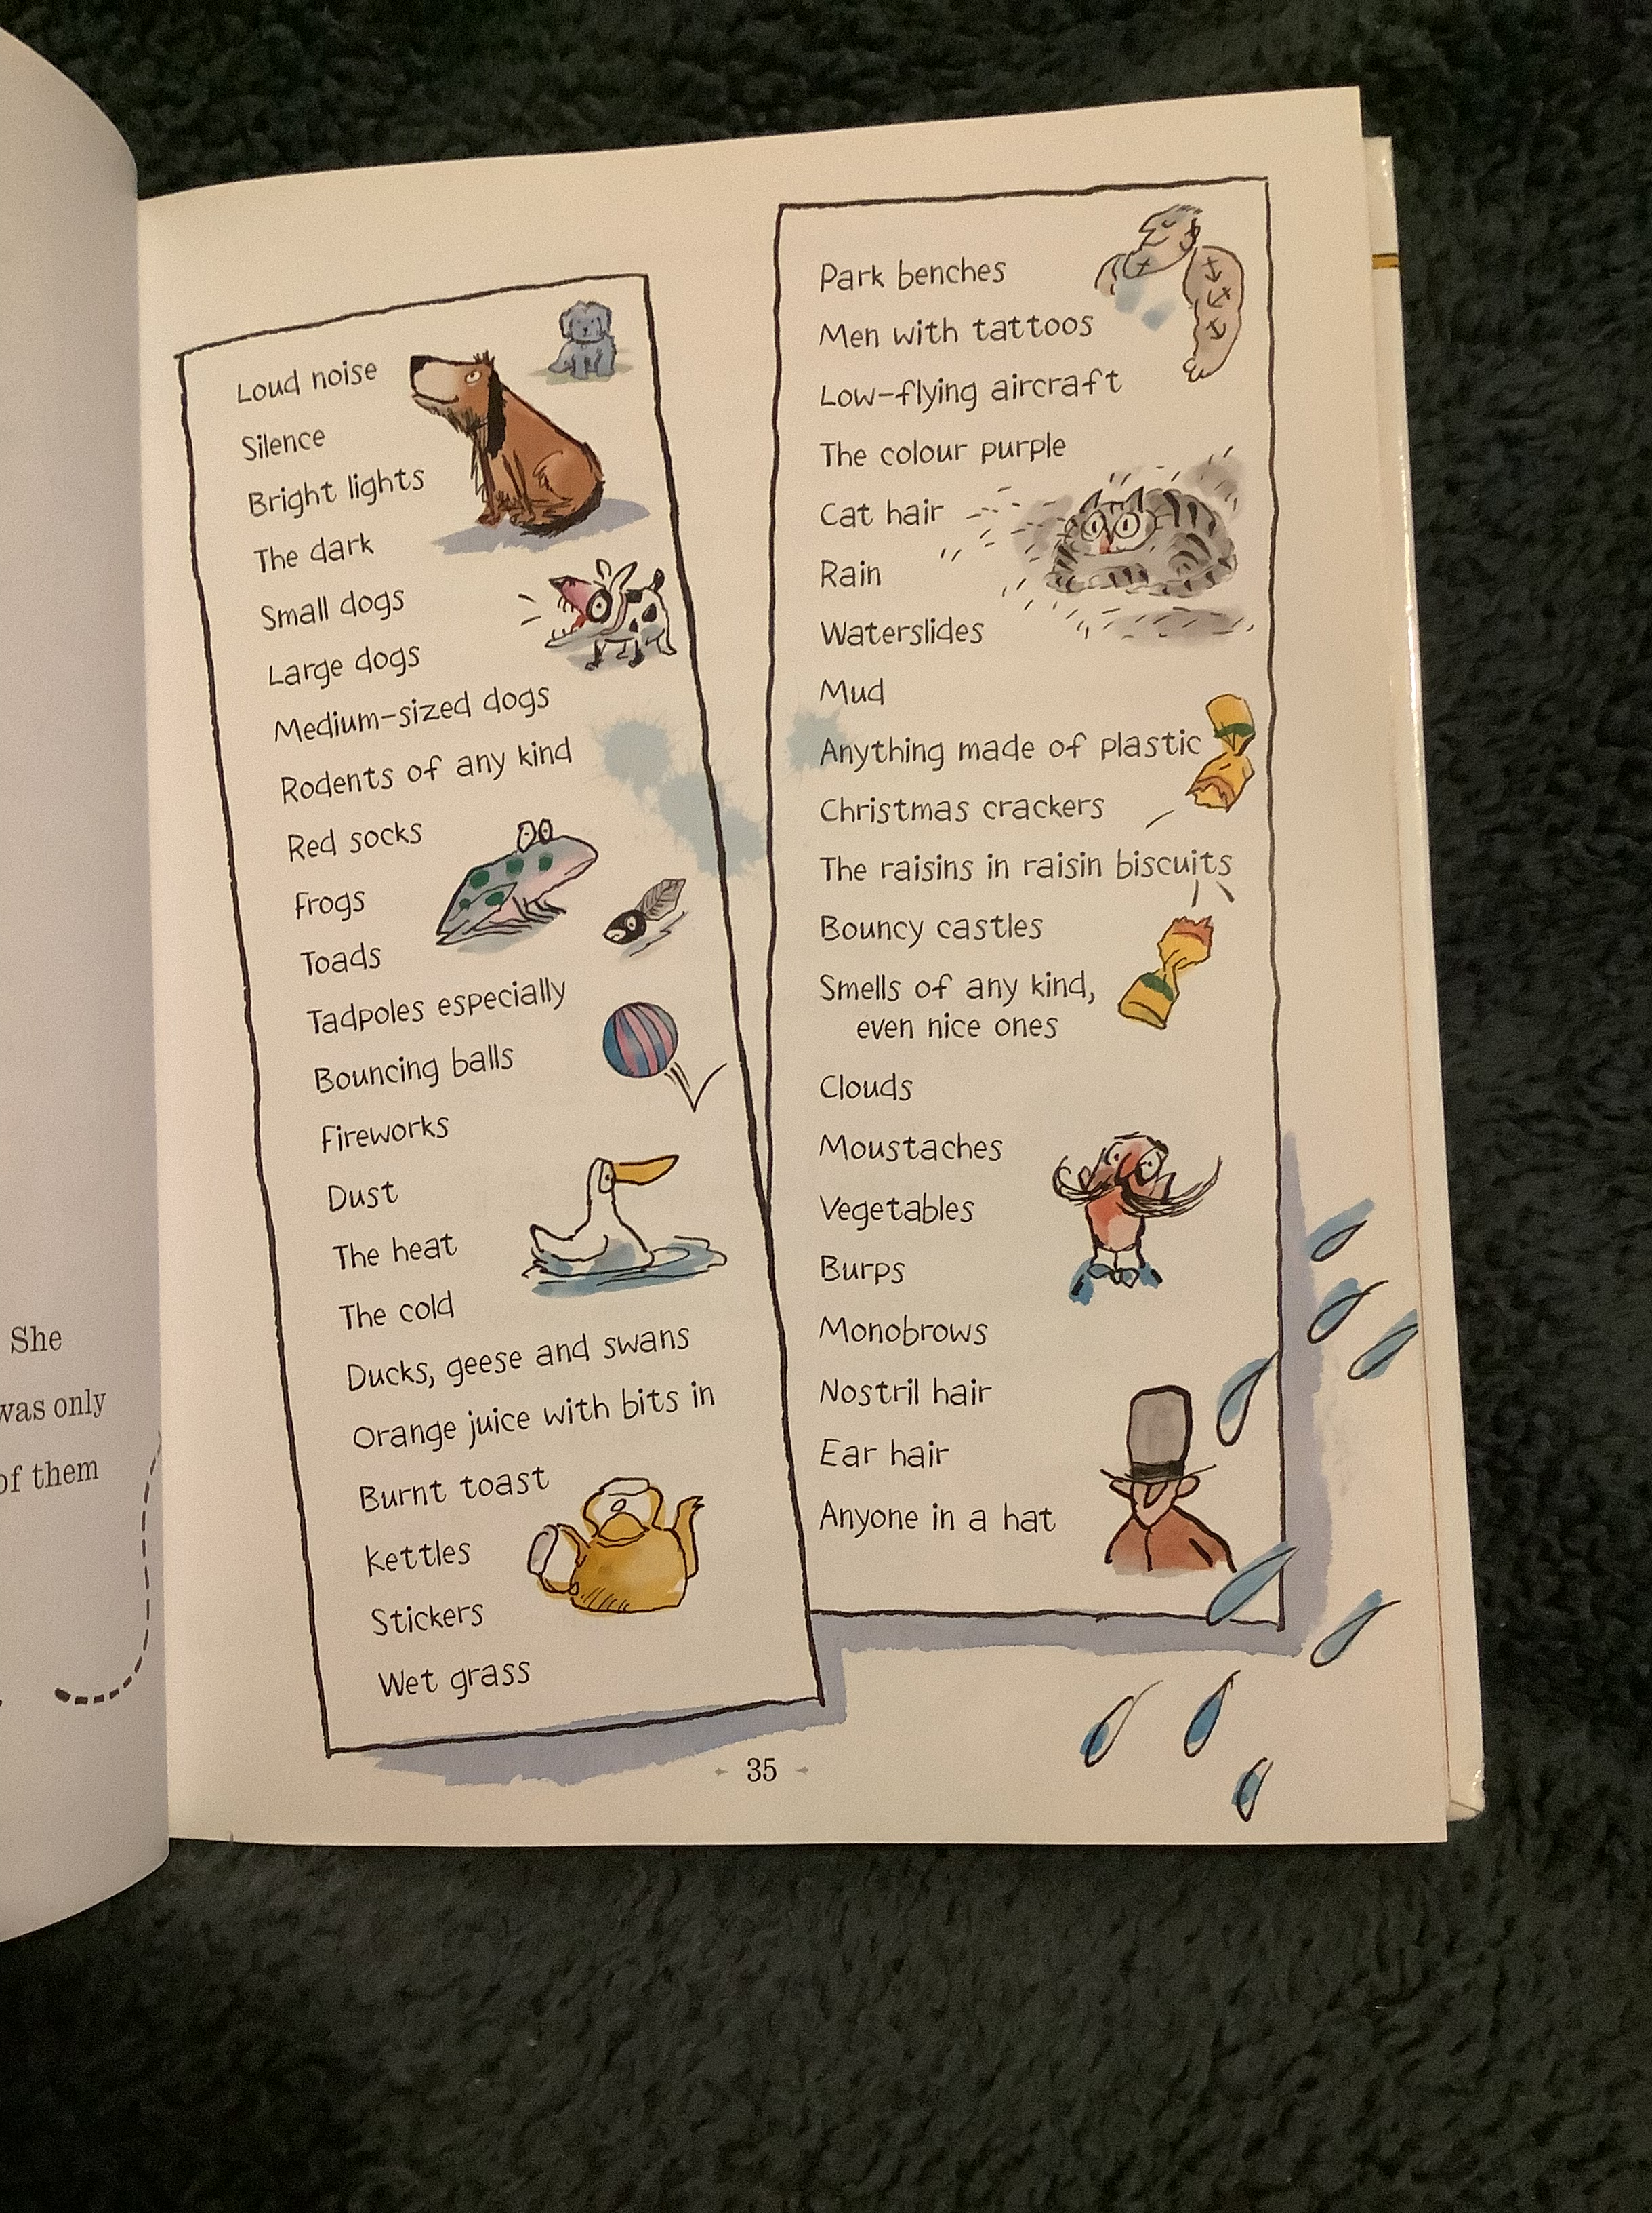
I have a little add on
She has a lot of things she doesn't like such as :

Slide 8
They also have a worlds worst children 3
That's the end

