Slide 1
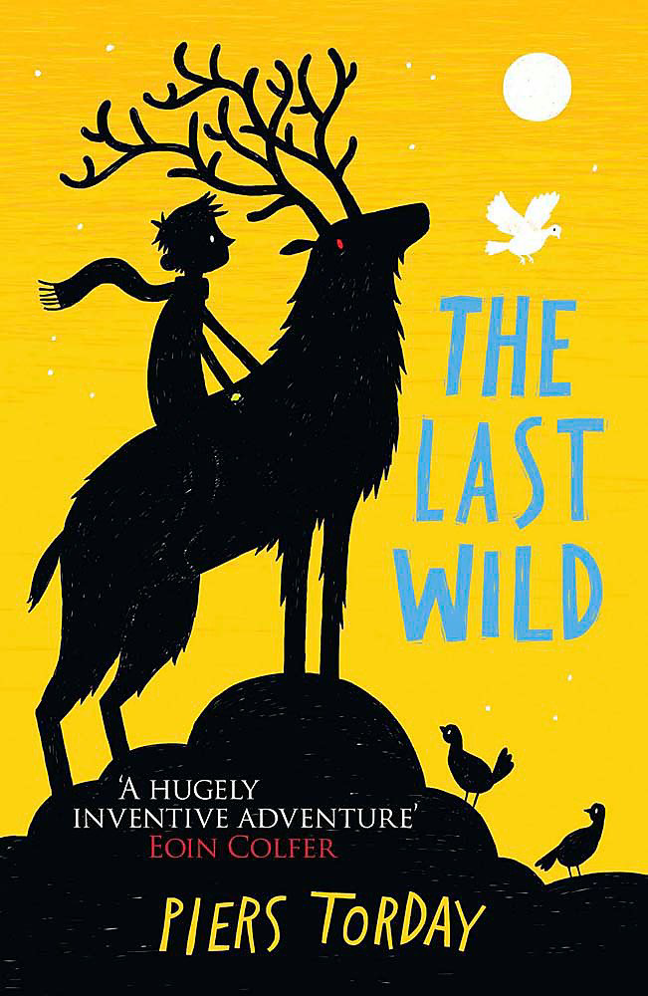
The last wild
This is the book I chose to read. It is called The Last Wild by Piers Torday.

Slide 2
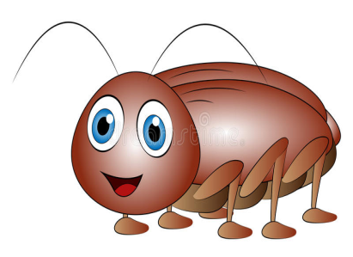
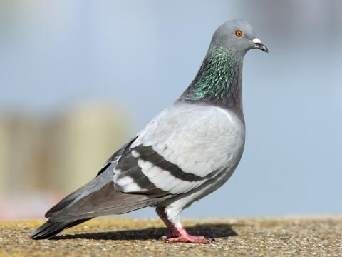
What it is about
My book is about a boy called Kester he is 12(nearly 13) His mum died just before he when to spectrum hall.
He was sent to a troubled kids hall called “ spectrum hall” for an unknown reason at a young age.
The world is in a lockdown because of a creature called the red eye that has killed most of the living creatures in the world except Birds, insects and some humans.
Kester thinks he is hallucinating when the pigeons and cockroaches talk to him by trying to help him escape spectrum hall (he’s not they are really talking to him)

Slide 3
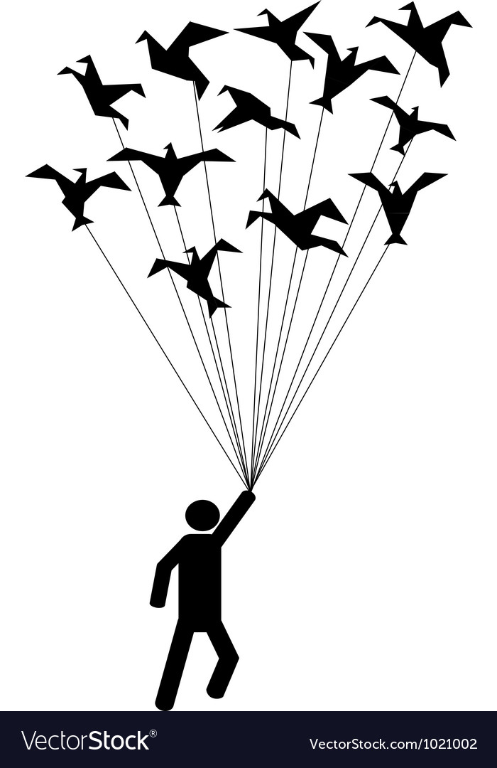
My favourite part
My favourite part is when Kester try’s to escape spectrum hall and he gets led to the edge of a cliff by the hall doctor and Kester falls off the cliff and the 151 pigeons catch him and help Kester escape.

Slide 4
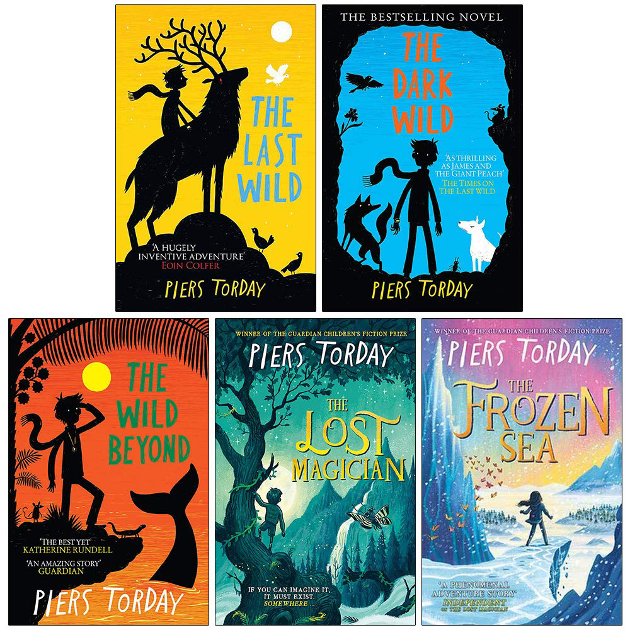
Why I chose this book
I chose this book because Mrs Dunlop told the class about it after she read the book at E.R.I.C time
I was also interested in the blurb because it sounded dramatic
No I have not read a book by the same author but I would like to another time.
I would like to read another book like it because I enjoyed this one so much.
The genre of the book is adventure.

Slide 5
Thank you
Thank you for listening and hope you enjoyed hearing about my book

