Slide 1
Your Task
1.DOWNLOAD this PowerPoint
2. Read slides 3-8 and watch any clips found on the slides
3. Go to Slide 2
4. Give yourself a score 1-5 for each skill (5 is the best)
5. Click on each skill. Add your score and 1-3 sentences explaining why you gave
yourself this score. See example below:
Independent Learning
Collaboration – 4
I often work well with a partner or in a group. I listen to other people’s ideas as well as contributing my own. I think I could work with pupils from other schools more often.
Communication
1
2
3
3
4
1
5
1
2
3
4
Creativity
Critical Thinking
5
Leadership

Slide 2
Independent Learning
Collaboration
Communication
1
1
1
2
2
Critical Thinking
3
Creativity
3
3
4
4
5
5
Leadership

Slide 3
Independent Learning
Complete an independent task or activity by knowing how, when ,and where to get help (i.e. you don’t rely on teacher guidance all the time).
https://www.youtube.com/watch?v=3EYRa_GtQPI

Slide 4
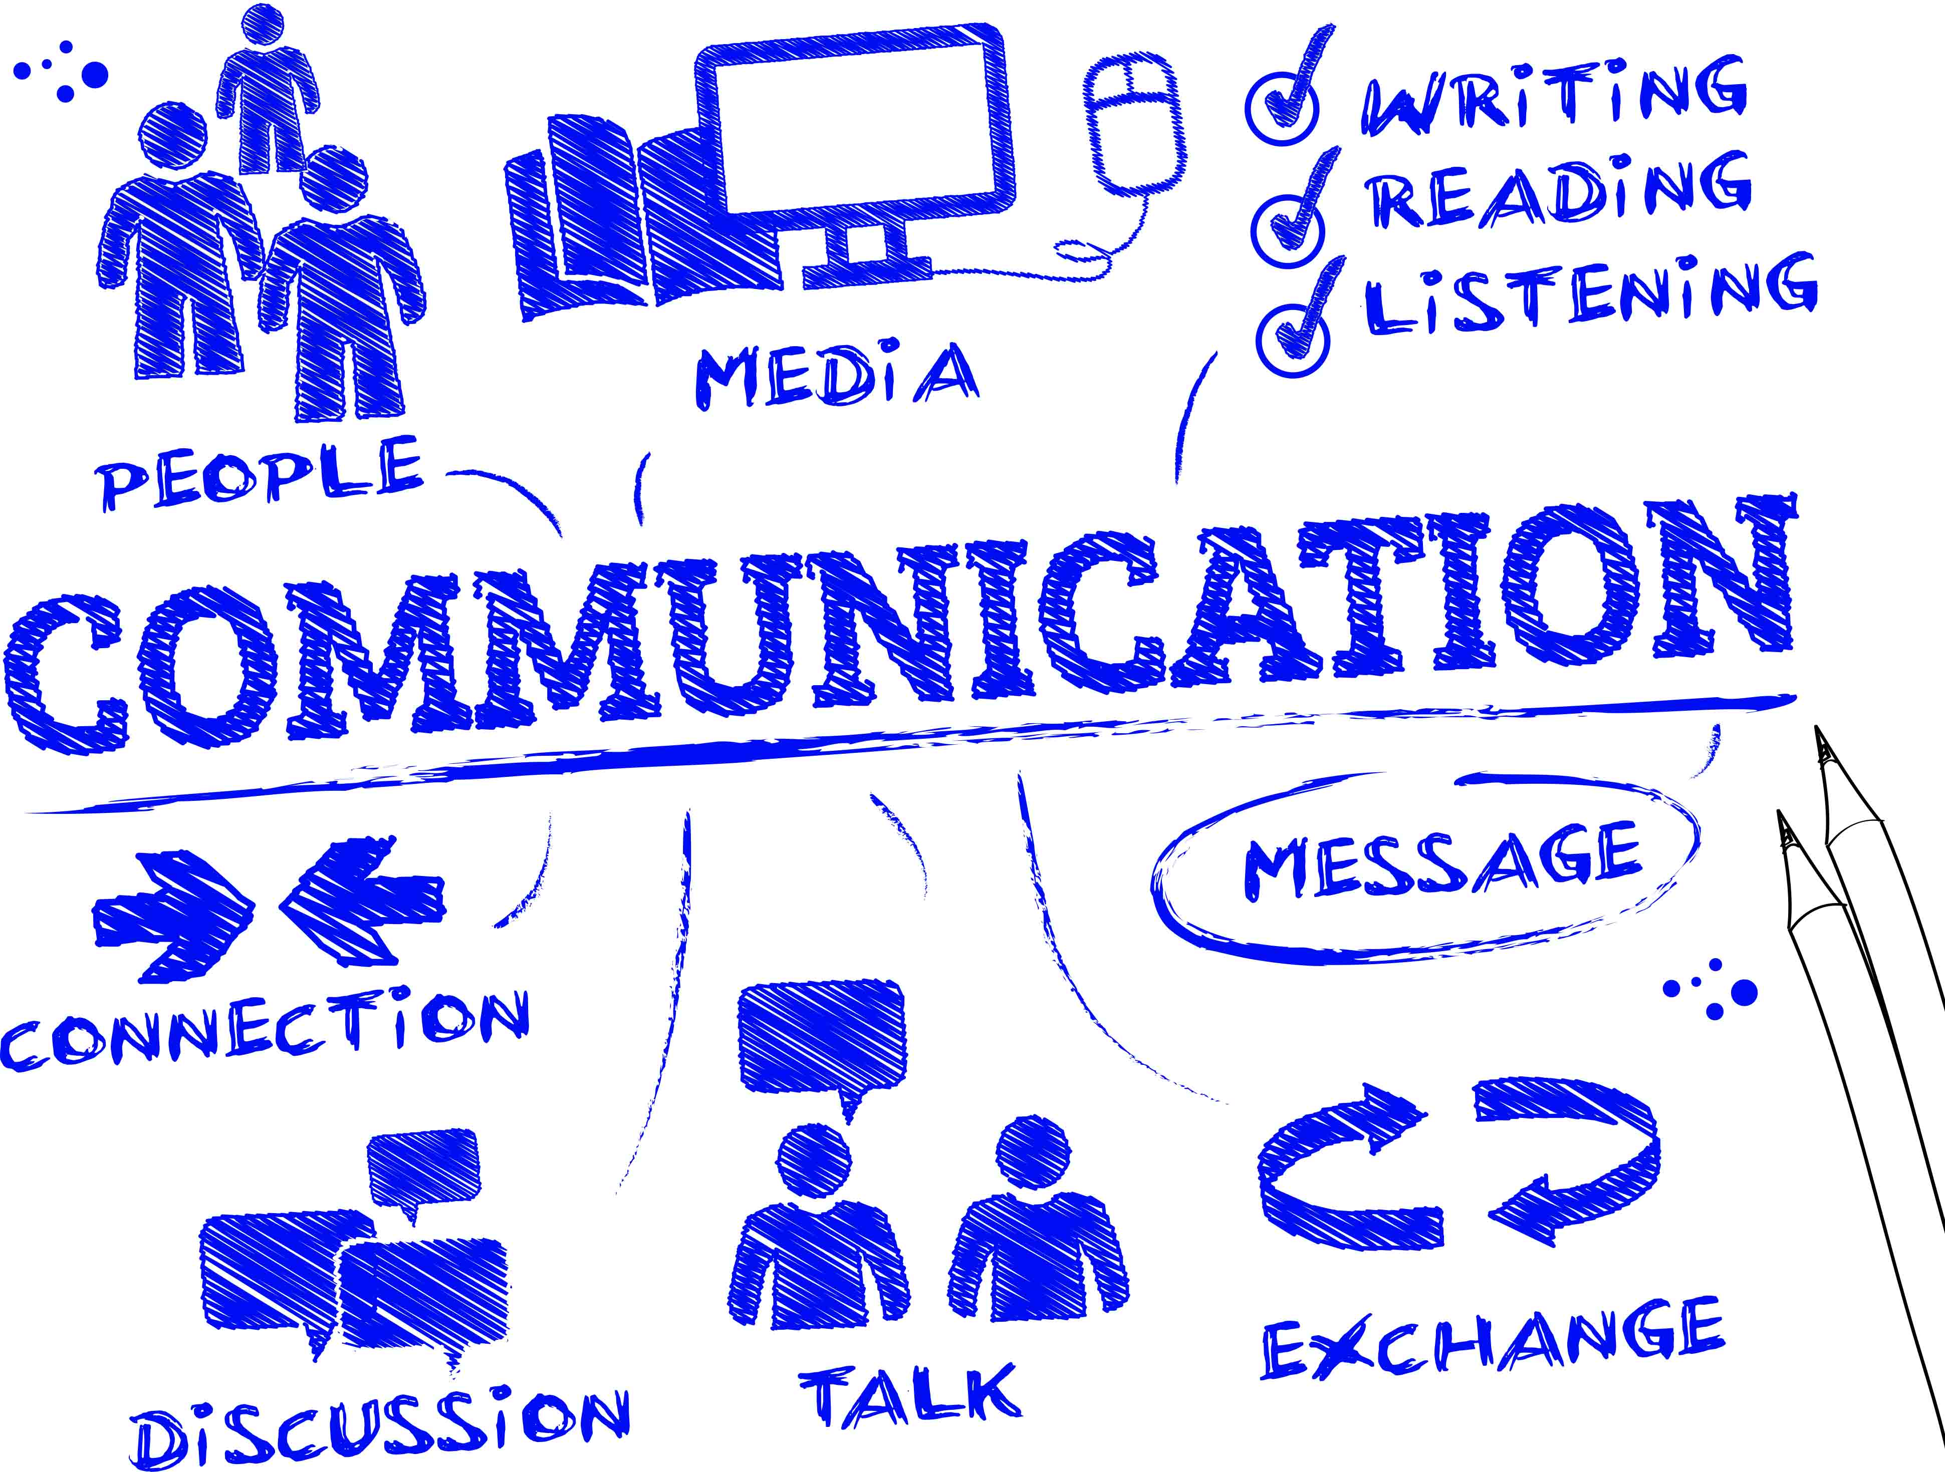
Communication
Accurately transfer information from one place [or person] to another.

Slide 5
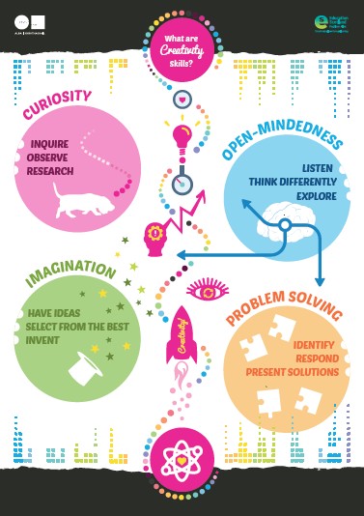
Creativity
Use your knowledge and skills imaginatively and in a productive way (i.e. when something new is made, performed or imagined.)
https://www.youtube.com/watch?v=MTCOExd0hDk

Slide 6
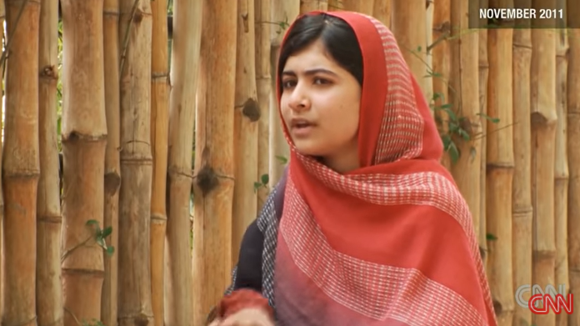
Leadership
Lead or influence people in a positive way to achieve a common goal.
https://www.youtube.com/watch?v=NIqOhxQ0-H8

Slide 7
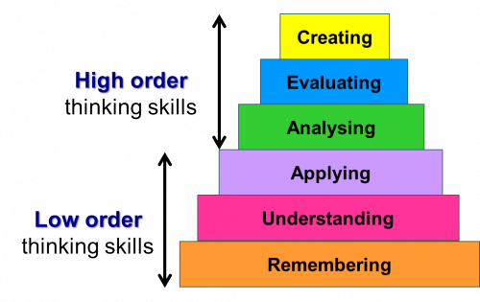
Critical Thinking
Use your higher order thinking skills to get to a solution, develop a strategy or make a proposal.
What is Critical Thinking?
https://www.youtube.com/watch?v=HnJ1bqXUnIM

Slide 8
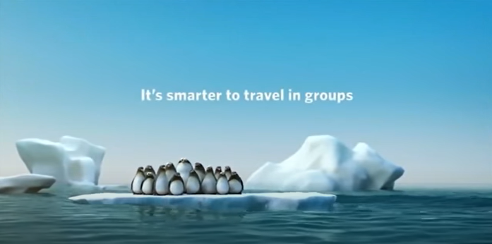
Collaboration
Work together on a problem or a task: pairs, groups or teams collaborate to achieve common goals.
https://www.youtube.com/watch?v=ZnjJpa1LBOY

