Slide 1
Hello and welcome ladies and gentlemen! Today we will show you what we have been up to for the 4th inspire challenge!
-all pictures belong to 6/7 don’t copyright us! Please.

Slide 2
As you can see this is our list of our amazing ideas in 6/7! Onto the next slide!

Slide 3
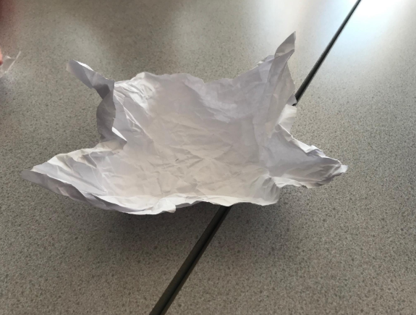
This is one of our marvellous students creation.

Slide 4
This is a student making a creation! Amazing, right?

Slide 5
Here are some more students and their creations!
-again these are 6/7 pictures don’t copyright me!

Slide 6
These are one of our students shoes!
-not too sure where the paper is….IT DISSAPERED!

Slide 7
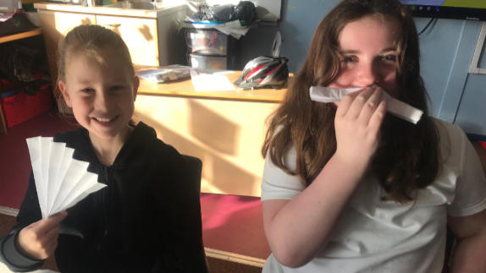
SOME MORE OF THESE AWESOME CREATIONS HERE!

Slide 8
Almost done! The last couple of pictures await you!

Slide 9
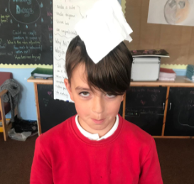
The last picture…good job you got through it!
-for the LAST TIME! All pictures belong to 6/7 DON’T COPYRIGHT ME

Slide 10
THAT WAS THE END OF THE 4TH INSPIRE CHALLENGE…BUT NOT THE END OF OUR JOURNEY.
-for the last LAST time all picture belong to 6/7 DON’T COPYRIGHT ME PLEASE!

