Slide 1
P1/A1 French 3rd June 2020
Les jours de la semaine

Slide 2
Vocabulary
Days of the week
Aim to teach all 7 days before leading up to months and birthdays in 1st and 2nd level.
C’est quel jour? What day is it?
C’est It’s
lundi Monday
mardi Tuesday
mercredi Wednesday
jeudi Thursday
vendredi Friday
samedi Saturday
dimanche Sunday
NB: Days of the week do not have capital letters in French

Slide 3
Activité 1
Sing “Days of the Week” song!

Slide 4
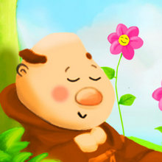
To the tune from Frère Jacques
Lundi, mardi,
Mercredi
Jeudi, vendredi
Samedi, dimanche

Slide 5
Activité 2
Days of the week activities

Slide 6
Days of the week activities.
Children look at the following slides and say which day of the week they might do the different activities on.
There are no right or wrong answers!
To say everyday it’s, “tous les jours!”

Slide 7
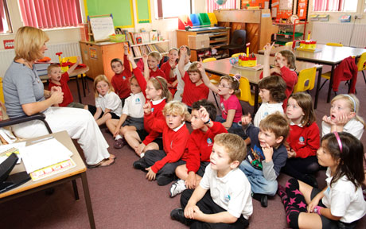
Je vais à l’école! C’est quel jour?
Notes:
I go to school. What day is it?

Slide 8
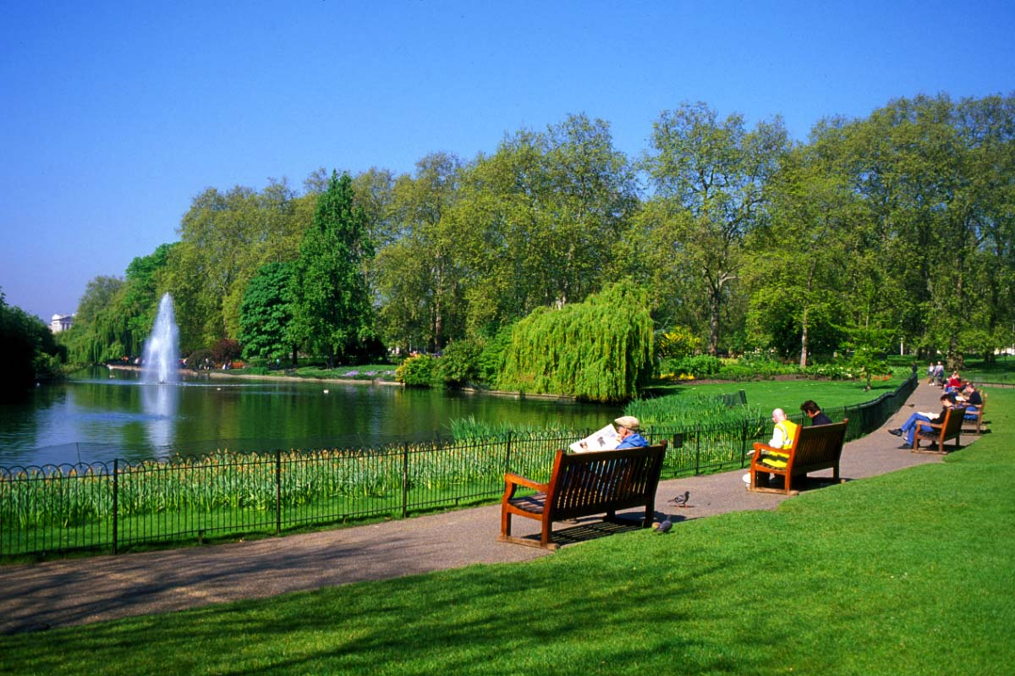
Je vais au parc. C’est quel jour?
Notes:
I go to the park. What day is it?

Slide 9
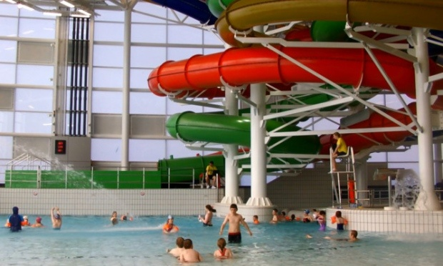
Je vais à la piscine. C’est quel jour?
Notes:
I go to the swimming pool. What day is it?

Slide 10
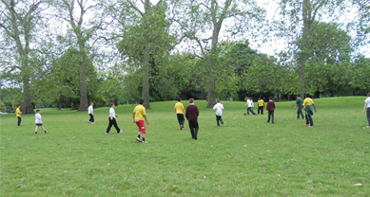
Je joue au foot. C’est quel jour?
Notes:
I play football. What day is it?

Slide 11
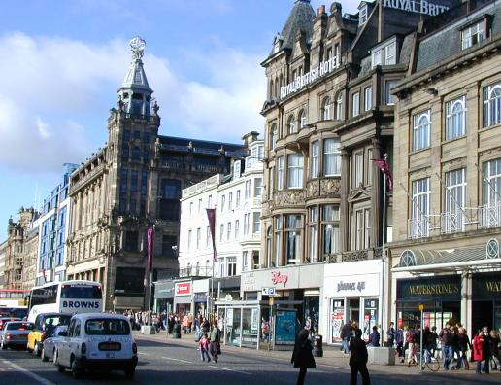
Je fais du shopping. C’est quel jour?
Notes:
I go shopping. What day is it?

Slide 12
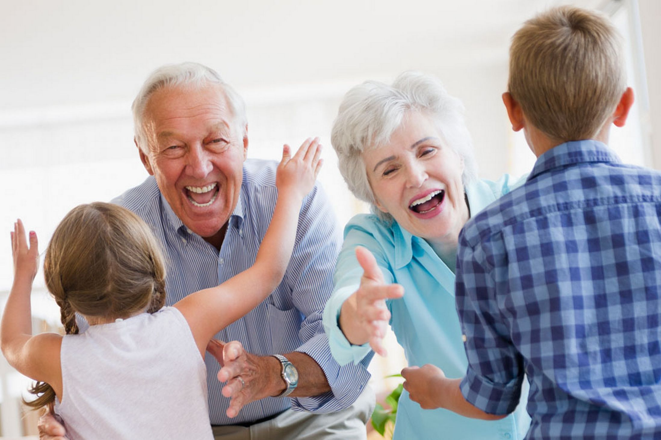
Je vais chez mes grand-parents. C’est quel jour?
Notes:
I go to my grand-parents. What day is it?

Slide 13
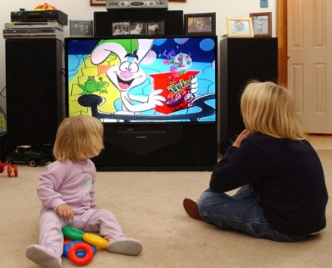
Je regarde la télé. C’est quel jour?
Notes:
I watch the TV. What day is it?

Slide 14
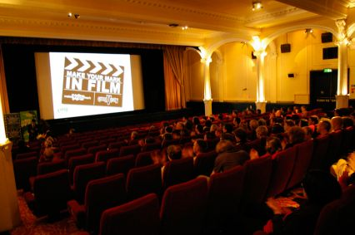
Je vais au cinéma. C’est quel jour?
Notes:
I watch the TV. What day is it?

Slide 15
Au revoir!

