Slide 1
Blackburn Primary School
Celebration Assembly
Friday the 29th of May 2020
Blackburn Primary, a school family, growing, learning and succeeding.

Slide 2
Shout outs from staff………..
We all miss you
Teaching staff
Miss Clarkson
Mrs McCarney
Mrs Topping
Mrs Bryce
Miss Hamill
Mrs McLuckie
Miss Miller
Mr Riding
Mrs Brodzka
Miss Anderson
Support staff
Miss Robertson
Mrs Wilmott
Mrs Smith
Miss Meikle
Mrs Anderson
Mrs Gilbert
Mrs Butler
Mrs Hamilton
Mrs McMillan

Slide 3
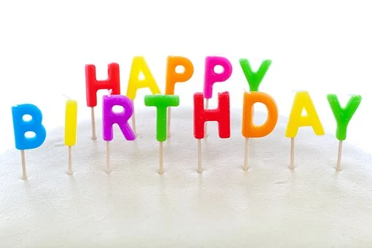
Shouts Out for pupils
Happy birthday Scotty! Hope you have a fantastic birthday even during lockdown! From all the BPS staff and pupils!

Slide 4
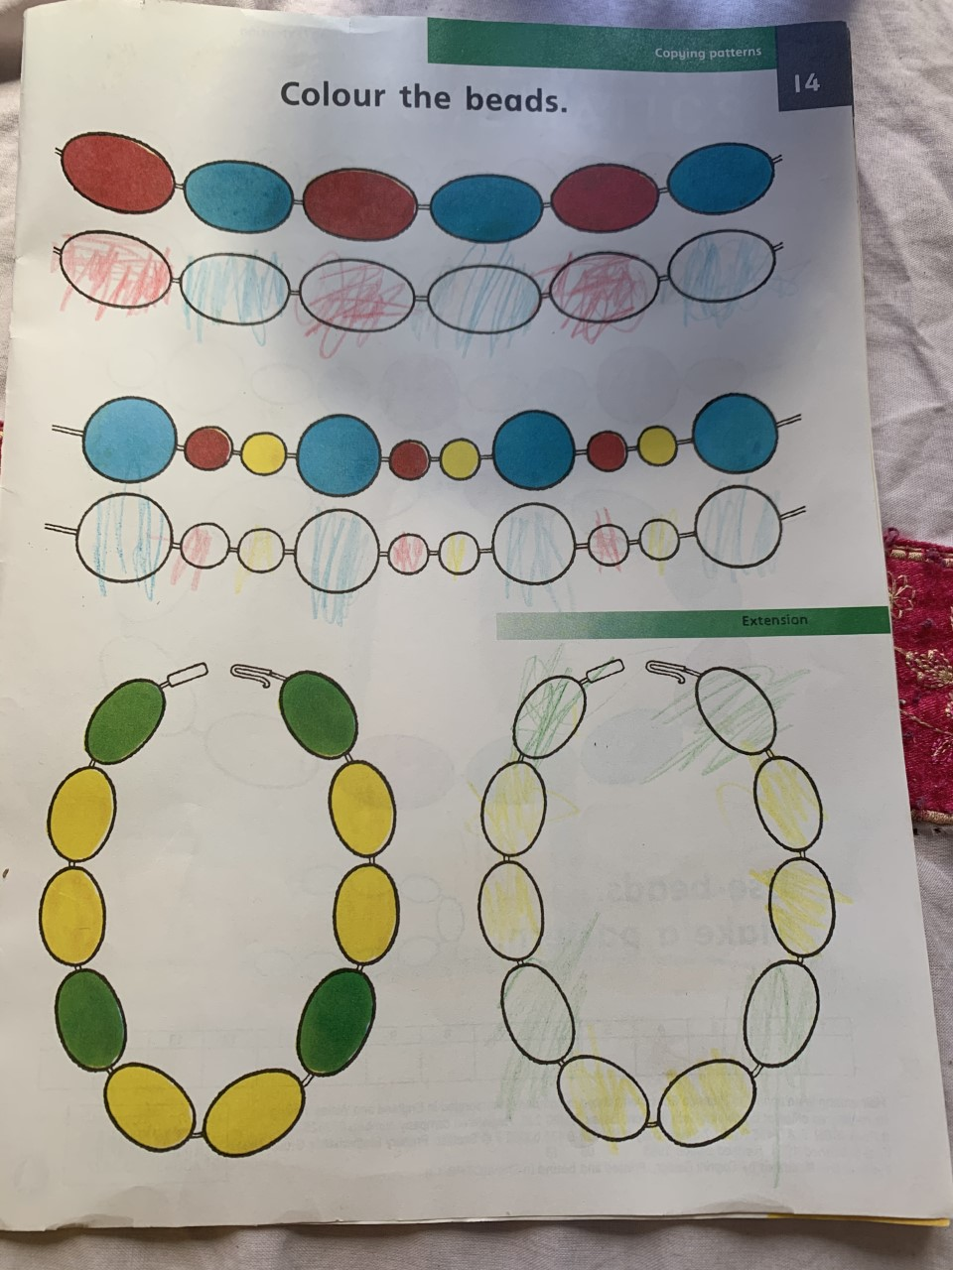
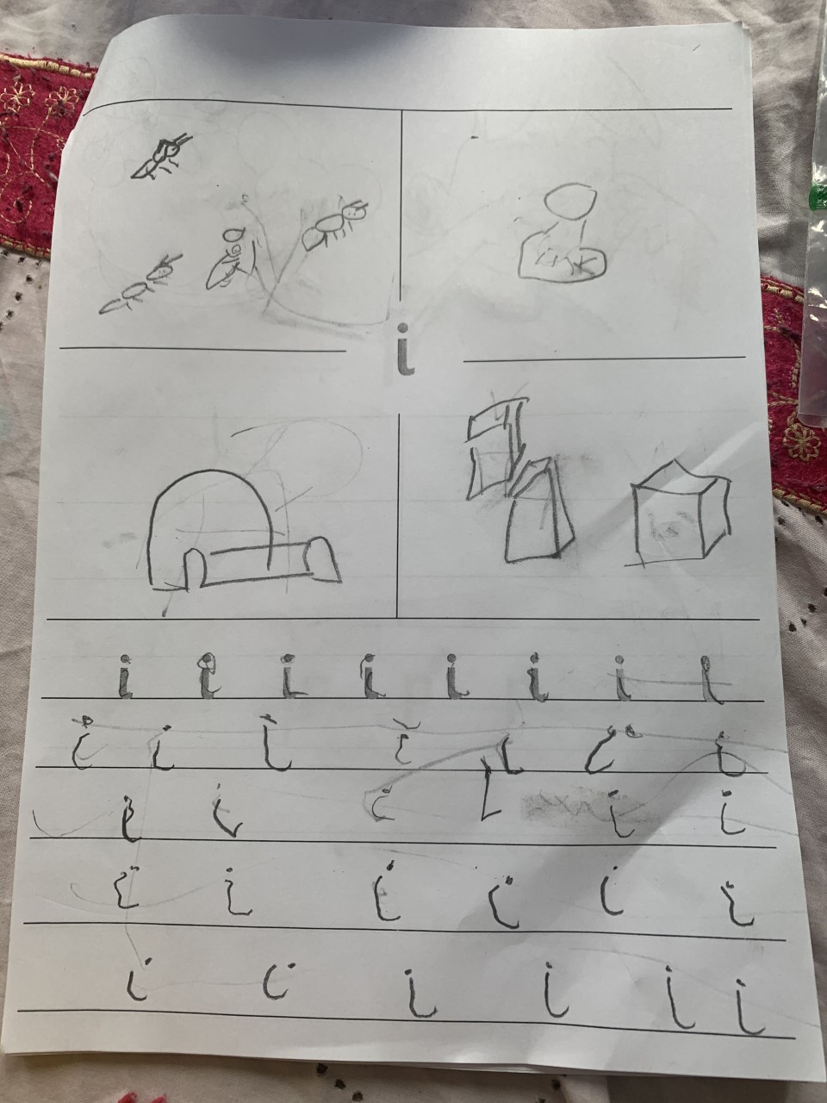
Well done to Raiyaan who has been learning the ‘i’ sound and working on pattern at home this week!

Slide 5
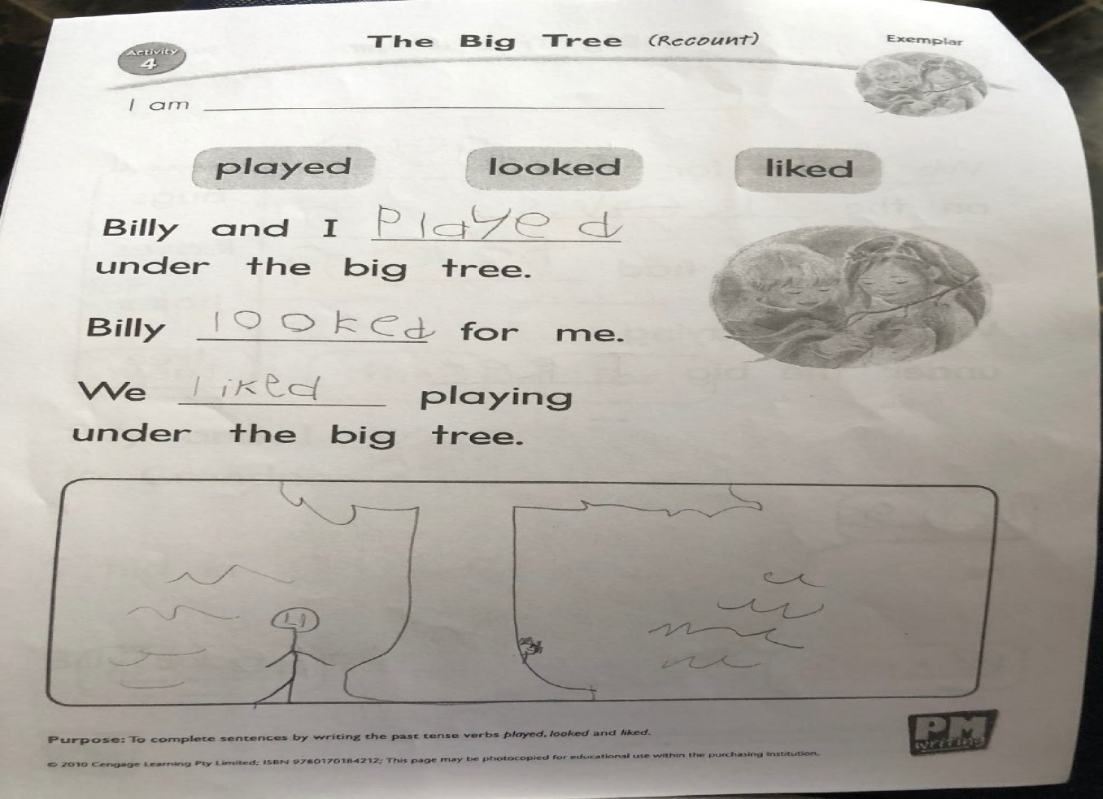
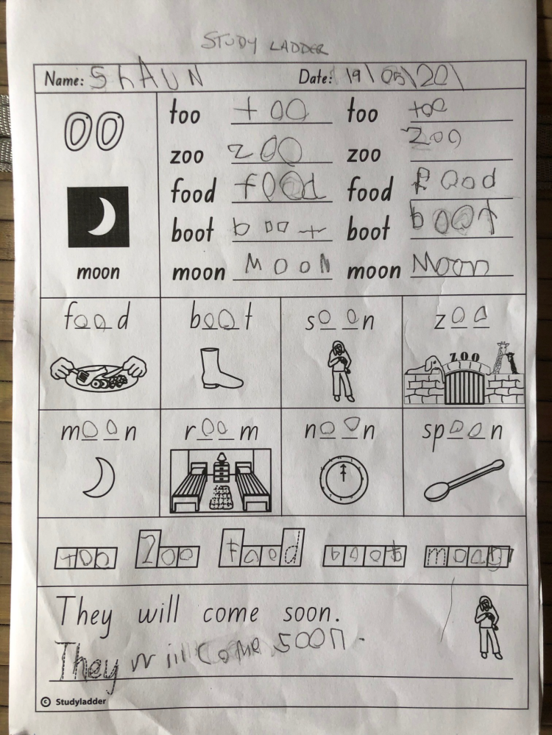
Well done to Shaun in A1 for consistently working hard at home to complete all of his literacy and numeracy tasks both online and from within his school closure pack!

Slide 6
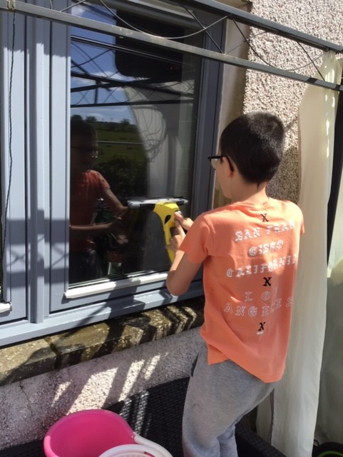
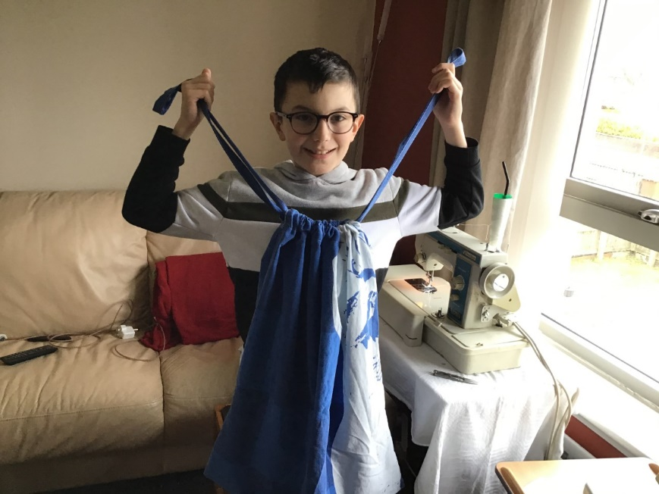
Well done to this A1 pupil who has learned to sew using a sewing machine to make bags for the NHS as well as helping out round the house by cleaning the windows! These are super skills for life and work... well done!

Slide 7
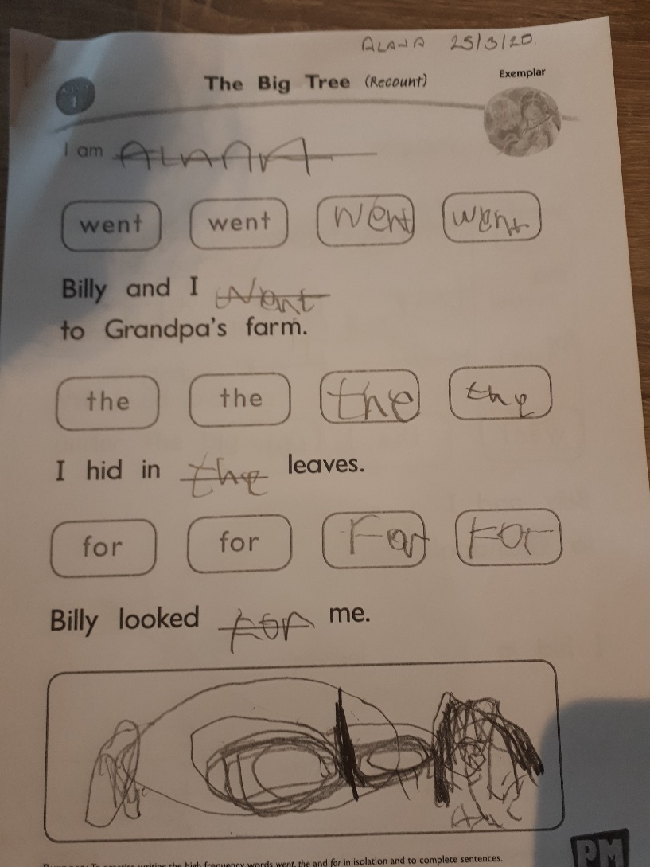
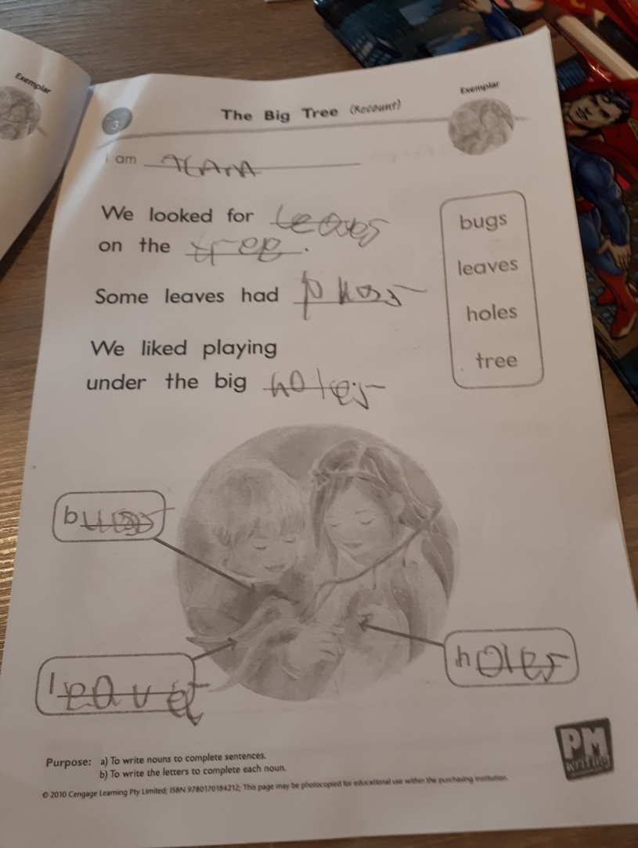
Well done to Alana in A2 for working hard on her PM Writing Tasks. Super Work

Slide 8

Well done to Grace for her brownie powerpoint!

Slide 9
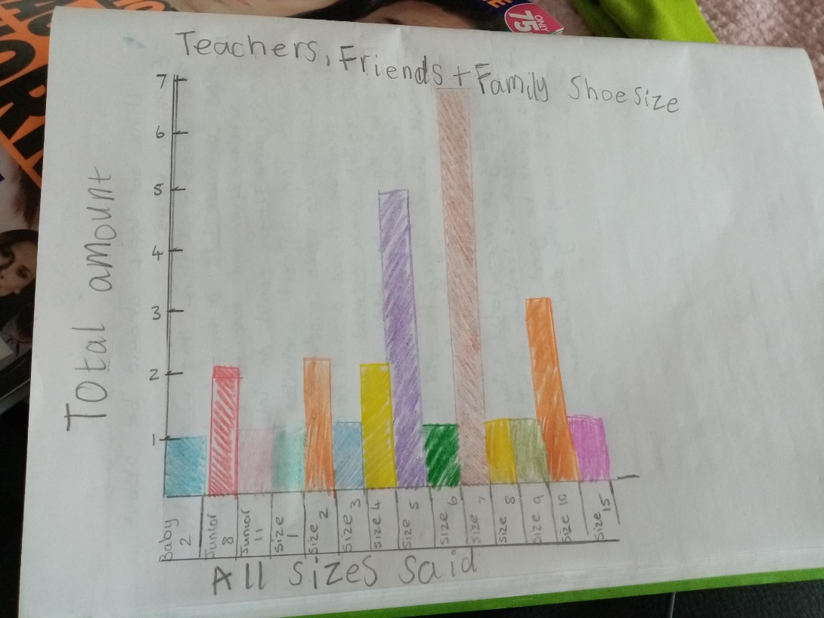
Well done to Leland for his survey and graph!

Slide 10
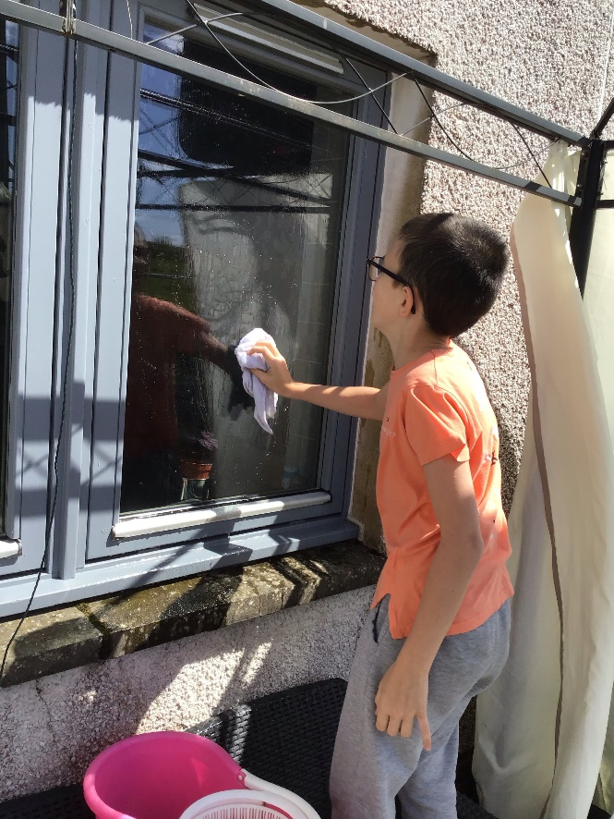
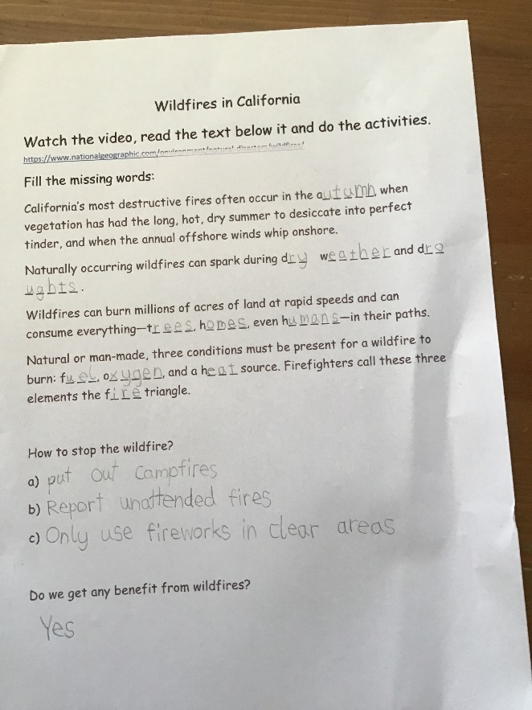
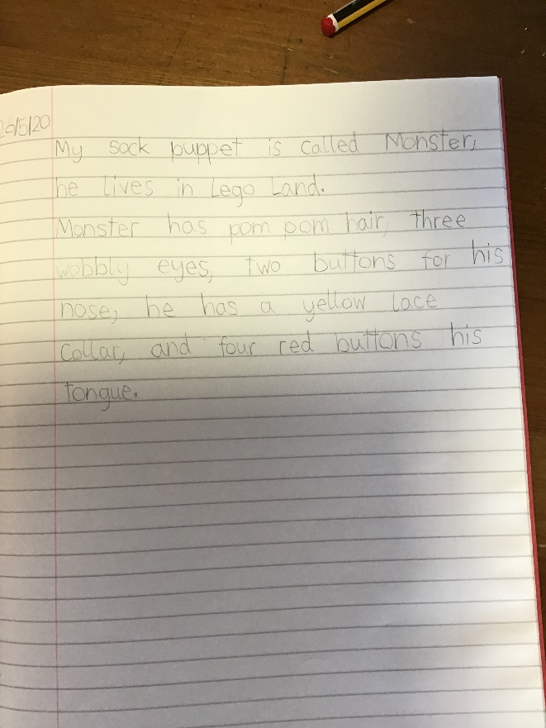
Well done to this A2 pupil who is constantly working hard! This week he used the puppet he made previously to write a description! He was also discovering new things about Wildfires and was helping his granny to clean the windows! Great work!

Slide 11
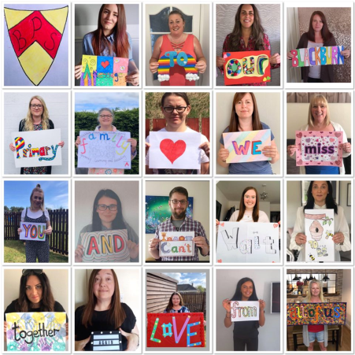
Scavenger Hunt Fun!
Well done to everyone that has managed to join in on our scavenger hunt! We will share more of the fantastic photos and work we have received early next week to give others a chance to join in over the weekend!
Well done to the Dickson family that managed to find all 9 incredibly fast!!

Slide 12
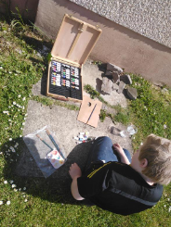
New Scavenger Hunts!
Well done to Scott Munro who has set up his own Rock scavenger hunt for pupils! More details will be put on the blog and Twitter for others to join in. Fantastic work!!!
We have heard others are doing this too and can’t wait to see more ☺

Slide 13
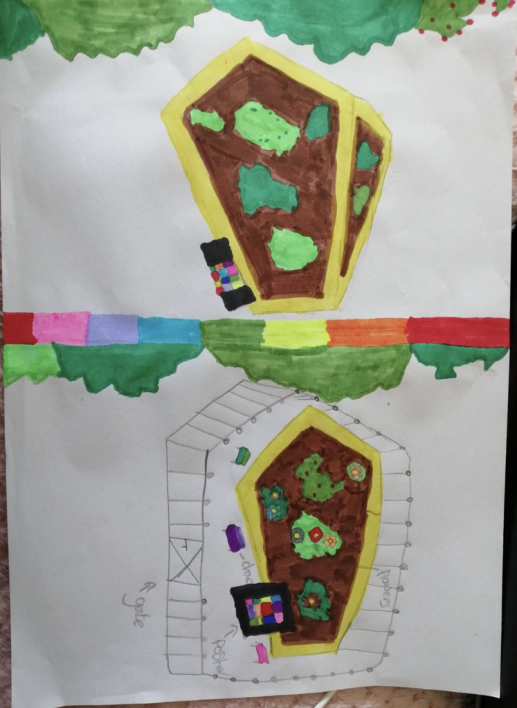
Morgan’s Garden Design
Morgan reimagined the community garden space in Blackburn this week as part of the Scavenger hunt challenge! What a fantastic design and we would love to see it come to life!

Slide 14
INspire Challenges!
A huge well done to those pupils that have completed some of the INspire challenges this week!
Austin, Morgan, Julia, Ellie and Scott you are making your teacher very proud by sharing your learning with pupils all over West Lothian!
We have also heard great things from our P4/5 pupils joining in too! Well done to Mason and Leland! ☺
https://blogs.glowscotland.org.uk/wl/stayinspired/ visit the website if you want to get involved!

Slide 15


Slide 16

Take care and stay safe
We all miss you and look forward to when we will see you all again from all the staff at Blackburn Primary School
Have a lovely weekend and we will be back in touch on Monday.

