Slide 1
Blackburn Primary School
Celebration Assembly
Friday the 22st of May 2020
Blackburn Primary, a school family, growing, learning and succeeding.

Slide 2
Shout outs from staff………..
We all miss you
Teaching staff
Miss Clarkson
Mrs McCarney
Mrs Topping
Mrs Bryce
Miss Hamill
Mrs McLuckie
Miss Miller
Mr Riding
Mrs Brodzka
Miss Anderson
Support staff
Miss Robertson
Mrs Wilmott
Mrs Smith
Miss Meikle
Mrs Anderson
Mrs Gilbert
Mrs Butler
Mrs Hamilton
Mrs McMillan

Slide 3
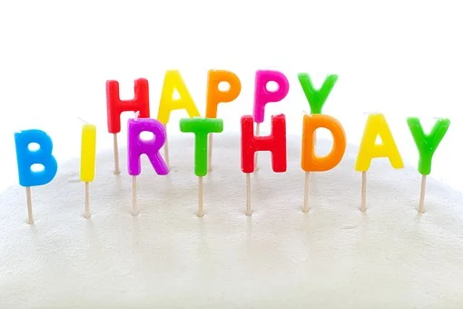
Shouts Out for pupils
Happy birthday Morgan! Hope you have a fantastic birthday even during lockdown! From all the BPS staff and pupils!

Slide 4
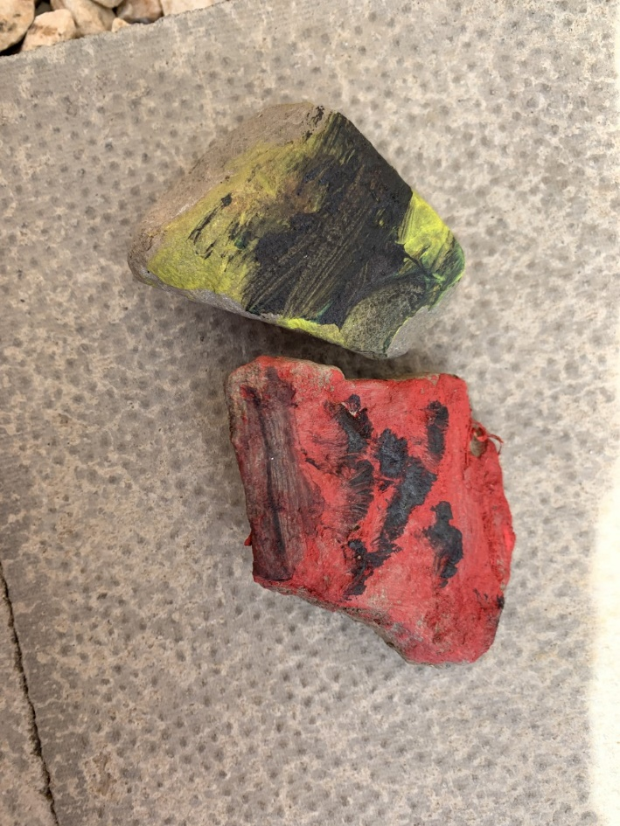
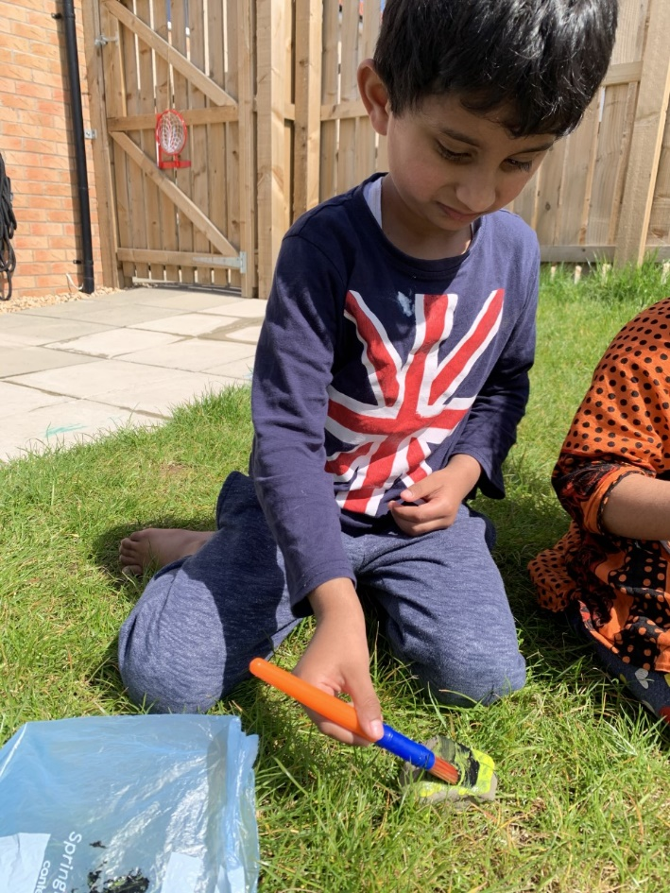
This A1 pupil has made some beautiful minibeasts by painting stones in art this week and he also created a weekly timetable for Marty the Zoo Keeper when we were learning about days of the week in numeracy. At home this week he also spoke using a full sentence for the first time. Such a superstar!

Slide 5
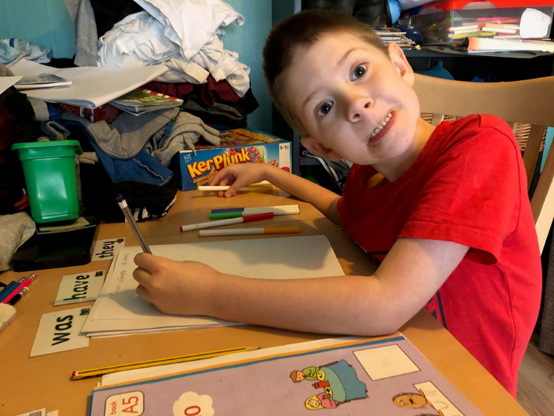
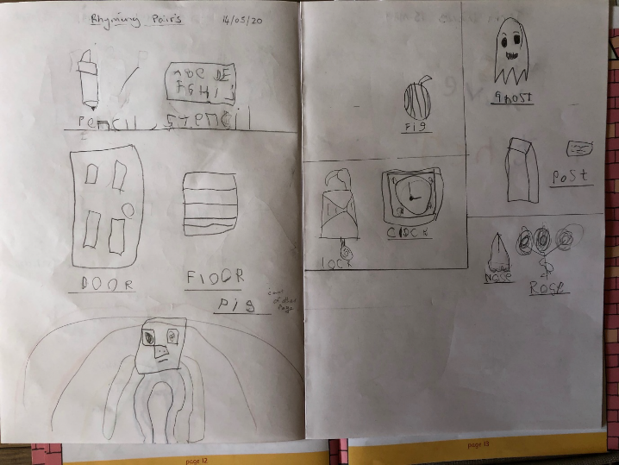
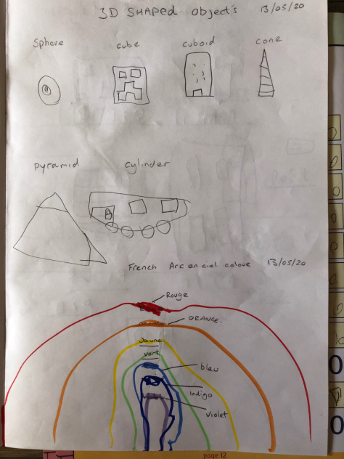
This A1 pupil has worked so hard on all of his tasks this week including learning tricky words, 3D shapes and rhyming words but I think a special mention is deserved for his amazing rainbow showing all of the colours in French. Great Job!

Slide 6
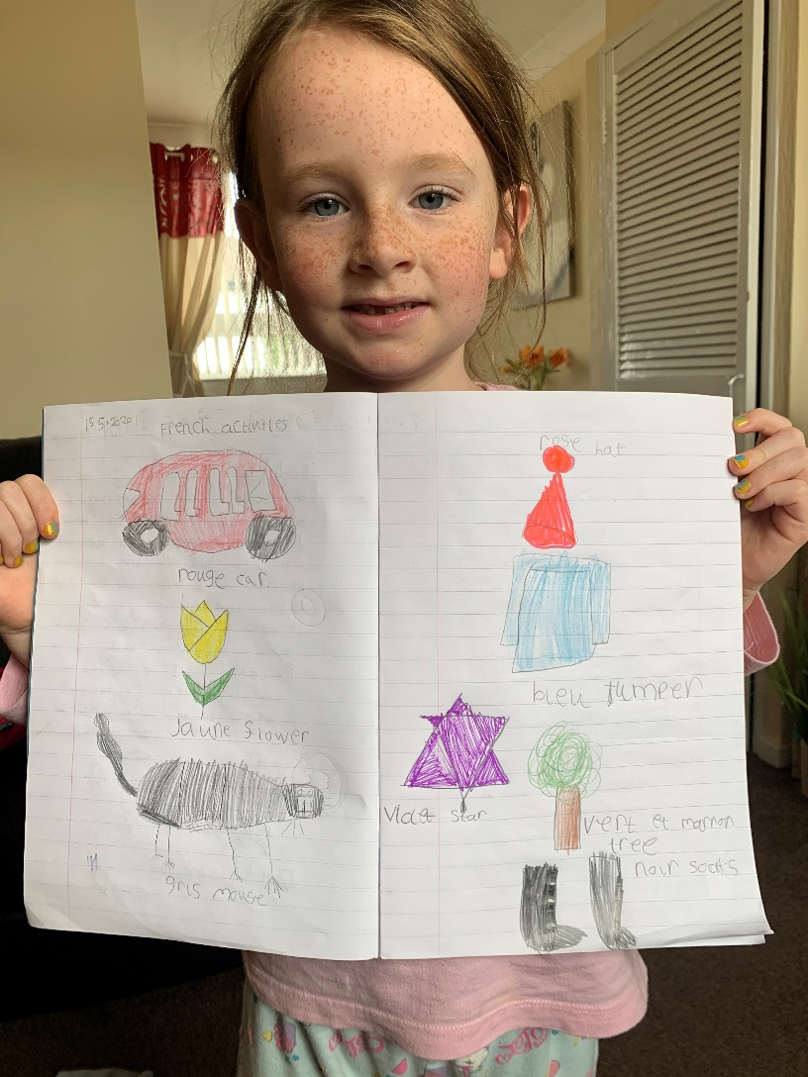
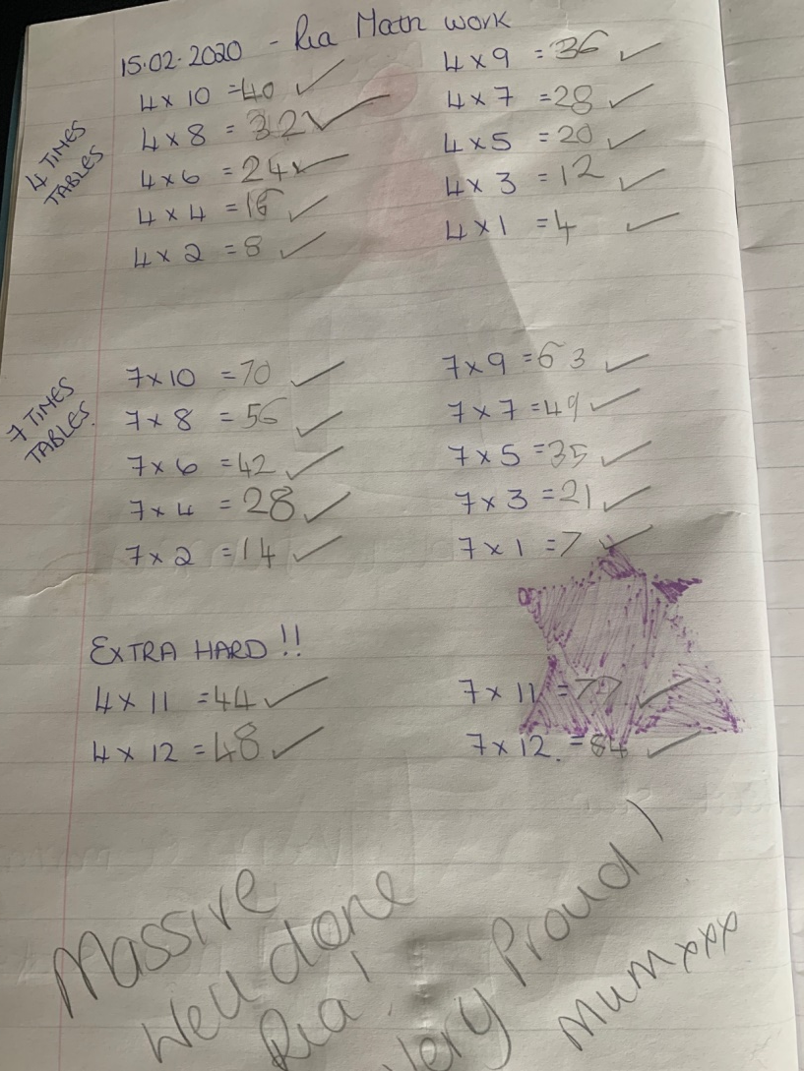
Well done to this P2/3 pupil who has been working very hard on her maths and French work this week!

Slide 7
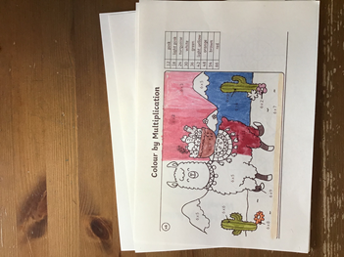
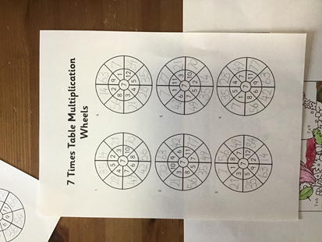
Well done to Mack for working really hard on his times tables the last few days, finishing all the worksheets and tasks set up on education city.

Slide 8
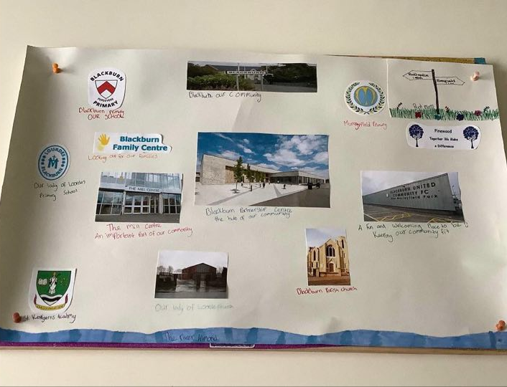
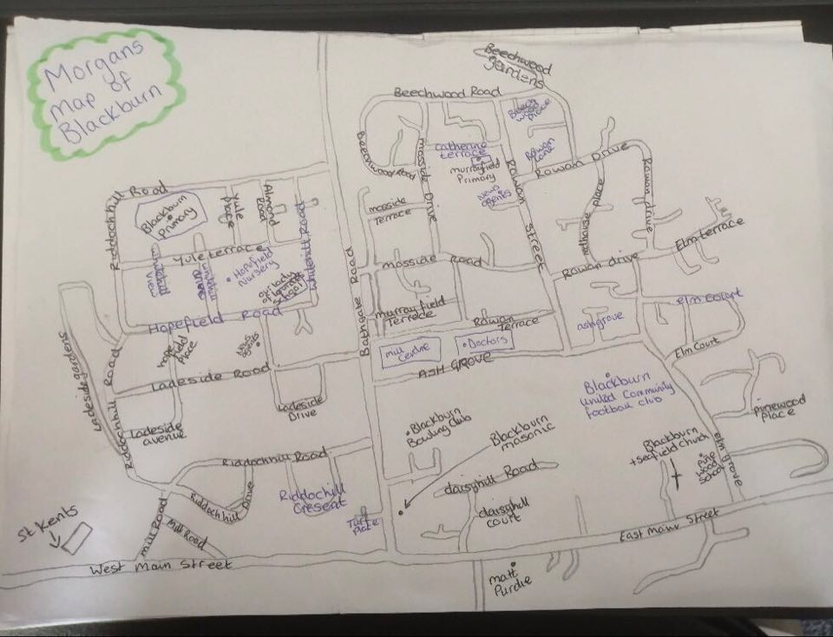
Well done to Morgan and Ellie R for their mapping projects and Scotland Reporter articles!

Slide 9
Well done to Eilidh for being so kind with her words of support
Well done to Austin, Scott and Ethan who are currently working on a collaborative project which sounds very exciting!
Well done to Ellie B on her fly-tipping article.

Slide 10
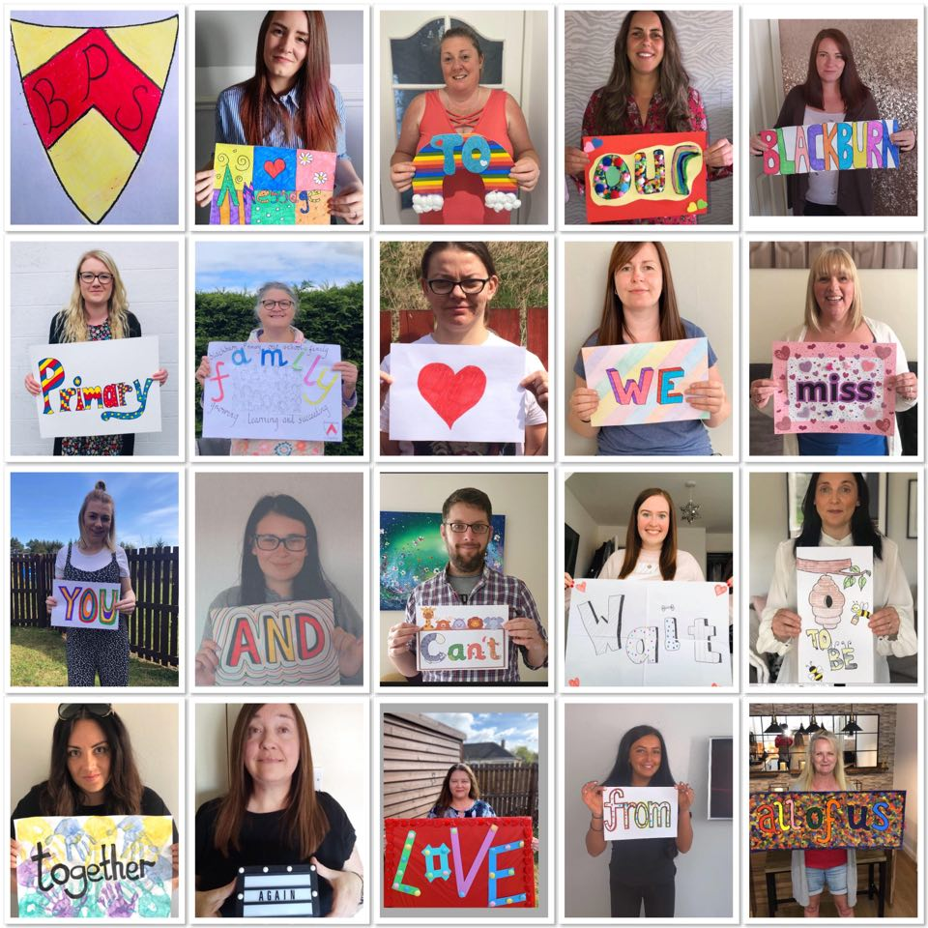

Slide 11

Take care and stay safe
We all miss you and look forward to when we will see you all again from all the staff at Blackburn Primary School
Have a lovely weekend and we will be back in touch on Monday.

