Slide 1
Blackburn Primary School
Celebration Assembly
Friday the 15th of May 2020
Blackburn Primary, a school family, growing, learning and succeeding.

Slide 2
Shout outs from staff………..
We all miss you
Teaching staff
Miss Clarkson
Mrs McCarney
Mrs Topping
Mrs Bryce
Miss Hamill
Mrs McLuckie
Miss Miller
Mr Riding
Mrs Brodzka
Miss Anderson
Support staff
Miss Robertson
Mrs Wilmott
Mrs Smith
Miss Meikle
Mrs Anderson
Mrs Gilbert
Mrs Butler
Mrs Hamilton
Mrs McMillan

Slide 3
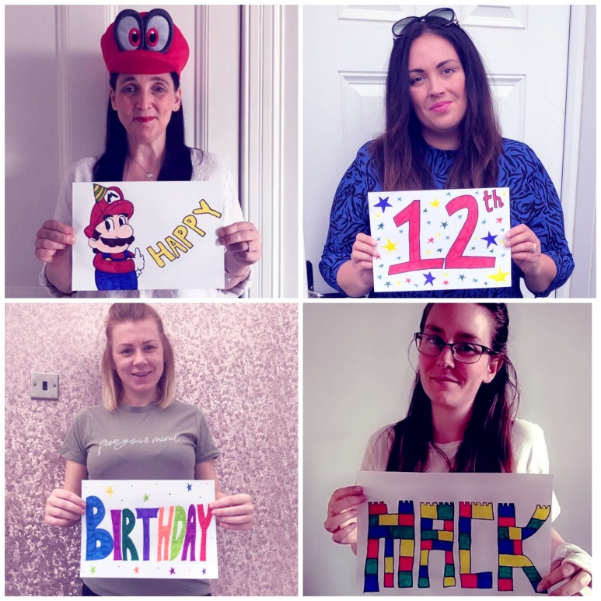
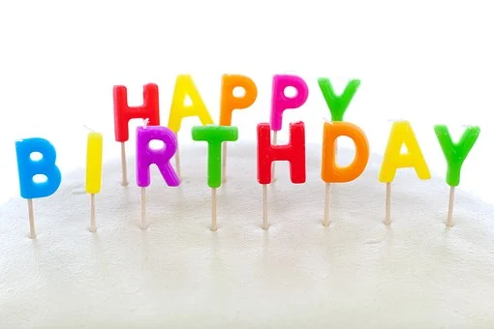
Shouts Out for pupils
Happy birthday Mack! Last year of your pre-teens! Have the best day celebrating lockdown style! Love from all the A1 and BPS staff! Happy birthday also to Marcel who is 6 today and Sophie who was 9 last week.

Slide 4
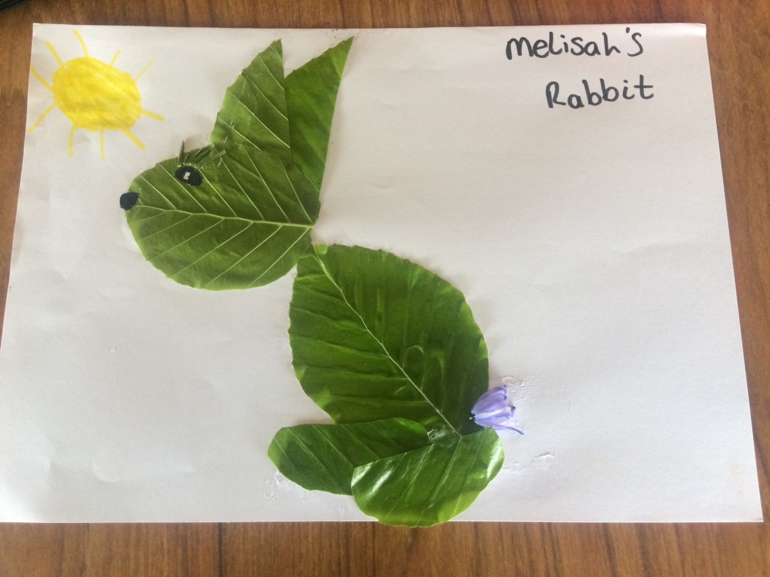
Well done to Melisah for creating this wonderful rabbit from things she found in her garden!

Slide 5
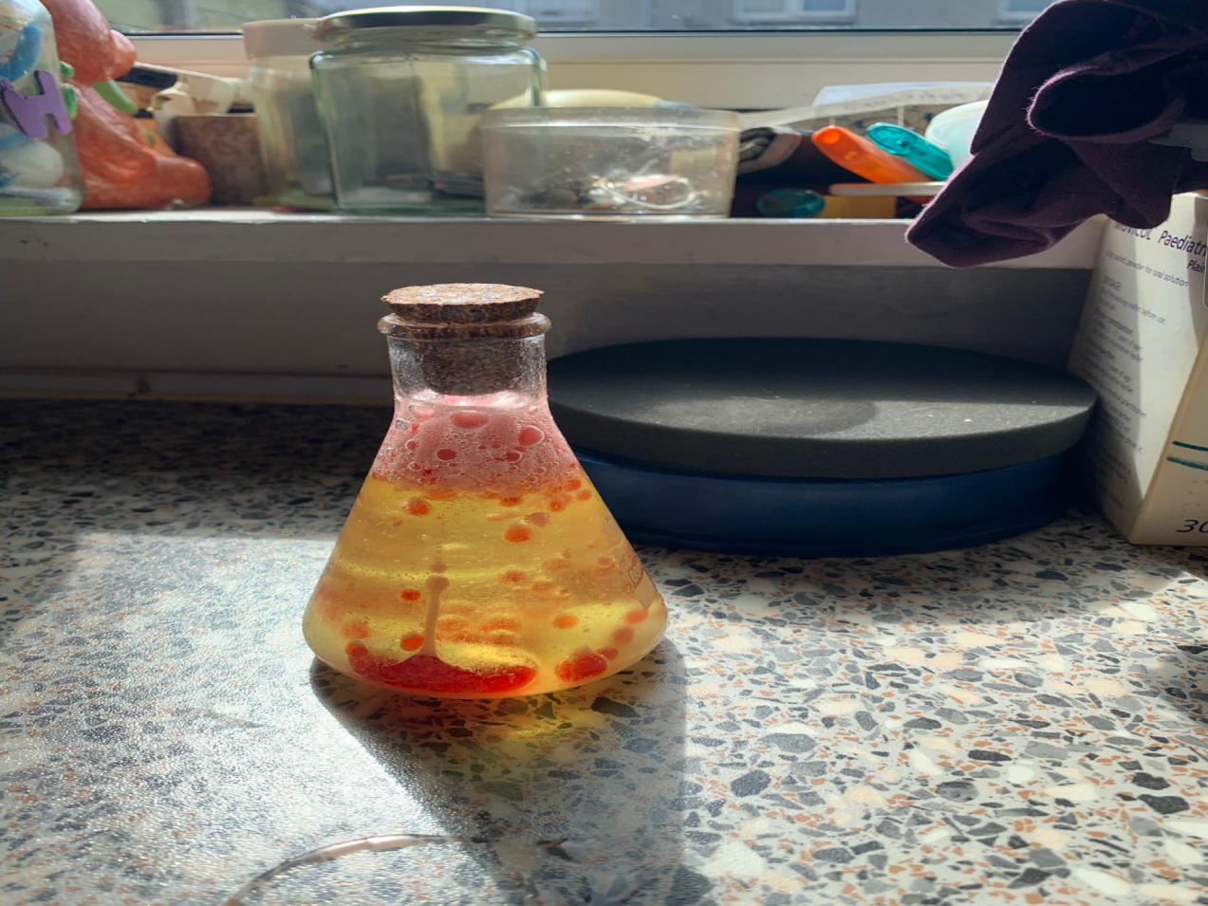
Well done Shaun who made this amazing lava lamp with his Dad!

Slide 6
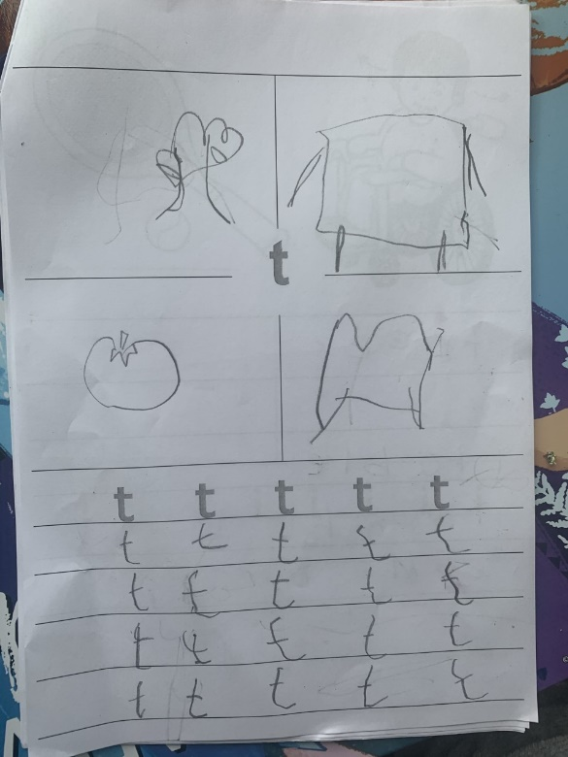
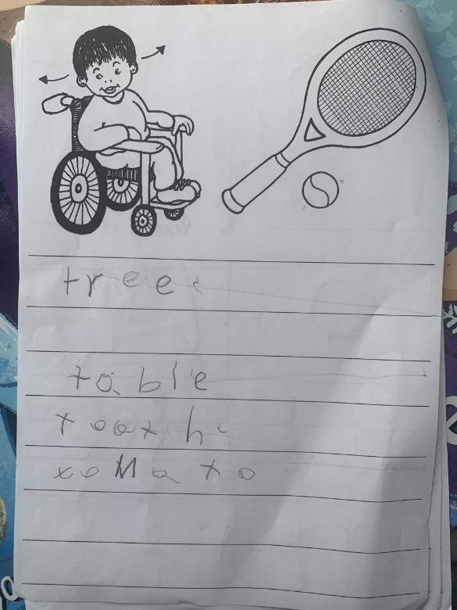
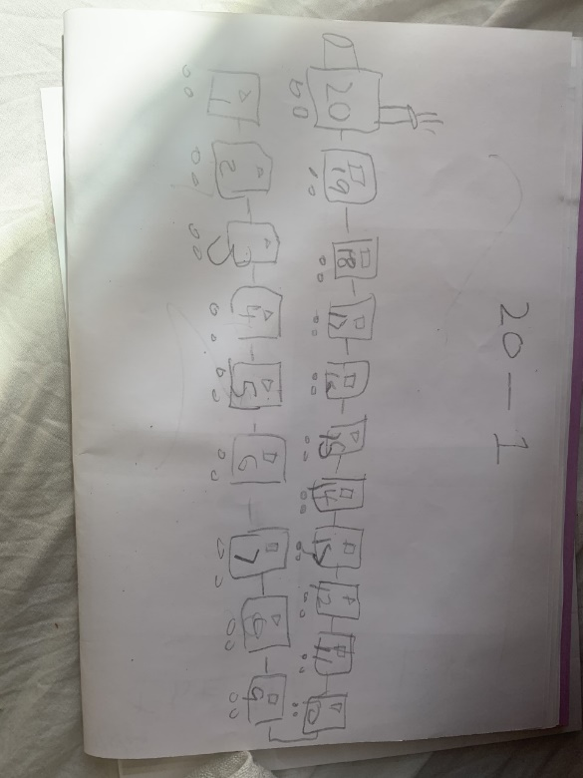
Excellent work from Raiyaan for learning all about ‘t’ through his phonics work and creating a countdown train for numbers from 20 to 0

Slide 7
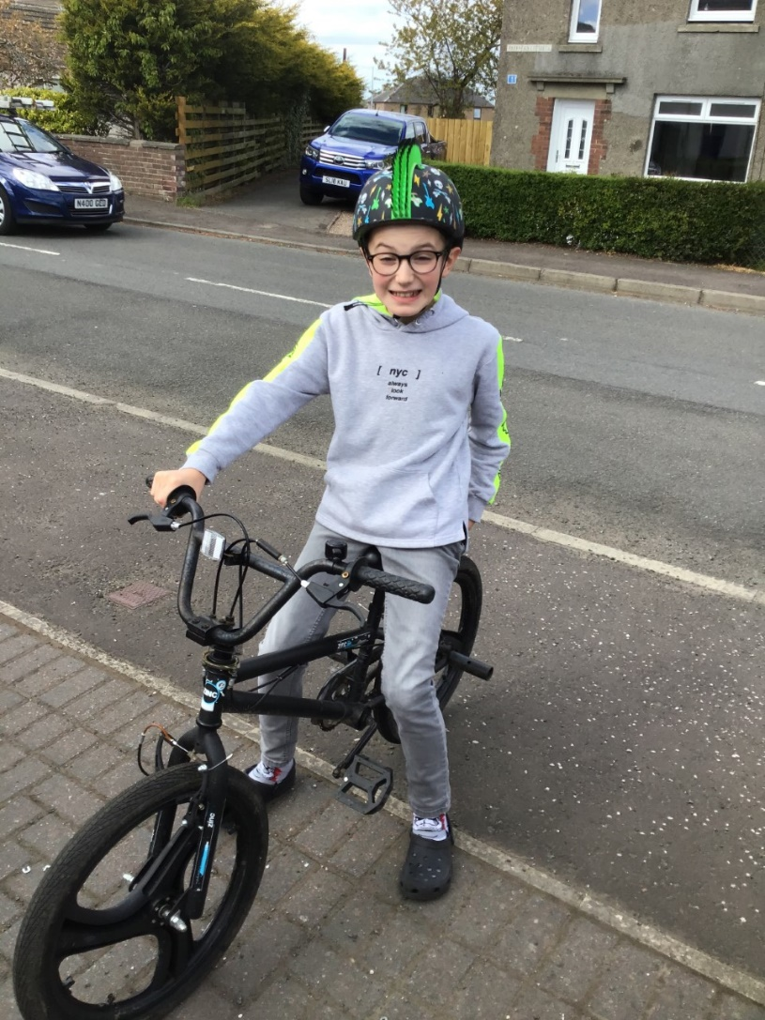
A huge well done to this boy in A1 who tried out his brothers bike this week and was able to ride it like a pro from the very first go!

Slide 8

Well done to Leland and Nathan for consistently doing their work!

Slide 9
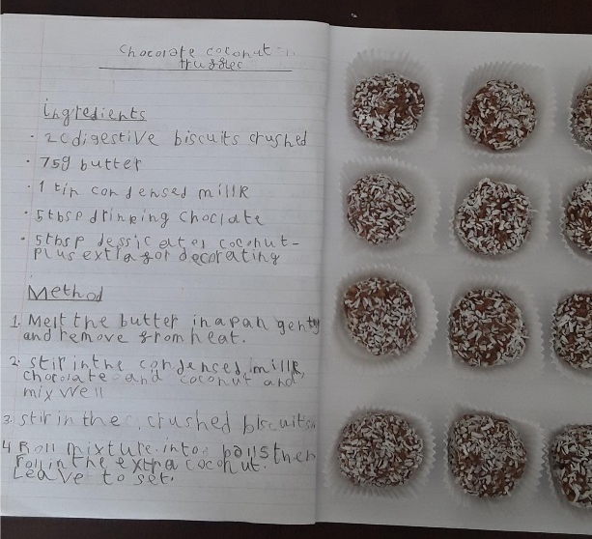
Well done to Jay L for his amazing recipe and baking.

Slide 10
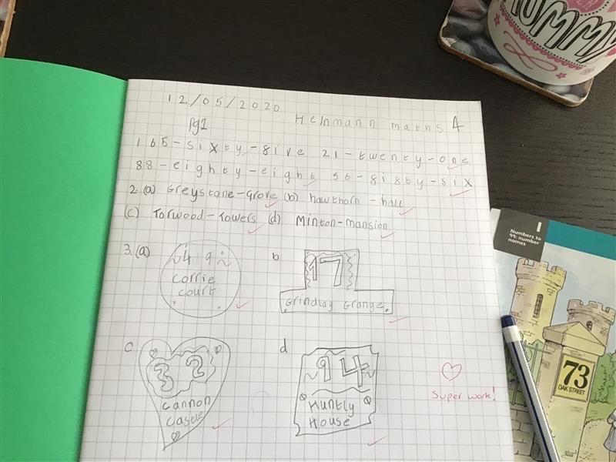
Well done to Grace for taking on extra revision in numeracy

Slide 11
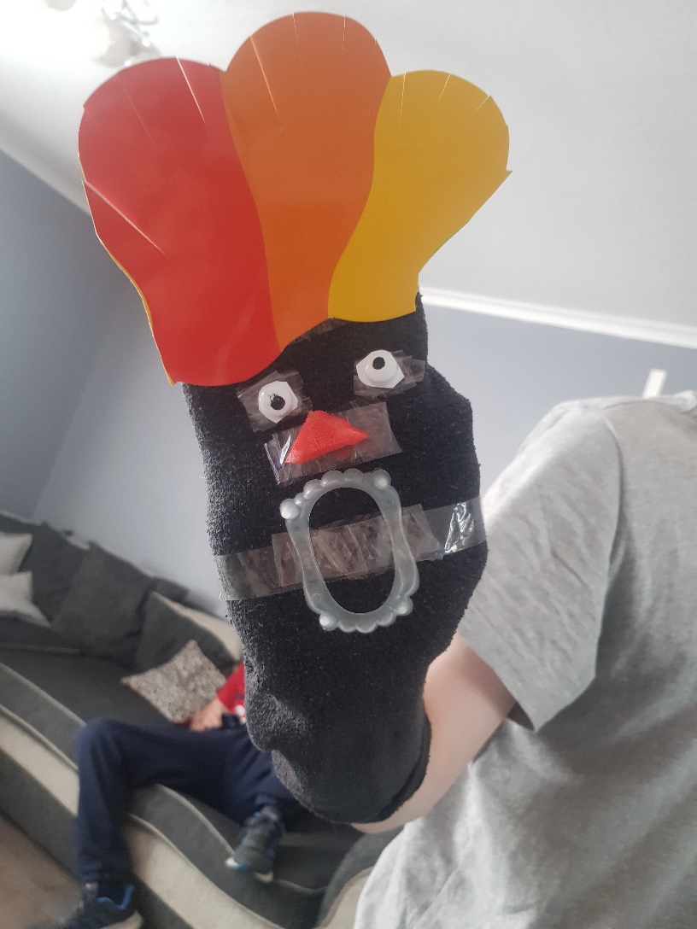
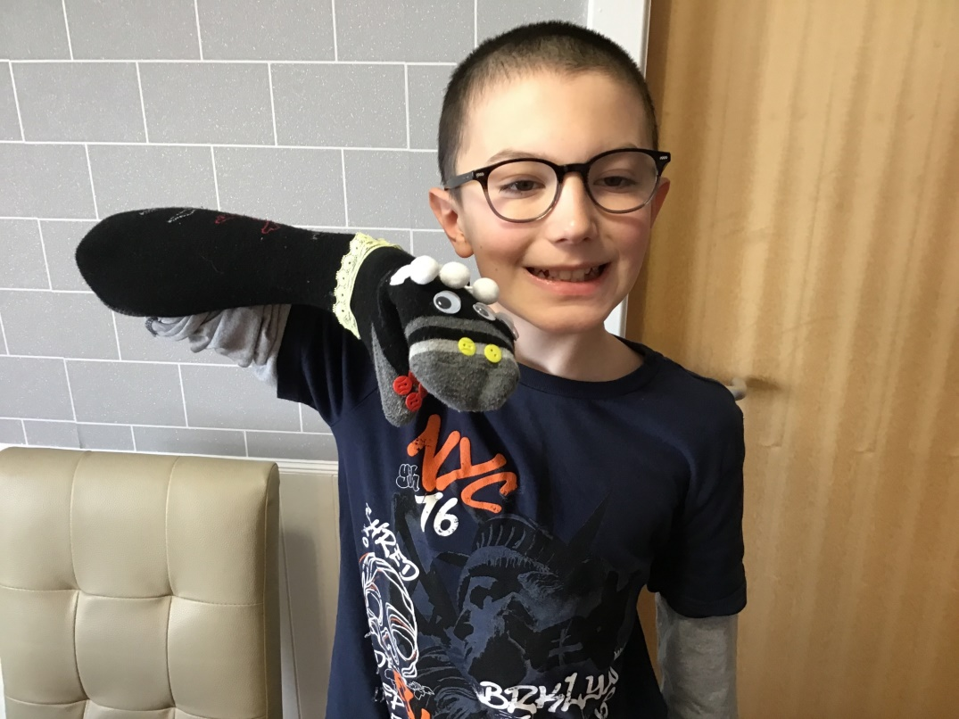
Well done to two our A2 boys for the beautiful puppets they made this week

Slide 12
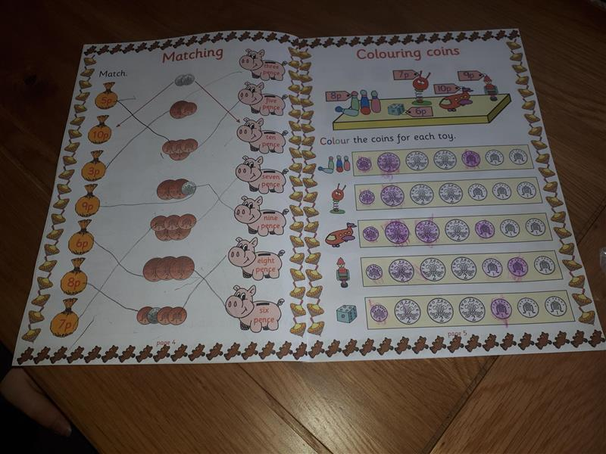
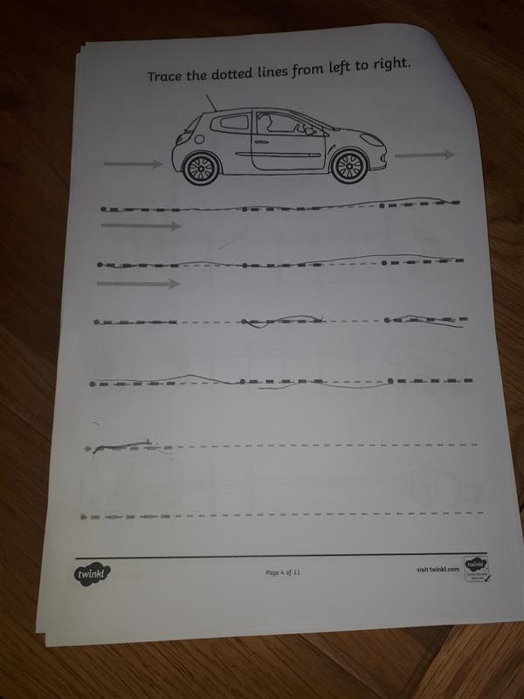
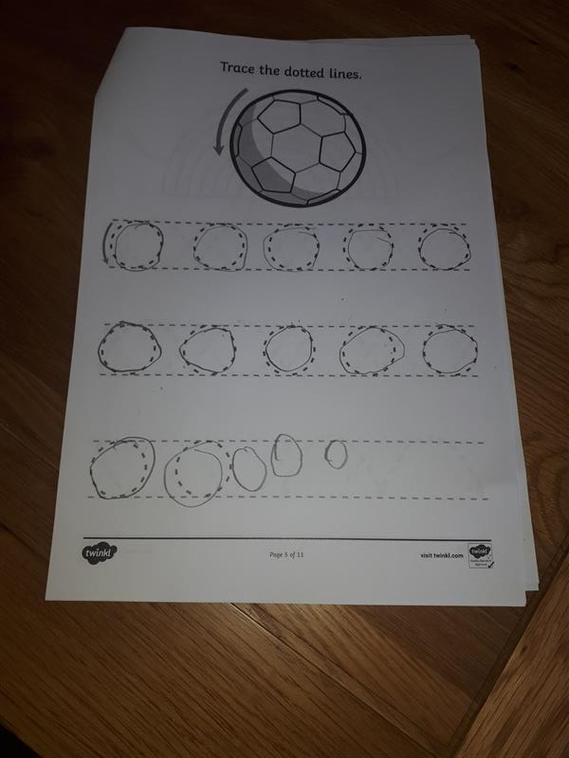
Well done to Alana for completing the work on Education City set up by Mrs Bryce and for working hard on her pencil control and money worksheet

Slide 13
Well done to Morgan who has been doing some excellent work with Scotland Reads with Miss Butler this week!
Well done to Charlie who has been working really hard on his Scotland Reads with Mrs Hamilton this week!

Slide 14
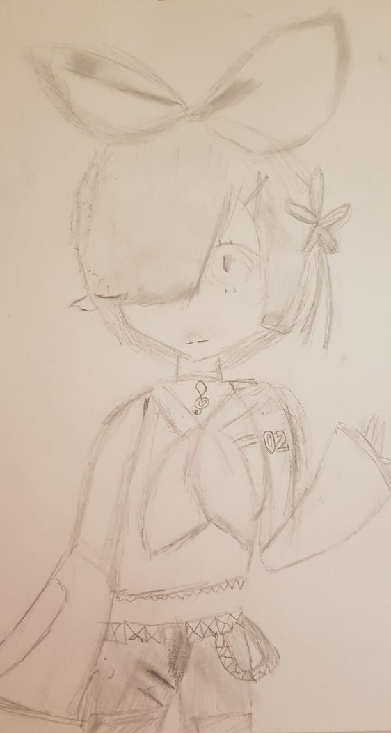
Well done to Kanza for the drawing she completed for the ‘Combinations’ inspire challenge

Slide 15
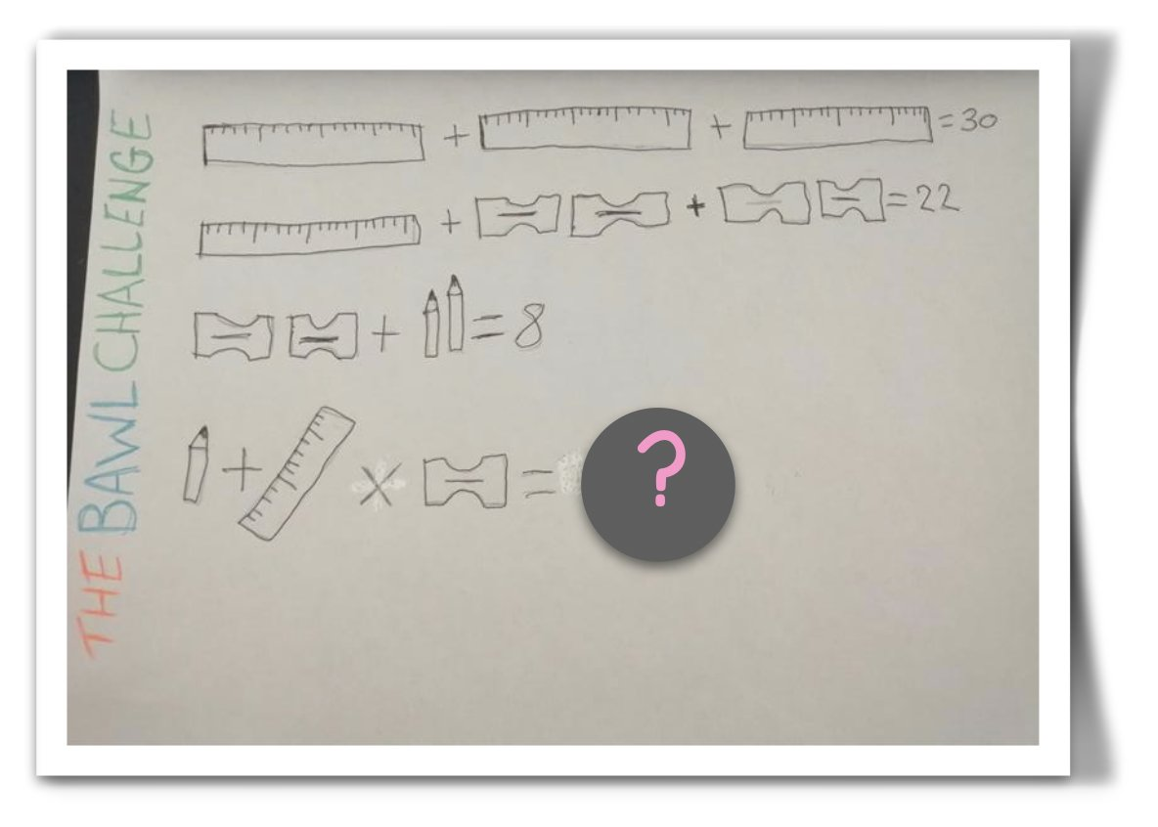
Well done to Morgan who has been creating her own maths questions based on the ‘combinations’ challenge. This challenge was discussed by lots of people on twitter and really got everyone thinking!

Slide 16
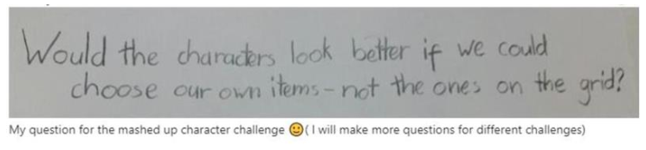
Well done to Julia and Ellie R for also joining the INspired community team. Ellie has had the confidence to share her second fitness video and inspire others! Julia challenged the boundaries of one of the 'Combinations' challenges and decided it might be better if pupils could create their own grid!

Slide 17
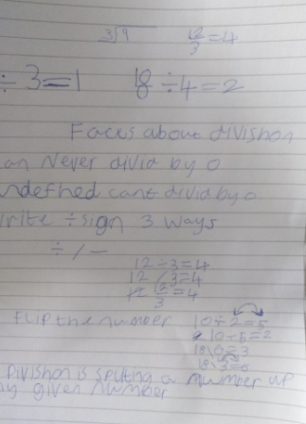
Well done to Scott who took control of his own learning and decided to look for ways to practise division!

Slide 18
Shout outs from Miss Anderson
I want to say well done to Austin for sharing his animations and helping pupils from other primary schools by giving great advice on how to make their own!! I can post Austin's original animation and his remastered version on Twitter – I am very proud!!
A wee shout out to our P7s that received their transition packs from the high school and have been attending the secondary transition Teams this week. Just don't forget about your P5/6/7 team - it's not time to leave yet! I've missed you all this week

Slide 19

Take care and stay safe
We all miss you and look forward to when we will see you all again from all the staff at Blackburn Primary School
Have a lovely weekend and we will be back in touch on Tuesday

