Slide 1
P1/A1 Wednesday 20th May French Early Level
Les jours de la semaine

Slide 2
Vocabulary
Days of the week
C’est quel jour? What day is it?
C’est It’s
lundi Monday
mardi Tuesday
mercredi Wednesday
jeudi Thursday
vendredi Friday
samedi Saturday
dimanche Sunday
NB: Days of the week do not have capital letters in French

Slide 3
Embedding the language
Ask, “C’est quel jour?” at the start of each slide before answering the correct day of the week.

Slide 4
C’est quel jour?
Notes:
What day is it?

Slide 5
C’est lundi
lundi

Slide 6
C’est mardi
mardi

Slide 7
C’est mercredi
mercredi

Slide 8
C’est jeudi
jeudi

Slide 9
C’est vendredi
vendredi

Slide 10
C’est samedi
samedi

Slide 11
C’est dimanche
dimanche

Slide 12
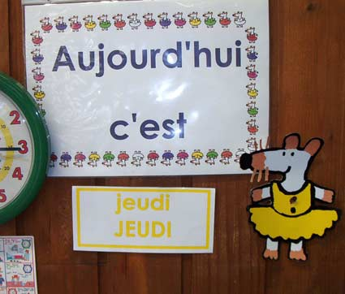
Activité 1
Days of the week rhyme

Slide 13
lundi mardi mercredi jeudi vendredi samedi dimanche
Notes:
Rhyme to practice learning the days in sequence. You can use them as you would for counting games.

Slide 14
Activité 2
Days of the week song

Slide 15
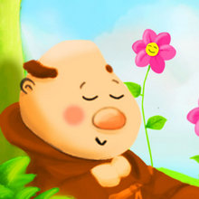
To the tune from Frère Jacques
Lundi, mardi,
Mercredi
Jeudi, vendredi
Samedi, dimanche

Slide 16
Activité 3
C’est quel jour?

Slide 17
C’est quel jour?
Pupils should look at the slides, listen to the day of the week in French and try and match the day of the week to the correct word in English.

Slide 18
C’est quel jour?
Tuesday
Sunday
dimanche
Monday
Wednesday

Slide 19
C’est quel jour?
Friday
Thursday
vendredi
Tuesday
Sunday

Slide 20
C’est quel jour?
Saturday
Monday
samedi
Tuesday
Thursday

Slide 21
C’est quel jour?
Tuesday
Sunday
mercredi
Monday
Wednesday

Slide 22
Au revoir!

