Slide 1
Wednesday 13th May P1/A1 French
Colours

Slide 2
Activité 1
Try to say the correct colour word in French before revealing the answer.
Remember to say “C’est……” first

Slide 4
Activité 2
Où est le….?

Slide 5
Où est le….?
For this activity, the children have to find where each colour is on the screen.
Où est means where is….
Voici means here is!

Slide 6
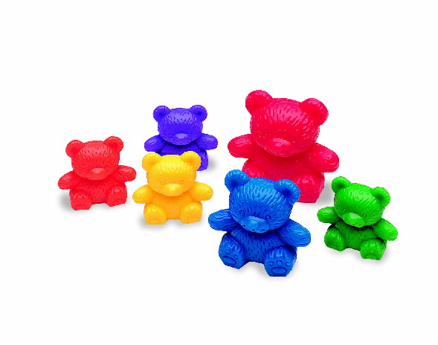
Où est le jaune?
Voici le jaune!
Notes:
Voici means here is

Slide 7
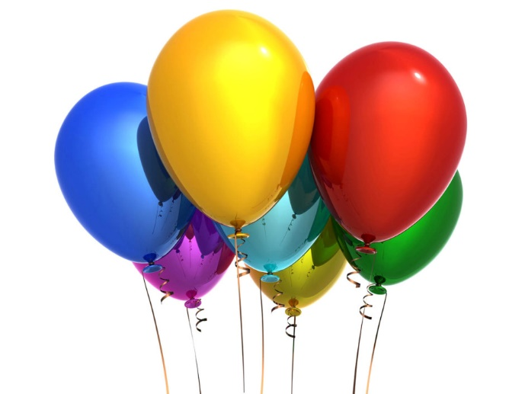
Où est le rouge?
Oui!
Voici le rouge!
Notes:
Voici means here is

Slide 8
Où est le bleu?
Oui!
Voici le bleu!
Notes:
Voici means here is

Slide 9
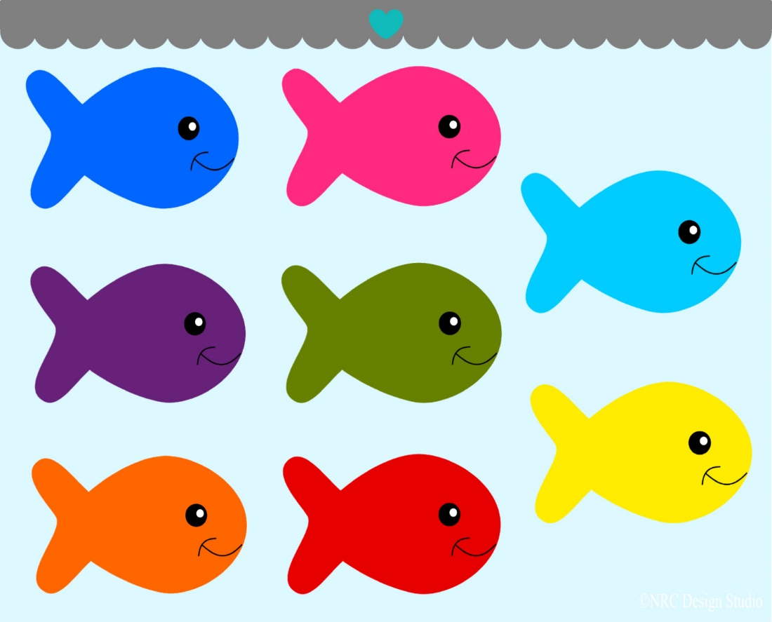
Où est l’orange?
Oui!
Voici l’orange!
Notes:
Voici means here is

Slide 10
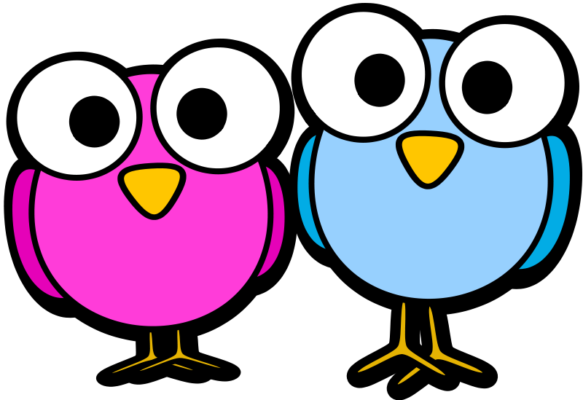
Où est le rose?
Super!
Voici le rose!
Notes:
Voici means here is

Slide 11
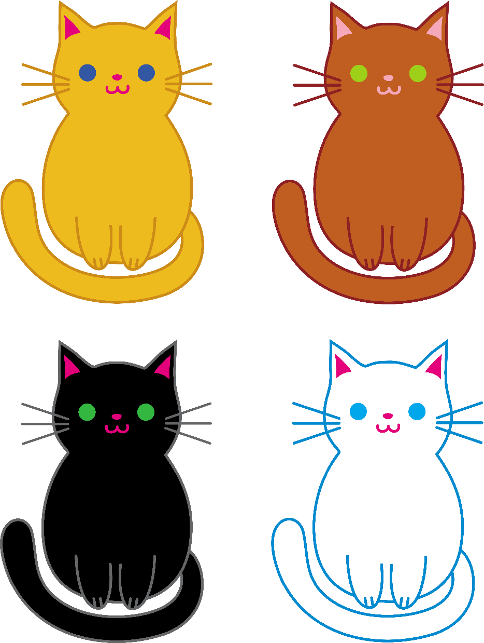
Où est le blanc?
Oui, très bien!
Voici
le blanc!
Notes:
Voici means here is

Slide 12
Où est le vert?
Voici le vert!
Notes:
Voici means here is

Slide 13
Poème des couleurs
C’est rouge?
Oui, c’est rouge!
C’est vert?
Oui, c’est vert!
C’est orange?
Oui! C’est orange!
C’est jaune?
Oui, c’est jaune!
Qu’est-ce que c’est?
C’est un arc en ciel!
Notes:
Qu’est-ce que c’est means What is it? And C’est un arc en ciel means it’s a rainbow! You can further develop this poem by adding in more colours and asking pupils to add them in as they know them. It could also be used as a display with pupils own rainbows alongside it ☺

Slide 14
Couleurs (to tune for Frère Jacques)
Bleu, blanc, jaune, vert
Bleu, blanc, jaune, vert
Violet
Violet
Orange, gris et marron
Orange, gris et marron
Rouge, noir, rose
Rouge, noir, rose
Notes:
Once pupils are confident as a group with this song, you can give them colour cards in groups (e.g. one group would have bleu, violet and orange and another group would have a different set of colours). They can then hold up their colour cards as they sing their own colour part of the song.
Another sample activity would be to have colour cards on pupils desks so they could point to each colour as they sing or listen and put them into the correct order of the song.

Slide 15
Au revoir!

