Slide 1
123
Number bonds to 10

Slide 2
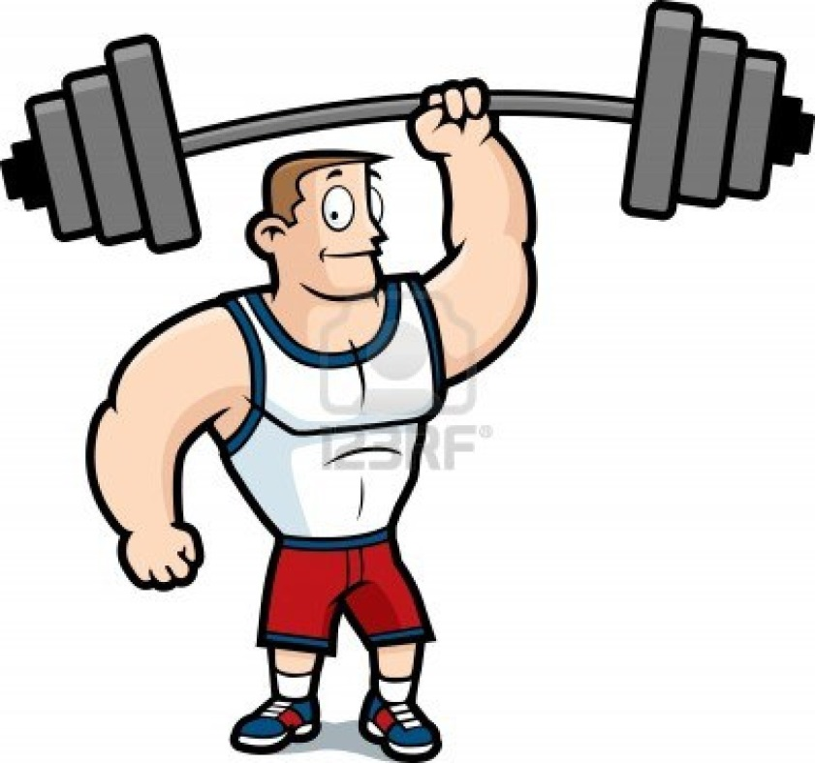
123
0 + 10
Big strong men

Slide 3
123
1 + 9
Feeling fine

Slide 4
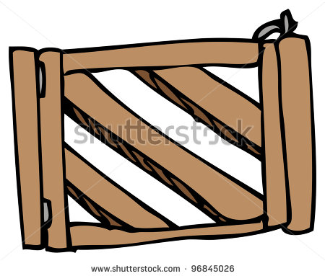
123
2 + 8
Open the gate

Slide 5
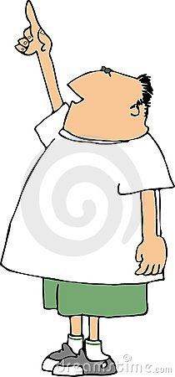
123
3 + 7
Point to heaven

Slide 6
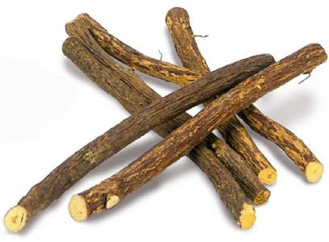
123
4 + 6
Pick up sticks

Slide 7
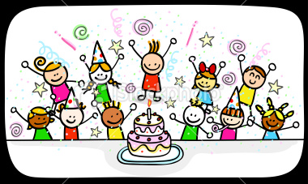
123
5 + 5
Come alive!

Slide 8
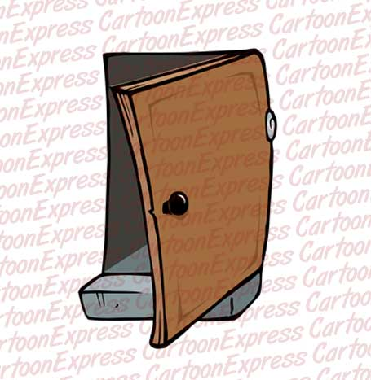
123
6 + 4
Knock on the door

Slide 9
123
7 + 3
Hot cup of tea

Slide 10
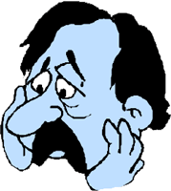
123
8 + 2
Feeling blue

Slide 11
123
9 + 1
Nearly done!

Slide 12
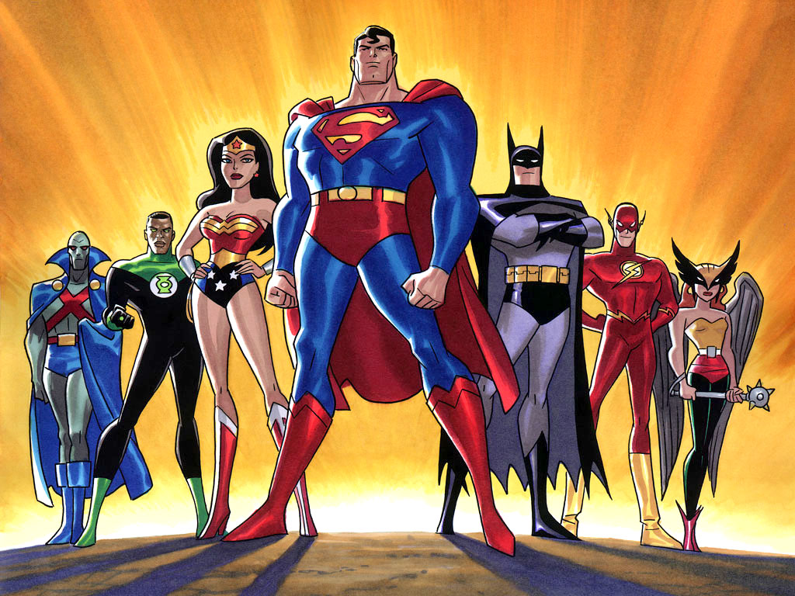
123
10 + 0
Are superheroes!

